Slide 1
E-Commerce Business and Projects
E-Commerce
Marcello Singadji, S.Kom, M.T
marcello.singadji@gmail.com

Slide 2
Learning Objectives
Understand the fundamental requirements for initiating an online business.
Describe the process of initiating and funding a start-up e-business or large e-project.
Understand the process of adding EC initiatives to an existing business.
Describe the issues and methods of transforming an organization into an e-business.
Describe the process of acquiring Web sites and evaluating building versus hosting options.
Understand the importance of providing and managing content and describe how to accomplish this.
Evaluate Web sites on design criteria, such as appearance, navigation, consistency, and performance.
Understand how search engine optimization can help a Web site obtain high placement in search engines.
Understand how to provide some major support e-services.
Understand the process of building an online storefront.
Be able to build an online storefront with templates.

Slide 3

Getting into E-Commerce
Almost any e-commerce initiative will require support activities and services, as well as plans for attracting visitors to a Web site
  Developing a Web site
  Hosting the Web site and selecting and registering a domain name
  Developing, updating, and managing the content of a Web site
  Designing a Web site for maximum usability
  Providing support services

Slide 4
Starting a New Online Business
An E-Start-Up is a Start-Up
  Creating a new company or adding an online project
    Identify a consumer or business need in the marketplace
    Investigate the opportunity
    Determine the business owner’s ability to meet the need
Online Business Planning
  Business plan
    A written document that identifies a company’s goals and outlines how the company intends to achieve the goals and at what cost.
  Business case
    A document that justifies the investment of internal, organizational resources in a specific application or project.

Slide 5
Starting a New Online Business
Funding a New Online Business
  First round of initial funding
    Angel investor
      A wealthy individual who contributes personal funds and possibly expertise at the earliest stage of business development.
  Second round of financing
    Venture capital (VC)
      Money invested in a business by an individual, a group of individuals (venture capitalists), or a funding company in exchange for equity in the business.
  Additional funding
    A large partner
  Initial public offering (IPO)

Slide 6

Starting a New Online Business
Adding EC Initiatives to an Existing Business
  A storefront
  A portal
  E-procurement
  Auctions and reverse auctions
  Other initiatives

Slide 7

Starting a New Online Business
Transforming to an E-Business
  Brick-and-mortar (old economy) organizations
    Pure-clicks (or virtual or pure-play) organizations
    Clicks-and-mortar (or clicks-and-brick) organizations
    Business process reengineering (BPR)

Slide 8

Starting a New Online Business
Transforming to an E-Business
  Business process management (BPM)
    Method for business restructuring that combines workflow systems and redesign methods; covers three process categories—people-to-people, systems-to-systems, and systems-to-people interactions.
  Software tools for facilitating transformation into e-business
  Change management (CM)

Slide 9
Roadmap to Becoming an E-Business

Slide 10
Building or Acquiring a Web Site
Classification of Web Sites
  Informational Web site
    A Web site that does little more than provide information about the business and its products and services
  Interactive Web site
    A Web site that provides opportunities for the customers and the business to communicate and share information
  Attractors
    Web site features that attract and interact with visitors in the target stakeholder group
  Transactional Web site
    A Web site that sells products and services.

Slide 11
Building or Acquiring a Web Site
Classification of Web Sites
  Collaborative Web site
    A site that allows business partners to collaborate.
Building a Web Site
  Step 1: Select a Web host
  Step 2: Register a domain name
  Step 3: Create and manage content
  Step 4: Design the Web site
  Step 5: Construct the Web site and test
  Step 6: Market and promote the Web site

Slide 12
Web Site Hosting and Domain Name
Web Hosting Options
  Storebuilder service
    A hosting service that provides disk space and services to help small and microbusinesses build a Web site quickly and cheaply
  Web hosting service
    A dedicated Web site hosting company that offers a wide range of hosting services and functionality to businesses of all sizes
  Mirror site
    An exact duplicate of an original Web site that is physically located on a Web server on another continent or in another country.
  Co-location
    A Web server owned and maintained by the business is given to a Web hosting service that manages the server’s connection to the Internet.

Slide 13
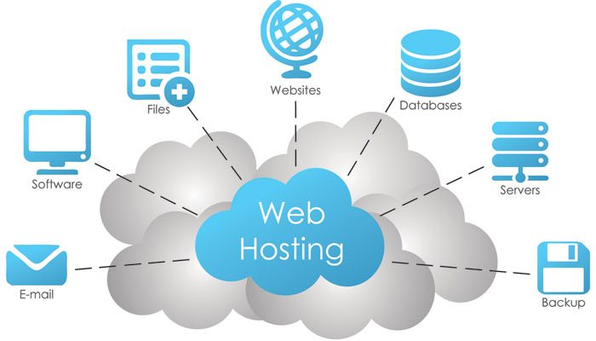
Web Site Hosting and Domain Name
Web Hosting Options
  ISP hosting service
    A hosting service that provides an independent, stand-alone Web site for small and medium-sized businesses
  Self-hosting
    When a business acquires the hardware, software, staff, and dedicated telecommunications services necessary to set up and manage its own Web site

Slide 14

Web Site Hosting and Domain Name
Registering a Domain Name
  Domain name
    A Web address that identifies a user (organization) via its Internet-connection server. It creates the Uniform Resources Locator (URL).
  Domain name registrar
    A business that assists prospective Web site owners with finding and registering the domain name of their choice

Slide 15
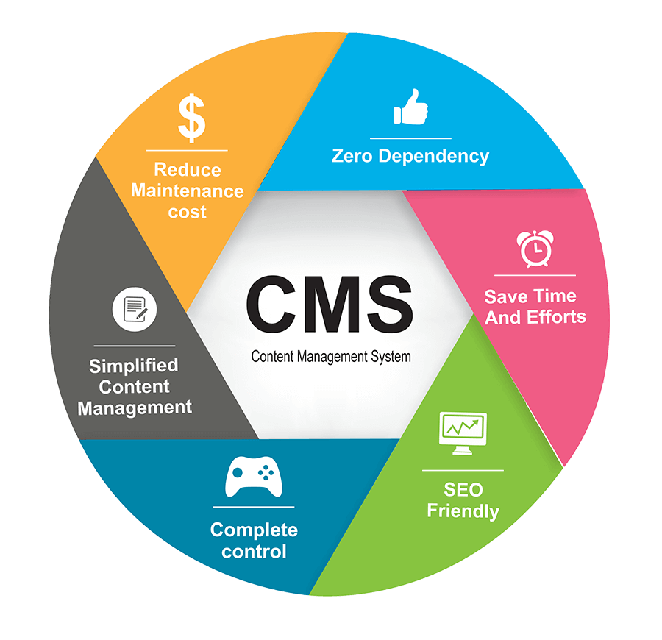
Content Management
Categories and Types of Content
  Dynamic Web content
    Content that must be kept up-to-date
  Commodity content
    Information that is widely available and generally free to access on the Web
  Primary and secondary content
    Cross-selling
      Offering similar or complementary products and services to increase sales.
    Up-selling
      Offering an upgraded version of the product in order to boost sales and profit.

Slide 16
Digital Content Delivery Life Cycle

Slide 17

Content Management
Creation or Acquisition?
  Buying content
  Buying from a syndicator
    Syndication
      The sale of the same good (e.g., digital content) to many customers, who then integrate it with other offerings and resell it or give it away free.
    Web syndication
      A form of syndication in which a section of a Web site is made available for other sites to use.

Slide 18

Content Management
Creation or Acquisition?
  Representative content-related vendors
  Content delivery networks
  Personalized content
    Web content that matches the needs and expectations of the individual visitor.
  E-newsletter
    A collection of short, informative articles sent at regular intervals by e-mail to individuals who have an interest in the newsletter’s topic.
  Writing effective content

Slide 19
The Syndication Supply Chain

Slide 20

Content Management
The process of adding, revising, and removing content from a Web site to keep content fresh, accurate, compelling, and credible
Types of Content Management
  Content testing and updating
  Measuring content quality
  Pitfalls of content management
  Content removal
  Content management software
  Catalog content and its management
  Content maximization and streaming services

Slide 21
Web Site Design
Web Site Design Criteria
  Navigation
  Consistency
  Response time
  Appearance
  Quality assurance
  Availability
  Interactivity
  Content
  Usability
  Security
  Scalability

Slide 22
Web Site Design
Information Architecture
  How the site and its Web pages are organized, labeled, and navigated to support browsing and searching throughout the Web site.
  A simple hierarchical Web site structure

Slide 23
Web Site Design
Information Architecture
  A simple linear Web site structure

Slide 24
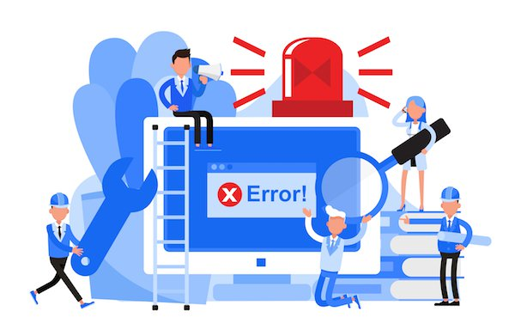
Web Site Design
Site Navigation
  Aids that help visitors find the information they need quickly and easily.
Miscellaneous
  Performance
  Colors and graphics
  Usability (of Web site)
    The quality of the user’s experience when interacting with the Web site.

Slide 25

Providing EC Support Services
Who Builds the Web Site?

Slide 26

Providing EC Support Services
Payments: Accepting Credit Cards
  Card-not-present (CNP) transaction
    A credit card transaction in which the merchant does not verify the customer’s signature.

Slide 27

Providing EC Support Services
Web Site Promotion
  Internal Web site promotion
    Signature file
      A simple text message an e-mail program automatically adds to outgoing messages.
  Search engine optimization (SEO)
    The application of strategies intended to position a Web site at the top of Web search engines.

Slide 28
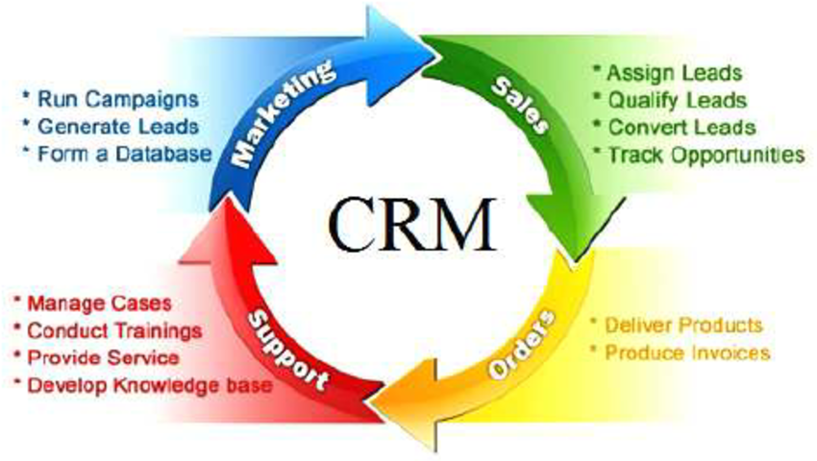
Providing EC Support Services
Customer Relationship Management (CRM)
  Using content to build customer relationships

Slide 29
Referensi
Introduction to Electronic Commerce, Ed. 2, Efraim Turban et al., Pearson

Slide 30


Slide 31

sekian

