Slide 1
Consumer Behavior, Market Research, and Advertisement
E-Commerce
Marcello Singadji, S.Kom, M.T
marcello.singadji@gmail.com

Slide 2
Learning Objectives
Describe the factors that influence consumer behavior online.
Understand the decision-making process of consumer purchasing online.
Describe how companies are building one-to-one relationships with customers.
Explain how personalization is accomplished online.
Discuss the issues of e-loyalty and e-trust in EC.
Describe consumer market research in EC.

Slide 3
Learning Objectives
Describe Internet marketing in B2B, including organizational buyer behavior.
Describe the objectives of Web advertising and its characteristics.
Describe the major advertising methods used on the Web.
Describe various online advertising strategies and types of promotions.
Describe permission marketing, ad management, localization, and other advertising-related issues.
Understand the role of intelligent agents in consumer issues and advertising applications.

Slide 4
4.1 Learning about
Consumer Behavior Online
A Model of Consumer Behavior Online
  Independent (or uncontrollable) variables can be categorized as personal characteristics and environmental characteristics
  Intervening (or moderating) variables are variables within the vendors’ control. They are divided into market stimuli and EC systems
  The decision-making process is influenced by the independent and intervening variables. This process ends with the buyers’ decisions resulting from the decision-making process
  The dependent variables describe types of decisions made by buyers (buyers’ control)

Slide 5
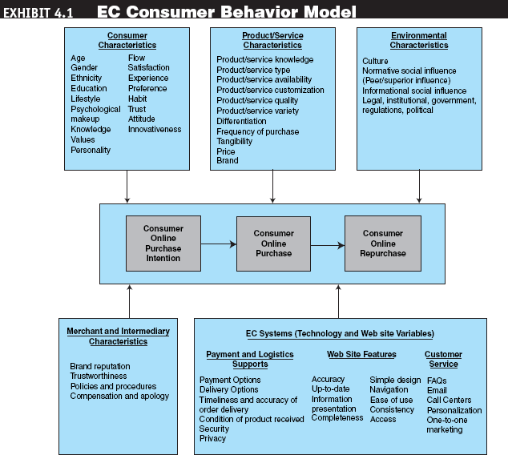
Independent
Variables
Buyer’s Decision
Buy or not?
What to buy?
Where (vendor)?
When?
How much to spend?
Dependent
Variables
(Results)
Intervening
(vendor-
controlled)
Variables

Slide 6
Exhibit 4.9 EC Consumer Behavior Model
Personal
Characteristics
Environmental
Characteristics
Age
Gender
Ethnicity
Education
Lifestyle
Psychological
Knowledge
Values
Personality
Social
Cultural/community
Other: legal, institutional,
governmental
Independent
Variables
Market Stimuli
Buyer’s Decision
Price
Brand
Promotions
Advertising
Product quality
Design
Decision
Process
(Group or
Individual)
Buy or not?
What to buy?
Where (vendor)?
When?
How much to spend?
Intervening
(vendor-
controlled)
Variables
EC Systems
Logistics
Support
Technical
Support
Customer
Service
Dependent
Variables
(Results)
Payments
Delivery
Web design
and content
Intelligent
agents
Security

Slide 7
Learning about Consumer Behavior Online (cont.)
Independent variables
  Personal characteristics (demographic variables)
    Age, gender
    Ethnicity, education
    Lifestyle, knowledge
    Value, personality
  Environmental variables
    Social variables
    Cultural/community variables
    Institutional, governmental variables
N
Notes:
What are most-cited reasons for not making purchase? (next slide)
Environmental variables
Social variables – family members, friends, coworkers, Internet communities (chatting)
Cultural/community variables – difference in countries, locations (city, urban etc.)
Institutional, governmental variables – government regulation, legal constraints, and situational factors

Slide 8
Learning about Consumer Behavior Online (cont.)
Intervening (moderating) variables
  variables are those that can be controlled by vendors
Dependent variables: the buying decisions
  customer makes several decisions
  “to buy or not to buy?”
  “what to buy?”
  “where, when, and how much to buy?”
N
Notes:
Intervening (moderating) variables
offline environment: price, brad, promotions, advertising, quality
physical environment: display in stores, logistics support, technical support, customer service.
Five adoption stages of online buying:
-- awareness, interest, evaluation, trial, and adoption

Slide 9
What are most-cited reasons for not making purchase?
Shipping charges (51%)
Difficulty in judging the quality of the product (44%)
Can’t return items easily (32%)
Credit and safety concerns (24%)
Can’t ask questions (23%)
Take too long to download the screen (16%)
Delivery time (15%)
Enjoy shopping offline (10%)
N
Notes:
According to Forrester Research only 1.9% of online consumers have actually had an unfavorable experience.
It is interesting to note that the more experience people have with Internet shopping, the more likely they are to spend more money online.

Slide 10
Decision-making Process
Is there a problem?
Intelligence
What are the alternatives?
Design
Which should you choose?
Choice
Is the choice working?
Implementation
Source: Simon, H. The New Science of Management Decisions, Prentice Hall, 1977

Slide 11
Decision by Objectives
conflict
intuition
COMPLEXITY
Logic
Analysis
GOAL
tradeoffs
Objectives/
Perspectives
Finance
H.R.
Technology
Marketing
Measurement
Alternatives
synthesis
Justifiable Recommendation
Improved Communication
Well Established Process
Best Overall Alternative

Slide 12
4.2 The Consumer
Decision-Making Process
Roles people play in the decision-making process
  Initiator
  Influencer
  Decider
  Buyer
  User
A Generic Purchasing-Decision Model
  Need identification
  Information search
  Evaluation of alternatives,
  Purchase and delivery
  Post-purchase behavior

Slide 13
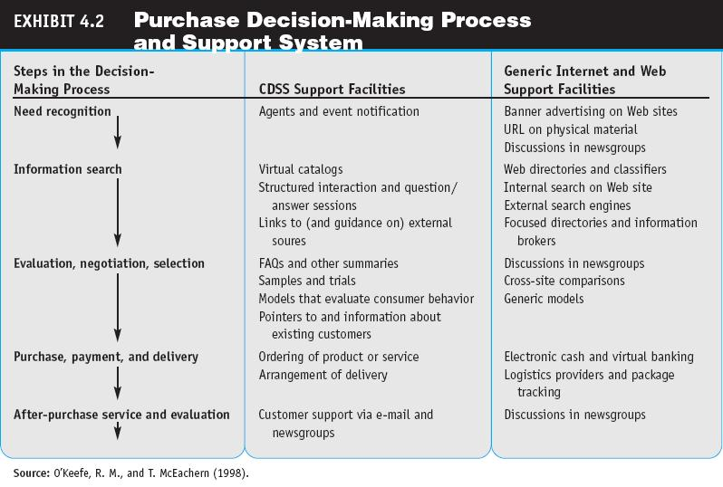

Slide 14
Consumer Decision
Making Process (cont.)
What? Where?
Product brokering: Deciding what product to buy
Merchant brokering: Deciding from whom (from what merchant) to buy a product
N
Notes:
This is the second (2) phase: information search
-- catalogs, advertising, promotions, and reference groups influence DM

Slide 15
The Consumer
Decision-Making Process
A Customer Decision Model in Web Purchasing
  Can be supported by both Consumer Decision Support System (CDSS) facilities and Internet and Web facilities

Slide 16
4.3 Mass Marketing, Market Segmentation, and One-to-One Marketing
one-to-one marketing
Marketing that treats each customer in a unique way
Mass Marketing
  Marketing efforts traditionally were targeted to everyone
  Targeted marketing—marketing and advertising efforts targeted to groups (market segmentation) or to individuals (one-to-one)—is a better approach

Slide 17
Mass Marketing, Market Segmentation, and One-to-One Marketing
market segmentation
The process of dividing a consumer market into logical groups for conducting marketing research and analyzing personal information

Slide 18
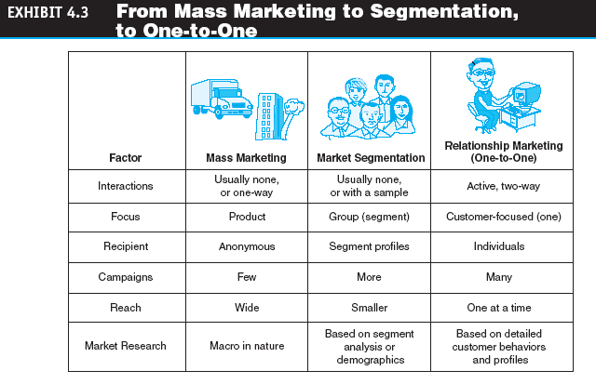
Mass Marketing, Market Segmentation, and One-to-One Marketing

Slide 19
Exhibit 4.4 The New Marketing Model - One-to-One Marketing and Personalization in EC
[1]
Customer Receives
Marketing Exposure
Marketing/Advertising
Chose to Best
Server/Reach Customer
[2]
Customer decides
on marketing medium
for response
“Four P’s”
(Product, Place,
Price, and
Promotion)
Updated Uniquely
to Customer
Customer
Relationships
[3]
Customer makes
purchase decision
[4]
Detailed transaction/
Behavior Data Collected
Customer Profile Based
on Behavior; Customer
Segmentation Developed
Database Update {…}
Source: Linden, A. Management Update: Data Mining Trends Enterprises Should Know About, Gartner Group, 2002

Slide 20
4.4 Personalization, Loyalty,
Trust, and Satisfaction in EC
personalization
The matching of services, products, and advertising content with individual consumers and their preferences
user profile
The requirements, preferences, behaviors, and demographic traits of a particular customer

Slide 21
Personalization in EC (cont.)
Major strategies used to compile user profiles
  Solicit information directly from the user
  Observe what people are doing online
    cookie
  Build from previous purchase patterns
  Perform marketing research
Cookie:
  A data file that is placed on a user’s hard drive by a Web server, frequently without disclosure or the user’s consent, that collects information about the user’s activities at a site.
Notes:
Solicit information directly from the user
-- ask the user to fill in a questionnaire or by conducting an interview with the user
Observe what people are doing online
-- cookie (is one of the most controversial issues in EC)
--A data file that is placed on a user’s hard drive by a Web server, frequently without disclosure or the user’s consent, that collects information about the user’s activities at a site
Build from previous purchase patterns
Perform marketing research
-- via data mining technique
Once a customer profile is constructed, a company matches the profile with a database of products, services, or contents. The actual matching process is usually done by software agent.

Slide 22
Customer Loyalty in EC (cont.)
Customer loyalty
  Customer loyalty: Degree to which a customer will stay with a specific vendor or brand
  Increased customer loyalty produces cost savings through:
    lower marketing costs
    lower transaction costs
    lower customer turnover expenses
    lower failure costs
  E-loyalty: Customer loyalty to an e-tailer
Notes:
One of the major objectives of 1-1 marketing is to increase customer loyalty.
It costs a company between five to eight times more to acquire a new customer than to keep an existing one.
E-tailer: a) acquire a new customer: >=$100 (Amazon.com >=$15) b) keep an existing customer (Amazon.com $2 - $4)
Discuss it with Porter’s model (switching cost and others)
Any company’s goal is to increase customer loyalty and the Web offers ample opportunities to increase loyalty.

Slide 23
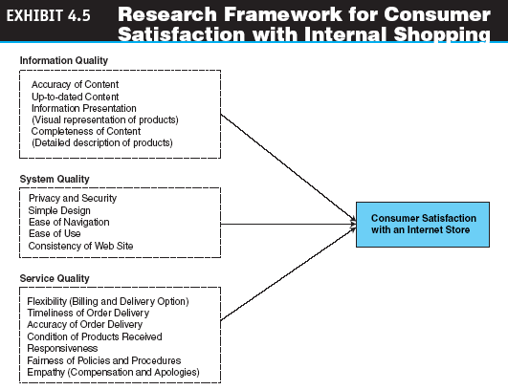
Personalization, Loyalty,
Trust, and Satisfaction in EC

Slide 24
Trust in EC (cont.)
Trust in EC
  Trust: The psychological status of involved parties who are willing to pursue further interaction to achieve a planned goal
  Trust is influenced by many variables
    Culture
    EC computing environment (security etc.)
    EC infrastructure
Notes:
Trust in particularly important in global EC transactions due to the difficulty in taking legal action in cases of a dispute or fraud and the potential for conflicts caused by differences in culture and business environments.

Slide 25
Initial Trust Model
Disposition to Trust
Propensity to Trust
Cognitive
Processes
Demographic
Dissimilarity
Trust
Trusting
Beliefs
Trusting
Intention
Institution-based
Trust
Procedural Justice
Notes:
Note: Bold items were included in McKnight et al.’s (1998) Initial Trust Model. Italicized items are constructs tested within current study.

Slide 26
One-to-One Marketing and Personalization in EC (cont.)
How to increase EC trust
  Affiliate with an objective third party
  Establish trustworthiness
  Between buyers and sellers trust is determined by:
    degree of initial success that each party experienced with EC and with each other
    well-defined roles and procedures for all parties involved
    realistic expectations as to outcomes from EC

Slide 27
Exhibit 4.6 The EC Trust Model
Trust certificates, seals
Vendor evaluation (BBB)
Product evaluation
Free samples
Return policy
Privacy statement
Co-branding, alliances
Education efforts by vendor
stressing the use of security,
size and financial resources
Simplicity of shopping
Navigation, Web design
Seller
Trust in
internet
merchant
Competency
EC Trust
Benevolence
Trust in internet
as shopping
channel
Reliability
Understandability
Trust in business
and regulatory
environments
Security/payment
Business culture
Consumer protection
Effective law
Demographics, previous experience,
personality, cultural differences
Peers success stories
Referrals
Source: Lee, Matthew K.Q. and E. Turban, “A Trust Model for Consumer Internet Shopping,” Vol. 6(1), M.E. Sharpe, Inc., 2001

Slide 28
BREAK-1
Application Case 4.1: Internet Market Research Expedites Time-To-Market at Proctor & Gamble (p.172)

Slide 29
Market Research for EC (cont.)
Limitations of online market research
  too much data may be available: need business intelligence to organize, edit, condense, and summarize it
  accuracy of responses
  loss of respondents because of equipment problems
  ethics and legality of Web tracking
  Online shoppers tend to be wealthy, employed, and well educated
  The lack of clear understanding of the online communication process and how online respondents think and interact in cyberspace
Notes:
Business intelligence – a solution/process to automate the process by using data warehousing and data mining.
Another important issue concerns 1) the lack of clear understanding of the online communication process and 2) how online respondents think and interact in cyberspace.
Web-based surveys typically have a lower response rate than e-mail surveys, and there is no respondent control for public surveys.
Anonymous respondents: 1) more truthful in their opinions, 2) loss of valuable informaiton about the demographics and characteristics, 3) security of information transmitted
Future trends: 50% of all market research will be done on the Internet. National telephone suverys will be the subject of research methodology folklore in 10 years (or 20 years).
How to overcome this problem – outsource its market research needs.

Slide 30
4.5 Market Research for EC
Goal of market research is to find information and knowledge that describes the relationships among:
  consumers
  products
  marketing methods
  marketers

Slide 31
Market Research for EC
Aim of marketing research is to:
  discover marketing opportunities and issues
  establish marketing plans
  better understand the purchasing process
  evaluate marketing performance
  develop advertising strategy
How?
  Market research tools
    data modeling
    data warehousing (data mining)
Notes:
On the WEB, the objective is to turn browsers into buyers.
Market research includes gathering information about topics such as the economy, industry, firms, products, pricing, distribution, competition, promotion, and consumer purchasing behavior.
How? surveyors
-- questionnaires, telephone, direct mail, email
-- focus groups (selected individuals)

Slide 32
Market Research for EC
  What are marketers looking for in EC market research?
    What are the purchase patterns for individuals and groups (market segmentation)?
    What factors encourage online purchasing?
    How can we identify those who are real buyers from those who are just browsing?
    How does an individual navigate—does the consumer check information first or do they go directly to ordering?
    What is the optimal Web page design?
Notes:
Major factors that are used for prediction are: product information requested, number of related e-mails, number of orders made, what products/services are ordered, and gender.
Typical questions that online market research attempts to answer are:
What are the purchase patterns for individuals and groups (segmentation)?
What factors encourage online purchasing?
How can we identify those who are real buyers from those who are just browsing?
How does an individual navigate – check information first or go directly ordering
What is the optimal Web page design?
Online market research provides marketing organizations with greater ability to understand the customer, the market, and the competition.
It can identify early shifts in product and customer trends, enabling marketers to identify products and marketing opportunities and to develop those products that customers really want to buy.

Slide 33
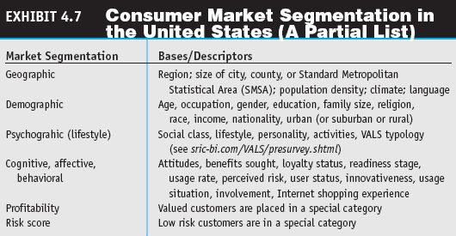
Market Research for EC

Slide 34
Market Research for EC
Methods for Conducting Market Research Online
  Market research that uses the Internet frequently is faster and more efficient and allows the researcher to access a more geographically diverse audience
  Web market researchers can conduct a very large study much more cheaply than with other methods

Slide 35
Market Research for EC
Market research for one-to-one approaches
  Direct solicitation of information (surveys, focus groups)
  Observing what customers are doing on the Web
  Collaborative filtering

Slide 36
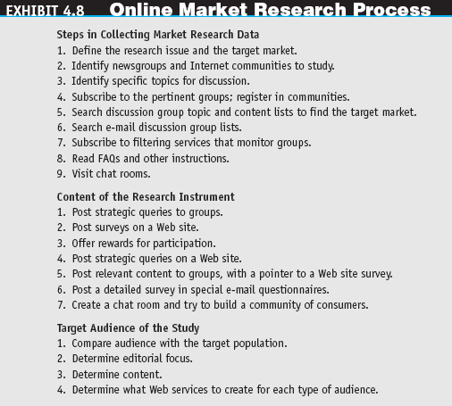
Market Research for EC

Slide 37
Market Research for EC
  Observing Customers
    transaction log
    A record of user activities at a company’s Web site
    clickstream behavior
    Customer movements on the Internet
    Web bugs
    Tiny graphics files embedded in e-mail messages and in Web sites that transmit information about users and their movements to a Web server
    spyware
    Software that gathers user information over an Internet connection without the user’s knowledge
Notes:
Online research methods range from 1-1 communication with specific customers (email) to moderated focus groups conducted in chat rooms to questionnaires.
According to a survey by GIT, more than 40% of the information people place on such questionnaires is incorrect. Therefore, appropriate design of Web questionnaires and incentives for true completion are critical for the validity of the results.
Online focus groups – may be costly and slow
Customer scenarios – situations that describe the customer’s needs and the manner in which the product fulfills the needs.
Tracking customer movements – to learn about customers by observing their behavior rather than by asking them questions (using cookies, web bugs, and spyware – privacy issue; next slide)

Slide 38
Market Research for EC
  clickstream data
  Data that occur inside the Web environment; they provide a trail of the user’s activities (the user’s clickstream behavior) in the Web site
  collaborative filtering
  A market research and personalization method that uses customer data to predict, based on formulas derived from behavioral sciences, what other products or services a customer may enjoy; predictions can be extended to other customers with similar profiles

Slide 39
Market Research for EC
Limitations of Online Market Research and How to Overcome Them
  To use data properly, one needs to organize, edit, condense, and summarize it, which is expensive and time consuming
  The solution to this problem is to automate the process by using data warehousing and data mining known as business intelligence

Slide 40
Market Research for EC
Biometric Marketing
  biometrics
  An individual’s unique physical or behavioral characteristics that can be used to identify an individual precisely (e.g., fingerprints)
Organizational Buyer Behavior
  A Behavioral Model of Organizational Buyers
    An organizational influences module is added to the B2B model

Slide 41
Exhibit (extra) CRM Applications
Customers
Customer systems
The Customer Experience
Customers
Sellers
Customer- Touching Systems
Users
Self-service
Customer
support
E-Commerce
Campaign
Management
Customer- Facing Systems
Integration
Contact
Center
Sales
Force
Automation
Field
Service
Automation
Customer Intelligence
Integration
Back Office Systems
Seller
Suppliers
Supplier Systems

Slide 42
CRM Applications and Tools
Data analysis and mining
  Analytic applications automate the processing and analysis of CRM data
    can be used to analyze the performance, efficiency, and effectiveness of an operation’s CRM applications
  Data mining involves sifting through an immense amount of data to discover previously unknown patterns
Notes:
Analytic apps process a warehouse’s data, whereas reports merely present that information.
Their output should enable a company to improve the operational apps that deliver customer experience in order to achieve the CRM objectives (forecast) of customer acquisition and retention.

Slide 43
Data Mining Examples
telephone company used a data mining tool to analyze their customer’s data warehouse. The data mining tool found about 10,000 supposedly residential customers that were expending over $1,000 monthly in phone bills.
After further study, the phone company discovered that they were really small business owners trying to avoid paying business rates
UK grocery store example

Slide 44
Other Data Mining Examples
65% of customers who did not use the credit card in the last six months are 88% likely to cancel their accounts.
If age < 30 and income <= $25,000 and credit rating < 3 and credit amount > $25,000 then the minimum loan term is 10 years.
82% of customers who bought a new TV 27" or larger are 90% likely to buy an entertainment center within the next 4 weeks.

Slide 45
4.6 Internet Marketing in B2B
Organizational buyer behavior
  number of organizational buyers is much smaller than the number of individual buyers
  transaction volumes are far larger
  terms of negotiations and purchasing are more complex
Notes:
B2B marketing is completely different from B2C marketing. Major differences also exist between B2B and B2C with respect to the nature of demand and supply and the trading process.
Organizations buy large quantities of direct materials that they consume or use in the production of goods and services and in the company’s operations.
They also buy indirect materials (PCs, delivery trucks, and office supplies) to support their production and operations processes.

Slide 46
Internet Marketing in B2B (cont.)
Methods for B2B online marketing
  Targeting customers
    contact all of its targeted customers individually when they are part of a well-defined group
    affiliation service (Amazon.com)
    advertising
  Electronic wholesalers
    intermediary sells directly to businesses, but does so exclusively online
Notes:
Traditional (off-line) B2B marketers use the following methods: trade shows, advertisements in industry magazines, email, paper catalogs, and salespeople that are not effective in the digital world.
How will B2B reach its potential customers in the e-world?
Affiliation program: Affiliates put a banner of another vendor (Amazon.com or CDNow) on their sites. A company pays a small commission every time when the affiliation company ‘drives traffic’ to its site if the customer makes a purchase.

Slide 47
Internet Marketing in B2B (cont.)
Other B2B marketing services
  Digital Cement
    provides corporate marketing portals that help companies market their products to business customers
  National Systems
    tracks what is going on in an industry
  BusinessTown
    provides information and services to small businesses, including start-ups

Slide 48
Internet Marketing in B2B (cont.)
Affiliate programs
  Placing banners on another vendor’s Web site
  Content alliance program in which content is exchanged so that all can obtain some free content
Infomediaries
Online data mining services
Affiliate marketing can be simply defined as
  A commission based arrangement where referring sites (affiliates or publishers) receive a commission on sales or leads by merchants (retailers)
Notes:
Affiliation program: Affiliates put a banner of another vendor (Amazon.com or CDNow) on their sites. A company pays a small commission every time when the affiliation company ‘drives traffic’ to its site if the customer makes a purchase. Marketing managers need to understand their customers’ shopping behavior in order to optimally advertise or approach customers in the future. Traditional B2C retailers: POS -> valuable marketing info.
Online environment: the potential of the information can only be realized if the clickstream data can be analyzed and mined to produce useful knowledge that can be used to improve services and marketing efforts.
Such B2C and B2B intermediaries are called infomediaries. Infomediaries start by processing existing information until new, useful information is extracted from it.
Purpose: B2B vendors use the information from infomediareis to identify likely buyers with much greater precision than ever before – leading to increased sales and drastically reduced marketing expenses.

Slide 49
Exhibit 4.9 EC Consumer Behavior Model
Personal
Characteristics
Environmental
Characteristics
Age
Gender
Ethnicity
Education
Lifestyle
Psychological
Knowledge
Values
Personality
Social
Cultural/community
Other: legal, institutional,
governmental
Independent
Variables
Market Stimuli
Buyer’s Decision
Price
Brand
Promotions
Advertising
Product quality
Design
Decision
Process
(Group or
Individual)
Buy or not?
What to buy?
Where (vendor)?
When?
How much to spend?
Intervening
(vendor-
controlled)
Variables
EC Systems
Logistics
Support
Technical
Support
Customer
Service
Dependent
Variables
(Results)
Payments
Delivery
Web design
and content
Intelligent
agents
Security

Slide 50
4.7 Web Advertising
interactive marketing
Online marketing, facilitated by the Internet, by which marketers and advertisers can interact directly with customers and consumers can interact with advertisers/vendors

Slide 51
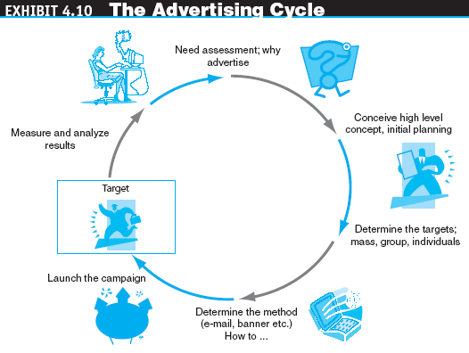
Web Advertising

Slide 52
Web Advertising
Some Internet Advertising Terminology
  ad views
  The number of times users call up a page that has a banner on it during a specific period; known as impressions or page views
  click (click-through or ad click)
  A count made each time a visitor clicks on an advertising banner to access the advertiser’s Web site
  CPM (cost per thousand impressions)
  The fee an advertiser pays for each 1,000 times a page with a banner ad is shown

Slide 53
Web Advertising
  conversion rate
  The percentage of clickers who actually make a purchase
  click-through rate (or ratio)
  The percentage of visitors who are exposed to a banner ad and click on it
  click-through ratio
  The ratio between the number of clicks on a banner ad and the number of times it is seen by viewers; measures the success of a banner in attracting visitors to click on the ad

Slide 54
Web Advertising
  hit
  A request for data from a Web page or file
  visit
  A series of requests during one navigation of a Web site; a pause of a certain length of time ends a visit
  unique visits
  A count of the number of visitors entering a site, regardless of how many pages are viewed per visit
  stickiness
  Characteristic that influences the average length of time a visitor stays in a site

Slide 55
Web Advertising
Why Internet Advertising?
Precise targeting
Interactivity
Rich media (grabs attention)
Cost reduction
Customer acquisition
Personalization
Timeliness
Location-basis
Linking
Digital branding

Slide 56
Web Advertising
advertising networks
Specialized firms that offer customized Web advertising, such as brokering ads and targeting ads to select groups of consumers

Slide 57
4.8 Online Advertising Methods
banner
On a Web page, a graphic advertising display linked to the advertiser’s Web page
keyword banners
Banner ads that appear when a predetermined word is queried from a search engine
random banners
Banner ads that appear at random, not as the result of the user’s action

Slide 58
Online Advertising Methods
banner swapping
An agreement between two companies to each display the other’s banner ad on its Web site
banner exchanges
Markets in which companies can trade or exchange placement of banner ads on each other’s Web sites

Slide 59
Online Advertising Methods
pop-up ad
An ad that appears in a separate window before, after, or during Internet surfing or when reading e-mail
pop-under ad
An ad that appears underneath the current browser window, so when the user closes the active window the ad is still on the screen
interstitial
An initial Web page or a portion of it that is used to capture the user’s attention for a short time while other content is loading

Slide 60
Online Advertising Methods
E-Mail Advertising
  E-mail advertising management
  E-mail advertising methods and successes
Newspaper-Like and Classified Ads
Search Engine Advertisement
  Improving a company’s search-engine ranking (optimization)
  Paid search-engine inclusion

Slide 61
Online Advertising Methods
  associated ad display (text links)
  An advertising strategy that displays a banner ad related to a key term entered in a search engine
  Google—The online advertising king
Advertising in Chat Rooms, Blogs, and Social Networks

Slide 62
Online Advertising Methods
Other Forms of Advertising
  advertorial
  An advertisement “disguised” to look like editorial content or general information
  Advertising in newsletters
  Posting press releases online
  advergaming
  The practice of using computer games to advertise a product, an organization, or a viewpoint

Slide 63
4.9 Advertising Strategies and Promotions Online
affiliate marketing
A marketing arrangement by which an organization refers consumers to the selling company’s Web site
With the ads-as-a-commodity approach, people are paid for time spent viewing an ad
viral marketing
Word-of-mouth marketing by which customers promote a product or service by telling others about it

Slide 64
Advertising Strategies and Promotions Online
  Webcasting
  A free Internet news service that broadcasts personalized news and information, including seminars, in categories selected by the user
Online Events, Promotions, and Attractions
  Live Web Events
  Admediation
    admediaries
    Third-party vendors that conduct promotions, especially large-scale ones
  Selling space by pixels

Slide 65
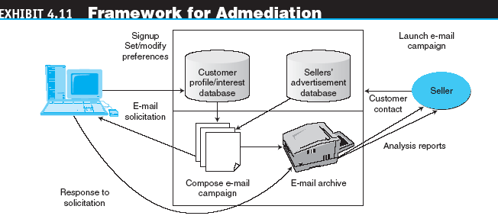
Advertising Strategies and Promotions Online

Slide 66
4.10 Special Advertising Topics
PERMISSION ADVERTISING
  spamming
  Using e-mail to send unwanted ads (sometimes floods of ads)
  permission advertising (permission marketing)
  Advertising (marketing) strategy in which customers agree to accept advertising and marketing materials (known as “opt-in”)

Slide 67
Special Advertising Topics
Advertisement as a Revenue Model
Measuring Online Advertising’s Effectiveness
ad management
Methodology and software that enable organizations to perform a variety of activities involved in Web advertising (e.g., tracking viewers, rotating ads)

Slide 68
Special Advertising Topics
localization
The process of converting media products developed in one environment (e.g., country) to a form culturally and linguistically acceptable in countries outside the original target market
Internet radio
A Web site that provides music, talk, and other entertainment, both live and stored, from a variety of radio stations

Slide 69

Special Advertising Topics
Wireless Advertising
Ad Content

Slide 70
4.11 Software Agents in
Marketing and Advertising Applications
A Framework for Classifying EC Agents
  Agents that support need identification (what to buy)
  Agents that support product brokering (from whom to buy)
  Agents that support merchant brokering and comparisons
  Agents that support buyer–seller negotiation
  Agents that support purchase and delivery
  Agents that support after-sale service and evaluation

Slide 71
Software Agents in
Marketing and Advertising Applications
Character-Based Animated Interactive Agents
  avatars
  Animated computer characters that exhibit humanlike movements and behaviors
  social computing
  An approach aimed at making the human–computer interface more natural
  chatterbots
  Animation characters that can talk (chat)

Slide 72
Managerial Issues
Do we understand our customers?
Should we use intelligent agents?
Who will conduct the market research?
Are customers satisfied with our Web site?
Can we use B2C marketing methods and research in B2B?
How do we decide where to advertise?

Slide 73
Managerial Issues
What is our commitment to Web advertising, and how will we coordinate Web and traditional advertising?
Should we integrate our Internet and non-Internet marketing campaigns?
What ethical issues should we consider?
Are any metrics available to guide advertisers?
Which Internet marketing/advertising channel to use?

Slide 74
BREAK-2
Application Case 4.2: Fujitsu Agents for Targeted Advertising in Japan
(p.202)

