Slide 1
Business-to-Business E-Commerce
E-Commerce
Marcello Singadji, S.Kom, M.T

Slide 2

Learning Objectives
Describe the B2B field.
Describe the major types of B2B models.
Discuss the characteristics of the sell-side marketplace, including auctions.
Describe the sell-side models.
Describe the characteristics of the buy-side marketplace and e-procurement.

Slide 3
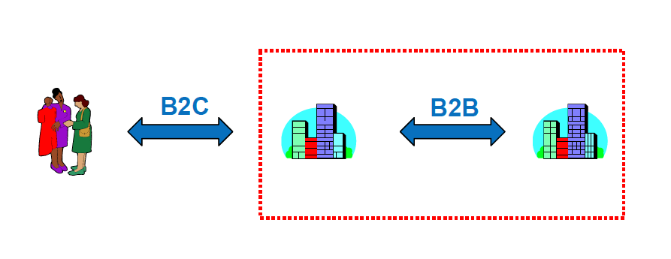
B2B E-Commerce
Business-to-business e-commerce (B2B EC)
  Transactions between businesses conducted electronically over the Internet, extranets, intranets, or private networks; also known as eB2B (electronic B2B) or just B2B.

Slide 4
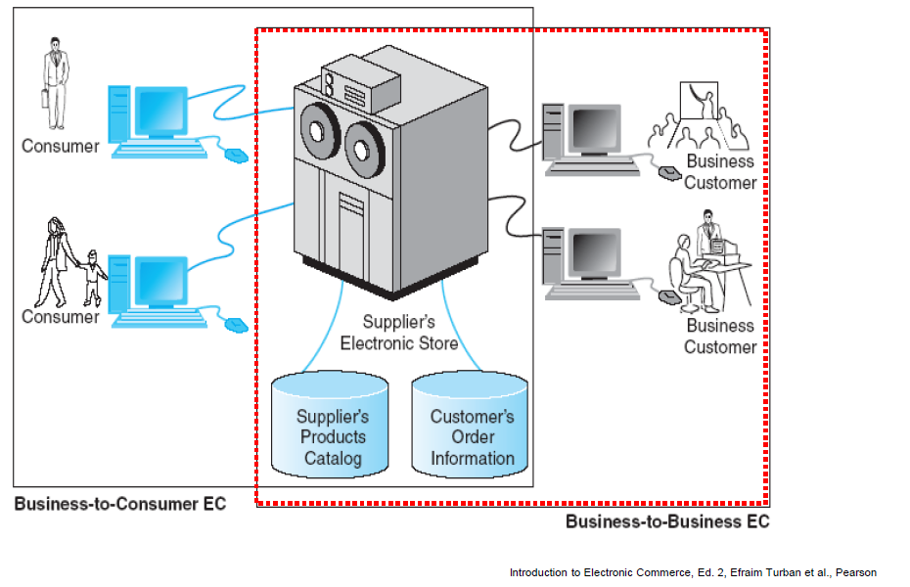
B2B E-Commerce
Business-to-business e-commerce (B2B EC)

Slide 5
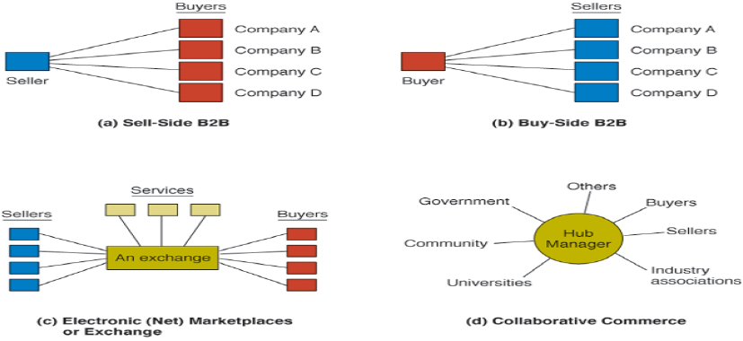
B2B E-Commerce
Basic Types of B2B Transactions and Activities

Slide 6

B2B E-Commerce

Slide 7
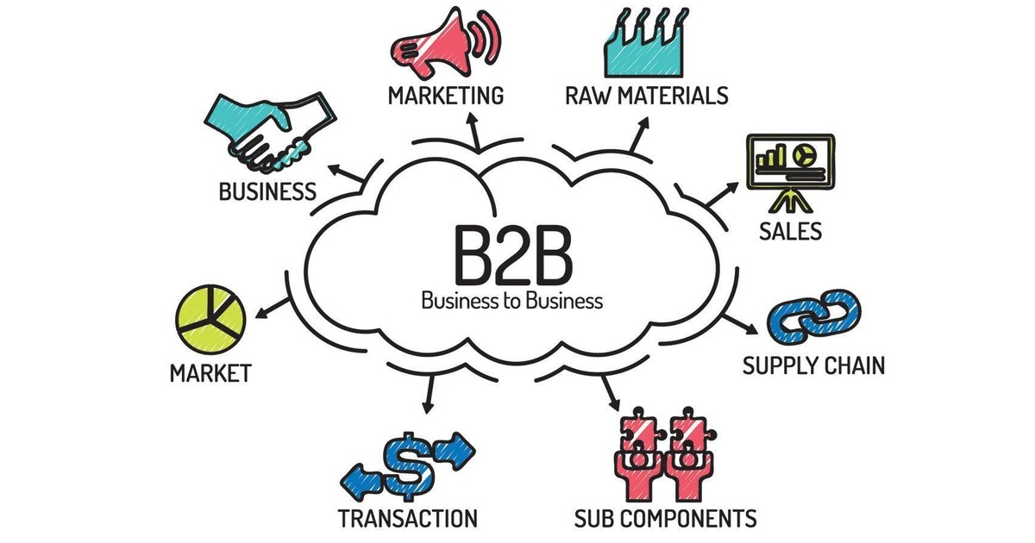
B2B E-Commerce

Slide 8


Slide 9

sekian

