Slide 1
Mechanisms, Platforms, and Tools E-Commerce
E-Commerce
Marcello Singadji, S.Kom, M.T

Slide 2
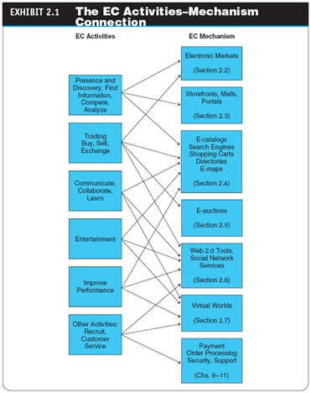

Slide 3
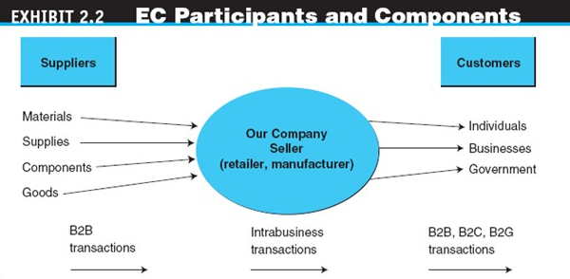

Slide 4
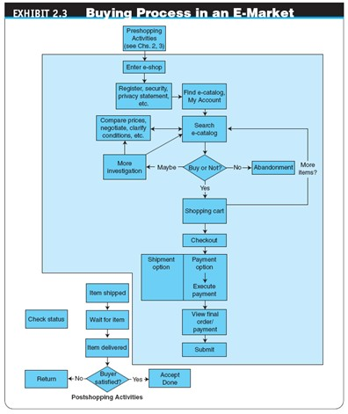

Slide 5
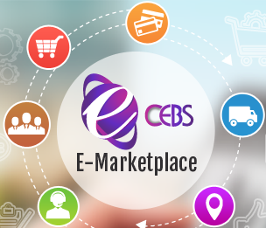
E-Marketplaces
The major components and players in a marketspace are:
  Customers
  Sellers
  Products and services
    digital products
      Goods that can be transformed to digital format and delivered over the Internet
  Infrastructure

Slide 6

E-Marketplaces
front end
The portion of an e-seller’s business processes through which customers interact, including the seller’s portal, electronic catalogs, a shopping cart, a search engine, and a payment gateway
back end
The activities that support online order fulfillment, inventory management, purchasing from suppliers, payment processing, packaging, and delivery
intermediary
A third party that operates between sellers and buyers

Slide 7

E-Marketplaces
TYPES OF E-MARKETPLACES
  sell-side e-marketplace
  A private e-marketplace in which one company sells either standard and/or customized products to qualified companies
  buy-side e-marketplace
  A private e-marketplace in which one company makes purchases from invited suppliers

Slide 8
Customer Shopping Mechanisms: Storefronts, Malls, and Portals
Webstore (storefront)
  A single company’s website where products or services are sold; usually has an online shopping cart associated with it Many Webstores target a specific industry and find their own unique corner of the market.
Microsites
e-mall (online mall)
  An online shopping center where many online stores are located
TYPES OF STORES AND MALLS
  General stores/malls
  Specialized stores/malls
  Regional versus global stores
  Pure-play versus click-and-mortar stores

Slide 9
Customer Shopping Mechanisms: Storefronts, Malls, and Portals
Web (information) portal
A single point of access, through a Web browser, to critical business I nformation located inside and outside (via Internet) an organization
  Types of Portals
    Commercial (public) portals
    Corporate portals
    Publishing portals
    Personal portals
    mobile portal
      A portal accessible via a mobile device.
    voice portal
      A portal accessed by telephone or cell phone.

Slide 10
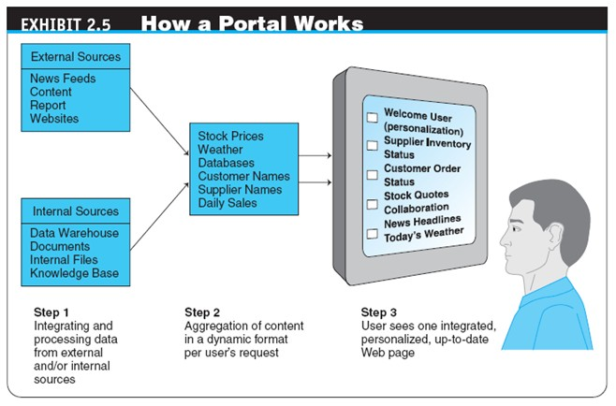

Slide 11
Customer Shopping Mechanisms: Storefronts, Malls, and Portals
THE ROLES AND VALUE OF INTERMEDIARIES IN E- MARKETPLACES
  Brokers
  infomediaries
  Electronic intermediaries that provide and/or control information flow in cyberspace, often aggregating information and selling it to others
  e-distributor
  An e-commerce intermediary that connects manufacturers with business buyers (customers) by aggregating the catalogs of many manufacturers in one place—the intermediary’s website

Slide 12
Merchant Solutions:
Electronic Catalogs, Search Engines, and Shopping Carts
electronic catalogs (e-catalogs)
The presentation of product information in an electronic form; the backbone of most e-selling sites
  Online Catalogs Versus Paper Catalogs

Slide 13
Merchant Solutions:
Electronic Catalogs, Search Engines, and Shopping Carts
EC SEARCH ACTIVITIES, TYPES, AND ENGINES
  Types of EC Searches
    Internet/Web Search
    enterprise search
    The practice of identifying and enabling specific content across the enterprise to be indexed, searched, and displayed to authorized users

Slide 14
Merchant Solutions:
Electronic Catalogs, Search Engines, and Shopping Carts
desktop search
Search tools that search the contents of a user’s or organization’s computer files, rather than searching the Internet The emphasis is on finding all the information that is available on the user’s PC, including Web browser histories, e-mail archives, and word- processed documents, as well as in all internal files and databases

Slide 15
Merchant Solutions:
Electronic Catalogs, Search Engines, and Shopping Carts
search engine
A computer program that can access databases of Internet resources, search for specific information or key words, and report the results
Software (Intelligent) Agents
Questions and Answers Online
Voice-Powered Search
Visual Shopping Search Engine

Slide 16
Merchant Solutions:
Electronic Catalogs, Search Engines, and Shopping Carts
electronic shopping cart
An order-processing technology that allows customers to accumulate items they wish to buy while they continue to shop
OTHER MECHANISMS IN MERCHANT SOFTWARE
  Other Shopping Engines
  Product Configuration

Slide 17
Auctions, Bartering, and Negotiating Online
auction
A competitive process in which a seller solicits consecutive bids from buyers (forward auctions) or a buyer solicits bids from sellers (backward auctions); prices are determined dynamically by the bids
dynamic pricing
Prices that change based on supply and demand relationships at any given time

Slide 18
Auctions, Bartering, and Negotiating Online
TRADITIONAL AUCTIONS VERSUS E-AUCTIONS
  Limitations of Traditional Offline Auctions
  electronic auctions (e-auctions)
  Auctions conducted online
INNOVATIVE AUCTIONS

Slide 19


Slide 20

sekian

