Slide 1
Keamanan Informasi dan Administrasi jaringan
Firewall

Slide 2
Konsep Firewall
salah satu lapisan pertahanan yang mengatur hubungan komputer dengan dunia luar melalui interogasi setiap traffic, packet, dan port-port yang diatur dengan rule-rule yang ada
Dilakukan dengan cara :
  Menyaring
  membatasi
  menolak
hubungan /kegiatan suatu segmen pada jaringan pribadi dengan jaringan luar yang bukan merupakan ruang lingkupnya

Slide 3


Konfigurasi Sederhana
pc (jaringan local) <==> firewall <==> internet (jaringan lain)
Boleh lewat mbak ? Nih surat-suratnya
Anak kecil ga boleh keluar.. sudah malam
Firewall

Slide 4
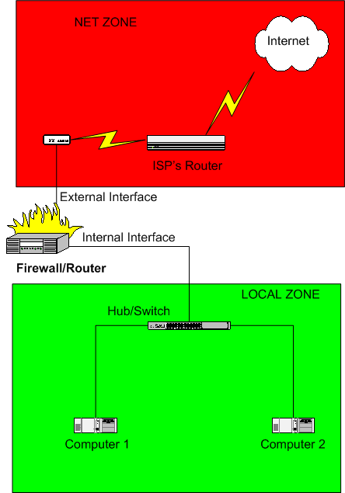
Firewall Topologi :
Basic Two-interface Firewall (no DMZ De-Militarized Zone )
Connects to ISP using DSL, Cable Modem, ISDN, Dial-up, …
Provides for “Internet Connection Sharing” of a single public IP address for a local network using SNAT/Masquerading

Slide 5
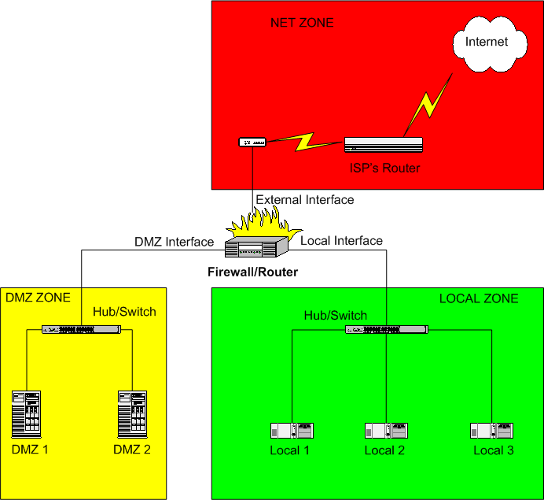
Firewall Topologi :
Three-interface Firewall (with DMZ)
Provides internet connection sharing of one or more public IP addresses.
Had a DMZ containing servers that are exposed to the internet.
If a server is hacked, the Firewall and the Local network aren’t compromised.

Slide 6
Tipe Firewall
Berdasarkan mekanisme cara kerja :
Packet Filtering
  Memfilter paket berdasarkan sumber, tujuan dan atribut paket (filter berdasar IP dan Port). Yang difilter IP, TCP, UDP, and ICMP headers and port number
Application Level
  Biasa disebut proxy firewall, filter bisa berdasarkan content paket
Circuit Level Gateway
  Filter berdasarkan sesi komunikasi, dengan pengawasan sesi handshake.
  Terdapat sesi NEW/ESTABLISH
Statefull Multilayer Inspection Firewall
  Kombinasi dari ketiga tipe firewall diatas

Slide 7
Circuit Level / Stateful Inspection Firewalls
Default Behavior
  Permit connections initiated by an internal host
  Deny connections initiated by an external host
  Can change default behavior with ACL
For DMZ Implementation
Automatically Accept Connection Attempt
Internet
Router
Automatically Deny Connection Attempt

Slide 8

DMZ Configuration
Place web servers in the “DMZ” network
Only allow web ports (TCP ports 80 and 443)
Firewall
internet
Web Server
Notes:
Only allow the services that are required. This example is a pretty easy one, HTTP and HTTPS are used for web communications and run on TCP ports 80 and 443. Sometimes you may have to open an application to the Internet that is not well documented, making the task of determining which ports to open all that more difficult.

Slide 9
DMZ Configuration
Don’t allow web servers access to your network
Allow local network to manage web servers (SSH)
Don’t allow servers to connect to the Internet
Patching is not convenient
Mas ..yang merah gak boleh lewat lho
Firewall
internet
Web Server
Notes:
If your web server is compromised you don’t want it to start attacking your local network. The DMZ configuration allows you to contain the vulnerable servers, and prevent a compromise from spreading. Also, you must allow the local network to connect to the web server, using a secure protocol such as SSH.
This one may take some convincing of you developers and systems administrators. In all reality your web servers do not need to connect out to the Internet . If one becomes compromised the first thing an attacker is going to do is download some malicious code (root kit, backdoor, sniffer, etc..). You can prevent this by not letting you web server connect to the Internet. This makes patching a little more difficult. Patches must be downloaded by another system, then copied to the web server. Numerous attacks have been (and many could have been) prevented if this simple rule was in place.

Slide 10
IPTABLES

Slide 11
IPTABLES
iptables is a networking administration command-line tool on Linux which interfaces to the kernel-provided Netfilter modules. This allows for stateless and stateful firewalls and NAT. It is useful to think of IPtables as being a specialised firewall-creation programming language.

Slide 12
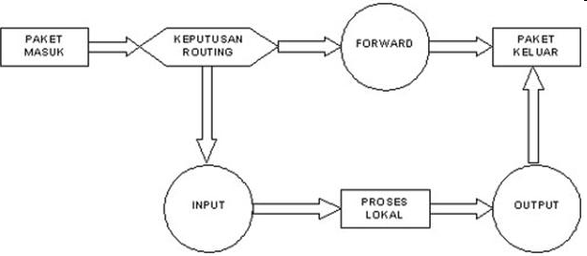
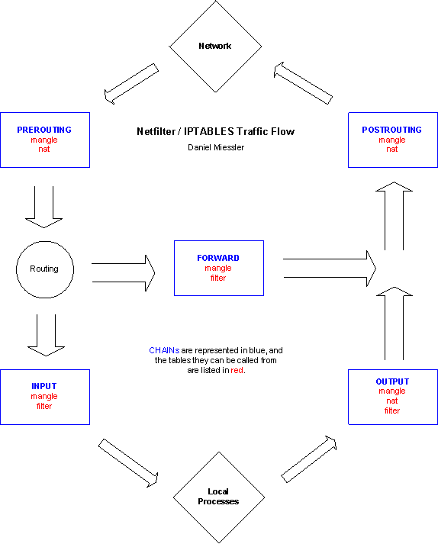
Prinsip Kerja iptables
Paket masuk diproses berdasarkan tujuan :
  Destination IP untuk Firewall → masuk proses input
  Destination IP bukan untuk firewall tapi diteruskan → masuk proses FORWARD
Selanjutnya dicocokkan berdasarkan tabel policy yang dipunyai firewall apakah di-accept atau di-drop

Slide 13
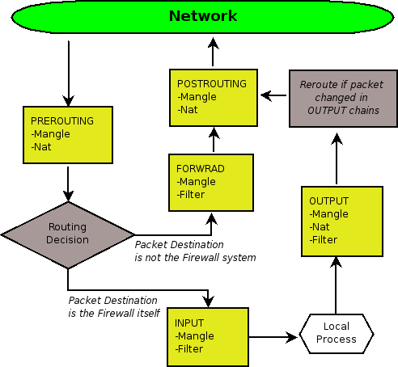
Prinsip Kerja Firewall
Firewall Machine

Slide 14
Sintaks IPTABLES
Opsi
  -A, menambah satu aturan baru ditempatkan pada posisi terakhir
  iptables –A INPUT …
  -D, menghapus rule
    iptables –D INPUT 1
    iptables –D –s 202.154.178.2 …
  -I, menambah aturan baru penempatan bisa disisipkan sesuai nomor
    iptables –I INPUT 3 –s 202.154.178.2 –j ACCEPT
  -R, mengganti rule
    iptables –R INPUT 2 –s –s 202.154.178.2 –j ACCEPT
  -F, menghapus seluruh rule
    iptables –F
  -L, melihat Rule
    iptables -L

Slide 15
Parameter
-p [!] protocol, protokol yang akan dicek
  iptables –A INPUT –p tcp …
-s [!] address/[mask], memeriksa kecocokan sumber paket
  iptables –A INPUT –s 10.252.44.145 …
-d [!] address/[mask], memerika kecocokan tujuan paket
  iptables –A INPUT –d 202.154.178.2 …
-j target, menentukan nasib paket, target misal ACCEPT/DROP/REJECT
  iptables –A INPUT –d 202.154.178 –j DROP
-i [!] interface_name, identifikasi kartu jaringan tempat masuknya data
  iptables –A INPUT –i etho ….
-o [!] interface_name, identifikasi kartu jaringan tempat keluarnya paket
  iptables –A OUTPUT –o eth1 ….

Slide 16
Match iptables
--mac address, matching paket berdasarkan nomor MAC Address
  Iptables –m mac –mac-address 44:45:53:54:00:FF
Multiport, mendifinisikan banyak port
  Iptables –m multiport –source-port 22,25,110,80 –j ACCEPT
State, mendefinisikan state dari koneksi
  Iptables –A INPUT –m state –state NEW, ESTABLISH –j ACCEPT

Slide 17
Target/Jump iptables
ACCEPT, setiap paket langsung diterima
  iptables –A INPUT –p tcp –dport 80 –j ACCEPT
DROP, paket datang langsung dibuang
  iptables –A INPUT –p tcp –dport 21 –j DROP
REJECT, paket yang ditolak akan dikirimi pesan ICMP error
  iptables –A INPUT –p tcp –dport 21 –j REJECT
SNAT, sumber paket dirubah, biasanya yang memiliki koneksi internet
  iptables –t nat –A POSROUTING –p tcp –o eth0 –j SNAT –to-source 202.154.178.2
DNAT, merubah tujuan alamat paket. Biasanya jika server alamat Ipnya lokal, supaya internet bisa tetap akses diubah ke publik
  iptables –t nat –A PREPROUTING –p tcp –d 202.154.178.2 –dport 80 –j DNAT –to-destination 192.168.1.1
MASQUERADE, untuk berbagi koneksi internet dimana no_ipnya terbatas, sebagai mapping ip lokal ke publik
  iptables –t nat –A POSTROUTING –o eth0 –dport 80 –j MASQUERADE
REDIRECT, sigunakan untuk transparent proxy
  ipatbles –t nat –A PREROUTING –p tcp –d 0/0 –dport 80 –j REDIRECT –to-port 8080
LOG, melakukan pencatatan terhadap aktifitas firewall kita, untuk melihat bisa dibuka /etc/syslog.conf
  iptables –A FORWARD –j LOG –log-level-debug
  iptables –A FORWARD –j LOG –log-tcp-options

Slide 18
Firewall Option
# Mengeluarkan Modul-modul Iptables
/sbin/modprobe ip_tables
/sbin/modprobe ip_conntrack
/sbin/modprobe iptable_filter
/sbin/modprobe iptable_mangle
/sbin/modprobe iptable_nat
/sbin/modprobe ipt_LOG
/sbin/modprobe ipt_limit
/sbin/modprobe ipt_state
/sbin/modprobe ip_conntrack_ftp
/sbin/modprobe ip_conntrack_irc
/sbin/modprobe ip_nat_ftp
/sbin/modprobe ip_nat_irc

Slide 19
Menghapus Rule iptables
# Menghapus aturan iptables
  $IPTABLES -F
  $IPTABLES -t nat -F
  $IPTABLES -t mangle -F
# Menghapus nama kolom yg dibuat manual
  $IPTABLES -X
  $IPTABLES -t nat -X
  $IPTABLES -t mangle -X

Slide 20

Terima Kasih

