Slide 1
Web Responsive
Web Standard Layout

Slide 2
Web Standard Layout
HTML5 Layout Semantic Elements/Tag
Web Layout on Mobile Phone
Web Layout on Tablet Low Res (min-width: 481px & max-width: 767px)
Web Layout on Tablet Hi Res (min-width: 768px & max-width: 1024px)
Web Layout on Desktop (min-width: 1025px & max-width: 1280px)

Slide 3
HTML5 Layout Semantic Elements/Tag
Daftar lengkap HTML layout semantic elements
    <header>
    <nav>
    <main>
    <article>
    <section>
    <aside>
    <footer>
    <details>
    <figcaption>
    <figure>
    <mark>
    <summary>
    <time>

Slide 4
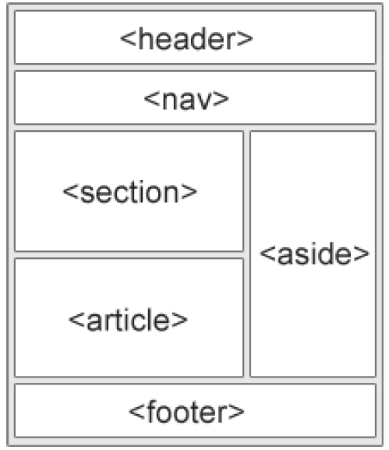
HTML5 Layout Semantic Elements/Tag
Layout umum HTML5 dengan semantic elementnya
<header>
<header>
<header>
<nav>
<nav>
<nav>
<main>
<main>
<main>
<article>
<aside>
<section>
<aside>
<article>
<aside>
<section>
<article>
<section>
<article>
<section>
<section>
<article>
<footer>
<footer>
<footer>

Slide 5
Web Layout on Mobile Phone
Mobile phone umumnya memiliki max-width: 480px
DIV
Div
nav
article
aside
footer

Slide 6
Web Layout on Tablet Low Res
Tablet low res umumnya memiliki min-width: 481px & max-width: 767px
DIV
Div
nav
article
aside
footer

Slide 7
Web Layout on Tablet Hi Res
Tablet low res umumnya memiliki min-width: 768px & max-width: 1024px
DIV
Div
nav
article
aside
footer

Slide 8
Web Layout on Desktop
min-width untuk desktop umumnya adalah 1025px
DIV
Header (100%)
Div
Nav
25%
Article
50%
Aside
25%
Footer (100%)

