Slide 1
DOM (Document Object Model
Intro DOM

Slide 2
Intro DOM
Hirarki Object Model pada DOM
DOM & Javascript

Slide 3
DOM
hirarki object model pada browser:
window
document
Body
Style
Event
Frame
History
Location
Navigator
Screen

Slide 4
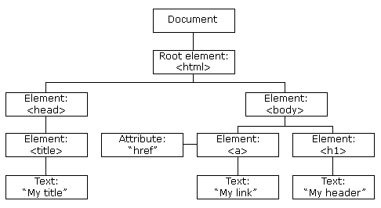
DOM
Contoh object model pada dokumen HTML

Slide 5
DOM dan Javascript
Property dan Method pada Object Document:
  Method document.write()
  Method document.createElement()
  Method document.getElementById()
  Method document.getElementsByClassName()
  Method document.getElementsByTagName()

Slide 6
DOM dan Javascript
Property dan Method pada Object Document:
  Method document.write()
  Contoh:
  <script>
  function ubah() {
  document.write("What is JavaScript?");
  document.write("<p><br/>How to work with JavaScript?", "<br/>What is jQuery?</p>");
  document.write("<div>Hello Madhav</div>")
  }
  </script>
  <body>
  <div id="noSatu" class="awal">Teks Awal</div>
  <button onclick="ubah();">Click Me</button>
  </body>

Slide 7
DOM dan Javascript
Property dan Method pada Object Document:
  Method document.createElement()
  Contoh:
  <script>
  var divTambahan = document.createElement('div');
  divTambahan.id="idDivBaru";
  divTambahan.innerText = "ini DIV tambahan";
  document.body.appendChild(divTambahan);
  </script>

Slide 8
DOM dan Javascript
Property dan Method pada Object Document:
  Method document.getElementById()
  Contoh:
  <script>
  function ubah() {
  document.getElementById("noSatu").innerText='Teks Baru';
  }
  </script>
  <body>
  <div id=“noSatu">Teks Awal</div>
  <button onclick=“ubah();">Click Me</button>
  </body>

Slide 9
DOM dan Javascript
Property dan Method pada Object Document:
  Method document.getElementsClassName()
  Contoh:
  <script>
  function ubah() {
  document.getElementsByClassName("awal")[0].innerText='Teks Baru';
  }
  </script>
  <body>
  <div id="noSatu" class="awal">Teks Awal</div>
  <button onclick="ubah();">Click Me</button>
  </body>

Slide 10
DOM dan Javascript
Property dan Method pada Object Document:
  Method document.getElementsTagName()
  Contoh:
  <script>
  function ubah() {
  document.getElementsByTagName(“div")[0].innerText='Teks Baru';
  }
  </script>
  <body>
  <div id="noSatu" class="awal">Teks Awal</div>
  <button onclick="ubah();">Click Me</button>
  </body>

Slide 11
Terima Kasih

Slide 12
Referensi
Augury, et. al, “Cara mudah membuat web dengan penguasaan CSS dan HTML”, Andi Publishing, 2009.
Molly E. Holzschlag, “Core CSS: Part 2”, DZone Refcardz, Dzone Inc, 2008.

