Slide 1
Enterprise Information Systems & Business Processes
Analisis Proses Bisnis

Slide 2
Objectives
What are the major types of systems in a business? What role do they play?
How do information systems support the major business functions?
Why should managers pay attention to business processes?
What are the benefits and challenges of using enterprise systems?
What are the benefits of using systems to support supply chain management and collaborative commerce?
What are the benefits of using information systems for customer relationship management and knowledge management?

Slide 3
Management Challenges
Integration: Different systems serve variety of functions, connecting organizational levels difficult, costly
Enlarging scope of management thinking: Huge system investments, long development time must be guided by common objectives

Slide 4
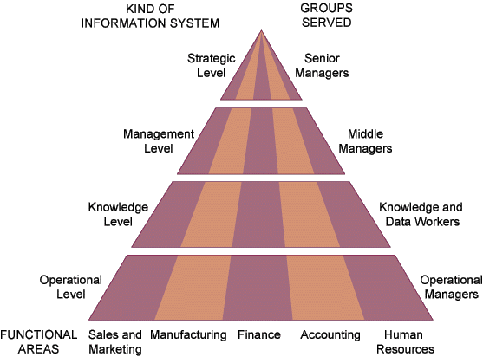
Key System Applications in The Organization

Slide 5
Major Types of Systems
Executive Support Systems (ESS)
Decision Support Systems (DSS)
Management Information Systems (MIS)
Knowledge Work Systems (KWS)
Office Automation Systems (OAS)
Transaction Processing Systems (TPS)

Slide 6
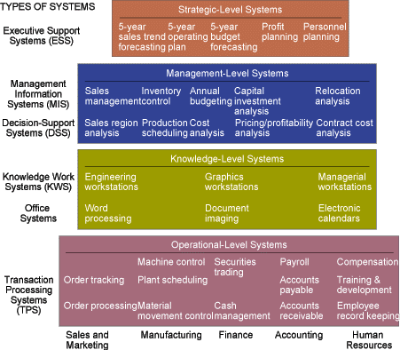

Slide 7
Transaction Processing Systems (TPS)
Basic business systems that serve the operational level
A computerized system that performs and records the daily routine transactions necessary to the conduct of the business

Slide 8
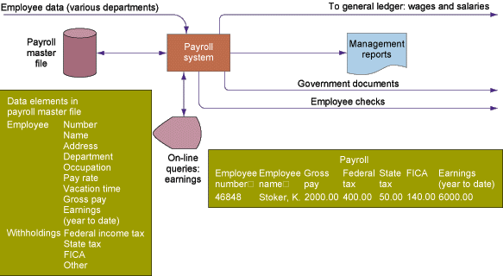
Transaction Processing Systems (TPS) - Payroll

Slide 9
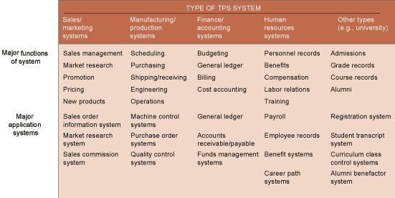
Types of TPS Systems

Slide 10
Knowledge Work Systems (KWS)
Knowledge level
  Inputs: Design specs
  Processing: Modeling
  Outputs: Designs, graphics
  Users: Technical staff
Example: Engineering work station

Slide 11
Management Information System (MIS)
Management level
  Inputs: High volume data
  Processing: Simple models
  Outputs: Summary reports
  Users: Middle managers
Example: Annual budgeting

Slide 12
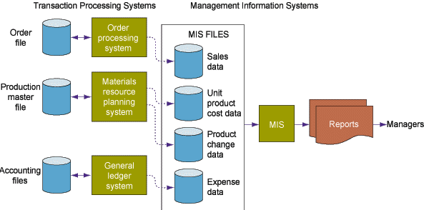
Management Information System (MIS)

Slide 13
Management Information System (MIS)
Structured and semi-structured decisions
Report control oriented
Past and present data
Internal orientation
Lengthy design process

Slide 14
Decision Support System (DSS)
Management level
  Inputs: Low volume data
  Processing: Interactive
  Outputs: Decision analysis
  Users: Professionals, staff
Example: Contract cost analysis

Slide 15
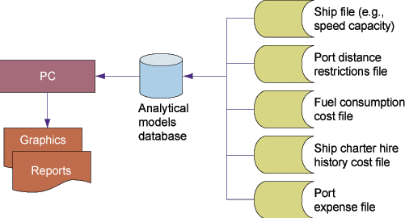
Decision Support System (DSS)

Slide 16
Executive Support System (ESS)
Strategic level
  Inputs: Aggregate data
  Processing: Interactive
  Outputs: Projections
  Users: Senior managers
Example: 5-year operating plan

Slide 17
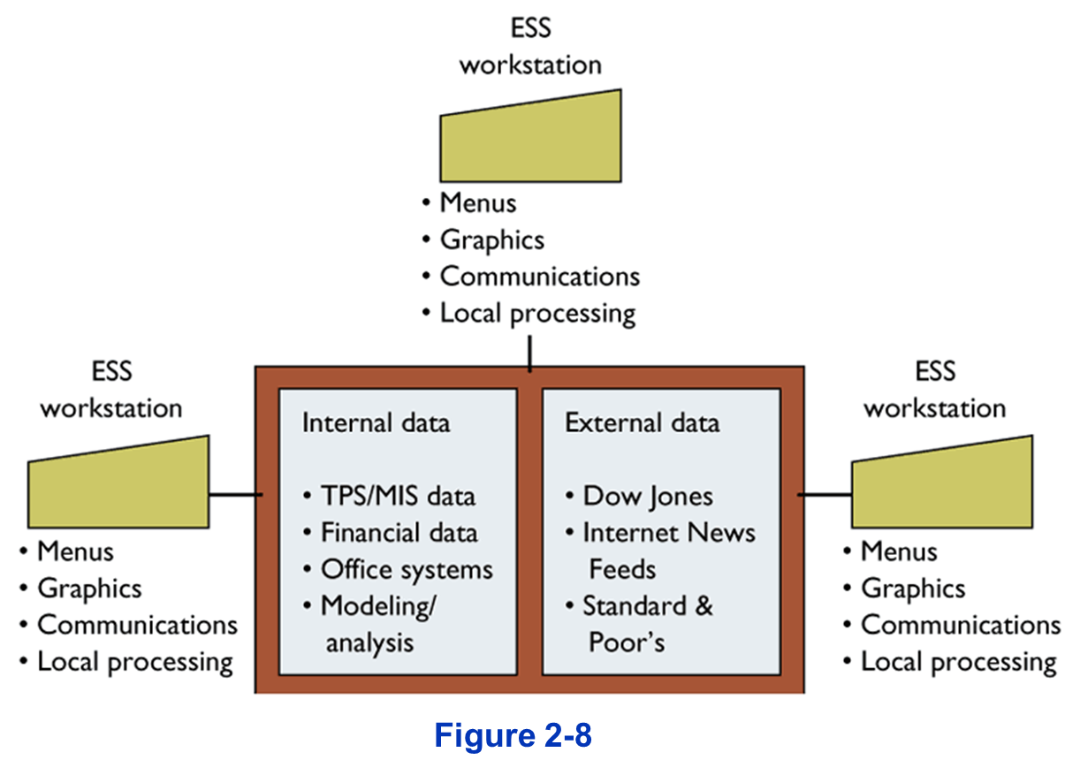
Executive Support System (ESS)

Slide 18
Executive support system (ESS)
Top level management
Designed to the individual
Ties CEO to all levels
Very expensive to keep up
Extensive support staff

Slide 19
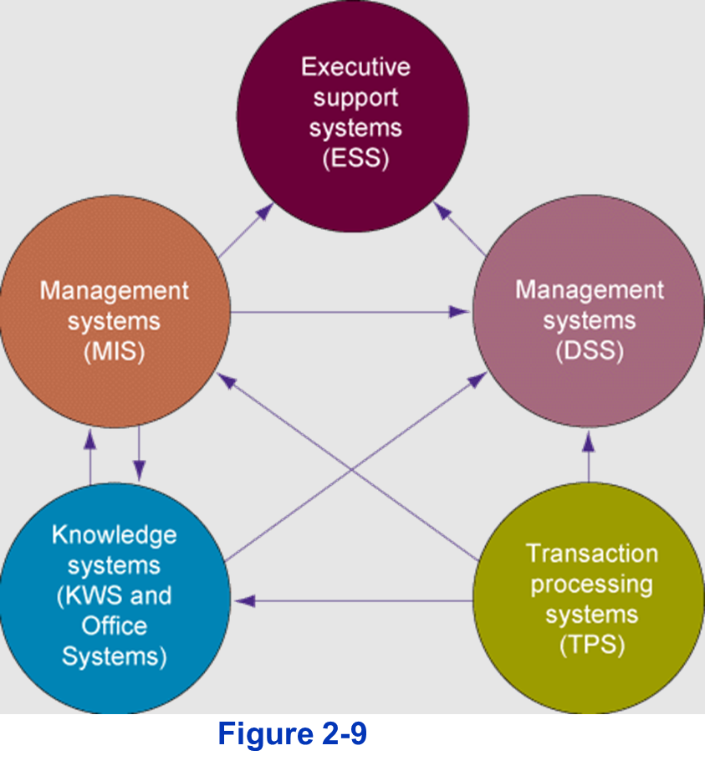
Interrelationships Among Systems

Slide 20
Sales and Marketing Systems
Major functions of systems:
  Sales management, market research, promotion, pricing, new products
Major application systems:
  Sales order info system, market research system, pricing system

Slide 21
Sales and Marketing Systems
SYSTEM | DESCRIPTION | ORGANIZATIONAL LEVEL
ORDER PROCESSING | ENTER, PROCESS, TRACK ORDERS | OPERATIONAL
MARKET ANALYSIS | IDENTIFY CUSTOMERS & MARKETS | KNOWLEDGE
PRICING ANALYSIS | DETERMINE PRICES | MANAGEMENT
SALES TRENDS | PREPARE 5-YEAR FORECASTS | STRATEGIC

Slide 22
Manufacturing and Production Systems
Major functions of systems:
  Scheduling, purchasing, shipping, receiving, engineering, operations
Major application systems:
  Materials resource planning systems, purchase order control systems, engineering systems, quality control systems

Slide 23
Manufacturing and Production Systems
SYSTEM | DESCRIPTION | ORGANIZATIONAL LEVEL
MACHINE CONTROL | CONTROL ACTIONS OF EQUIPMENT | OPERATIONAL
COMPUTER-AIDED-DESIGN | DESIGN NEW PRODUCTS | KNOWLEDGE
PRODUCTION PLANNING | DECIDE NUMBER, SCHEDULE OF PRODUCTS | MANAGEMENT
FACILITIES LOCATION | DECIDE WHERE TO LOCATE FACILITIES | STRATEGIC

Slide 24
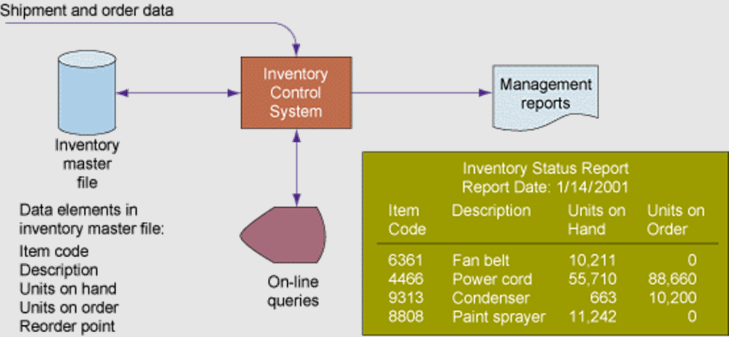
Overview of Inventory Systems

Slide 25
Financing and Accounting Systems
Major functions of systems:
  Budgeting, general ledger, billing, cost accounting
Major application systems:
  General ledger, accounts receivable, accounts payable, budgeting, funds management systems

Slide 26
Financing and Accounting Systems
SYSTEM | DESCRIPTION | ORGANIZATIONAL LEVEL
ACCOUNTS RECEIVABLE | TRACK MONEY OWED TO FIRM | OPERATIONAL
PORTFOLIO ANALYSIS | DESIGN FIRM'S INVESTMENTS | KNOWLEDGE
BUDGETING | PREPARE SHORT TERM BUDGETS | MANAGEMENT
PROFIT PLANNING | PLAN LONG-TERM PROFITS | STRATEGIC

Slide 27
Human Resource Systems
Major functions of systems:
  Personnel records, benefits, compensation, labor relations, training
Major application systems:
  Payroll, employee records, benefit systems, career path systems, personnel training systems

Slide 28
Human Resource Systems
SYSTEM | DESCRIPTION | ORGANIZATIONAL LEVEL
TRAINING & DEVELOPMENT | TRACK TRAINING, SKILLS, APPRAISALS | OPERATIONAL
CAREER PATHING | DESIGN EMPLOYEE CAREER PATHS | KNOWLEDGE
COMPENSATION ANALYSIS | MONITOR WAGES, SALARIES, BENEFITS | MANAGEMENT
HUMAN RESOURCES PLANNING | PLAN LONG-TERM LABOR FORCE NEEDS | STRATEGIC

Slide 29
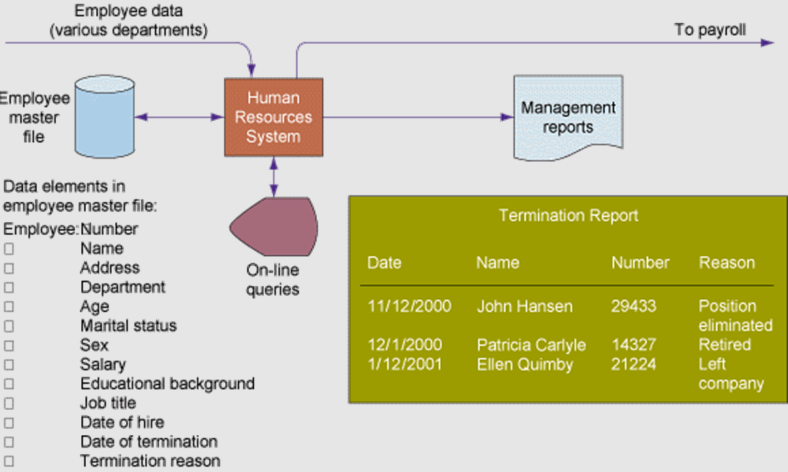
Human Resource Systems

Slide 30
Business Processes and Information Systems
Business processes
  Manner in which work is organized, coordinated, and focused to produce a valuable product or service
  Concrete work flows of material, information, and knowledge—sets of activities
  Unique ways to coordinate work, information, and knowledge
  Ways in which management chooses to coordinate work

Slide 31
Business Processes and Information Systems
Information systems help organizations
  Achieve great efficiencies by automating parts of processes
  Rethink and streamline processes

Slide 32
Examples of Business Processes
Manufacturing and production: Assembling product, checking quality, producing bills of materials
Sales and marketing: Identifying customers, creating customer awareness, selling

Slide 33
Examples of Business Processes
Finance and accounting: Paying creditors, creating financial statements, managing cash accounts
Human Resources: Hiring employees, evaluating performance, enrolling employees in benefits plans

Slide 34
Business Processes and Information Systems
Cross-Functional Business Processes
  Transcend boundary between sales, marketing, manufacturing, and research and development
  Group employees from different functional specialties to a complete piece of work
  Example: Order Fulfillment Process

Slide 35
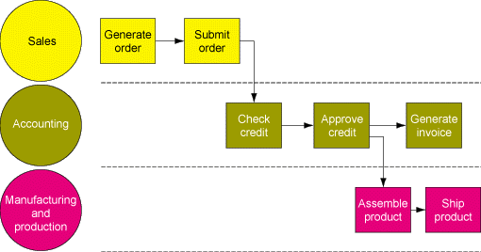
The Order Fulfillment Process

Slide 36
Customer Relationship Management (CRM)
Manages all ways used by firms to deal with existing and potential new customers
Business and Technology discipline
Uses information system to coordinate entire business processes of a firm
Provides end-to-end customer care
Provides a unified view of customer across the company
Consolidates customer data from multiple sources and provides analytical tools for answering questions

Slide 37
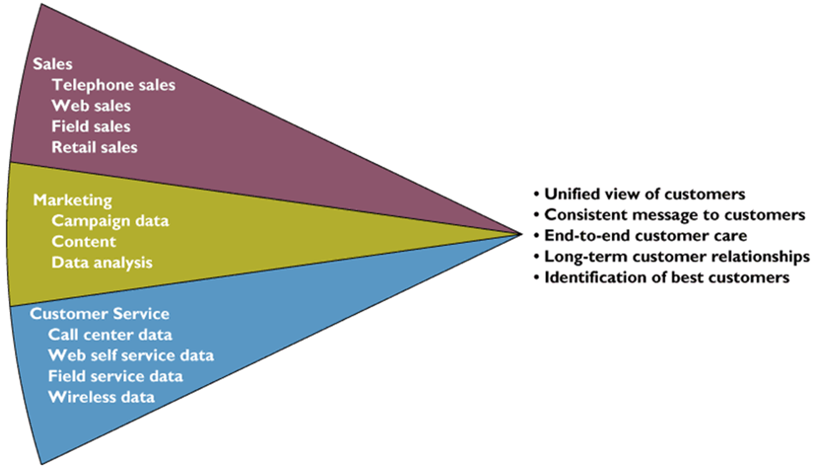
Customer Relationship Management (CRM)

Slide 38
Supply Chain Management (SCM)
Close linkage and coordination of activities involved in buying, making, and moving a product
Integrates supplier, manufacturer, distributor, and customer logistics time
Reduces time, redundant effort, and inventory costs
Network of organizations and business processes
Helps in procurement of materials, transformation of raw materials into intermediate and finished products
Helps in distribution of the finished products to customers
Includes reverse logistics - returned items flow in the reverse direction from the buyer back to the seller

Slide 39
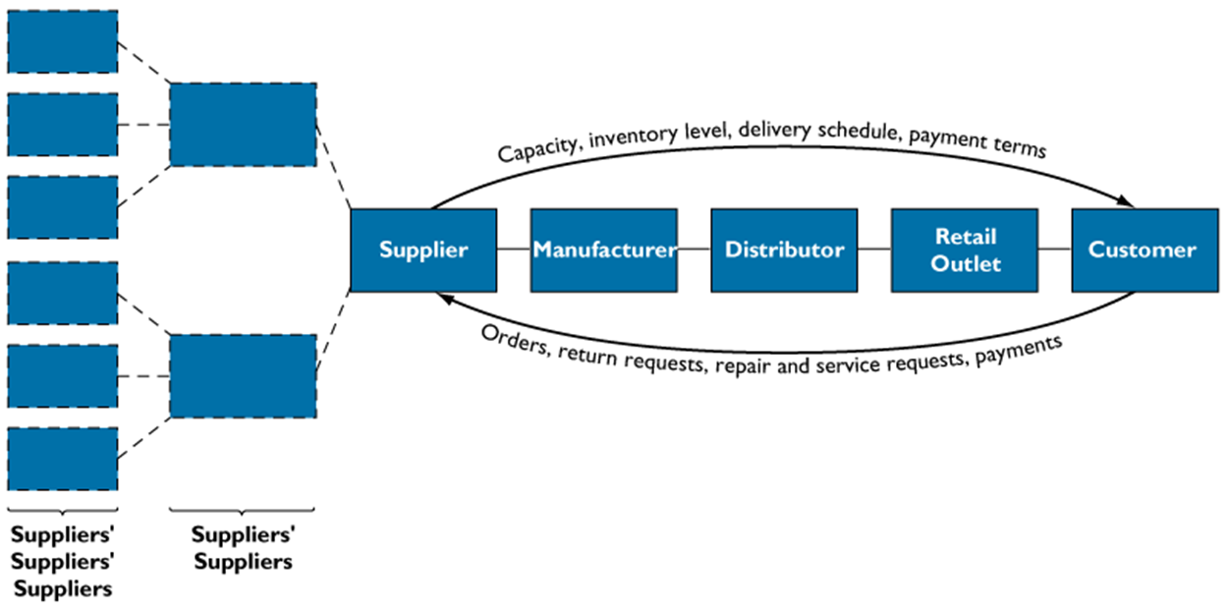
Supply Chain Management

Slide 40
How Information Systems Facilitate Supply Chain Management
Decide when, what to produce, store, move
Rapidly communicate orders
Communicate orders, track order status
Check inventory availability, monitor levels
Track shipments
Plan production based on actual demand
Rapidly communicate product design change
Provide product specifications
Share information about defect rates, returns

Slide 41
Supply Chain Management (SCM)
Supply chain planning system: Enables firm to generate forecasts for a product and to develop sourcing and a manufacturing plan for the product
Supply chain execution system: Manages flow of products through distribution centers and warehouses

Slide 42
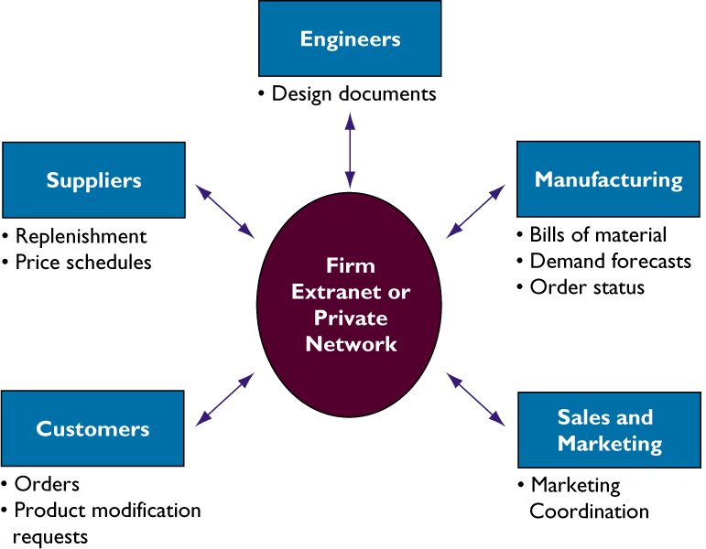
Collaborative Commerce
Uses digital technologies to enable multiple organizations to collaboratively design, develop, build, move, and manage products
Increases efficiencies in reducing product design life cycles, minimizing excess inventory, forecasting demand, and keeping partners and customers informed

Slide 43
Industrial Networks
Private Industrial Networks
  Web-enabled networks
  Link systems of multiple firms in an industry
  Coordinate transorganizational business processes

Slide 44
Traditional View of the Systems
Within the business: There are functions, each having its uses of information systems
Outside the organization’s boundaries: There are customers and vendors
Functions tend to work in isolation

Slide 45
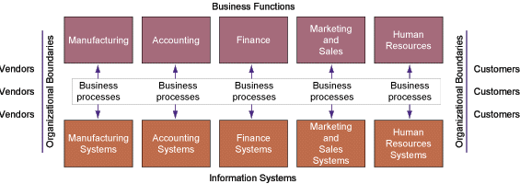
Traditional View of the Systems

Slide 46
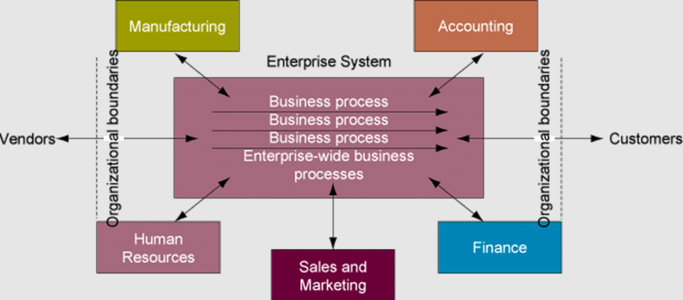
Enterprise Systems

Slide 47
Benefits of Enterprise Systems
Firm structure and organization: One organization
Management: Firm-wide knowledge-based management processes
Technology: Unified platform
Business: More efficient operations and customer-driven business processes

Slide 48
THAT’S ALL
See You Next Session

