Slide 1
Project Management Life Cycle (I)
Analisis Proses Bisnis

Slide 2





Project Management Body of Knowledge (PMBOK) Phase;
Initiation
Planning
Executing
Controlling

Slide 3

Project Management Body of Knowledge
- Initiation Phase;

Slide 4
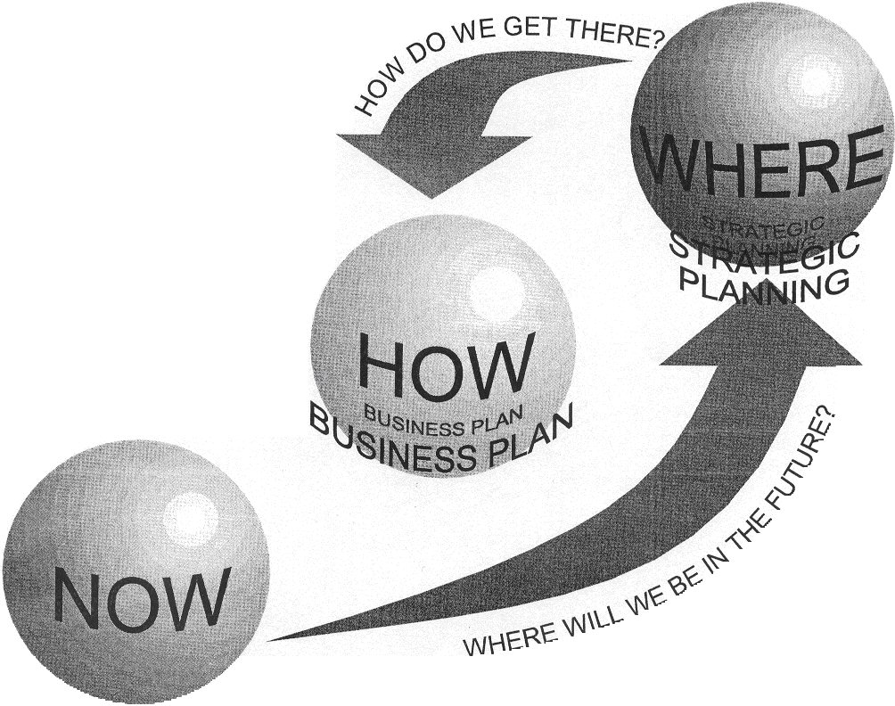
Project Management Body of Knowledge
- Planning Phase;

Slide 5
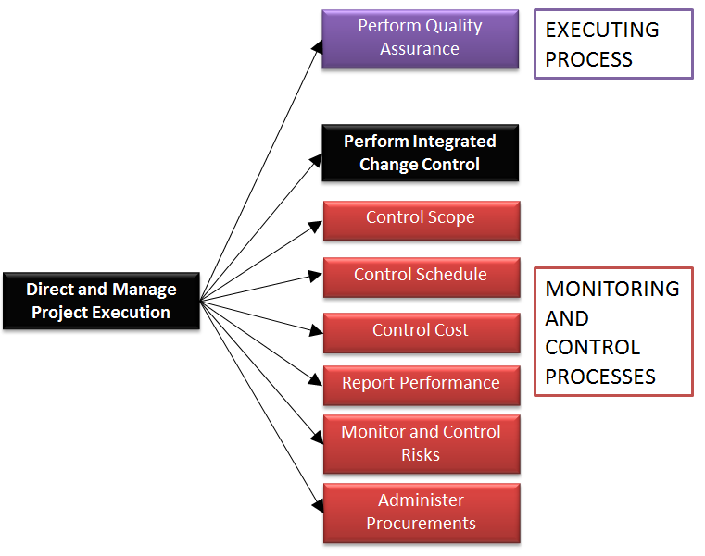
Project Management Body of Knowledge
- Executing & Controlling Phase;

Slide 6
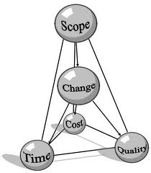

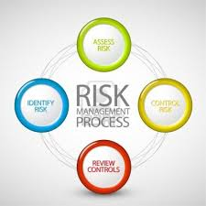



9 Major Knowledge Areas of Project Management Expertise Required;
Scope Management
Communications Management
Risk Management
Human Resources Management
Integration Management
Quality Management
Cost Management
Time Management
Procurement Management

Slide 7
PROJECT MANAGEMENT KNOWLEDGE AREAS

Slide 8
Project Management Lifecycle & Knowledge Areas
LIFECYCLE. KNOWLEDGE . |  | PRELIMINARY |  | INITIATION |  | PLANNIG |  | EXECUTING & CONTROLLING |  | CLOSING
Integration Management
Scope Management
Communications Management
Risk Management
Human Resource Management
Procurement Management
Time Management
Cost Management
Quality Management

Slide 9
COMMUNICATIONS MANAGEMENT PROCESS
“Project Communications Management includes the Processes required to ensure timely and appropriate generation, collection, dissemination, storage,and ultimate disposition of project information.”

Slide 10
A RISK MANAGEMENT PROCESS
“Project Risk Management includes the processes concerned with identifying, analyzing, and responding to project risk.”

Slide 11
THAT’S ALL
See You Next Session

Slide 12
REFERENSI
Project Management Methodology Guidebook, Chandler - Arizona, 2010

