Slide 1
Perancangan dan Pemrograman Web
Week 13
Model View Controller
Oleh: Chaerul Anwar, MTI

Slide 3
Objective
Bekerja dengan database menggunakan PHP
Create, modify, and delete table menggunakan PHP - Framework
Menggunakan PHP – Framework untuk mengolah database

Slide 4
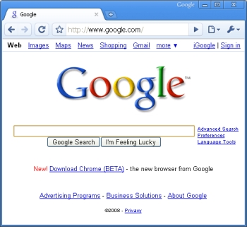
Tipe framework yang dominan: MVC
Framework yang berdasarkan MVC membagi komponen
dalam 3 bagian – Model, View, Controller
Model
DB
HTML, CSS, Templates
Controller
Template

Slide 5
PHP & MVC
The model view controller pattern is the most used pattern for today’s world web applications
It has been used for the first time in Smalltalk and then adopted and popularized by Java
At present there are more than a dozen PHP web frameworks based on MVC pattern

Slide 6
PHP & MVC
The model is responsible to manage the data
The view (presentation) is responsible to display the data provided by the model in a specific format
The controller handles the model and view layers to work together

Slide 7
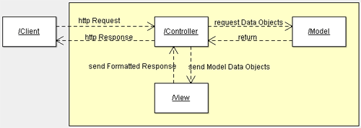
PHP & MVC

Slide 8
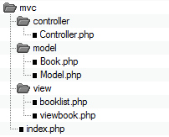
PHP & MVC

Slide 9
model/Book.php
<?php
class Book {
public $title;
public $author;
public $description;
public function __construct($title, $author, $description)
{
$this->title = $title;
$this->author = $author;
$this->description = $description;
}
}
?>

Slide 10
model/Model.php
<?php
include_once("model/Book.php");
class Model {
public function getBookList()
{
// here goes some hardcoded values to simulate the database
return array(
"Jungle Book" => new Book("Jungle Book", "R. Kipling", "A classic book."),
"Moonwalker" => new Book("Moonwalker", "J. Walker", ""),
"PHP for Dummies" => new Book("PHP for Dummies", "Some Smart Guy", "")
);
}
public function getBook($title)
{
// we use the previous function to get all the books
// and then we return the requested one.
// in a real life scenario this will be done through
// a database select command
$allBooks = $this->getBookList();
return $allBooks[$title];
}
}
?>

Slide 11
view/viewbook.php
<html>
<head></head>
<body>
<?php
echo 'Title:' . $book->title . '<br/>';
echo 'Author:' . $book->author . '<br/>';
echo 'Description:' . $book->description . '<br/>';
?>
</body>
</html>

Slide 12
view/booklist.php
<html>
<head></head>
<body>
<table>
<tbody>
<tr><td>Title</td><td>Author</td><td>Description</td></tr>
</tbody>
<?php
foreach ($books as $book) {
echo '<tr><td><a href="index.php?book=' .
$book->title . '">' . $book->title . '</a></td><td>' .
$book->author . '</td><td>' . $book->description . '</td></tr>';
}
?>
</table>
</body>
</html>

Slide 13
controller/Controller.php
<?php
include_once("model/Model.php");
class Controller {
public $model;
public function __construct()
{
$this->model = new Model();
}

Slide 14
controller/Controller.php
public function invoke()
{
if (!isset($_GET['book']))
{
// no special book is requested, we'll show a list of all available books
$books = $this->model->getBookList();
include 'view/booklist.php';
}
else
{
// show the requested book
$book = $this->model->getBook($_GET['book']);
include 'view/viewbook.php';
}
}
}
?>

Slide 15
index.php
<?php
// All interaction goes through the index and is forwarded
// directly to the controller
include_once("controller/Controller.php");
$controller = new Controller();
$controller->invoke();
?>

Slide 16
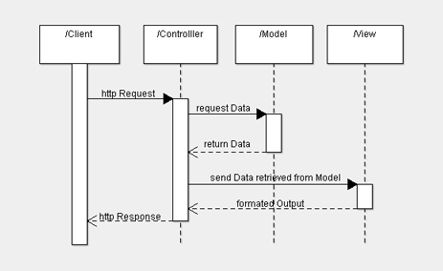
PHP & MVC

Slide 17
Sekian - Terima Kasih

