Slide 1
Information Systems Development
Introduction to Information System
Marcello Singadji | marcello.singadji@upj.ac.id

Slide 2
Learning Objectives
explain the overall process of developing a new software application;
explain the differences between software development methodologies;
understand the different types of programming languages used to develop software;
understand some of the issues surrounding the development of websites and mobile applications;
identify the four primary implementation policies.
Notes:
Tujuan Pembelajaran:
Memahami perbedaan data, informasi, dan pengetahuan.
Memahami perbedaan arsitektur teknologi informasi dan infrastruktur teknologi informasi.
Mampu mendeskripsikan lingkungan bisnis global dan infrastruktur teknologi informasi yang baru.
Mendiskusikan hubungan antara tekanan bisnis, tanggapan/kesiapan perusahaan, dan sistem informasi.

Slide 3
Programming
Programming is the process of creating a set of logical instructions for a digital device to follow using a programming language
  Coding

Slide 4
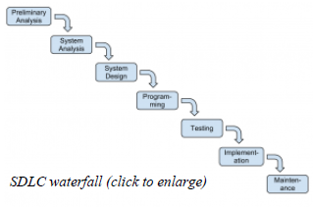
Systems-Development Life Cycle
SDLC was developed for large, structured projects.
  Preliminary Analysis
  System Analysis
  System Design
  Programming
  Testing
  Implementation
  Maintenance

Slide 5
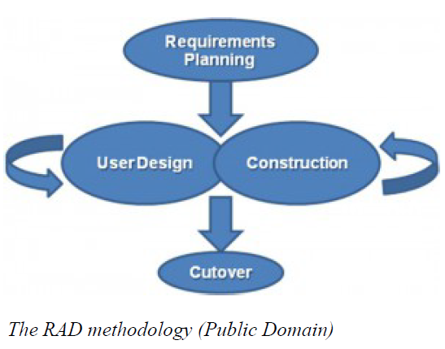
Software-Development Methodologies
Rapid Application Development
  Softwaredevelopment (or systems-development) methodology that focuses on quickly building a working model of the software, getting feedback from users, and then using that feedback to update the working model.

Slide 6
Software-Development Methodologies
Agile Methodologies
  small cross-functional teams that include development-team members and users
  daily status meetings to discuss the current state of the project
  short time-frame increments (from days to one or two weeks) for each change to be completed
  at the end of each iteration, a working project is completed to demonstrate to the stakeholders
The goal of the agile methodologies is to provide the flexibility of an iterative approach while ensuring a quality product

Slide 7
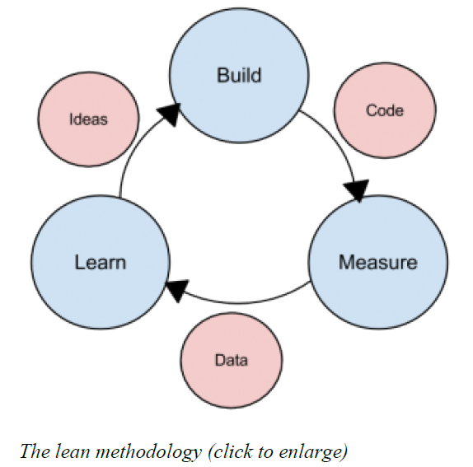
Software-Development Methodologies
Lean Methodology
  One last methodology we will discuss is a relatively new concept taken from the business bestseller The Lean Startup, by Eric Reis
  focus is on taking an initial idea and developing a minimum viable product (MVP)

Slide 8
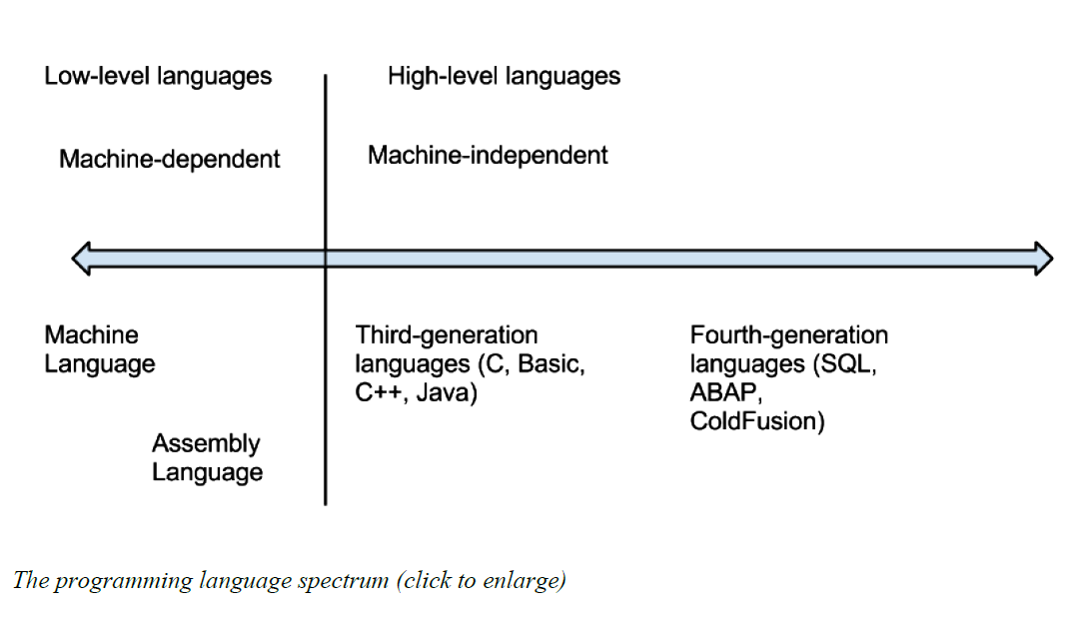
Programming Languages
Software developers create software using one of several programming languages

Slide 9
Compiled vs. Interpreted
Compiled language, the program code is translated into a machine-readable form called an executable that can be run on the hardware
  C
  C++
Interpreted language
  PHP
  PERL
  Python

Slide 10
Procedural vs. Object-Oriented
Procedural programming language is designed to allow a programmer to define a specific starting point for the program and then execute sequentially
  focuses on the sequence of activities to be performed
Object-oriented programming language is set up so that the programmer defines “objects” that can take certain actions based on input from the user
  focuses on the different items being manipulated

Slide 11
Programming Tools
To write a program, a programmer needs little more than a text editor and a good idea
To be more efficient at programming, additional tools, such as an integrated development environment (IDE) or computer-aided software-engineering (CASE) tools, can be used
  IDE
    Notepad++, Microsoft Visual Studio
  CASE tools
    Visual Paradigm, Rational Rose, Rational Robot, Easy Case

Slide 12


Slide 13
Referensi
Introduction to Information Systems, Third Edition, R. Kelly Rainer Jr, Casey G. Cegielski, Wiley

Slide 14


