Slide 1
Lecture 04:
Multilayer Perceptron
By:
Nur Uddin, Ph.D

Slide 2
Multilayer Perceptron (MLP)

Slide 3
Signal Directions in MLP

Slide 4
Differentiation with respect to a vector

Slide 5
Differentiation with respect to a vector (cont’d)

Slide 6
Differentiation with respect to a vector (cont’d)

Slide 7
Unconstrained Optimization

Slide 8
Steepest Descent Method

Slide 9
Forward Computation
See the white board

Slide 10
Part 2
Multi Layer Perceptron (MLP):
Backward Computation (Backpropagation)

Slide 11

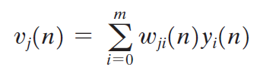

MLP Forward Computation
Training data:

Slide 12




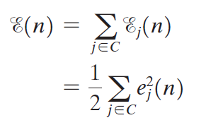
MLP Error

Slide 13

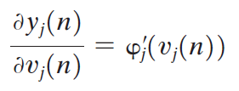
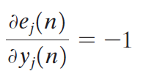

Backpropagation

Slide 14




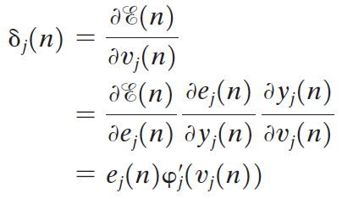
Backpropagation (Cont’d)

Slide 15
Backward computation (Backpropagation)

Slide 16
Backward computation (Backpropagation)

Slide 17

Activation Function
Logistic Function (Sigmoid)
Hyperbolic Tangent

