Slide 1
Lecture 09:
Introduction Image Recognition using Neural Networks
By:
Nur Uddin, Ph.D

Slide 2
Network Architectures
1. Single-Layer Feedforward Networks

Slide 3
Network Architectures (Cont’d)
2. Multilayer Feedforward Networks
This architecture is called 10-4-2 network.

Slide 4
Network Architectures (Cont’d)
3. Recurrent Networks

Slide 5
Knowledge Representation
Knowledge refers to stored information or models used by a person or machine to interpret, predict, and appropriately respond to the outside world.
The primary characteristics of knowledge representation are twofold:
  What information is actually made explicit.
  How the information is physically encoded for subsequent use.

Slide 6
Knowledge Representation (Cont’d)
A major task for a neural network is to learn a model of the world and to maintain the model sufficiently consistently with the real world so as to achieve the specified goals of the application of interest.
Knowledge of the world consists of two kinds of information:
  The known world state, represented by facts about what is and what has been known; this form of knowledge is referred to as prior information.
  Observations (measurements) of the world, obtained by means of sensors designed to probe the environment, in which the neural network is supposed to operate.

Slide 7
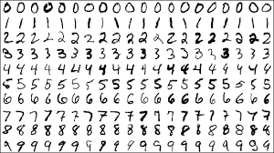
Training Data
A set of input–output pairs, with each pair consisting of an input signal and the corresponding desired response, is referred to as a set of training data.
Example: handwritten-digit recognition problem

