Slide 1
Lecture 02:
Perceptron
By:
Nur Uddin, Ph.D

Slide 2
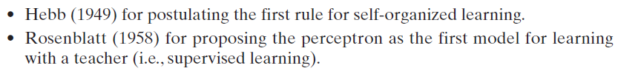
History

Slide 3
History
Pioneering work on neural network:
  McCulloch and Pitts (1943) for introducing the idea of neural networks as computing machines.
  Hebb (1949) for postulating the first rule for self-organized learning.
  Rosenblatt (1958) for proposing the perceptron as the first model for learning with a teacher (i.e., supervised learning).

Slide 4
Perceptron
The perceptron is the simplest form of a neural network.
It is used to classify linearly separable patterns.
The learning algorithm was developed by Rosenblatt (1958, 1962) for his perceptron brain model.

Slide 5
Linearly Separable Patterns

Slide 6
Perceptron Model
Rosenblatt’s perceptron is built around a nonlinear neuron, namely, the McCulloch–Pitts model of a neuron.
Exercise:
Calculate the output !

Slide 7
Mathematics Model of Perceptron

Slide 8
Classification
Question 1:
How to make classification?
Question 2:
What is the activation function?

Slide 9
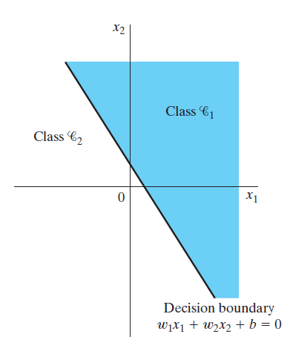
Decision Boundary

Slide 10
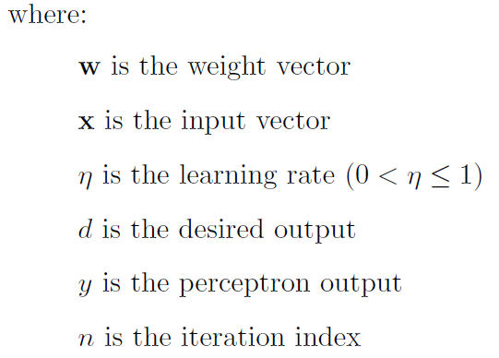
Learning Algorithm

Slide 11
Example 1: Restaurants Survey
Price | Taste | Buy ?
5 | 6 | Yes
5 | 7 | Yes
6 | 3 | No
6 | 8 | Yes
7 | 3 | No
7 | 5 | No
8 | 3 | No
8 | 5 | No
9 | 6 | No
9 | 9 | Yes
10 | 7 | No

Slide 12
Example 1: Restaurants Survey (Cont’d)
Price | Taste | Buy ?
5 | 6 | 1
5 | 7 | 1
6 | 3 | 0
6 | 8 | 1
7 | 3 | 0
7 | 5 | 0
8 | 3 | 0
8 | 5 | 0
9 | 6 | 0
9 | 9 | 1
10 | 7 | 0

Slide 13
Classification using Perceptron
Training
Test (Generalization)

Slide 14
Example 1: Grading System
Mid | Final | Score | Grade
60 | 50 | 54 | Fail
70 | 60 | 64 | Pass
40 | 80 | 64 | Pass
60 | 65 | 63 | Pass
80 | 50 | 62 | Pass
70 | 50 | 58 | Fail
65 | 55 | 59 | Fail
30 | 80 | 60 | Pass
80 | 40 | 56 | Fail
90 | 30 | 54 | Fail
50 | 70 | 62 | Pass
Score =
  Mid exam: 40%
  Final exam: 60%
Grading system =
  Pass: score ≥ 60
  Fail : score < 60

Slide 15
Example 1: Grading System
Mid | Final | Score | Grade
60 | 50 | 54 | Fail
70 | 60 | 64 | Pass
40 | 80 | 64 | Pass
60 | 65 | 63 | Pass
80 | 50 | 62 | Pass
70 | 50 | 58 | Fail
65 | 55 | 59 | Fail
30 | 80 | 60 | Pass
80 | 40 | 56 | Fail
90 | 30 | 54 | Fail
50 | 70 | 62 | Pass
Score =
  Mid exam: 40%
  Final exam: 60%
Grading system =
  Pass: score ≥ 60
  Fail : score < 60

Slide 16
Exercise 1: Airlines Passenger Survey (Economy Class)

