Slide 1
Lecture 01:
Introduction
By:
Nur Uddin, Ph.D

Slide 2
Part 1

Slide 3
Neural Network as an Adaptive Machine
A neural network is a massively parallel distributed processor made up of simple processing units that has a natural propensity for storing experiential knowledge and making it available for use.
It resembles the brain in two respects:
Knowledge is acquired by the network from its environment through a learning process.
Interneuron connection strengths, known as synaptic weights, are used to store the acquired knowledge.

Slide 4
Artificial Neural Network
Commonly referred to as “neural networks”.
A neural network is a machine that is designed to model the way in which the brain performs a particular task or function of interest.
The neural network is usually implemented by using electronic components or is simulated in software on a digital computer.

Slide 5
Motivation of Neural Network
Motivation: human brain computes in an entirely different way from conventional digital computers.
The brain is highly complex, nonlinear, and parallel computer.
Note:
Compute : process information
Computer : information-processing system

Slide 6
Example: Human Vision
A human vision is an information-processing system to provide a visual representation of the environment around us.
The brain routinely accomplishes perceptual recognition tasks (e.g., recognizing a familiar face in an unfamiliar scene) in approximately 100–200 ms, whereas tasks of much lesser complexity take a great deal longer on a powerful computer).

Slide 7
How Does the Brain Work ?
At birth, a brain already has considerable structure and the ability to build up its own rules of behavior through what we usually refer to as “experience.”
Indeed, experience is built up over time, with much of the development (i.e., hardwiring) of the human brain taking place during the first two years from birth, but the development continues well beyond that stage.

Slide 8
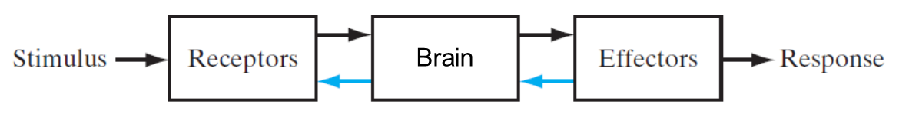
Nervous System
The brain continually receives information, perceives it, and makes appropriate decisions.
Two sets of arrows are shown in the figure:
  Forward transmission
  Feedback in the system.
The receptors convert stimuli from the human body or the external environment into electrical impulses that convey information to the brain.
The effectors convert electrical impulses generated by the neural net into discernible responses as system outputs.

Slide 9
Nervous System vs Computer
ADC
CPU
DAC

Slide 10
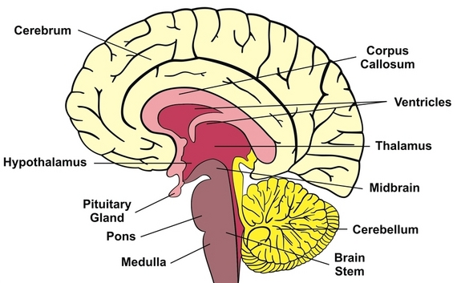
Human Brain

Slide 11
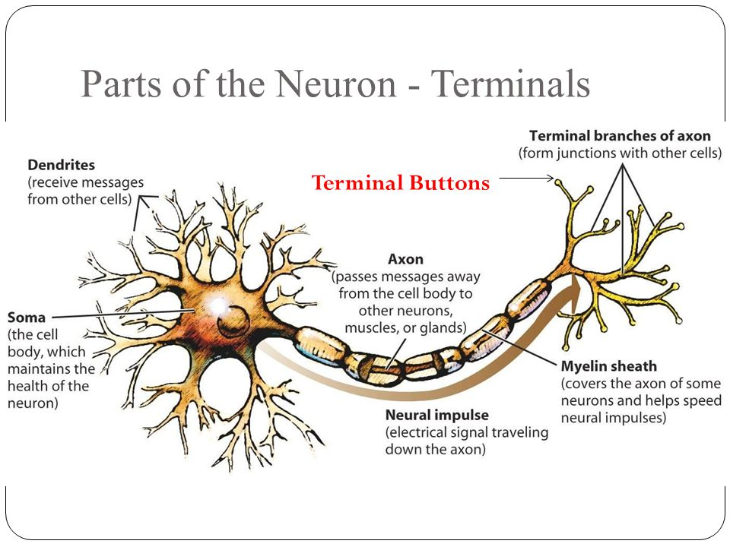
Human Brain
Processing element of brain is known as neuron.

Slide 12

Model of Neuron

Slide 13
Neuron

Slide 14
Elements of Neuron Model
A set of synapses, each synapse is characterized by a weight to strength the input signals.
An adder for summing the weighted input signals.
An activation function for limiting the amplitude of the output of a neuron
A bias for increasing or lowering the net input of the activation function.

Slide 15
Mathematical Model of Neuron

Slide 16
Mathematical Model of Neuron (Cont’d)

Slide 17
Activation Function
Threshold function

Slide 18
Activation Function (Cont’d)
Sigmoid function

Slide 19
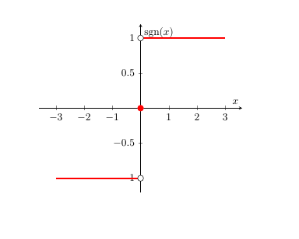
Activation Function (Cont’d)
3. Signum function

Slide 20
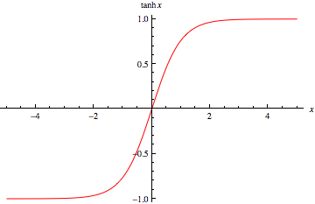
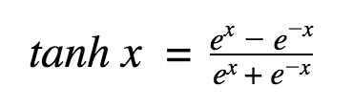
Activation Function (Cont’d)
4. Hyperbolic tangent function

Slide 21
Part 2

Slide 22
Signal-Flow Graph
Signal-flow graphs, with a well-defined set of rules, were originally developed by Mason (1953, 1956) for linear networks.
Signal-flow graphs do provide a neat method for the portrayal of the flow of signals in a neural network.
A signal-flow graph is a network of directed links (branches) that are interconnected at certain points called nodes.
A typical node j has an associated node signal x_{j}.
A typical directed link originates at node j and terminates on node k; it has an associated transfer function, that specifies the manner in which the signal y_{k} at node k depends on the signal x_{j} at node j.

Slide 23
Rules of Signal-Flow Graph
Rule 1: A signal flows along a link only in the direction defined by the arrow on the link.
Two different types of links in NN:
  1. Synaptic links : a linear input–output relation.
  2. Activation links : a nonlinear input–output relation.

Slide 24
Rules of Signal-Flow Graph (Cont’d)
Rule 2: A node signal equals the algebraic sum of all signals entering the node via the incoming links.

Slide 25
Rules of Signal-Flow Graph (Cont’d)
Rule 3: The signal at a node is transmitted to each outgoing link originating from that node with the same value.

Slide 26
Exercise 1
Draw signal flow graph of neuron

Slide 27
Architectural Graph of Neuron

Slide 28
Feedback
Feedback: applying the system output as part the system input.
: closed-loop operator
: open-loop operator

Slide 29
Example 2
Infinite-duration impulse response (IIR)

Slide 30
Network Architectures
1. Single-Layer Feedforward Networks

Slide 31
Network Architectures (Cont’d)
2. Multilayer Feedforward Networks
This architecture is called 10-4-2 network.

Slide 32
Network Architectures (Cont’d)
3. Recurrent Networks

Slide 33
Knowledge Representation
Knowledge refers to stored information or models used by a person or machine to interpret, predict, and appropriately respond to the outside world.
The primary characteristics of knowledge representation are twofold:
  What information is actually made explicit.
  How the information is physically encoded for subsequent use.

Slide 34
Knowledge Representation (Cont’d)
A major task for a neural network is to learn a model of the world and to maintain the model sufficiently consistently with the real world so as to achieve the specified goals of the application of interest.
Knowledge of the world consists of two kinds of information:
  The known world state, represented by facts about what is and what has been known; this form of knowledge is referred to as prior information.
  Observations (measurements) of the world, obtained by means of sensors designed to probe the environment, in which the neural network is supposed to operate.

Slide 35
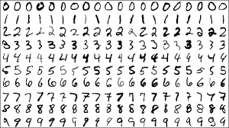
Training Data
A set of input–output pairs, with each pair consisting of an input signal and the corresponding desired response, is referred to as a set of training data.
Example: handwritten-digit recognition problem

Slide 36
Example of Neural Network Design for Hand-written Digit Recognition
Select in an appropriate architecture
  input layer = number to the pixels of an input image
  output layer = 10 neurons (one for each digit).
A subset of examples is then used to train the network by means of a suitable algorithm. This phase of the network design is called learning.
The recognition performance of the trained network is tested with data not seen before.

Slide 37
Part 3

Slide 38
Learning Processes
Learning with a teacher (Supervised Learning)
Learning without a teacher
  Reinforcement learning
  Unsupervised learning

Slide 39
Supervised Learning
In conceptual terms, we may think of the teacher as having knowledge of the environment, with that knowledge being represented by a set of input–output examples.

Slide 40
Reinforcement Learning
Continued interaction with the environment in order to minimize a scalar index of performance.
The goal is to minimize a cost-to-go function, the cumulative cost of actions taken over a sequence of steps instead of simply the immediate cost.

Slide 41
Unsupervised Learning
In unsupervised, or self-organized, learning, there is no external teacher or critic to oversee the learning process, as indicated in Fig. 26.
For a specific task-independent measure, once the network has become tuned to the statistical regularities of the input data, the network develops the ability to form internal representations for encoding features of the input and thereby to create new classes automatically (Becker, 1991).

Slide 42
Applications of Neural Network
Pattern recognition
Function Approximation:
  System identification
  Inverse modeling
Control

Slide 43
System Identification

Slide 44
Inverse Modeling

Slide 45
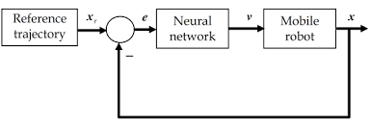
Control

