Slide 1

Metode Numerik
INF308
Mohammad Nasucha, S.T., M.Sc., PhD
Program Studi Informatika
Universitas Pembangunan Jaya

Slide 2
Minggu ke-15
Tambahan / Tinjauan Ulang Materi
Penjelasan tentang UAS

Slide 3
FDTD - A Brief History

Slide 4
FDTD - A Brief History
Year | Key Achievement | By
1928 | A necessary condition for convergence while solving certain partial differential equations | Richard Courant, Kurt Friedrichs, Hans Lewy [28]
1966 | The space-domain time-domain computation method for EM waves was firstly introduced: Space discretization using a 3D grid Employment of Maxwell’s equations | K. S. Yee [29]
1980 | Acronym FDTD was firstly mentioned | Allen Taflove
1994 | Perfectly Matched Layer to avoid reflection | Jean-Pierre Berenger
1995 - Now | Method improvement | Other Researchers

Slide 5
FDTD Principles

Slide 6

FDTD Principles (5)
∆x
Interleaving of H and E
Ez(i, j+1)
Ez(i+1, j+1)
y
Hx(i, j+0.5)
∆y
P(i, j)
Ez(i, j)
Ez(i+1, j)
Hy(i-0.5, j)
Hy(i+0.5, j)
$\overline{E}(n)$ $\overline{E}\left(n+1\right) \overline{E}\left(n+2\right)$
Hx(i, j-0.5)
t = n.Δt
n-0,5 n n+0.5 n+1 n+1.5 n+2
$\overline{H}\left(n−0.5\right)$ $\overline{H}\left(n+0.5\right) \overline{H}\left(n+1.5\right)$
z
x
In Time-Domain In Space-Domain
The value of H _{(n-0.5)} technically can be obtained by averaging the value of H _{(n-1)} and H_{(n)}, i.e.:
 | ${\overline{H}}_{\left(n−0.5\right)}= \frac{{\overline{H}}_{\left(n−1\right)}+{\overline{H}}_{\left(n\right)}}{2}$ | (3-11)
Notes:
This diagram explains the interleaving existence of magnetic field and electric field.
In Time Order
Electric field exists due to the existence of magnetic field just before now, and
Magnetic field exists due the existence of electric field just before now.
In Space Domain
Electric field exists due to the existence of magnetic field nearby, and
Magnetic field exists due the existence of electric field nearby.

Slide 7
Realisasi Persamaan ODE dll pada Komputasi FDTD

Slide 8
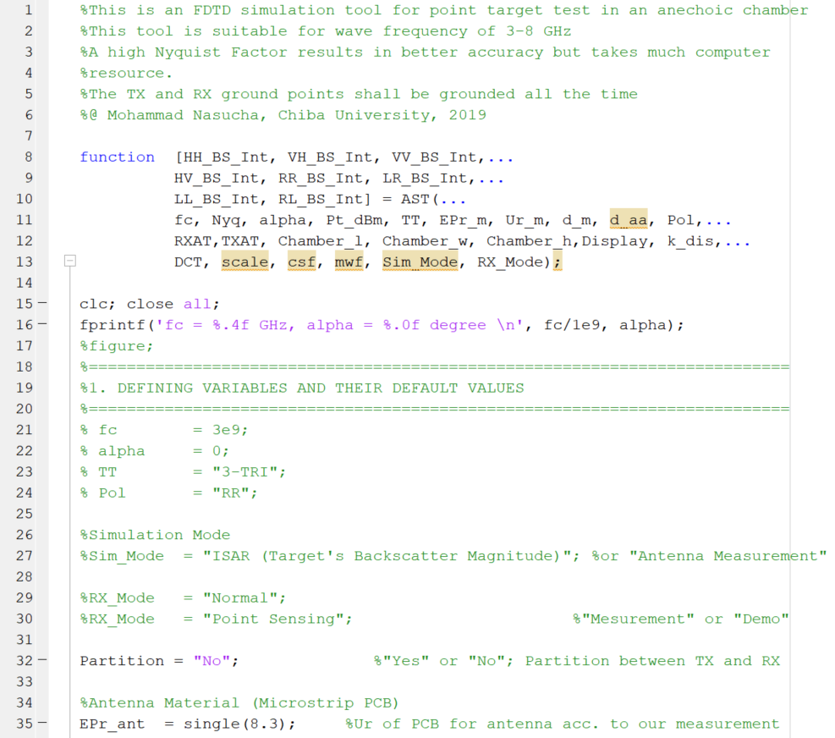

Cuplikan Coding FDTD (1)
Notes:
Good afternoon sensei.
My name is Mohammad Nasucha
The Title of my doctoral thesis is
SCATTERING OF CIRCULARLY POLARIZED ELECTROMAGNETIC WAVES
STUDIED BY
FINITE-DIFFERENCE-TIME-DOMAIN METHOD
AND ANECHOIC CHAMBER EXPERIMENT

Slide 9
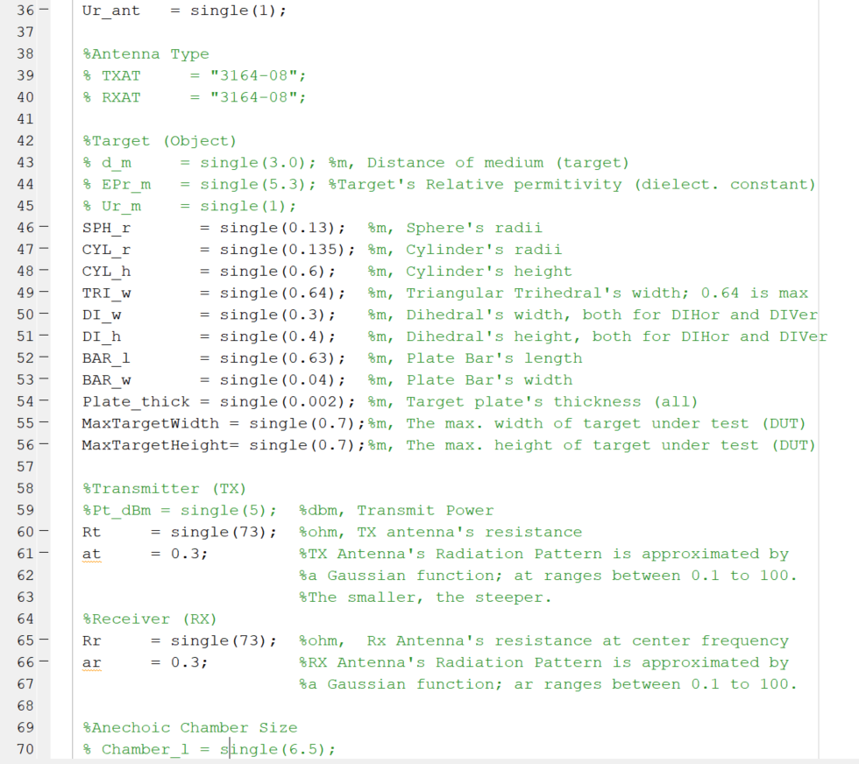
Cuplikan Coding FDTD (2)
Notes:
Good afternoon sensei.
My name is Mohammad Nasucha
The Title of my doctoral thesis is
SCATTERING OF CIRCULARLY POLARIZED ELECTROMAGNETIC WAVES
STUDIED BY
FINITE-DIFFERENCE-TIME-DOMAIN METHOD
AND ANECHOIC CHAMBER EXPERIMENT

Slide 10
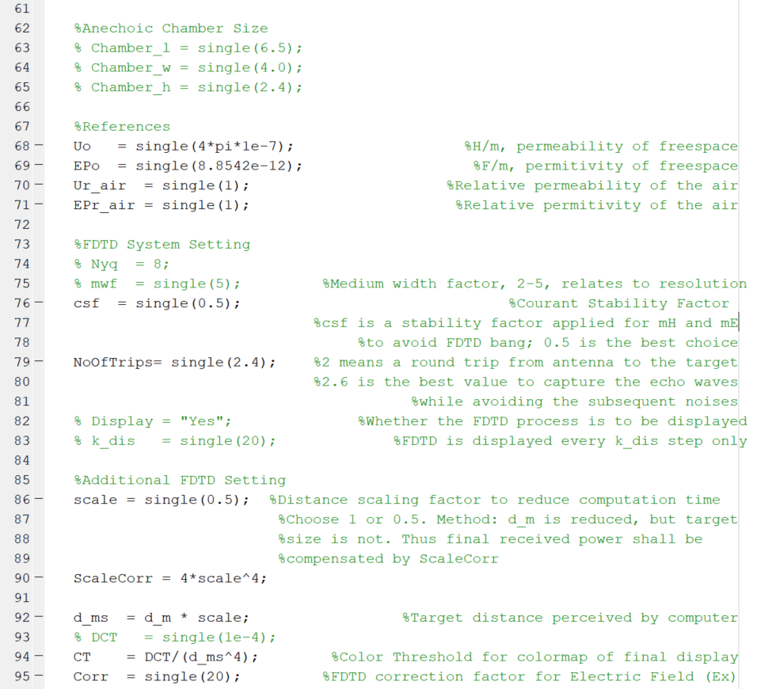
Cuplikan Coding FDTD (3)
Notes:
Good afternoon sensei.
My name is Mohammad Nasucha
The Title of my doctoral thesis is
SCATTERING OF CIRCULARLY POLARIZED ELECTROMAGNETIC WAVES
STUDIED BY
FINITE-DIFFERENCE-TIME-DOMAIN METHOD
AND ANECHOIC CHAMBER EXPERIMENT

Slide 11
Beberapa Istilah Penting pada Materi Sesi ke-13 & 14
Ordinary Differential Equation (ODE).
Finite-Difference Time-Domain adalah sebuah metode komputasi dengan prinsip Space-Domain Time-Domain. Tokoh-tokoh yang berkontribusi besar terhadap visualisasi gelombang elektromagnetik melalui FDTD: Michael Firaday, James Clerk Maxwell, Richard Courant, Kurt Friedrichs, Hans Lewy, Kane S. Yee, Allen Taflove
Method
Algorithm
Procedure
Pada konteks matematika diskrit atau metode numerik dikenal notasi untuk merepresentasikan variabel waktu, yaitu: n-1, n, n+1, dst.
Notes:
Good afternoon sensei.
My name is Mohammad Nasucha
The Title of my doctoral thesis is
SCATTERING OF CIRCULARLY POLARIZED ELECTROMAGNETIC WAVES
STUDIED BY
FINITE-DIFFERENCE-TIME-DOMAIN METHOD
AND ANECHOIC CHAMBER EXPERIMENT

Slide 12
Penjelasan UAS
Notes:
Good afternoon sensei.
My name is Mohammad Nasucha
The Title of my doctoral thesis is
SCATTERING OF CIRCULARLY POLARIZED ELECTROMAGNETIC WAVES
STUDIED BY
FINITE-DIFFERENCE-TIME-DOMAIN METHOD
AND ANECHOIC CHAMBER EXPERIMENT

Slide 13
Penjelasan UAS
UAS berupa small projects. Presentasikan hasil kerja Anda atas project 1 dan project 2 dalam sebuah video berdurasi 3 menit. Khusus untuk project 2, sertakan juga sebuah file pdf yang berisi codingnya.
Unggahlah video dan file pdf tersebut ke Google Classroom menurut kode kelas sebagaimana telah diberitahukan pada sesi kuliah, khususnya pada halaman Tugas Kelas (Classworks), pada bagian Ujian Akhir Semester (UAS). Batas waktu pengunggahan adalah Jumat 15 Mei 2020 pukul 10.00.
Menyontek adalah ilegal. Penyontek dan pemberi contekan mendapatkan sanksi nilai.

