Slide 1

Metode Numerik
INF308
Mohammad Nasucha, S.T., M.Sc., PhD
Program Studi Informatika
Universitas Pembangunan Jaya

Slide 2
Sesi Ke-13
Ordinary Differential Equations (ODEs) (3)

Slide 3
Penyegaran Materi Yang Lalu

Slide 4
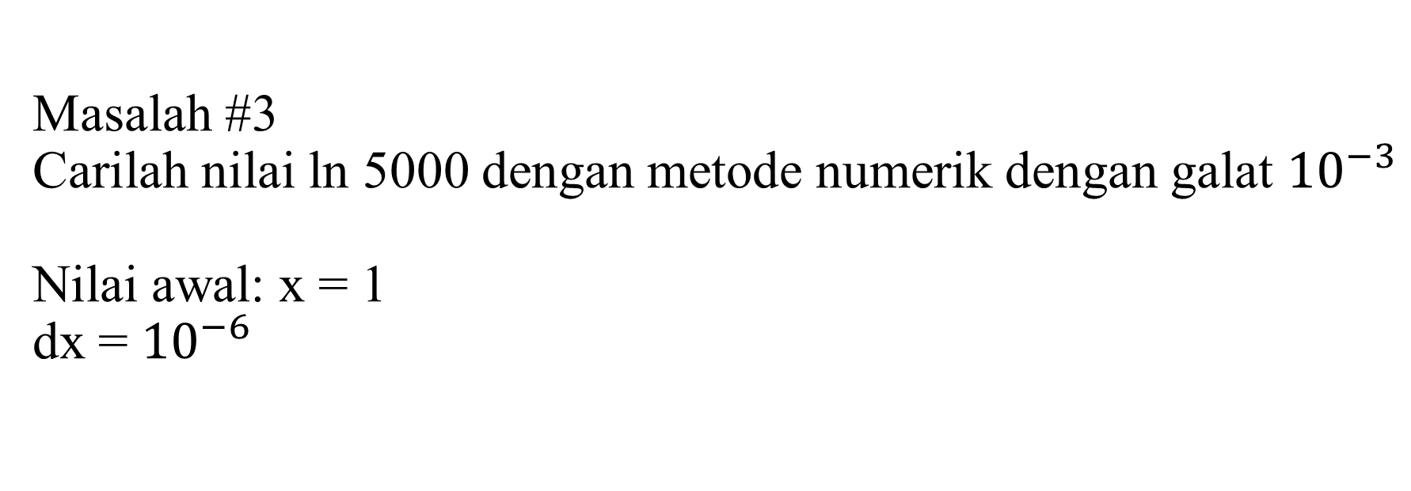
Solusi dari Masalah #3
Masalah #3
Carilah nilai ln 5000 dengan metode numerik dengan galat ${10}^{−3}$
Nilai awal: x = 1
dx = ${10}^{−6}$

Slide 5
Solusi dari Masalah #3
Algoritma Penyelesaian
Rumuskan masalah dengan persamaan matematika, misalnya e^x = 5000. x=?
Tentukan nilai yang ditargetkan dan beri nama, misalnya dalam hal ini y = 5000.
Tentukan tebakan awal dari solusi (nilai awal), misalnya x = 1.
Tentukan besarnya pertambahan nilai, misalnya dx = 0.000001.
Cek nilai sementara dan cek seberapa jauh bedanya dengan nilai target.
Tentukan nilai galat yang ditargetkan, misalnya galat = 0.001.
Cek galat sementara: galat_sementara = [nilai target – nilai sementara]
Jika galat_sementara > galat, lakukan penambahan nilai x, yaitu x = x + dx.
Ulang kembali langkah 1 s.d. 8, hentikan jika galat_sementara <= galat.

Slide 6
Contoh Penerapan Problem Solving ODE:
ODE pada Sains di Bidang Radar

Slide 7
Latar Belakang

Slide 8
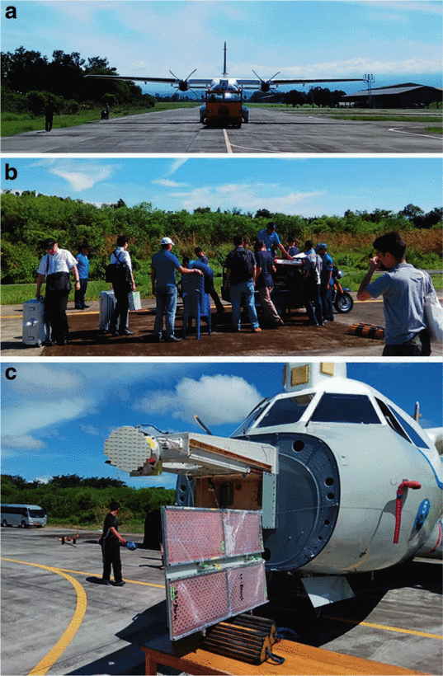
Motivasi dan Tujuan Riset
Motivasi Riset
Penginderaan jauh (remote sensing) menyumbang keuntungan untuk manusia:
  Dalam pelestarian bumi
  Dalam hal mitigasi bencana alam
  Dalam peningkatan produktivitas industri
Kami bermaksud untuk berkontribusi di dalam pengembangan teknologi penginderaan jauh.
Tujuan Riset
Memahami karakteristik pantulan / sebaran gelombang eletromagnetik terpolarisasi melingkar (gelombang CP), dalam upaya untuk mengungkap apakah gelombang jenis ini lebih efektif digunakan pada Synthetic Aperture Radar (SAR) dibandingkan gelombang elektromagnetik terpolarisasi linier (gelombang LP).
JMRSL’s CP-SAR onboard
of CN-235 in Makassar.
at the Hinotori 2 mission
Notes:
The Motivation is as follows:
As we have been recently developing a CP-SAR for airborne and spaceborne, understanding the behavior of CP waves is important.
So, the Goal of the Research is
understanding the behavior of the EM waves, especially the scattering characteristic of CP waves.

Slide 9
Latar Belakang Masalah
Kita perlu memahami karakteristik pantulan / sebaran gelombang elektromagnetik terpolarisasi melingkar (gelombang CP).
Komputasi bisa berguna untuk memperkirakan karakteristik pantulan / sebaran tersebut.
Secara khusus, dengan menerapkan Finite-Difference Time-Domain (FDTD), komputasi diharapkan bisa melakukan perhitungan sekaligus memvisualisasikan karakteristik pantulan / sebaran tersebut.
Notes:
The problem background can be mentioned as follows:
In regard to the CP-SAR, we need to understand the scattering characteristics of CP waves.
For that sake, computation can be useful
- Especially, the FDTD-based computation can visualize the scattering pattern of the waves.

Slide 10
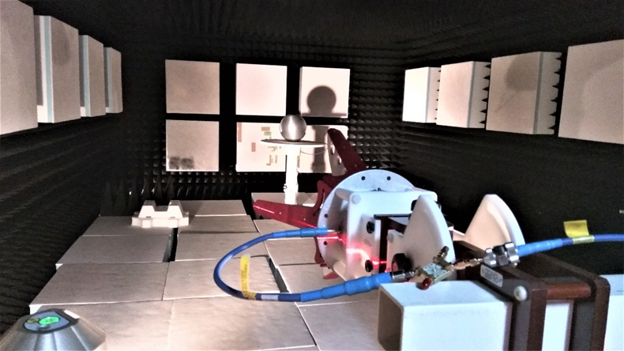
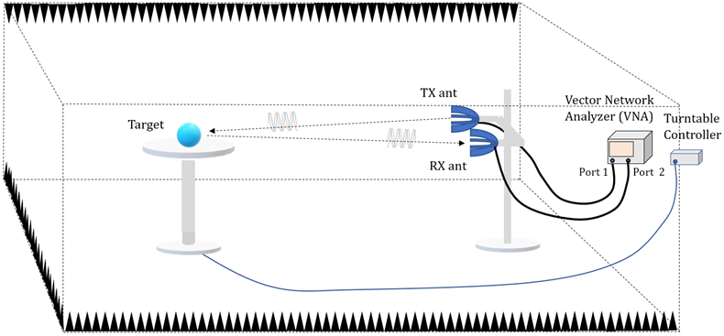
Rincian Teknis (1)
Properti Anechoic Chamber
6.5 m
4.0 m
Radiation-
Absorbent
Material
2.4 m
Notes:
The second technical background to be mentioned is the knowledge about an anechoic chamber.
The anechoic chamber is a cuboid, that has six walls that are covered by absorbers. The size of our anechoic chamber is 6.5 by 4.0 by 2.4 m.
Within the chamber, there are: a TX antenna, an RX antenna, and a scatterer or target.
Any other objects reside in the chamber are assumed to be not reflecting the EM waves or covered by absorbers.

Slide 11
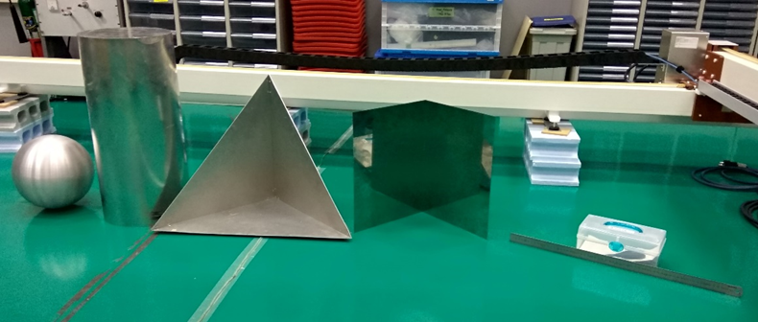
Rincian Teknis (2)
Corner Reflector sebagai Scatterer (Pemantul / Penyebar Gelombang)
Notes:
The third technical background to be mentioned is the Corner Reflectors, being a Scatterer.
In our laboratory we have a sphere, a cylinder, a trihedral, a dihedral, a horizontal bar and a vertical bar.
We used the same bar for the horizontal and the vertical bar, just with different standing orientations.
The cylinder and the dihedral are not part of this report.

Slide 12
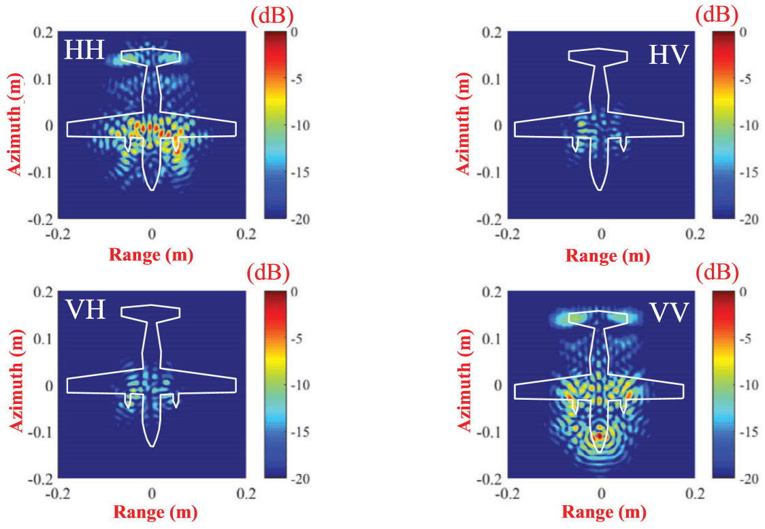
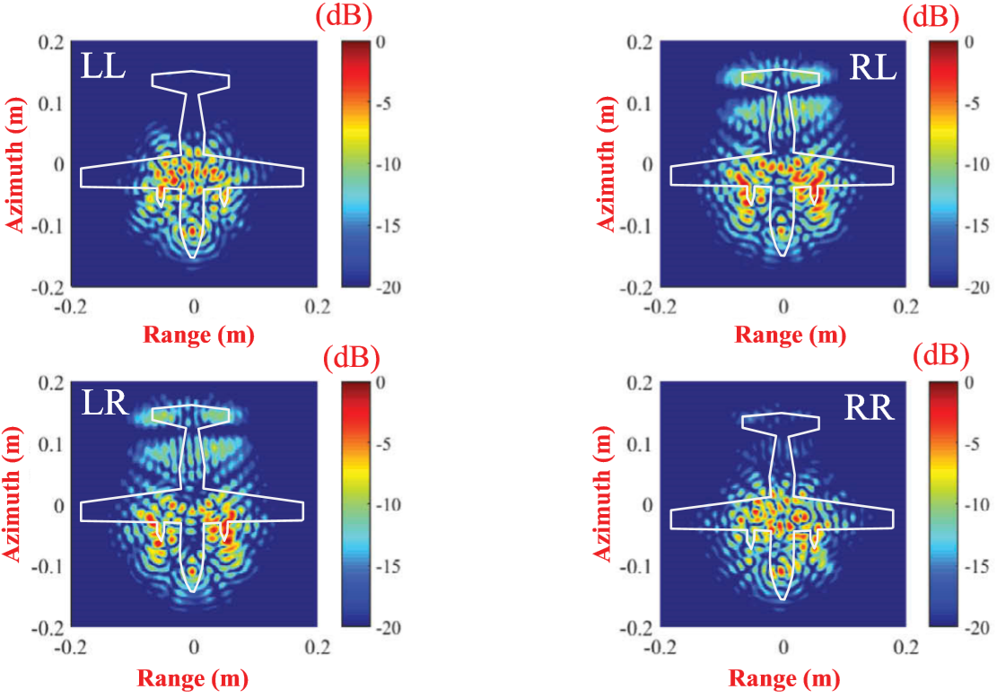
Hasil Riset Sebelumnya oleh JMRSL
Hasil Imaging menggunakan LP Modes Hasil Imaging menggunakan CP Modes
Langsung dilaksanakan dengan eksperimen, tidak didahului dengan komputasi.
Temuan:
Pola pantulan / sebaran gelombang CP tidak banyak berubah pada berbagai mode-nya, dibandingkan terhadap gelombang LP. Dengan kata lain, gelombang CP lebih bisa diandalkan untuk imaging daripada gelombang LP.
Notes:
State of the Art of the Issue can be explained as follows:
What have been achieved up to recently are:
+ First, the computation tools such as MAFIA, CST, FEKO, HFSS are available but they are not dedicated for anechoic chamber.
+ Second, study on field distribution in an anechoic chamber have been done, but not with CP waves.
+ Third, computation or calculation on backscattering by corner reflectors have been reported, but not with CP waves, and not with time-domain computation.
+ And, generating CP waves by computation have been done, but using complex CP antennas [3, 53]
What have not been done up to recently are:
- A computation tool that is dedicated for time-domain EM wave simulation in an anechoic chamber is not available
- Generating & receiving CP waves using simple linear antennas and phase-shifters has not been done

Slide 13
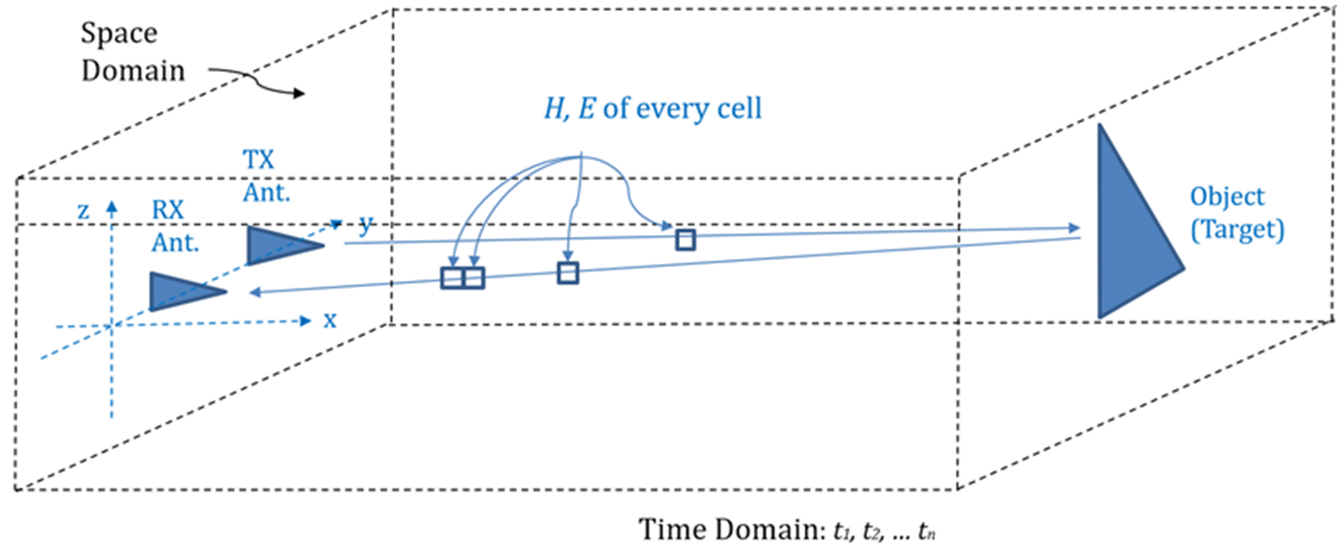

Metode FDTD (1)
Apa itu FDTD?
Sebuah metode komputasi numerik untuk menyelesaikan persamaan diferensial pada ranah ruang dan waktu.
$$\overline{H},\overline{E} of every cell$$
Penerapannya:
Untuk memvisualisasikan perambatan gelombang pada berbagai medium.
Untuk memperkirakan nilai dari properti gelombang pada setiap titik pada ruang pengujian pada setiap waktu.
Notes:
FDTD method can be used to visualize the motion and scattering of waves,
also to predict the value of the wave’s properties at every cell and every timestamp of interest.

Slide 14

Metode FDTD (2)
Interleaving of $\overline{H}$ and $\overline{E}$
∆x
Ez(i, j+1)
Ez(i+1, j+1)
y
Hx(i, j+0.5)
∆y
P(i, j)
Ez(i, j)
Ez(i+1, j)
$\overline{E}(n)$ $\overline{E}\left(n+1\right) \overline{E}\left(n+2\right)$
Hy(i-0.5, j)
Hy(i+0.5, j)
Hx(i, j-0.5)
t = n.Δt
n-0,5 n n+0.5 n+1 n+1.5 n+2
$\overline{H}\left(n−0.5\right)$ $\overline{H}\left(n+0.5\right) \overline{H}\left(n+1.5\right)$
z
x
In Time-Domain in Space-Domain
Notes:
This diagram explains the interleaving existence of magnetic field and electric field.
In Time Order
Electric field exists due to the existence of magnetic field just before now, and
Magnetic field exists due the existence of electric field just before now.
In Space Domain
Electric field exists due to the existence of magnetic field nearby, and
Magnetic field exists due the existence of electric field nearby.

Slide 15
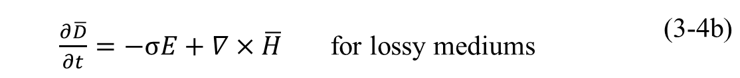
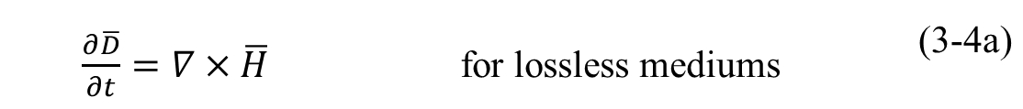
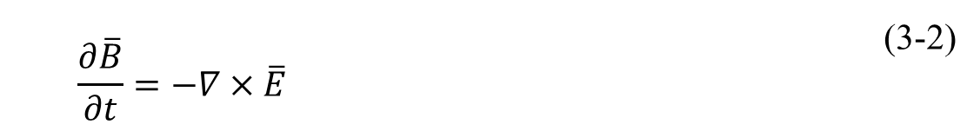
Metode FDTD (3)
Fenomena fisika gelombang elektromagnetik dideskripsikan dengan baik dengan persamaan Maxwell.
Dua dari empat persamaan tersebut adalah ODE.
Phenomenon #1:
Phenomenon #2:
Phenomenon #3:
Phenomenon #4:
 | $\overline{B}=μ\overline{H}$ | (3-1)
 | $$\frac{∂\overline{B}}{∂t}=−∇×\overline{E}$$ | (3-2)
 | $\overline{D}=ε\overline{E}$ | (3-3)
 | $\frac{∂\overline{D}}{∂t}=∇×\overline{H}$ for lossless mediums | (3-4a)
 | $\frac{∂\overline{D}}{∂t}=−σE+∇×\overline{H}$ for lossy mediums | (3-4b)
Notes:
There are, at least four physical phenomena that explain the propagation of EM waves.
These phenomenon involve the role of
- Magnetic Flux Density
- Electric Flux Density
- Magnetic Field, and
- Electric Field

