Slide 1
Teori Bahasa dan Automata
Lecture 13:
Algorithm
By:
Nur Uddin, Ph.D

Slide 2
Chapter 8
Algorithms

Slide 3
OBJECTIVES
After reading this chapter, the reader should
be able to:
Understand the concept of an algorithm.
Define and use the three constructs for developing
algorithms: sequence, decision, and repetition.
Understand and use three tools to represent algorithms:
flowchart, pseudocode, and structure chart.
Understand the concept of modularity and subalgorithms.
List and comprehend common algorithms.

Slide 4
8.1
CONCEPT

Slide 5
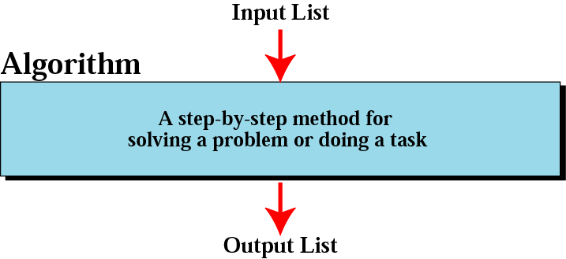
Figure 8-1
Informal definition of an algorithm
used in a computer

Slide 6
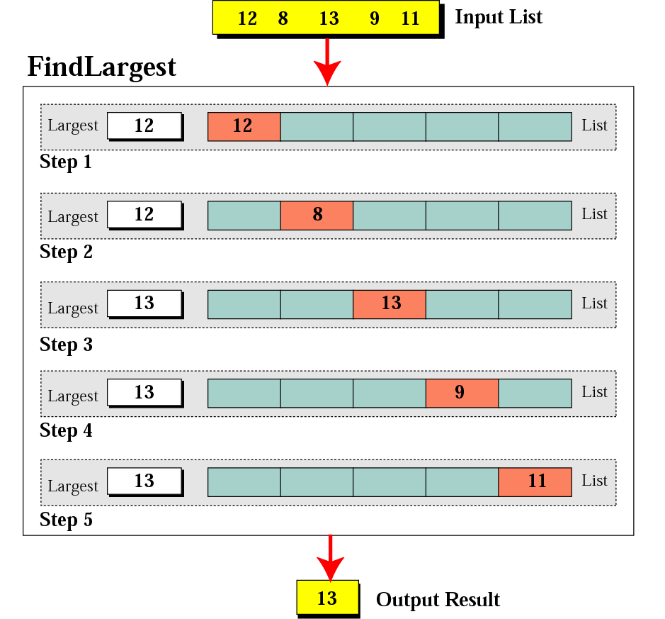
Figure 8-2
Finding the largest integer
among five integers

Slide 7
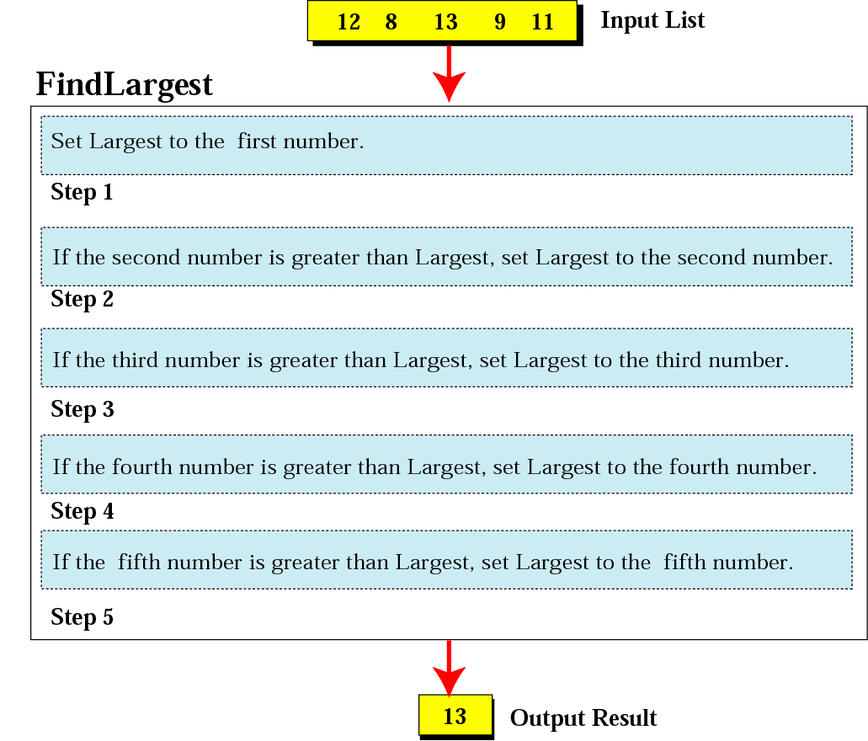
Figure 8-3
Defining actions in FindLargest algorithm

Slide 8
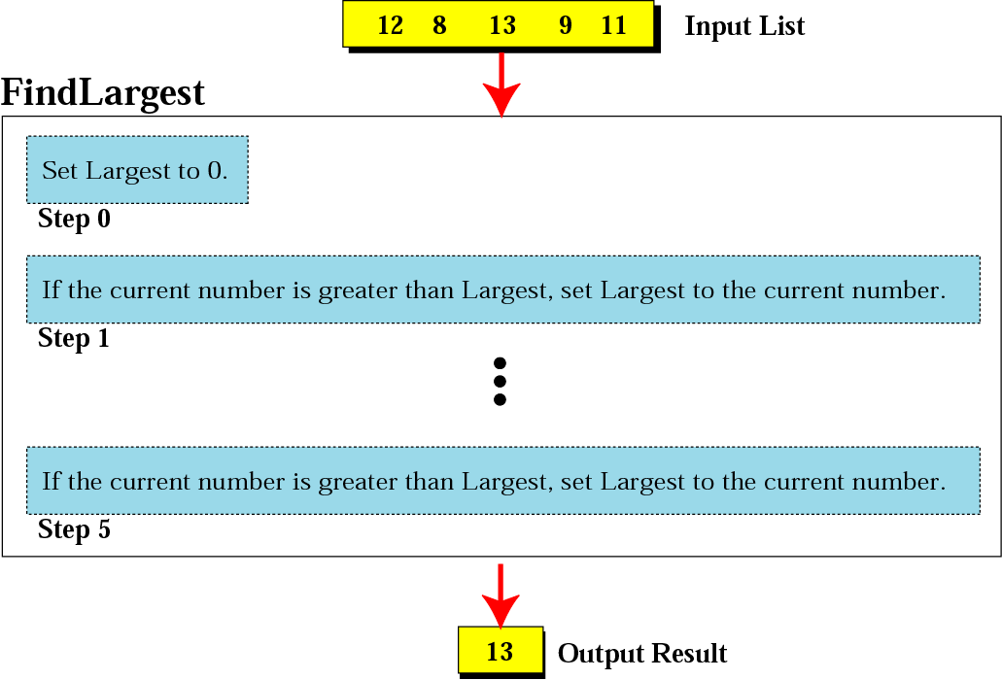
Figure 8-4
FindLargest refined

Slide 9
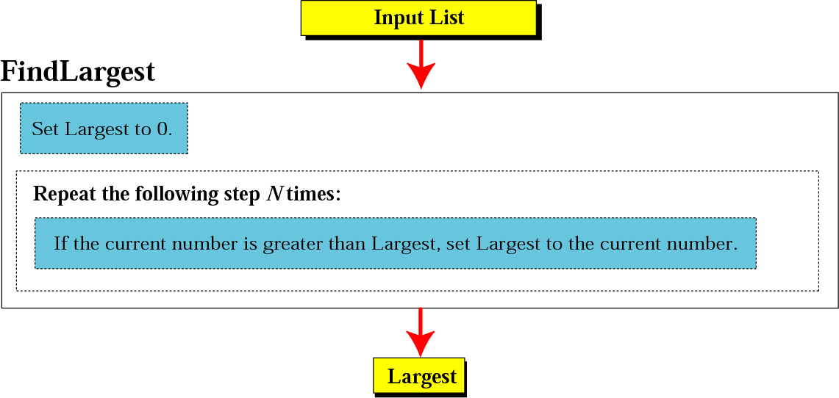
Figure 8-5
Generalization of FindLargest

Slide 10
8.2
THREE CONSTRUCTS

Slide 11
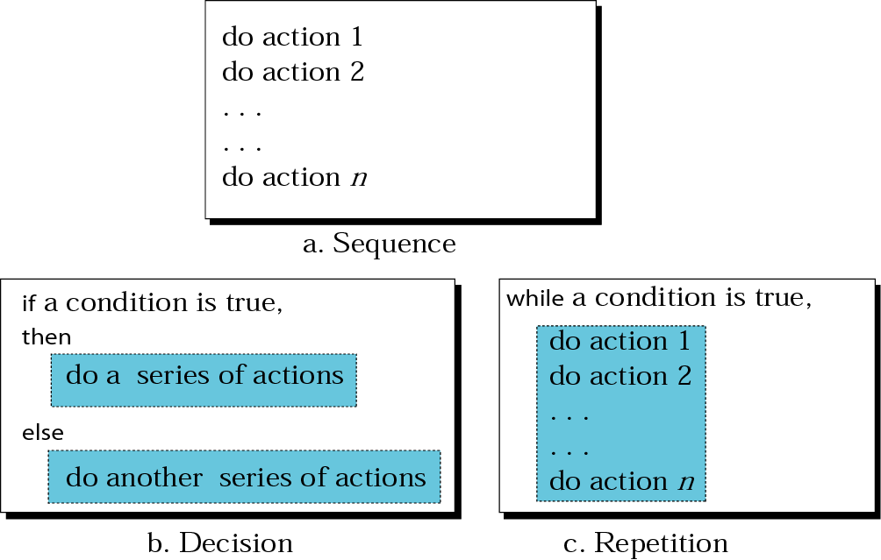
Figure 8-6
Three constructs

Slide 12
8.3
ALGORITHM
REPRESENTATION

Slide 13
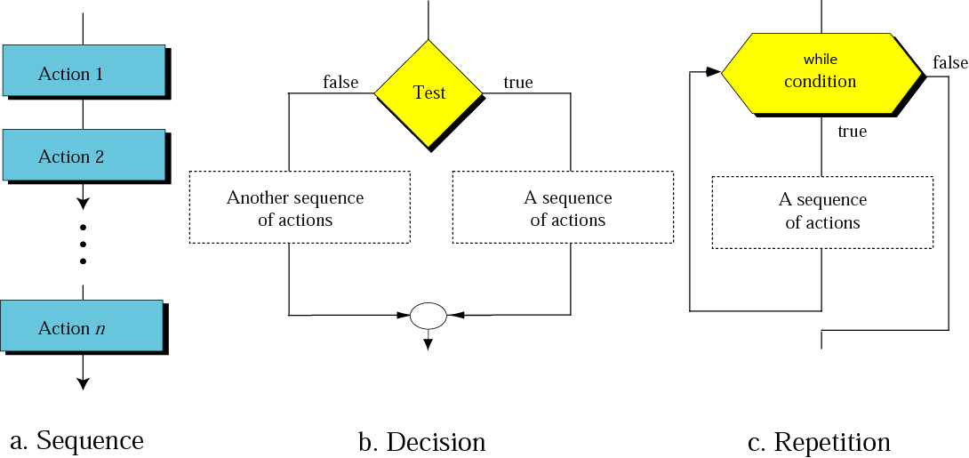
Figure 8-7
Flowcharts for three constructs

Slide 14
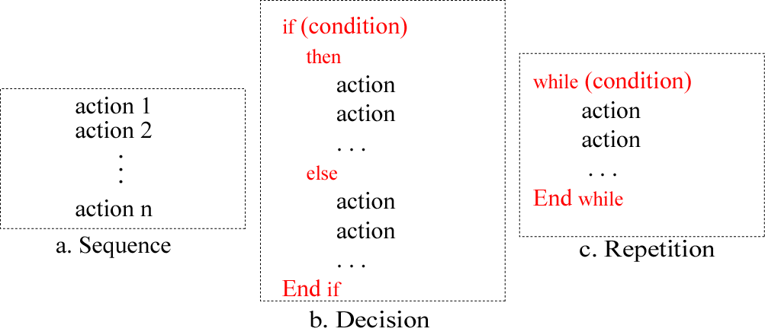
Figure 8-8
Pseudocode for three constructs

Slide 15
Example 1
Write an algorithm in pseudocode that finds the average of two numbers
Solution
See Algorithm 8.1 on the next slide.

Slide 16
Algorithm 8.1:
Average of two
AverageOfTwo
Input: Two numbers
Add the two numbers
Divide the result by 2
Return the result by step 2
End

Slide 17
Example 2
Write an algorithm to change a numeric grade to a pass/no pass grade.
Solution
See Algorithm 8.2 on the next slide.

Slide 18
Algorithm 8.2:
Pass/no pass Grade
Pass/NoPassGrade
Input: One number
if (the number is greater than or equal to 70)
then
  1.1 Set the grade to “pass”
  else
  1.2 Set the grade to “nopass”
  End if
Return the grade
End

Slide 19
Example 3
Write an algorithm to change a numeric grade to a letter grade.
Solution
See Algorithm 8.3 on the next slide.

Slide 20
Algorithm 8.3:
Letter grade
LetterGrade
Input: One number
1. if (the number is between 90 and 100, inclusive)
then
  1.1 Set the grade to “A”
  End if
2. if (the number is between 80 and 89, inclusive)
then
  2.1 Set the grade to “B”
  End if
Continues on the next slide

Slide 21
Algorithm 8.3:
Letter grade (continued)
3. if (the number is between 70 and 79, inclusive)
then
  3.1 Set the grade to “C”
  End if
4. if (the number is between 60 and 69, inclusive)
then
  4.1 Set the grade to “D”
  End if
Continues on the next slide

Slide 22
Algorithm 8.3:
Letter grade (continued)
5. If (the number is less than 60)
then
  5.1 Set the grade to “F”
  End if
6. Return the grade
  End

Slide 23
Example 4
Write an algorithm to find the largest of a set of numbers. You do not know the number of numbers.
Solution
See Algorithm 8.4 on the next slide.

Slide 24
Algorithm 8.4:
Find largest
FindLargest
Input: A list of positive integers
Set Largest to 0
while (more integers)
2.1 if (the integer is greater than Largest)
then
2.1.1 Set largest to the value of the integer
End if
End while
Return Largest
End

Slide 25
Example 5
Write an algorithm to find the largest of 1000 numbers.
Solution
See Algorithm 8.5 on the next slide.

Slide 26
Algorithm 8.5:
Find largest of 1000 numbers
FindLargest
Input: 1000 positive integers
Set Largest to 0
Set Counter to 0
while (Counter less than 1000)
3.1 if (the integer is greater than Largest)
then
3.1.1 Set Largest to the value of the integer
End if
3.2 Increment Counter
End while
Return Largest
End

