Slide 1
Teori Bahasa dan Automata
Lecture 11-12:
Turing Machines
By:
Nur Uddin, Ph.D

Slide 2
Model of computing devices
We have learned:
Finite automata
➔ good model for a device with small amount of memory
Pushdown automata
➔ good model for a device with unlimited memory that us usable only in the last in, first out manner of stack.
From the model that we have learned, both models have limitation to described general purpose computer.

Slide 3
Turing Machine
First proposed by Alan Turing in 1936.
It is similar to a finite automaton but with an unlimited and unrestricted memory.
Turing machine is a much more accurate model of a general purpose computer.

Slide 4
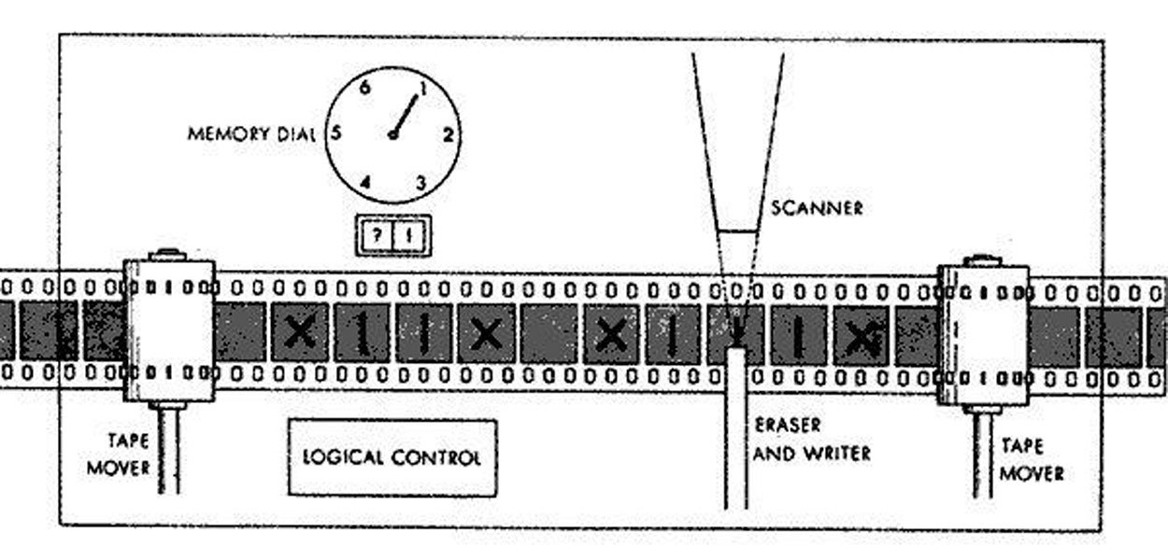
Turing Machines
The Turing machine model uses an infinite tape as its unlimited memory.
Initially the tape contains only the input string and is blank everywhere else.
If the machine needs to store information, it may write this information on the tape.
To read the information that it has written, the machine can move its head back over it.

Slide 5
Turing Machines
The machine continues computing until it decides to produce an output.
The outputs accept and reject are obtained by entering designated accepting and rejecting states.
If it doesn’t enter an accepting or a rejecting state, it will go on forever, never halting (stop).

Slide 6
Summary of the Turing Machine
A Turing machine can both write on the tape and read from it.
The read–write head can move both to the left and to the right.
The tape is infinite.
The special states for rejecting and accepting take effect immediately

Slide 7
Example 1
Turing machine M1 for testing membership in the language:
We want M1 to accept if its input is a member of B and to reject otherwise.
Your goal is to determine whether the input is a member of B—that is, whether the input comprises two identical strings separated by a # symbol.
Your goal is to determine whether the input is a member of B—that is, whether the input comprises two identical strings separated by a # symbol.
The obvious strategy is to zig-zag to the corresponding places on the two sides of the # and determine whether they match. Place marks on the tape to keep track of which places correspond.

Slide 8
Example 1 (cont’d)

Slide 9
Example 1 (cont’d)
The following figure contains several nonconsecutive snapshots of M1’s tape after it is started on input 011000#011000.

Slide 10
Formal Definition of Turing Machine

Slide 11
Turing Machine Computation
A Turing machine computes as follows:
The on the leftmost n squares of the tape, and the rest of the tape is blank (i.e., filled with blank symbols).
The head starts on the leftmost square of the tape. Note that Σ does not contain the blank symbol, so the first blank appearing on the tape marks the end of the input.
Once M has started, the computation proceeds according to the rules described by the transition function.
The computation continues until it enters either the accept or reject states, at which point it halts. If neither occurs, M goes on forever.

Slide 12
TM: Configuration
As Turing machine computes, changes occur in the current state, the current tape contents, and the current head location.
Setting of these three items is called a configuration of the Turing machine and represented as follows:
  For a state q and two strings u and v over the tape alphabet Γ, we write uqv for the configuration where the current state is q, the current tape contents is uv, and the current head location is the first symbol of v.
  The tape contains only blanks following the last symbol of v.

Slide 13

TM: Configuration Example
For example,
$1011q_{7}01111$
represents the configuration when the tape is 101101111, the current state is $q_{7}$, and the head is currently on the second 0.

Slide 14
TM: Yield
Say that configuration C1 yields configuration C2 if the Turing machine can legally go from C1 to C2 in a single step.
We define this notion formally as follows.

Slide 15
TM: Process flow configurations
The start configuration of M on input w is the configuration q0 w, which indicates that the machine is in the start state q0 with its head at the leftmost position on the tape.
In an accepting configuration, the state of the configuration is qaccept.
In a rejecting configuration, the state of the configuration is qreject.
Accepting and rejecting configurations are halting configurations and do not yield further configurations.

Slide 16
TM: Accept condition
A Turing machine M accepts input w if a sequence of configurations C1, C2, . . . , Ck exists, where:

Slide 17
Turing Recognizable

Slide 18
Turing - decidable
When we start a Turing machine on an input, three outcomes are possible. The machine may accept, reject, or loop. By loop we mean that the machine simply does not halt.
A Turing machine M can fail to accept an input by entering the qreject state and rejecting, or by looping. Sometimes distinguishing a machine that is looping from one that is merely taking a long time is difficult.
For this reason, we prefer Turing machines that halt on all inputs; such machines never loop. These machines are called deciders because they always make a decision to accept or reject.
A decider that recognizes some language also is said to decide that language.

