Slide 1
Module 12
Network Configuration

Slide 2
Exam Objective
4.4 Your Computer on the Network
Objective Summary
  Working with the Internet, network, and routers
  Domain Name Service
  Network configuration

Slide 3
Basic Networking

Slide 4
Basic Network terminology
Host - a host is any device that communicates with another device on a network.
Network - A network is a collection of two or more hosts (computers) that are able to communicate with each other.
Internet - A publically accessible network that connects millions of hosts throughout the world.
Wi-Fi - The term Wi-Fi refers to wireless networks.

Slide 5
Basic Network terminology (cont)
Server/Service - When a host provides a feature to another host, that feature is called a service. Example: a web server provides the service of web pages.
Client - A client is a host that is accessing a server.
Router - Also called a gateway, a router is a machine that connects hosts from one network to another network.

Slide 6
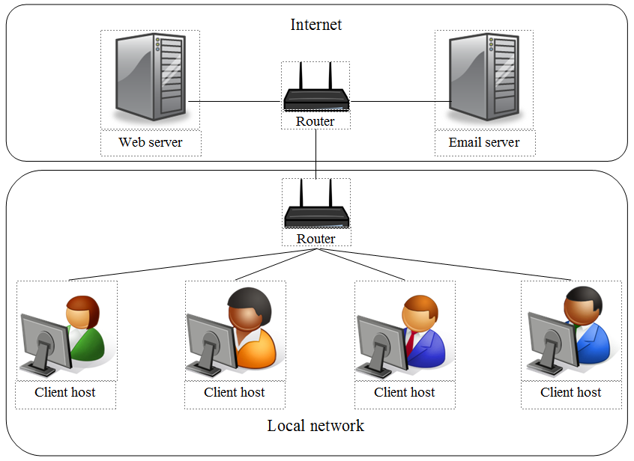
Basic Network terminology (cont)

Slide 7
Networking Features Terminology
Network packet - Used to send network communication between hosts.
IP address - An Internet Protocol (IP) address is a unique number assigned to a hosts on a network.
Network mask - Also called a netmask or mask, a network mask is a number system that can be used to define which IP addresses are considered to be within a single network.

Slide 8
Networking Features
Terminology (cont)
Hostname - Each host is provided a human-understandable name, called a hostname. Hostnames are translated into IP addresses before the network packet is sent on the network.
DHCP - Hosts can be assigned hostnames, IP addresses and other network-related information by a DHCP (Dynamic Host Configuration Protocol) server.
DNS - A server that provides the service of translating IP addresses to hostnames.

Slide 9
Networking Features
Terminology (cont)
Ethernet - In a wired network environment, Ethernet is the most common way to physically connect the hosts into a network.
TCP/IP - The Transmission Control Protocol/Internet Protocol (TCP/IP) is a fancy name for a collection of protocols (remember, protocol = set of rules) that are used to define how network communication should take place between hosts.

Slide 10
IP Addressing

Slide 11
IP addresses
Hosts "address" network packets by using the IP address of the destination machine.
Two different types of IP addresses: IPv4 and IPv6.
In an IPv4 address, a total of four “8-bit” (8-bit = numbers from 0 to 25) numbers are used to define the address (example: 192.168.10.120).
In an IPv6 network the addresses are much larger, 128-bit addresses (example: 2001:0db8:85a3:0042:1000:8a2e:0370:7334)

Slide 12
Configuring the Network

Slide 13
Configuring Network Devices
Two questions to ask:
  Wired or wireless?
  DHCP or static address?
Desktop machines will normally use wired network while a laptop will use wireless.
Normally a wired machine uses static IP address, wireless machines typically use DHCP.

Slide 14
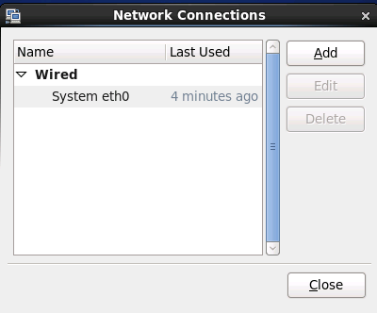
Configuring the Network Using a GUI
Click on System in the menu bar, then Preferences and then Network Connections.

Slide 15
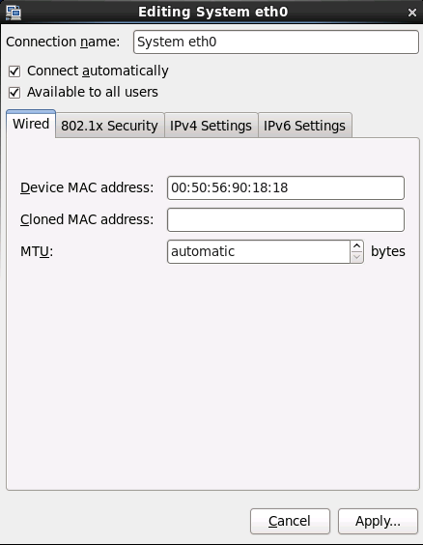
Configuring the Network
Using a GUI (cont)
To modify this network device, click on the device name and then click the Edit button.

Slide 16
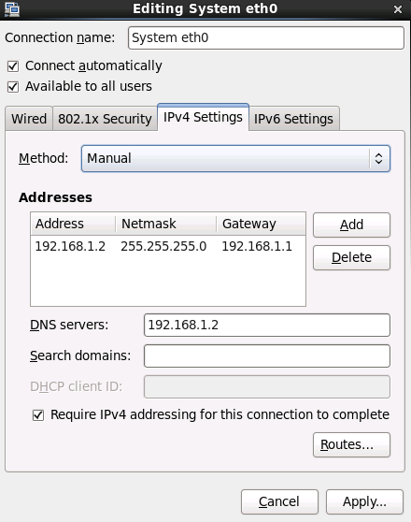
Configuring the Network
Using a GUI (cont)
If you click on the IPv4 Settings tab, you can change key IPv4 values.

Slide 17
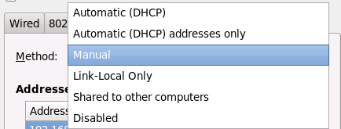
Configuring the Network
Using a GUI (cont)
Click method to change from Manual to DHCP

Slide 18
Configuring the Network
Using Configuration Files
Primary interface configuration file:
  /etc/sysconfig/network-scripts/ifcfg-eth0
IPv4 settings for static host:
  IPADDR (hosts IP address)
  GATEWAY (router’s IP address)
  DNS1 (DNS server’s IP address)
IPv4 settings for DHCP client host:
  BOOTPROTO set to “dhcp”

Slide 19
Configuring the Network Using Configuration Files (cont)
Additional configuration files:
  /etc/sysconfig/network – NETWORK and HOSTNAME settings
  /etc/resolv.conf – DNS server settings
  /etc/hosts – Local hostname to IP address translation
  /etc/nsswitch.conf – Used to modify which hostname to IP address translation service to use

Slide 20
Restarting the network
After changing a network configuration file, you either need to reboot the machine or run the following command as the administrator to make the changes take affect:
  service network restart

Slide 21
Network Utilities

Slide 22
Network Tools
ifconfig - Displays interface configuration information.
route - Displays the routing table.
ping - Used to determine if a remote machine can be contacted via the network.
netstat - Display network statistics.
dig - Displays query results from DNS servers.
ssh - Allows a user to login to a remote machine.

