Slide 1
Module 10
Understanding Computer Hardware

Slide 2
Exam Objective
4.2 Understanding Computer Hardware
Objective Summary
  Researching computer hardware

Slide 3
Viewing CPU Information

Slide 4
Processors
Central Processing Unit (also know as the CPU or processor) performs the decision and calculations for the Operating System.
Connected to other hardware via the motherboard.
Multiprocessor = system with more than one CPU.
Multi-core = more than one processor on a single chip.

Slide 5
Processors (continued)
Two processor types:
  x86 (32 bit)
  x86_64 (64 bit)
x86 invented in 1978, x86_64 invented in 2000.
X86 is limited to 4GB RAM.
x86_64 has limited software support.

Slide 6
Viewing CPU Information
View CPU information with one of the following commands:
  arch
  lspcu
  cat /proc/cpuinfo
The /proc/cpuinfo file contains flags which describes key CPU features.

Slide 7
System Information

Slide 8
Motherboards and Buses
Hardware communicates via the motherboard or buses.
Basic Input and Output System (BIOS) is what the hardware uses to communicate.
System Management BIOS (SMBIOS) is the standard that defines the data structures of the communications.

Slide 9
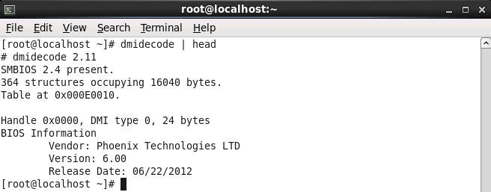
Motherboards and Buses (cont)
The dmidecode command displays SMBIOS information:

Slide 10
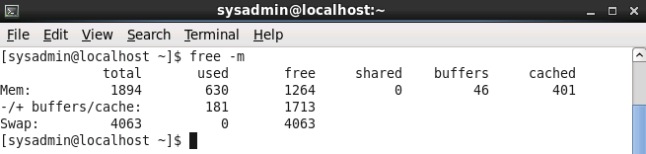
RAM
Random Access Memory (RAM) is where program and system data is stored.
Virtual memory (swap space) is hard drive space that is used when available RAM is low.
The free command can display memory utilization:

Slide 11
Peripheral Devices

Slide 12
Peripheral Devices
Devices not directly attached to motherboard are called peripheral devices.
Two common types:
  Peripheral Component Interconnect (PCI)
  Universal Serial Bus (USB)

Slide 13
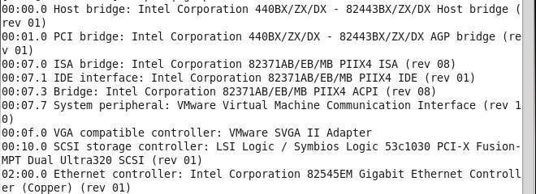
PCI Devices
View devices with lspci command:

Slide 14
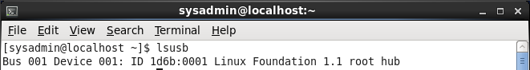
USB Devices
Are considered hot-plug because they can be added to the system while it is running.
View devices with lsusb command:
Use –v option for more verbose information.

Slide 15
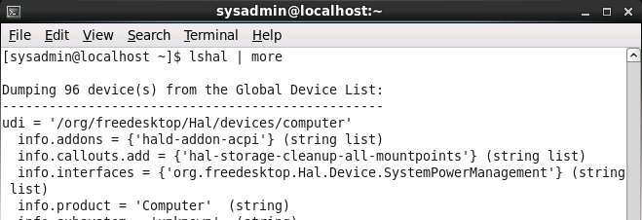
HAL
Hardware Abstraction Layer keeps track of all system hardware.
The hald daemon (process) provides this information to other programs.
View HAL data with the lshal command:

Slide 16
Disk Devices
Also called hard drives.
Can be connected directly to motherboard, to PCI or USB.
Are divided into partitions.
Two partitioning types:
  Master Boot Record (MBR)
  GUID Partitioning Table (GPT)

Slide 17
Boot Records

Slide 18
MBR
Older technology.
Still commonly used.
Tools to view and modify MBR partitions:
  fdisk
  cfdisk
  sfdisk

Slide 19
GPT
Newer technology.
Allows for larger partitions than MBR.
Tools to view and modify MBR partitions:
  gdisk
  cgdisk
  sgdisk

Slide 20
Device Names
IDE drives are assigned filenames that start with hd and are stored in the /dev directory.
USB, SATA and SCSI drives are assigned names that start with sd.
First drive is assigned the letter a, second drive is assigned the letter b, etc.
Examples:
  First IDE drive: /dev/hda
  First SATA drive: /dev/sda
  Second IDE drive: /dev/hdb

Slide 21
Partition Records

Slide 22
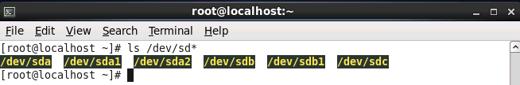
Partition Names
Partitions are assigned numeric values: 1, 2, 3, etc.
Examples:
  First partition of first IDE drive: /dev/hda1
  Second partition of second SATA drive: /dev/sdb2
View partition and disk devices on system:

Slide 23
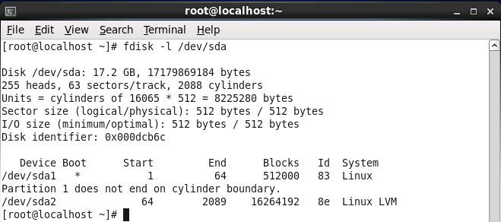
View Partition Information
The –l option to the fdisk command can be used to view partition information:

Slide 24
Video Display Devices
No video standards, requiring specific drivers for specific video cards.
Two types of connections:
  Video Graphics Array (VGA)
  Digital Visual Interface (DVI)
Monitor and video card must both support selected resolution.
Typically X.org server determines proper resolution.
Configuration file: /etc/X11/xorg.conf

