Slide 1
Pertemuan 1b
http://www.w3schools.com/html/html_basic.asp

Slide 2
HTML Basic Examples

Slide 3
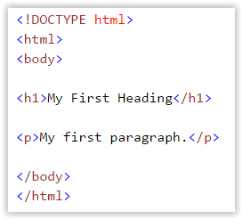
HTML Documents
All HTML documents must start with a type declaration: <!DOCTYPE html>.
The HTML document itself begins with <html> and ends with </html>.
The visible part of the HTML document is between <body> and </body>.

Slide 4
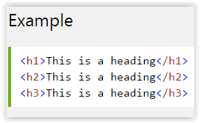
HTML Headings
HTML headings are defined with the <h1> to <h6> tags:

Slide 5
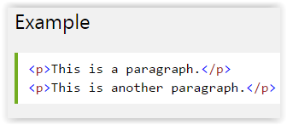
HTML Paragraphs
HTML paragraphs are defined with the <p> tag:

Slide 6
HTML Links
HTML links are defined with the <a> tag:
The link's destination is specified in the href attribute.
Attributes are used to provide additional information about HTML elements.

Slide 7
HTML Images
HTML images are defined with the <img> tag.
The source file (src), alternative text (alt), and size (width and height) are provided as attributes:

