Slide 1
Desain web
Pertemuan 1
http://www.w3schools.com/html/html_intro.asp

Slide 2
HTML Introduction

Slide 3
What is HTML?
HTML is a markup language for describing web documents (web pages).
HTML stands for Hyper Text Markup Language
A markup language is a set of markup tags
HTML documents are described by HTML tags
Each HTML tag describes different document content

Slide 4
HTML Example

Slide 5
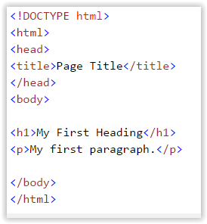
A small HTML document

Slide 6
Example Explained
  The DOCTYPE declaration defines the document type to be HTML
  The text between <html> and </html> describes an HTML document
  The text between <head> and </head> provides information about the document
  The text between <title> and </title> provides a title for the document
  The text between <body> and </body> describes the visible page content
  The text between <h1> and </h1> describes a heading
  The text between <p> and </p> describes a paragraph
Using this description, a web browser can display a document with a heading and a paragraph.

Slide 7
HTML Tags
HTML tags are keywords (tag names) surrounded by angle brackets:
<tagname>content</tagname>
HTML tags normally come in pairs like <p> and </p>
The first tag in a pair is the start tag, the second tag is the end tag
The end tag is written like the start tag, but with a slash before the tag name
The start tag is often called the opening tag. The end tag is often called the closing tag.

Slide 8
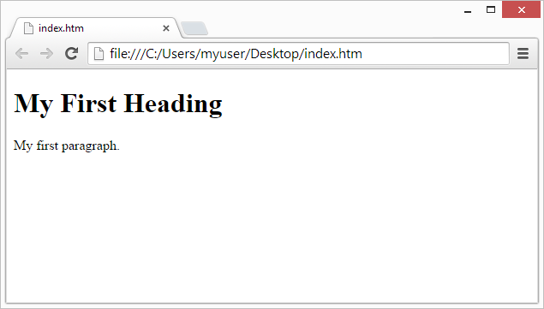
Web Browsers
The purpose of a web browser (Chrome, IE, Firefox, Safari) is to read HTML documents and display them.
The browser does not display the HTML tags, but uses them to determine how to display the document:

Slide 9
HTML Page Structure

Slide 10
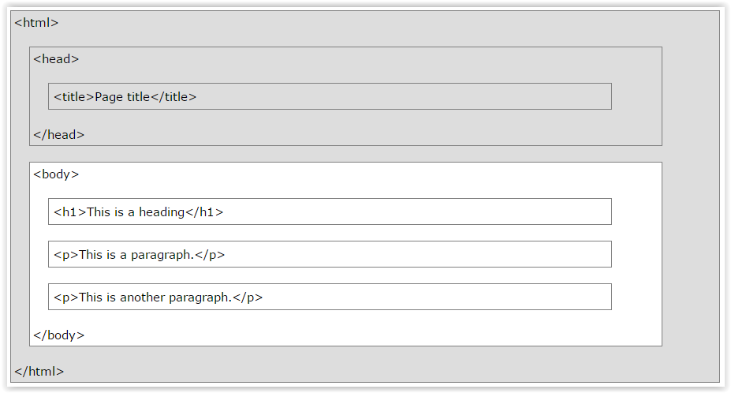
A visualization of an HTML page structure

Slide 11
The <!DOCTYPE> Declaration
The <!DOCTYPE> declaration helps the browser to display a web page correctly.
There are different document types on the web.
To display a document correctly, the browser must know both type and version.
The doctype declaration is not case sensitive. All cases are acceptable:
  <!DOCTYPE html>
  <!DOCTYPE HTML>
  <!doctype html>
  <!Doctype Html>

Slide 12
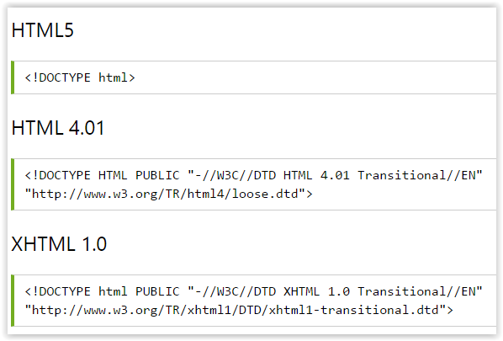
Common Declarations

Slide 13
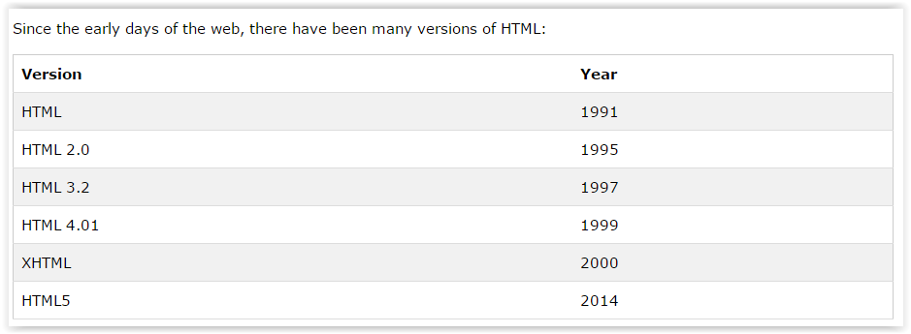
HTML Versions

Slide 14
END

