Slide 1
Instructor Materials
Chapter 4: Network Addressing
Networking Essentials
Notes:
Cisco Networking Academy Program
Networking Essentials
Chapter 4: Network Addressing

Slide 2
Instructor Materials – Chapter 4 Planning Guide
This PowerPoint deck is divided in two parts:
Instructor Planning Guide
  Information to help you become familiar with the chapter
  Teaching aids
Instructor Class Presentation
  Optional slides that you can use in the classroom
  Begins on slide # 8
Note: Remove the Planning Guide from this presentation before sharing with anyone.
Notes:
2

Slide 3
Networking Essentials
Instructor Planning Guide
Chapter 4: Network Addressing
Notes:
Networking Essentials Planning Guide
Chapter 4: Network Addressing

Slide 4
Chapter 4: Activities
What activities are associated with this chapter?
Page # | Activity Type | Activity Name
4.1.1.2 | Packet Tracer | Connecting to a Web Server
4.1.3.2 | Interactive Activity | Network Addresses
4.1.4.3 | Lab | Using Windows Calculator for Binary Conversions
4.2.2.3 | Interactive Activity | Public or Private
4.2.3.4 | Interactive Activity | Who Gets this Message?
4.3.3.3 | Packet Tracer | Configure DHCP on a Wireless Router
4.4.3.2 | Packet Tracer | Examine NAT on a Wireless Router
4.5.2.4 | Interactive Activity | IPv6 Address Notation
The password used in the Packet Tracer activities in this chapter is: PT_net1
Notes:
4

Slide 5
Chapter 4: Assessment
Students should complete Chapter 4, “Assessment” after completing Chapter 4.
Quizzes, labs, Packet Tracers and other activities can be used to informally assess student progress.
Notes:
5

Slide 6
Chapter 4: Additional Help
For additional help with teaching strategies, including lesson plans, analogies for difficult concepts, and discussion topics, visit the Facebook page for community and peer support at the following: www.facebook.com/cisconetworkingacademy.
Notes:
6

Slide 7
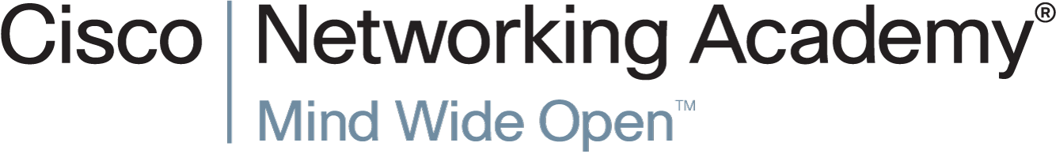

Slide 8
Chapter 4: Network Addressing
Networking Essentials
Notes:
Cisco Networking Academy Program
Networking Essentials
Chapter 4: Network Addressing

Slide 9
Chapter 4 - Sections & Objectives
4.1 IPv4 Addresses and Subnet Masks
  Explain the features of an IPv4 address.
4.2 Types of IPv4 Addresses
  Explain the features of the different types of IPv4 addresses.
4.3 How IPv4 Addresses are Obtained
  Configure a DHCP server.
4.4 IPv4 Address Management
  Explain the need for public and private addressing.
4.5 Addressing with IPv6
  Explain the need for IPv6.
Notes:
9

Slide 10
4.1 IPv4 Addresses and Subnet Masks
Notes:
Cisco Networking Academy Program
Networking Essentials
Chapter 4: Network Addressing

Slide 11
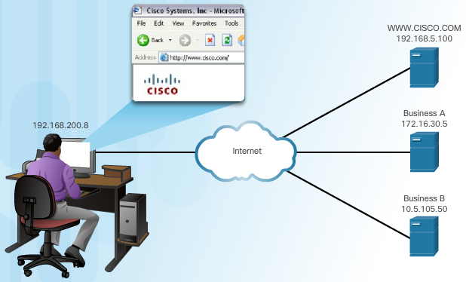
IPv4 Addresses and Subnet Masks
Purpose of the IPv4 Address
What is an IPv4 Address?
  Is a logical network address that identifies a particular host
  Configured and is unique on the network for communications
  Is associated with a network interface card
Notes:
4.1 – IPv4 Addresses and Subnet Masks
4.1.1 – Purpose of the IPv4 Address

Slide 12
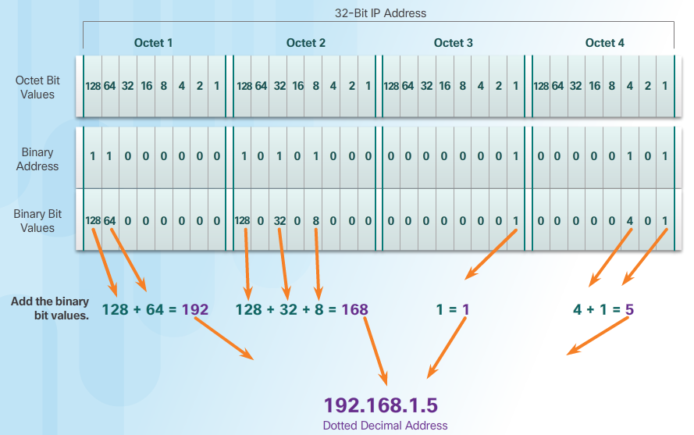
IPv4 Addresses and Subnet Masks
IP Address Structure
IPv4 Addressing
  32 binary bits
  For ease of use, the 32 bits are group into four 8-bit bytes called octets.
  The octets are represented in dotted-decimal notation.
Binary to Decimal
Notes:
4.1 – IPv4 Addresses and Subnet Masks
4.1.2 – IP Address Structure

Slide 13
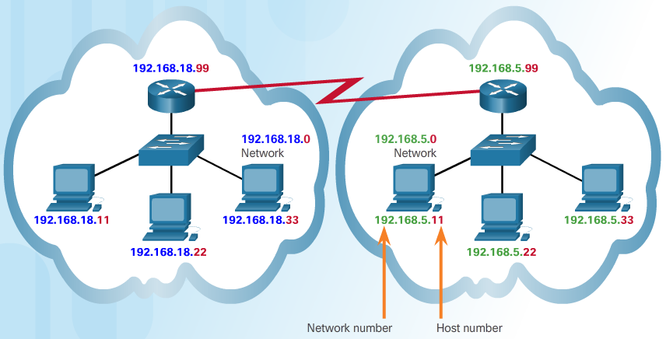
IPv4 Addresses and Subnet Masks
Parts of an IP Address
Networks and Hosts
  Logical 32-bit IPv4 address is hierarchical and is made up of two parts
    Network
    Host
Notes:
4.1 – IPv4 Addresses and Subnet Masks
4.1.3 – Parts of an IP Address

Slide 14
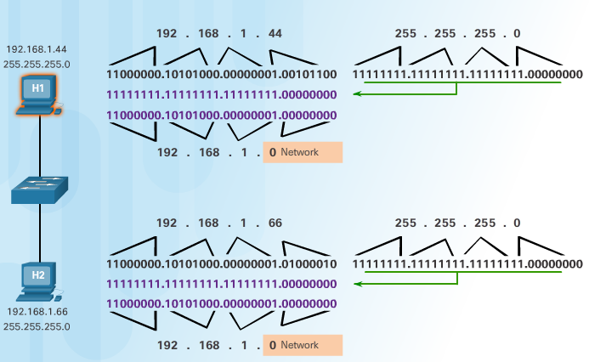
IPv4 Addresses and Subnet Masks
How IP Addresses and Subnet Masks Interact
Are You on My Network?
  When a host sends a packet, it compares its subnet mask to its own IPv4 address and the destination IPv4 address.
Subnet Masks
  Common subnet masks: 255.0.0.0 (8-bits), 255.255.0.0 (16 bits) and 255.255.255.0 (24 bits).
  Number of hosts: 2^{x} - 2
Notes:
4.1 – IPv4 Addresses and Subnet Masks
4.1.4 – How IP Addresses and Subnet Masks Interact

Slide 15
4.2 Types of IPv4 Addresses
Notes:
Cisco Networking Academy Program
Networking Essentials
Chapter 4: Network Addressing

Slide 16
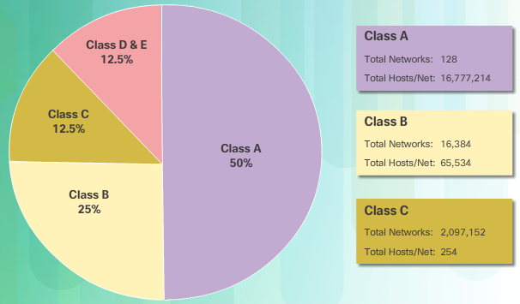
Types of IPv4 Addresses
IPv4 Address Classes and Default Subnet Masks
Classful Addressing
  Class A (0.0.0.0/8 to 127.0.0.0/8) supports extremely large networks.
  Class B (128.0.0.0 /16 – 191.255.0.0 /16) supports the needs of moderate to large size networks.
  Class C (192.0.0.0 /24 – 223.255.255.0 /24) supports small networks with a maximum of 254 hosts.
Classless Addressing
  IPv4 addresses allocated on
  any address bit boundary
  Delays the depletion and
  exhaustion of IPv4 addresses
  Classless Inter-Domain
  Routing (CIDR)
Notes:
4.2 – Types of IPv4 Addresses
4.2.1 – IPv4 Address Classes and Default Subnet Masks

Slide 17

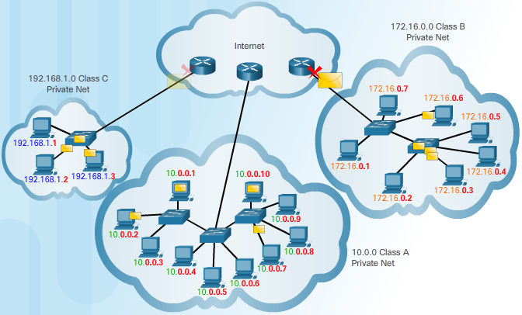
Types of IPv4 Addresses
Public and Private IP Addresses
Private IPv4 Addressing
Using Private IPv4 Addresses
  Does not connect directly to the Internet
  Visible on local network only
  Loopback address:
  127.0.0.0 network
Notes:
4.2 – Types of IPv4 Addresses
4.2.2 – Public and Private IP Addresses

Slide 18
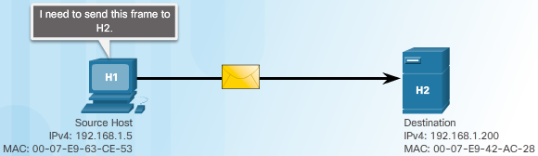
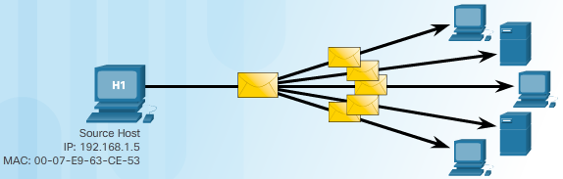
Types of IPv4 Addresses
Unicast, Broadcast and Multicast Addresses
A Message for Me
  Unique destination MAC
  and IP addresses
Something for Everyone
  Broadcast MAC and IP address:
    MAC address: FFFF:FFFF:FFFF
    Host portion of IP Address is all 1s
Notes:
4.2 – Types of IPv4 Addresses
4.2.3 – Unicast, Broadcast and Multicast Addresses

Slide 19
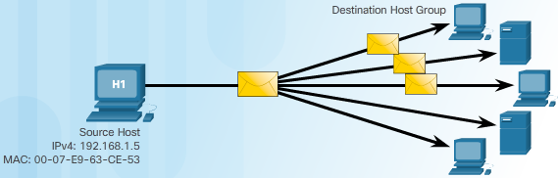
Types of IPv4 Addresses
Unicast, Broadcast and Multicast Addresses (Cont.)
Just for this Group
  A single packet is sent to a selected set of hosts in the multicast group
  Reserved IPv4 address
    Reserved multicast range: 224.0.0.0 to 239.255.255.255
    Reserved multicast range on local network: 224.0.0.0 to 224.0.0.255
Notes:
4.2 – Types of IPv4 Addresses
4.2.3 – Unicast, Broadcast and Multicast Addresses (Cont.)

Slide 20
4.3 How IPv4 Addresses are Obtained
Notes:
Cisco Networking Academy Program
Networking Essentials
Chapter 4: Network Addressing

Slide 21
How IPv4 Addresses are Obtained
Static and Dynamic Address Assignment
Assigning Addresses
  Can be done statically or dynamically
  Assign an IPv4 address, subnet mask, default gateway and other necessary info for network communications
  Static IPv4 addresses:
    Hosts, such as servers and printers, that need particular addresses
    Can be time consuming and error prone
    Need to maintain an accurate list of which IPv4 addresses
  Dynamic IPv4 Address Assignment
    Dynamic Host Configuration Protocol (DHCP) allows for automatic assignment of addressing information
    Preferred method of assignment for a large network
    IP addresses can be reallocated when they become available
Notes:
4.3 – How IPv4 Addresses are Obtained
4.3.1 – Static and Dynamic Address Assignment

Slide 22
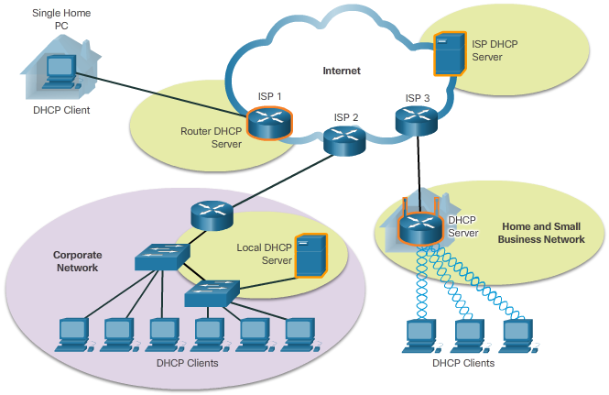
How IPv4 Addresses are Obtained
DHCP Servers
Where Do DHCP Addresses Come From?
  Medium to large network
    Usually a local dedicated PC-based server
  Home network
    A wireless router can serve as a client to receive IP configuration information from the ISP
    A wireless router can
    act as a DHCP server
    for the hosts in the local
    network
Notes:
4.3 – How IPv4 Addresses are Obtained
4.3.2 – DHCP Servers

Slide 23
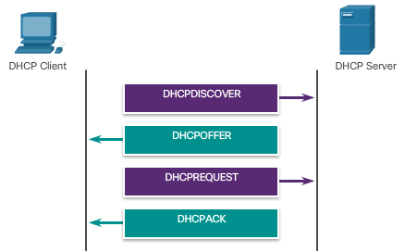
How IPv4 Addresses are Obtained
Configuring DHCP
How Does IPv4 DHCP Work?
  Client sends a DHCP Discover message.
    A destination IPv4 address of 255.255.255.255 (32 ones)
    A destination MAC address of FF-FF-FF-FF-FF-FF (48 ones).
  DHCP server will respond with a DHCP Offer, suggesting an IPv4 address for the client.
  The host sends a DHCP
  Request to that server
  asking to use the suggested
  IPv4 address.
  The server responds with a
  DHCP Acknowledgment.
Notes:
4.3 – How IPv4 Addresses are Obtained
4.3.3 – Configuring DHCP

Slide 24
4.4 IPv4 Address Management
Notes:
Cisco Networking Academy Program
Networking Essentials
Chapter 4: Network Addressing

Slide 25
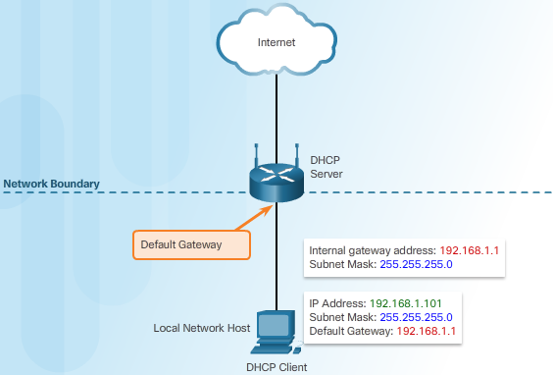
IPv4 Address Management
Network Boundaries and Address Space
Gateways to Other Networks
  Each host on a network uses a default gateway to reach other networks.
  The default gateway is the IPv4 address of the router interface connected to the network where the host is attached
Notes:
4.4 – IPv4 Address Management
4.4.1 – Network Boundaries and Address Space

Slide 26
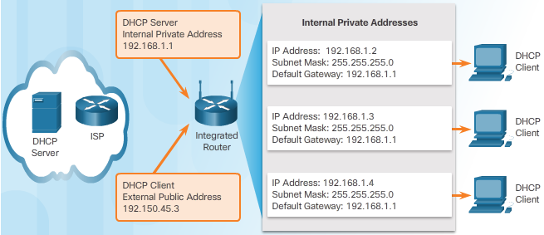
IPv4 Address Management
Address Assignment
Who is on the Inside?
  Internal hosts must be assigned addresses within the same network as the integrated router statically or through DHCP. It also provides IPv4 address, subnet mask, default gateway and other network information.
  The network assigned to the Internet side of the integrated router is referred to as the external, or outside, network. ISPs usually provide an Internet-routable address, which enables hosts connected to the integrated router to have access to the Internet.
  The integrated router serves as the boundary between the local internal network and the external Internet.
Notes:
4.4 – IPv4 Address Management
4.4.2 – Address Assignment

Slide 27
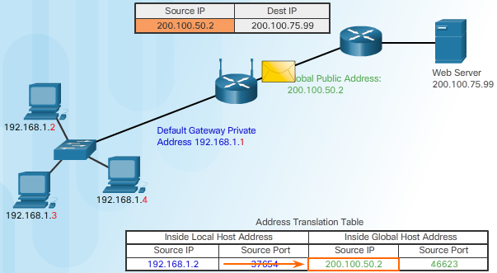
IPv4 Address Management
Network Address Translation
From IPv4 Private to Public Addresses
  Network Address Translation
    Translate private addresses into unique Internet-routable public addresses for outgoing packets
    The process is reversed for incoming packets
    The router can translate many internal IPv4 addresses to the same public address
Notes:
4.4 – IPv4 Address Management
4.4.3 – Network Address Translation

Slide 28
4.5 Addressing with IPv6
Notes:
Cisco Networking Academy Program
Networking Essentials
Chapter 4: Network Addressing

Slide 29
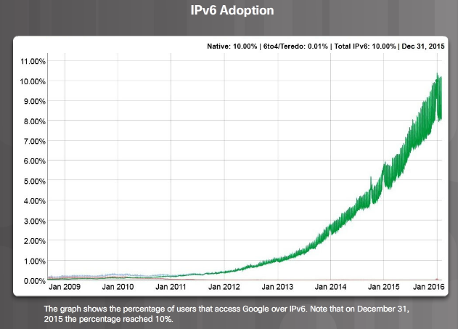
Addressing with IPv6
Are You Ready for Change?
Need more IP addresses
  An IPv4 address is 32 bits (4 bytes) long.
  An IPv6 address is 128 bits (16 bytes) in length.
IPv6 benefits
  More IP addresses
  No need for NAT
  Autoconfiguration capabilities
Change is Coming
  NAT has prolonged the life of IPv4
  IPv6 adoption rate is increasing
Notes:
4.5 – Addressing with IPv6
4.5.1 – Are You Ready for Change?

Slide 30

Addressing with IPv6
How is IPv6 Different?
IPv6 Differences
  Address autoconfiguration
  Link-local address
    Communications within the same network
IPv6 Address Formatting
  Compressing IPv6 Addresses Rules
    Omit Leading Zeros
    Omit One “all zero” Segment
Notes:
4.5 – Addressing with IPv6
4.5.2 – How is IPv6 Different?

Slide 32


