Slide 1
Instructor Materials
Chapter 2
Networks in Our Daily Lives
Networking Essentials
Notes:
Cisco Networking Academy Program
Networking Essentials
Chapter 2: Networks in Our Daily Lives

Slide 2
Instructor Materials - Chapter 2 Planning Guide
This PowerPoint deck is divided in two parts:
Instructor Planning Guide
  Information to help you become familiar with the chapter
  Teaching aids
Instructor Class Presentation
  Optional slides that you can use in the classroom
  Begins on slide # 8
Note:
Remove the Planning Guide from this presentation before sharing with anyone.
Notes:
2

Slide 3
Networking Essentials
Instructor Planning Guide
Chapter 2: Networks in Our Daily Lives
Notes:
Networking Essentials
Chapter 2: Networks in Our Daily Lives

Slide 4
Chapter 2: Activities
What activities are associated with this chapter?
Page # | Activity Type | Activity Name
2.1.1.4 | Interactive Activity | Network Types and Applications
2.1.2.2 | Interactive Activity | Identify the Network Components
2.1.2.5 | Lab | Determining the IP Address Configuration of a Computer
2.3.3.3 | Interactive Activity | Is Fiber the Best Choice?
2.3.4.3 | Lab | Building an Ethernet Crossover Cable
2.3.4.4 | Interactive Activity | Networking Terms
Notes:
4

Slide 5
Chapter 2: Assessment
Students should complete Chapter 2, “Assessment” after completing Chapter 2.
Quizzes, labs, Packet Tracers and other activities can be used to informally assess student progress.
Notes:
5

Slide 6
Chapter 2: Additional Help
For additional help with teaching strategies, including lesson plans, analogies for difficult concepts, and discussion topics, visit the Facebook page for community and peer support at the following: www.facebook.com/cisconetworkingacademy.
Notes:
6

Slide 7


Slide 8
Chapter 2: Networks in Our Daily Lives
Networking Essentials
Notes:
Cisco Networking Academy Program
Networking Essentials
Chapter 2: Networks in Our Daily Lives

Slide 9
Chapter 2 - Sections & Objectives
2.1 Getting Online
  Explain the basic requirements for getting online.
2.2 Other Network Considerations
  Explain the importance of network representations.
2.3 Cabling and Media
  Build an Ethernet cable.
Notes:
9

Slide 10
2.1 Getting Online
Notes:
Cisco Networking Academy Program
Networking Essentials
Chapter 2: Networks in Our Daily Lives

Slide 11

Getting Online
Networks are Everywhere
Mobile phones use radio waves to transmit voice signals to antennas mounted on
towers located in specific geographic areas.
The abbreviations 3G, 4G, and 4G-LTE are used to describe enhanced cell phone
networks that are optimized for the fast transmission of data.
Other networks that are used by smart phones include GPS, Wi-Fi, Bluetooth, and
NFC.
Notes:
2.1 – Getting Online
2.1.1 – Networks are Everywhere

Slide 12
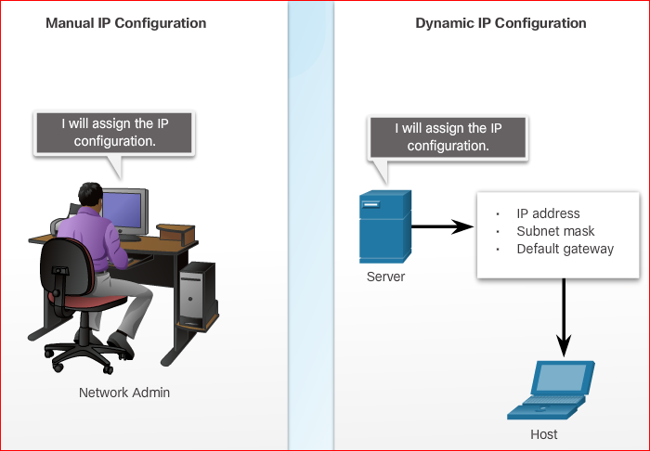
Getting Online
Local Network Connections
Some examples of network components are personal computers, servers, networking
devices, and cabling. These components can be grouped into four categories: hosts,
shared peripherals, network devices, and network media.
There are three parts to the IP configuration which must be correct for the device to
send and receive information on the network:
  IP address - identifies the host on the
  network.
  Subnet mask - identifies the
  network on which the host is connected.
  Default gateway - identifies the
  networking device that the host uses to
  access the Internet or another remote
  network.
An IP address can be configured manually
or assigned automatically by another device.
Notes:
2.1 – Getting Online
2.1.2 – Local Network Connections

Slide 13
2.2 Other Network Considerations
Notes:
Cisco Networking Academy Program
Networking Essentials
Chapter 2: Networks in Our Daily Lives

Slide 14
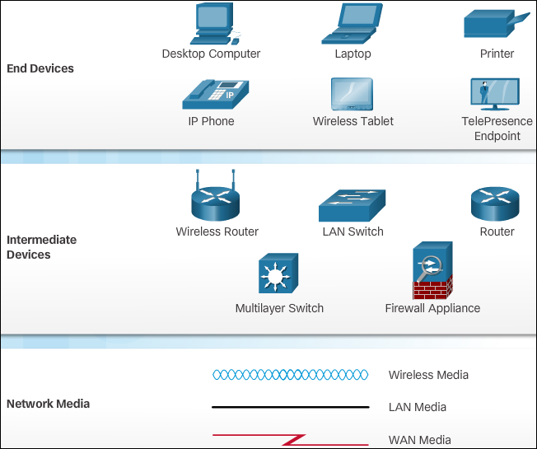
Other Network Considerations
Keeping Track of it All
As a network grows in size and complexity, it is important that the network is well-planned, logically organized, and appropriately documented.
When networks are installed, a physical topology is created to record where each host is located and how it is connected to the network. The physical topology also shows where the wiring is installed and the locations of the networking devices that connect the hosts.
Notes:
2.2 – Other Network Considerations
2.2.1 – Keeping Track of it All

Slide 15
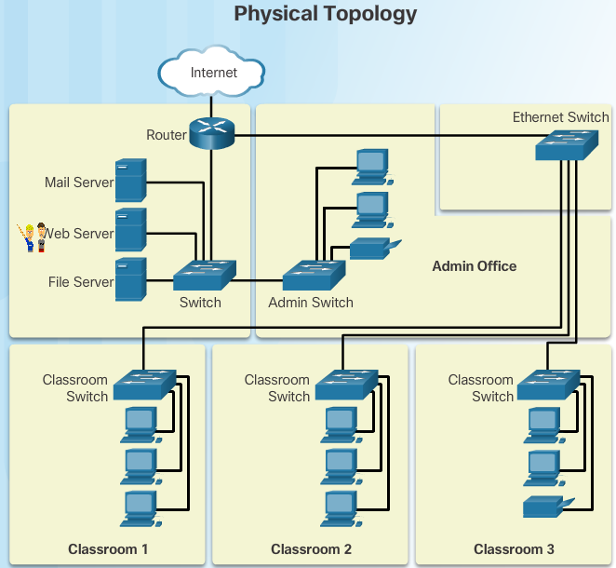
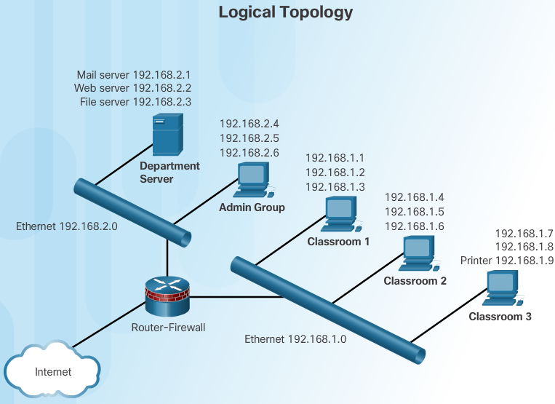
Other Network Considerations
Keeping Track of it All
A logical topology illustrates the device names, IP addressing, configuration
information, and network designations. These are logical pieces of information that
may change more frequently than the physical topology of a network.
The icons in the image are used to create both physical and logical topologies.
Notes:
2.2 – Other Network Considerations
2.2.1 – Keeping Track of it All

Slide 16
2.3 Cabling and Media
Notes:
Cisco Networking Academy Program
Networking Essentials
Chapter 2: Networks in Our Daily Lives

Slide 17
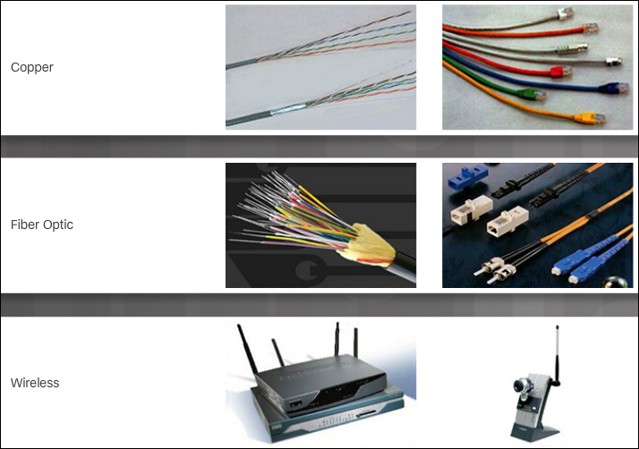
Cabling and Media
Types of Network Media
Modern networks primarily use three types of media to interconnect devices and to provide the pathway over which data can be transmitted:
  Copper wires within cables
  Glass or plastic fibers (fiber-optic cable)
  Wireless transmission
Twisted-Pair (TP) is a type of copper cable. TP is the most common type of
network cabling.
Coaxial Cable is usually made of copper or aluminum. It is used by cable
television companies to provide service, and for satellite communication systems.
Fiber-optic cables are made of glass or plastic. They have a very high bandwidth,
so they can carry vast amounts of data. Fiber-optic is used in backbone networks,
large enterprise environments, and large data centers.
Notes:
2.3 – Cabling and Media
2.3.1 – Types of Network Media

Slide 18
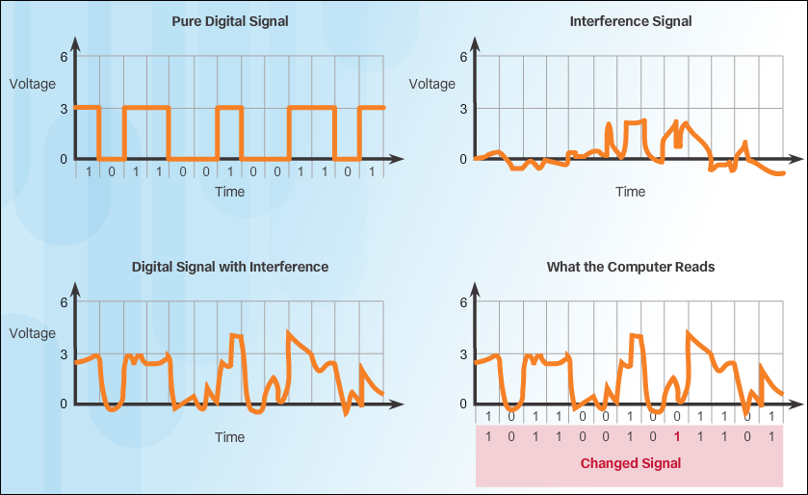
Cabling and Media
Ethernet Cabling
Data transmission over copper cable is sensitive to electromagnetic interference
(EMI), which can reduce the data throughput rate. Another source of interference,
known as crosstalk, occurs when long lengths of cables are bundled together. The
electrical impulses from one cable may cross over to an adjacent cable.
There are two commonly installed types of twisted-pair cable: Unshielded
twisted-pair (UTP) and Shielded twisted-pair (STP).
Notes:
2.3 – Cabling and Media
2.3.2 – Ethernet Cabling

Slide 19
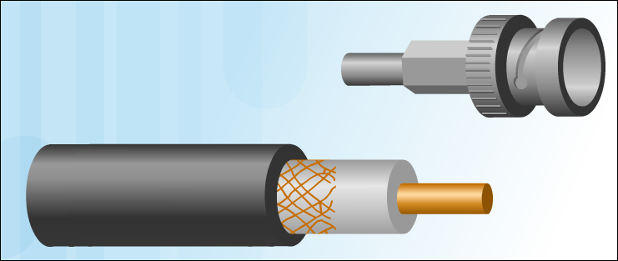
Cabling and Media
Other Types of Network Cabling
Like twisted-pair, coaxial cable (or coax) carries data in the form of electrical signals. It has better shielding than UTP and can carry more data. Coaxial cable is usually constructed of either copper or aluminum.
Fiber-optic cable is constructed of either glass or plastic, neither of which conducts electricity. It is immune to EMI and RFI, and is suitable for installation in environments where interference is a problem.
Notes:
2.3 – Cabling and Media
2.3.3 – Other Types of Network Cabling

Slide 20
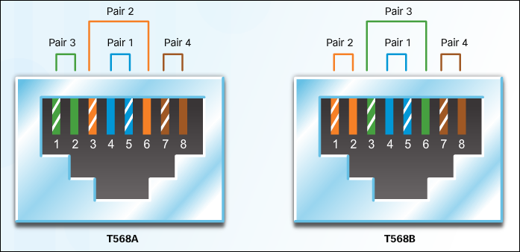
Cabling and Media
Do the Colors Matter?
There are two wiring schemes, called T568A and T568B. Each wiring scheme defines the pinout, or order of wire connections, on the end of the cable.
Ethernet NICs and ports on networking devices send data over UTP cables. Specific pins on the connector are associated with a transmit function and a receive function. The interfaces on each device transmit and receive data on designated wires within the cable.
Notes:
2.3 – Cabling and Media
2.3.4 – Do the Colors Matter?

Slide 22


