Slide 1

Internet-Based Temperature Monitoring System for Hydroponic
Presented by: Nur Uddin
Nur Uddin^{1,3,*}, Hendi Hermawan^{1,3}, Teddy M. Darajat ^{2,3}, and Setiari Marwanto⁴
¹⁾ Dept. of Informatics, Universitas Pembangunan Jaya, Tangerang Selatan, Banten, Indonesia
²⁾ Dept. of Product Design, Universitas Pembangunan Jaya, Tangerang Selatan, Banten, Indonesia
³⁾ Center for Urban Studies, Universitas Pembangunan Jaya, Tangerang Selatan, Banten, Indonesia
⁴⁾ Indonesian Soil Research Institute, Bogor, West Java, Indonesia

Slide 2
Hydroponic (Introduction & Motivation)
Hydroponic is a planting method by using nutrient solution instead of soil. This method is suitable to be applied in urban farming.
The hydroponic requires maintenance of the nutrient solution periodically that includes quantity and quality of the nutrient.
Parameters of the solution quality, e.g., temperature, acidity, and concentration

Slide 3
Research scope
Develop IoT-based monitoring system of hydroponic.
Develop a low-cost prototype of the IoT-based monitoring system with a specific case for hydroponic temperature.
Collecting real-time measurement data that is accessible from anywhere and can be applied in advanced data analysis, e.g., by applying artificial intelligence.

Slide 4
Model of IoT-based monitoring system
IoT-based monitoring system:
Real-time measurement
Cloud data storage
Anywhere & anytime data access

Slide 5
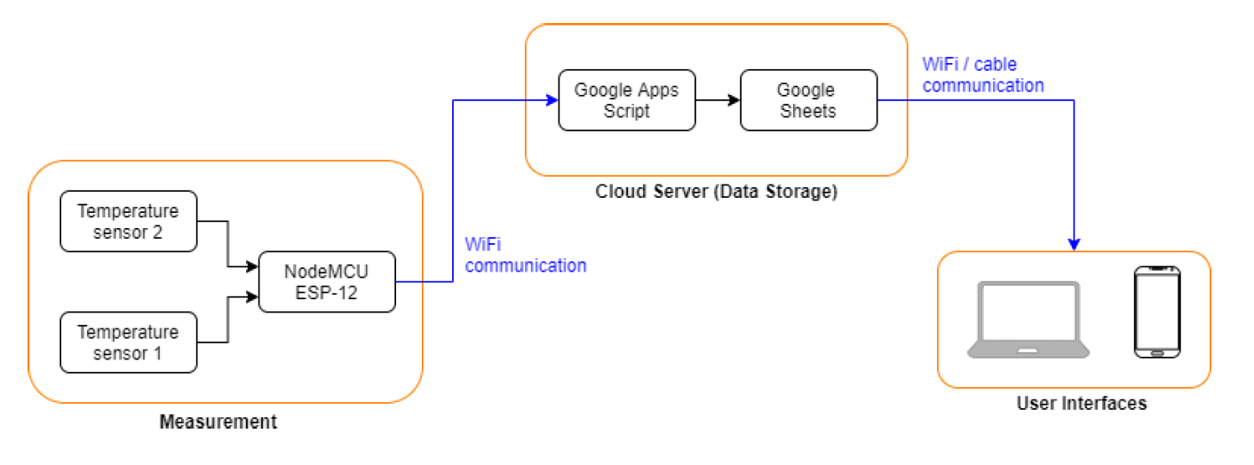
Data flow of IoT-based monitoring system
IoT-based monitoring system:
Real-time measurement
Cloud data storage
Anywhere & anytime data access

Slide 6
Main Components and Circuit Diagram
Main components:
1) Temperature sensors
DS18B20, a low-cost water-proof temperature sensor with measurement range -10 to 85 °C and accuracy ±0.5 °C.
2) Microcontroller
NodeMCU ESP-12, a low cost microcontroller with a built-in WiFi communication module.

Slide 7
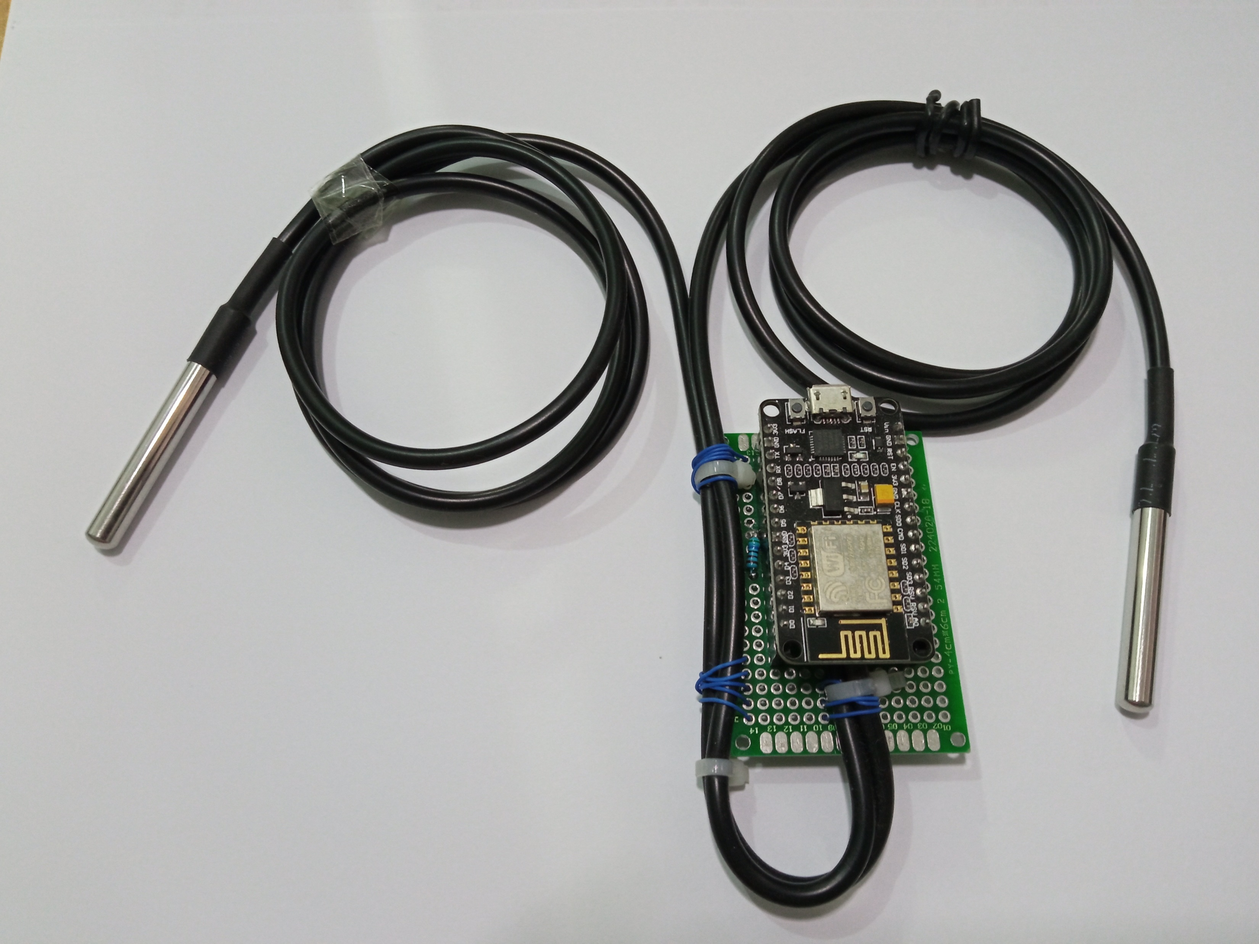
Prototype and Components Cost
No | Component Name | Quantity | Price (IDR)
1 | NodeMCU ESP-12 | 1 unit | 50.000
2 | Temperature sensor DS18B20 + resistor 4k7 | 2 set | 30.000
3 | PCB and cable | 1 set | 5.000
Total |  |  | 85.000
Temperature Sensor
Temperature
Sensor DS18B20
NodeMCU ESP-12

Slide 8
Experimental setup
Temperature sensor T1 measures the nutrient solution temperature. It is dipped into the nutrient solution.
Temperature sensor T1 measures the ambient temperature.
Temperature measurement is done every 30 seconds continuously for several days.

Slide 9
Experimental results #1
Tabular data of measured temperatures
Plot of measured temperatures

Slide 10
Experimental results #2
Measurements interval: 30 seconds.
Comparison
Delay
It is found from the monitoring system has delay up to 6 seconds in each transmitting the measurement data.

Slide 11
Conclusion
A temperature monitoring system for hydroponic plant has been developed with a case of temperature monitoring.
The monitoring system is able to provide reliable and real-time measurement data of the hydroponic temperatures. However, it has delay up to 6 seconds but is tolerated.
The measurement data is stored and presented in Google Sheets that can be accessed by users form anywhere through internet using a computer or mobile device.
Presenting the measurement data in the Google Sheets provides a flexibility for further data processing and analysis to the users.

Slide 12
Thank you

