Slide 1
Selamat Datang di “Programming Essentials in Python”
Instruktur: Hendi Hermawan, S.T., M.T.I.
hendiananta@gmail.com / 085710098205

Slide 2
Profil Hendi Hermawan, S.T., M.T.I.
hendiananta@gmail.com / 085710098205
Dosen:
Teknik Informatika, UMB, 2004-2010
Multimedia, STDI Interstudi, 2010-2014
Teknik Informatika, STTI NIIT I-Tech, 2005-2014
Teknik Informatika, Univ. Pembangunan Jaya, 2014-skg
Instruktur Cisco Academy Indonesia
Founder depokhosting.com

Slide 3
Modules, packages, string and list methods, and exceptions
Modul 5

Slide 4
In This Module, You Will Learn About
Python modules: their rationale, function, how to import them in different ways, and present the content of some standard modules provided by Python;
the way in which modules are coupled together to make packages.
the concept of an exception and Python's implementation of it, including the try-except instruction, with its applications, and the raise instruction.
strings and their specific methods, together with their similarities and differences compared to lists.

Slide 5
Module ?
A python module can be defined as a python program file which contains a python code including python functions, class, or variables.
In other words, we can say that our python code file saved with the extension (.py) is treated as the module. We may have a runnable code inside the python module.
Modules in Python provides us the flexibility to organize the code in a logical way.
To use the functionality of one module into another, we must have to import the specific module.
Consider a module to be the same as a code library.
A file containing a set of functions you want to include in your application.

Slide 6
Importing Modules
Example:
Output:

Slide 7
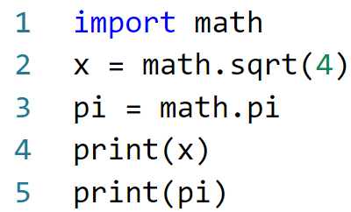
Importing Modules
Example:

Slide 8
Using from ... import
To refer to items from a module within your program’s namespace, you can use the from ... import statement.
When you import modules this way, you can refer to the functions by name rather than through dot notation
Example:

Slide 9
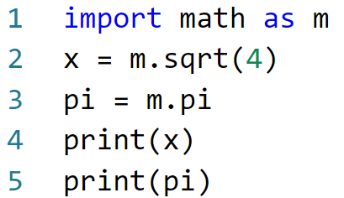
Aliasing Modules
Sintax:
import [module] as [another_name]
Example:

Slide 10
Create a Module
To create a module just save the code you want in a file with the file extension .py
Example: Save this code in a file named mymodule.py

Slide 11
Use a Module
Now we can use the module we just created, by using the import statement
Example: Create another file and import mymodule

