Slide 1
Selamat Datang di “Programming Essentials in Python”
Instruktur: Hendi Hermawan, S.T., M.T.I.
hendiananta@gmail.com / 085710098205

Slide 2
Profil Hendi Hermawan, S.T., M.T.I.
hendiananta@gmail.com / 085710098205
Dosen:
Teknik Informatika, UMB, 2004-2010
Multimedia, STDI Interstudi, 2010-2014
Teknik Informatika, STTI NIIT I-Tech, 2005-2014
Teknik Informatika, Univ. Pembangunan Jaya, 2014-skg
Instruktur Cisco Academy Indonesia
Founder depokhosting.com

Slide 3
Silabus “Programming Essentials in Python”
Senin - Part 1: Basics
Modul 1 - Introduction to python and computer programming
Modul 2 - Data types, variables, basic input-output operations, basic operators
Modul 3 - Boolean values, conditional execution, loops, lists and list processing, logical and bitwise operations
Selasa - Part 1: Basics
Modul 4 - Functions, tuples, dictionaries, and data processing

Slide 4
Silabus “Programming Essentials in Python”
Rabu - Part 2: Intermediate
Modul 5 - Modules, packages, string and list methods, and exceptions
Kamis - Part 2: Intermediate
Modul 6 - The object-oriented approach: classes, methods, objects, and the standard objective features; exception handling, and working with files
Jum’at
Review materi
Ujian Teori
Ujian Praktek

Slide 5
Function, Tuples, Dictionaries, and Data Processing
Modul 4

Slide 6
In This Module, You Will Learn About
Defining and using functions;
Different ways of passing arguments;
Name scopes;
Tuples and dictionaries;
Data processing.

Slide 7
Function
A function is a block of code which only runs when it is called.
You can pass data, known as parameters, into a function.
A function can return data as a result.

Slide 8
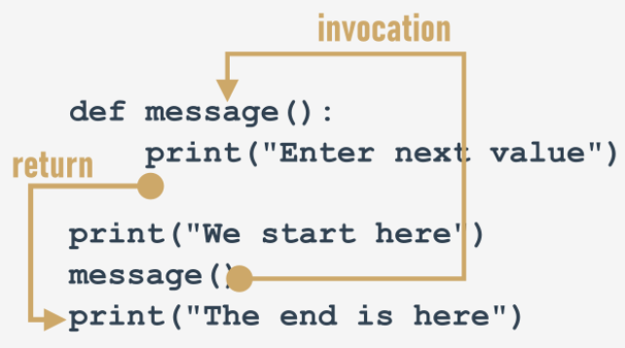
Function - Creating & Calling a Function
A function is defined , using the def keyword, example:

Slide 9
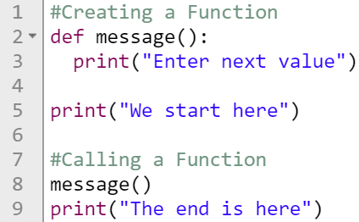
Function - Creating & Calling a Function
Example: Output:

Slide 10
Function - Parametrized Functions
Information can be passed to functions as parameter.
Parameters are specified after the function name, inside the parentheses.
You can add as many parameters as you want, just separate them with a comma.
The following example has a function with one parameter (fname). When the function is called, we pass along a first name, which is used inside the function to print the full name

Slide 11
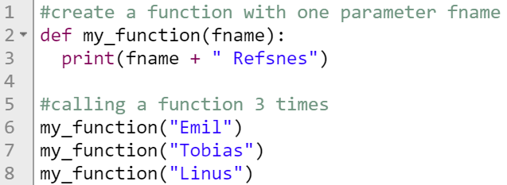
Function - Parametrized Functions
Example
Output:

Slide 12
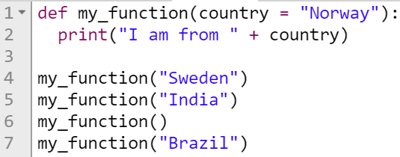
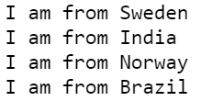
Function - Default Parameter Value
The following example shows how to use a default parameter value.
If we call the function without parameter, it uses the default value.
Example: Output:

Slide 13
Function - Default Parameter Value
Example:
Output:

Slide 14
Function - Return Values
To let a function return a value, use the return statement
Example:
Output:

Slide 15
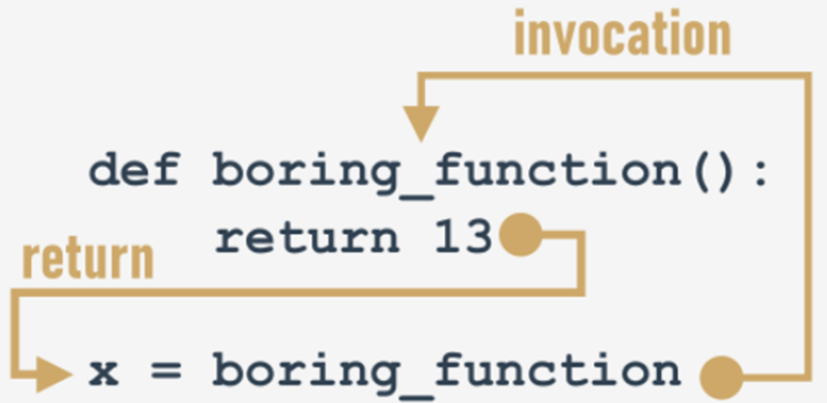
Function - Return Values

Slide 16
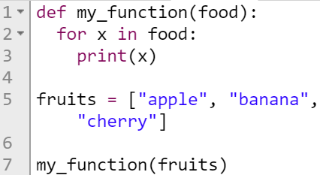
Function - Passing a List as a Parameter
You can send any data types of parameter to a function (string, number, list, dictionary etc.), and it will be treated as the same data type inside the function.
E.g. if you send a List as a parameter, it will still be a List when it reaches the function.
Example: Output:

Slide 17
Function - Functions and scopes
A variable existing outside a function has a scope inside the functions' bodies, excluding those of them which define a variable of the same name.
Example:
Output:

Slide 18
Function - Functions and scopes
The global keyword
Using this keyword inside a function with the name (or names separated with commas) of a variable(s), forces Python to refrain from creating a new variable inside the function - the one accessible from outside will be used instead.
Output:

Slide 19
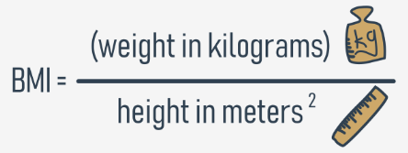
Function – Two or More Parameter
Example:
Let's get started on a function to evaluate the Body Mass Index (BMI).
It seems that this new function will have two parameters.
Its name will be bmi, but if you prefer any other name, use it instead.
Let's code the function.

Slide 20
Function – Two or More Parameter
Example:
Output:

Slide 21
Function – Recursion
Python also accepts function recursion, which means a defined function can call itself.
Recursion is a common mathematical and programming concept.
It means that a function calls itself.
This has the benefit of meaning that you can loop through data to reach a result.

Slide 22
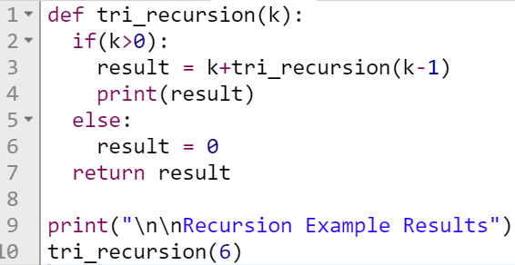
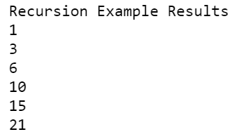
Function – Recursion
Example: Output:

Slide 23
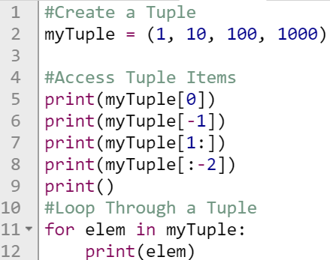
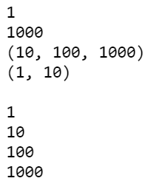
Tuples
A tuple is a collection which is ordered and unchangeable.
In Python tuples are written with round brackets.
Example: Output:

Slide 24
Tuples
What else can tuples do for you?
the len() function accepts tuples, and returns the number of elements contained inside;
the + operator can join tuples together (we've shown you this already)
the * operator can multiply tuples, just like lists;
the in and not in operators work in the same way as in lists.

Slide 25
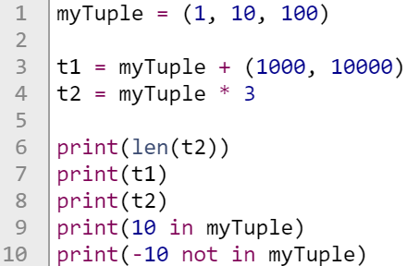
Tuples
Example: Output:

Slide 26
Dictionary
A dictionary is a collection which is unordered, changeable and indexed.
In Python dictionaries are written with curly brackets, and they have keys and values.
Example

