Slide 1
Discrete Mathematics
Lecture 2:
Propositional Logic
By:
Nur Uddin, Ph.D

Slide 2
Propositional Logic
A proposition is a declarative sentence (that is, a sentence that declares a fact) that is either true or false, but not both.

Slide 3
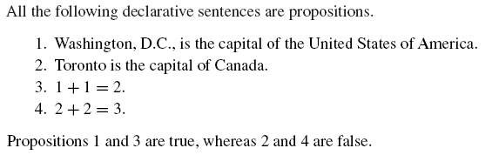
Example 1: Propositions

Slide 4
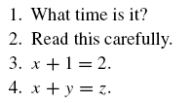
Example 2: Not propositions

Slide 5
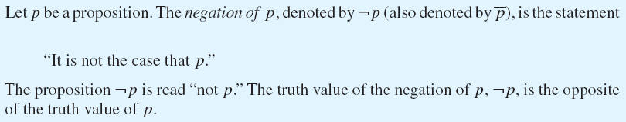
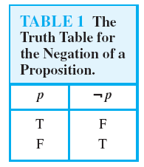
Negation

Slide 6
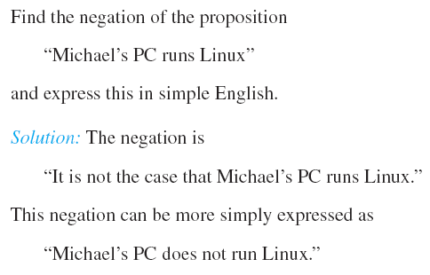
Example 3

Slide 7
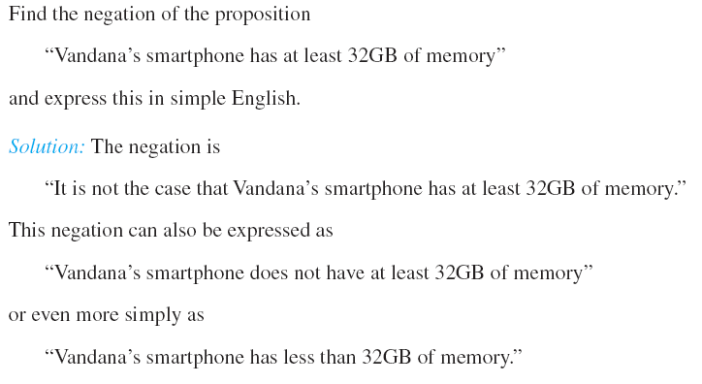
Example 4

Slide 8
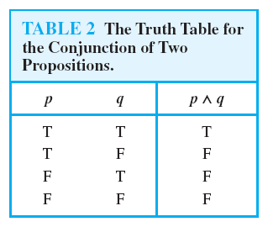
Conjunction

Slide 9
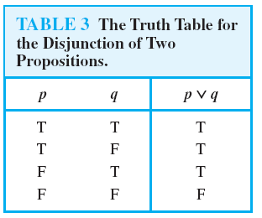
Disjunction

Slide 10
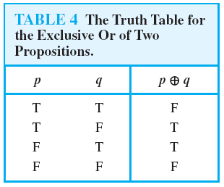
Exclusive OR

Slide 11
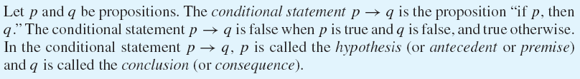
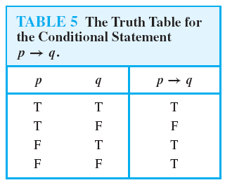
Conditional Statement

Slide 12
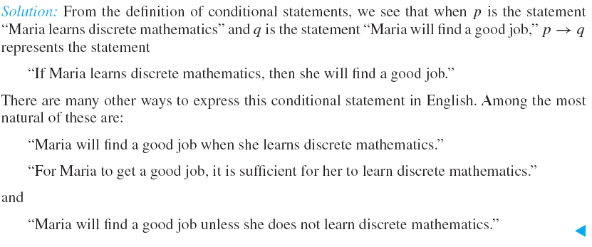
Example 5: Conditional Statement

Slide 13
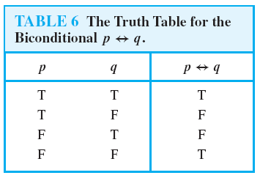
Biconditional Statement

Slide 14
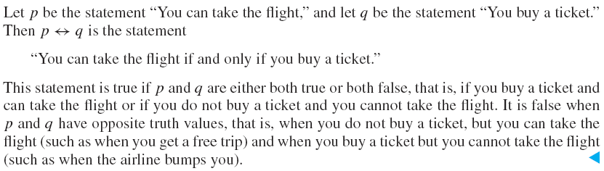
Example 6: Biconditional Statement

Slide 15

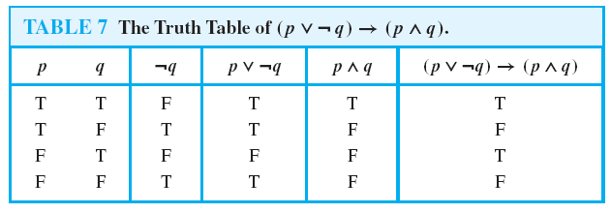
Example 6: Compound proposition
Construct the truth table of the compound proposition
Solution:

Slide 16
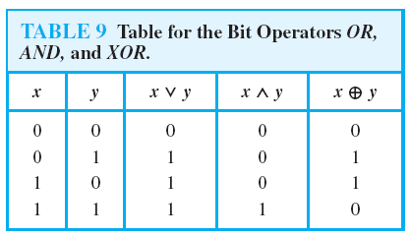
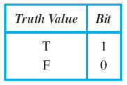
Bit Operations

Slide 17
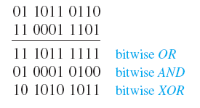
Example 7: Bit Operation

Slide 18

Design a stair lighting system

Slide 19
Quiz 1
1. Construct a true table of the following compound propositions
a.
b.
c.
d.
2. Evaluate of these expressions
a.
b.
c.

