Slide 1
Calculus 2
Lecture 0:
Introduction
By:
Nur Uddin, Ph.D

Slide 2
Calculus 1 vs Calculus 2
Calculus 1:
Intro
Function #1
Function #2
Limit and Continuity #1
Limit and Continuity #2
Derivative #1
Review
Derivative #2 (implicit derivative)
Application of derivative (extreme & optimization)
Integrals #1
Integral #2
Application of integrals
Integral and Transcendental Function
Review
Calculus 2:
Technique of integration
First order differential equation #1
First order differential equation #2
Infinite sequences and series
Parametric equations & polar coordinates #1
Parametric equations & polar coordinates #2
Review
Vector and the geometry of space #1
Vector and the geometry of space #2
Vector-valued function and motion in space
Partial derivatives
Multiple integrals
Integral and vector fields
Review

Slide 3
Penilaian
Ujian Akhir Semester : 30%
Ujian Tengah Semester : 30%
Tugas : 30%
Keaktivan : 10%

Slide 4
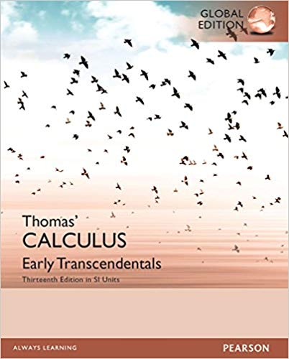
Text book

