Slide 1
Calculus 1
Lecture 1:
Calculus & Real Numbers
By:
Nur Uddin, Ph.D
Calculus 1 - INF101 - UPJ/INF/UDN

Slide 2
What is Calculus ?
Some of mathematic branches:
  Calculus is the mathematical study of continuous change.
  Geometry is the study of shape.
  Algebra is the study of generalizations of arithmetic operations.
Calculus:
  Differential calculus
  Differential calculus concerns instantaneous rates of change and the
  slopes of curves
  Integral calculus
  Integral calculus concerns accumulation of quantities and the areas
  under and between curves.
Source: https://en.wikipedia.org/wiki/Calculus
Calculus 1 - INF101 - UPJ/INF/UDN

Slide 3
Definition Calculus in Dictionary
Calculus is an area of advanced mathematics in which continuously changing values are studied
( https://dictionary.cambridge.org/dictionary/english/calculus )
Calculus 1 - INF101 - UPJ/INF/UDN

Slide 4
Why we need calculus?
Calculus is a branch of mathematics that involves the study of rates of change.
Before calculus was invented, all math was static: It could only help calculate objects that were perfectly still. But the universe is constantly moving and changing.
Source: https://www.thoughtco.com/definition-of-calculus-2311607
Calculus 1 - INF101 - UPJ/INF/UDN

Slide 5
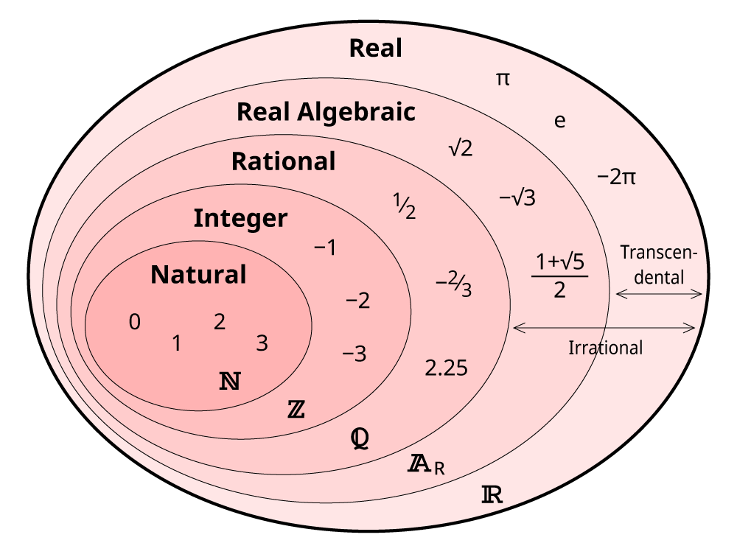
Numbers
An algebraic number is any complex number (including real numbers) that is a root of a non-zero polynomial (that is, a value which causes the polynomial to equal 0).
Calculus 1 - INF101 - UPJ/INF/UDN

Slide 6
Real Number
Calculus 1 - INF101 - UPJ/INF/UDN

Slide 7
Real line
Calculus 1 - INF101 - UPJ/INF/UDN

Slide 8
Subsets of Real Numbers
Calculus 1 - INF101 - UPJ/INF/UDN

Slide 9
Interval
Calculus 1 - INF101 - UPJ/INF/UDN

Slide 10
Inequalities
Solve the following inequalities
Calculus 1 - INF101 - UPJ/INF/UDN

Slide 11
Absolute values
Calculus 1 - INF101 - UPJ/INF/UDN

Slide 12
An absolute value is a distance
Calculus 1 - INF101 - UPJ/INF/UDN

Slide 13
Absolute value and square root
Calculus 1 - INF101 - UPJ/INF/UDN

