Slide 1
Calculus 1
Lecture 1-A:
Introduction
By:
Nur Uddin, Ph.D
Calculus 1 – IFA101 - UPJ/INF/UDN

Slide 2
Materi pokok
Sistem Bilangan, Persamaan, Pertaksamaan
Limit Fungsi
Derivative dan Aplikasiya
Integral dan Aplikasinya
Calculus 1 - INF101 - UPJ/INF/UDN

Slide 3
Penilaian
Ujian Akhir Semester : 30%
Ujian Tengah Semester : 30%
Tugas : 30%
Keaktifan : 10%
Calculus 1 - INF101 - UPJ/INF/UDN

Slide 4
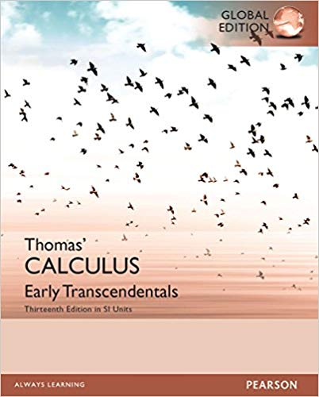
Text book
Thomas, G. B., Weir, M. D., Hass, J., & Giordano, F. R. (2014). Thomas' Calculus: Early Transcendentals 13th Edition. Boston: Pearson.
Calculus 1 - INF101 - UPJ/INF/UDN

Slide 5
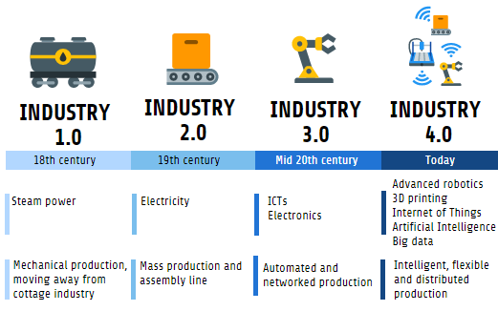
Industrial Revolutions (#2)

Slide 6
Keywords of Industrial Revolutions
Industrial revolution 1: Mechanisation
Industrial revolution 2: Electrification
Industrial revolution 3: Digitalisation
Industrial revolution 4: Cyber-physical systems (intelligence & connectivity)
Cybernetics: the science of control and communications in the animal and machine

Slide 7
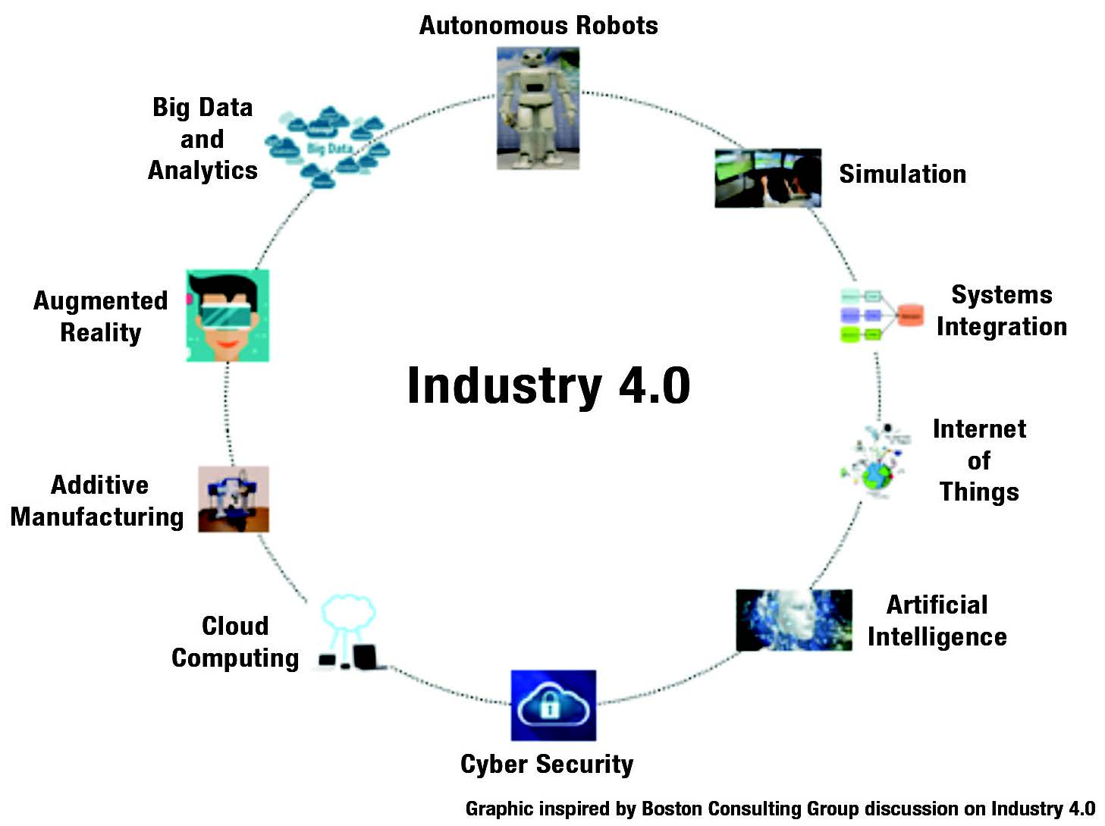
Industry 4.0

Slide 9

Example of Calculus Applied in Autonomous Robot
Path:
Initial posture of the robot:
Assuming that the robot has an ideal controller:

Slide 10
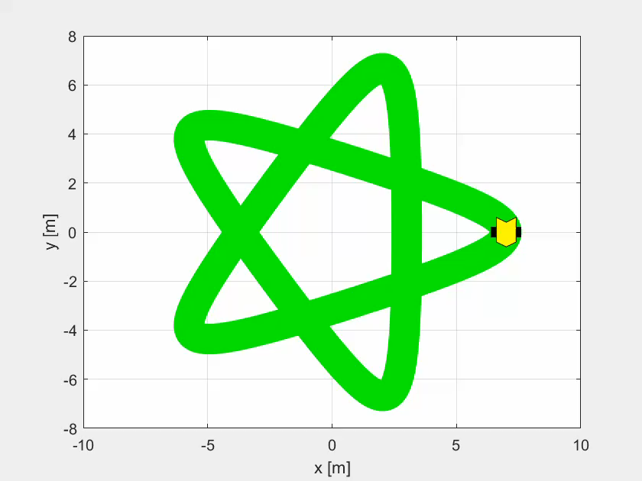
Results (1)

Slide 11
Results (2)

