Slide 1
Reality in Ethics
HEPPR Pertemuan 13

Slide 2
How aware are you in social issues?
How many social issues that interest you?
What made you aware or interest in them?
Personal experiences?
Ads?
Social Media?
Influencer?
PR Campaign?

Slide 5
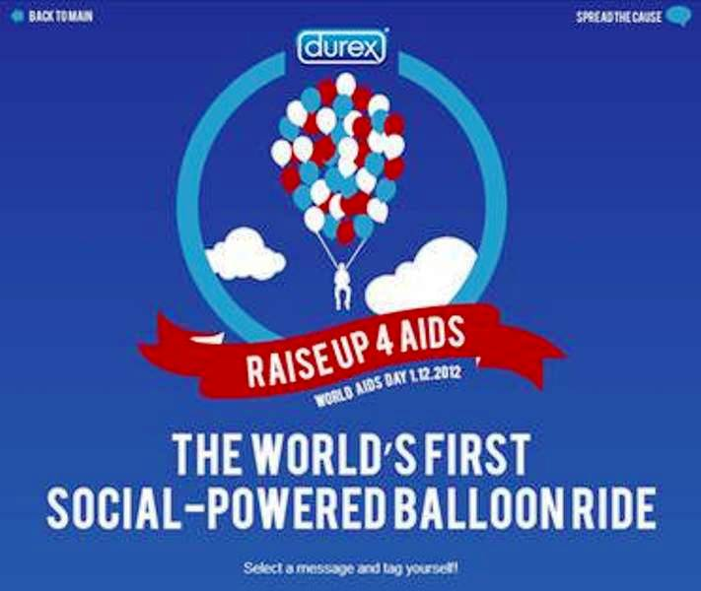

Slide 9
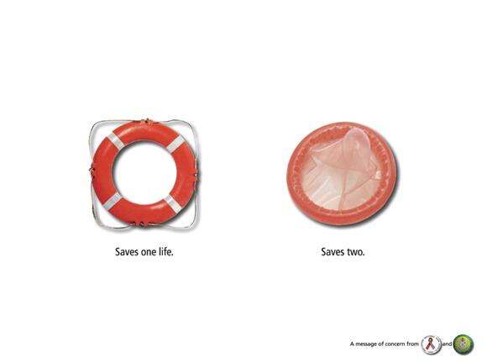

Slide 12
What differences did you find?

Slide 13
Cause-related marketing and strategic philanthropy programs are bedrock public relations tools with enormous capacities to develop mutually beneficial outcomes for both the sponsoring organization and the cause being supported.
‘Good causes’ are usually in desperate need of support from the profit-minded sector and profit-minded organizations need to enhance the communities in which they function. So, it seems like a marriage made in heaven.
But are there any ethical lines that need to be considered in the strategic decision-making about which causes to support?

Slide 14
A STAPLE OF COMMUNITY RELATIONS
What could be a more noble objective than to give back to the community?
The term strategic philanthropy is now widely used to identify a profitmaking organization’s strategic public relations approach in support of community activities.
Cause-related marketing, often confused by marketers with social marketing, is the tactic that identifies an organization’s products or services with a specific social cause.
Social marketing, by contrast and by definition, is a campaign created (usually by an organization devoted to the cause) for the sole purpose of selling the cause (or behavior change), with no hidden agenda of selling products.

Slide 15
Whereas it seems like a truly good thing for profit-minded organizations to give back to their communities, there are some issues that are often not considered, or quickly discarded as irrelevant, by the public relations professionals engaged in finding the best way both to promote the organization as community-minded and truly make a difference.
These two issues of mutuality often conflict.

Slide 16
SEEKING A GOOD FIT
What brand do you think that are related to one particular issue?
Let’s say the issue is breast cancer.
Is it the issue is really big and need our attention?
Or is it just because the problem is emotionally attached to our body perception?
Breast cancer awareness is a big business now.

Slide 17
Supporting causes or big business?

Slide 18
FROM GOOD CAUSES TO GOOD TASTE
https://www.youtube.com/watch?v=Wh2sZ9K_VaM
https://www.youtube.com/watch?v=p0OPj6XkMLw
https://www.youtube.com/watch?v=Suq0FhISbvQ

Slide 19
Plagiarism and Ghost Author
Every day we write speeches, memos, annual report letters, product and service marketing letters and so much more for the employers and clients who have hired us to help them with their communication challenges.
They have hired us because we possess the skills that they lack.
Hiring a PR ‘representative’ to help someone/company promote their new business – essentially ghost-writing – with his/their name signed to them.
when someone’s name appears on such things as novels, magazine articles or op-ed pieces, the assumption is that the person actually penned the words; thus for another person’s name to appear is, in fact, lying. To follow this line of reasoning further, we could assume that anyone who has ever hired a ghost writer is essentially lying to the public.

Slide 20
https://www.youtube.com/watch?v=RcbiGsDMmCM

Slide 21
What is plagiarism?
The Compact Oxford English Dictionary defines the verb ‘to plagiarize’ as follows: ‘to take (the work or idea of someone else) and pass it off as one’s own’.
For example, the Modern Languages Association (MLA) defines plagiarism as using another person’s ideas or work without giving credit. The MLA further suggests that much plagiarism is unintentional and the result of sloppy research;
however does not apply in the PR situations to which we refer to online source Infoplease.
It defines plagiarism as ‘the unauthorized use or close imitation of the language and thoughts of another author and the representation of them as one’s own original work’.
This practical addition of the term ‘unauthorized’ begins to bring us closer to an understanding of whether or not PR does, indeed, resort to plagiarism.

Slide 22
ACCEPTABLE VERSUS UNACCEPTABLE USES
The first, and an area where most of us will never tread, is the celebrity autobiography. Many (perhaps even most) celebrities, and this includes everyone from Hollywood stars to politicians, hire ghostwriters.
Speeches are another area where ghosting is probably more the norm than the exception, and it is an important area of PR writing.
public relations professionals often write opinion/editorial pieces for their CEOs or others in their organization whose bylines will appear in the newspaper. This is one area that is very controversial when it comes to the ethics of ghosting.
Some editors of magazines and newspapers have declared that ghostwritten opinion pieces are in their view dishonest. An ethical PR person hired to write an op/ed piece under someone else’s byline will agree to assist in the writing, but not to ghost write it entirely. Polishing someone else’s prose is an acceptable practice.

Slide 23
ACCEPTABLE VERSUS UNACCEPTABLE USES
One area where ghosting is considered completely unacceptable is in academic writing.
What do you think about love letters?
Generally, passing off someone else’s work as your own is considered to be plagiarism at best. However, when it comes to the work-for-hire issue, it is considered acceptable.

