Slide 1
Hukum dan etika profesi pr
Pertemuan 2 – Kebenaran dalam PR

Slide 2
Bacalah Press Release Berikut!

Slide 3
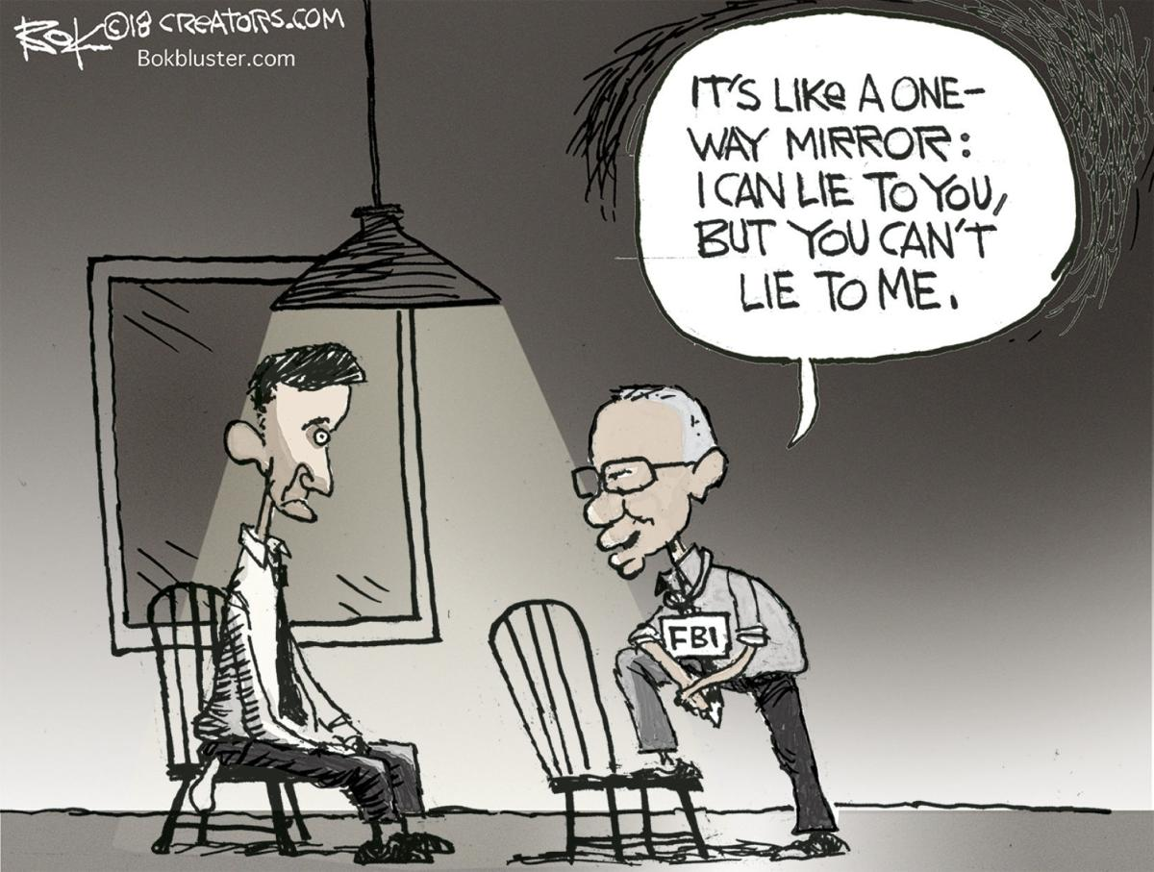
An Epidemic of Lying
Have you ever lied?
‘white lies’
Most other religious traditions, however, also have guidelines regarding the virtue of telling the truth.

Slide 4
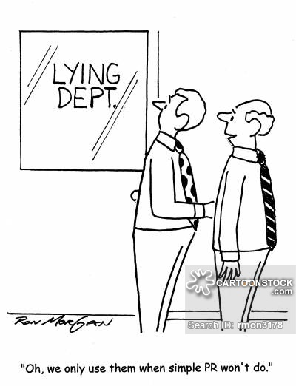
The ‘Truth’ in PR
Public relations is a public communication function and as such its practitioners have responsibilities that speak to the greater good – whether we like it or not.
The public are skeptical of the truth of what is communicated to them and we really don’t have a right to clog up the channels of public communication with more untruths or half-truths.
Codes of ethics of professional associations of public relations practitioners provide chapter and verse on the need for the truth.

Slide 5
Chartered Institute of Public Relations (CIPR) Code of Conduct says: ‘Members of the Institute of Public Relations agree to… deal honestly and fairly in business with employers, employees, clients, fellow professionals, other professions and the public.’
The Canadian Public Relations Society’s Code of Professional Standards is even more specific. It states: ‘A member shall practice the highest standards of honesty, accuracy, integrity and truth, and shall not knowingly disseminate false or misleading information’, and goes on to drill this down even further: ‘Members shall not make extravagant claims or unfair comparisons, nor assume credit for ideas and words not their own.’
Defining what the truth is in public relations, just as in other aspects of our lives, however, is a challenge.

Slide 6
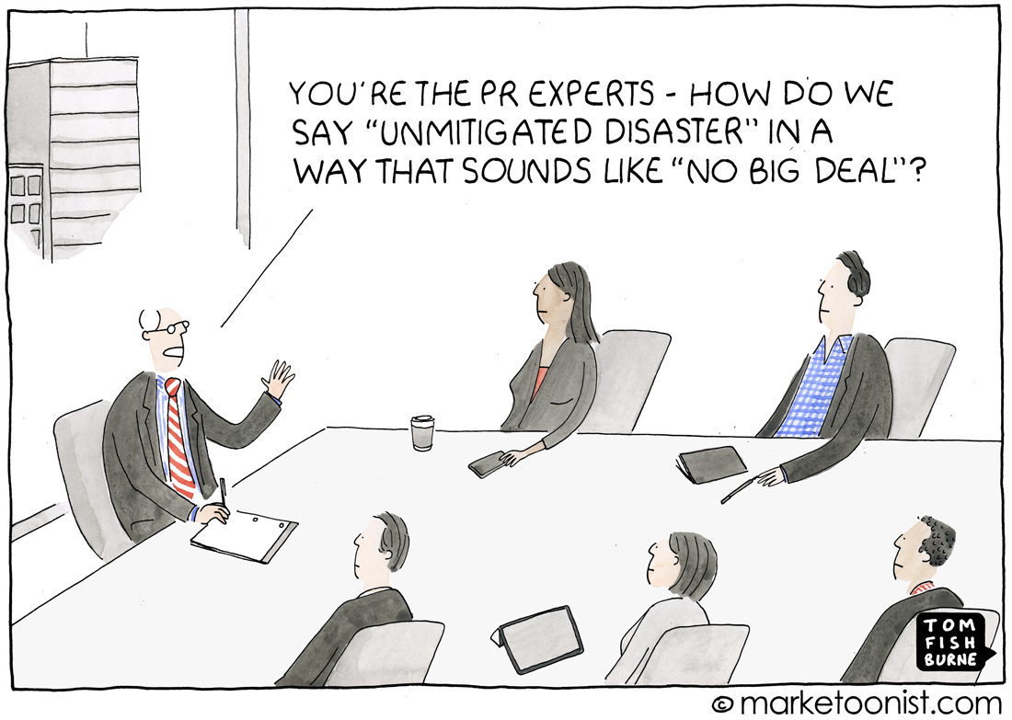

Slide 7
PR and Lawyer
O’Malley, “if you want to be an ethical public relations practitioner, you choose to serve clients whose self-defined interests are, in [your] view correct. And [you] don’t serve those whose purposes and interests are incorrect. Period.”

Slide 8
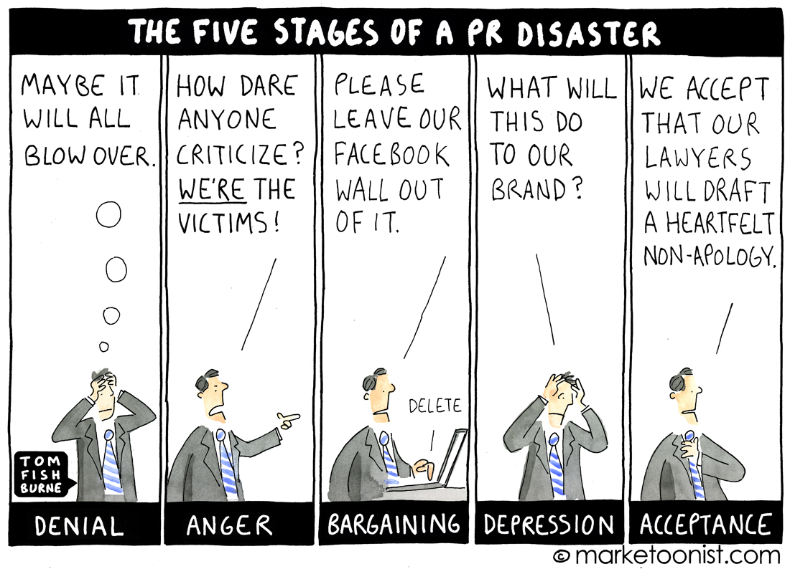

Slide 9
CAN YOU PREDICT HONESTY?
This world is full of competition
Let’s do honesty assessment!

Slide 10
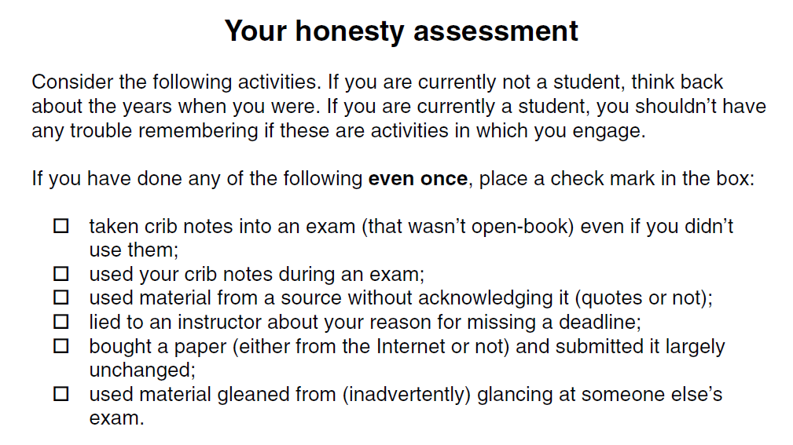

Slide 11
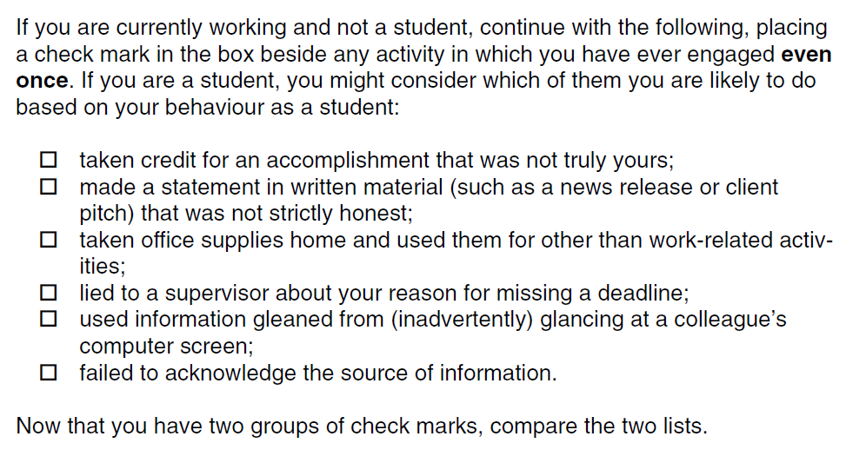

Slide 12
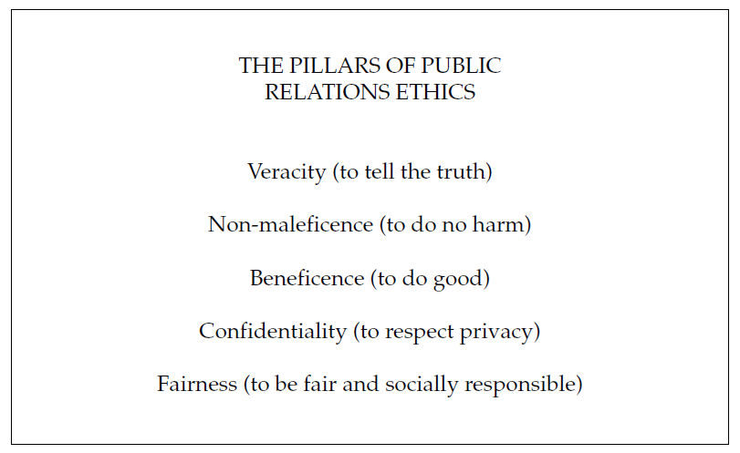
ONE PRINCIPLE AMONG SEVERAL

Slide 13
TRUTH AND TRUST
If you don’t tell the truth, then your publics, once they are aware of this, have difficulty trusting you. If a public does not trust you, then the relationship deteriorates.
In today’s world of business, it seems clear that telling the truth is sometimes overshadowed by other duties.
Now, read the story in your book!

Slide 14
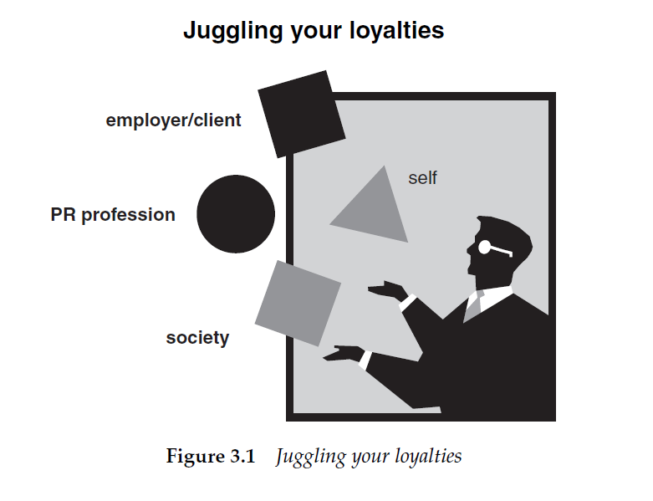
TO WHOM ARE YOU LOYAL?

Slide 15
Thank you
Questions?

