Slide 1
Writing Advertising Copy
(Part 3)

Slide 2
Daftar Materi
Penjelasan Infografis
Pembuatan Infografis

Slide 3
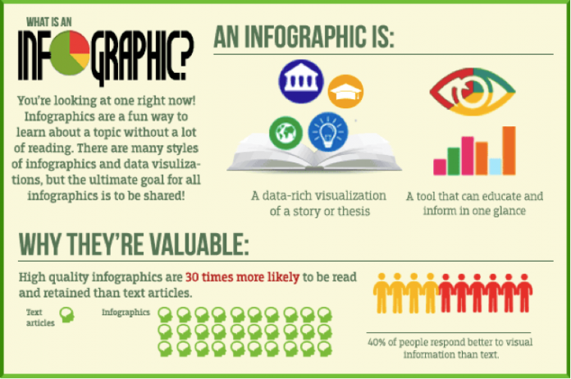
Notes:
Tambahin contoh infografis dan dos and donts for infografis

Slide 4
Goal:
To Communicate Complex Information Quickly & Clearly
Petunjuk Infografis
Content:
Bar / Column / Pie Chart
Bulleted or Numbered list
Diagram
Illustrated Graphic
Notes:
Tambahin contoh infografis dan dos and donts for infografis

Slide 5
Petunjuk Infografis
Tipe Infografis
Visual
When to use:
cut down on text
make a plain article more interesting
increase the sharing potential
Notes:
Tambahin contoh infografis dan dos and donts for infografis

Slide 6
Petunjuk Infografis
Tipe Infografis
List-Based
When to use:
Support a specific claim or argument
Notes:
Tambahin contoh infografis dan dos and donts for infografis

Slide 7
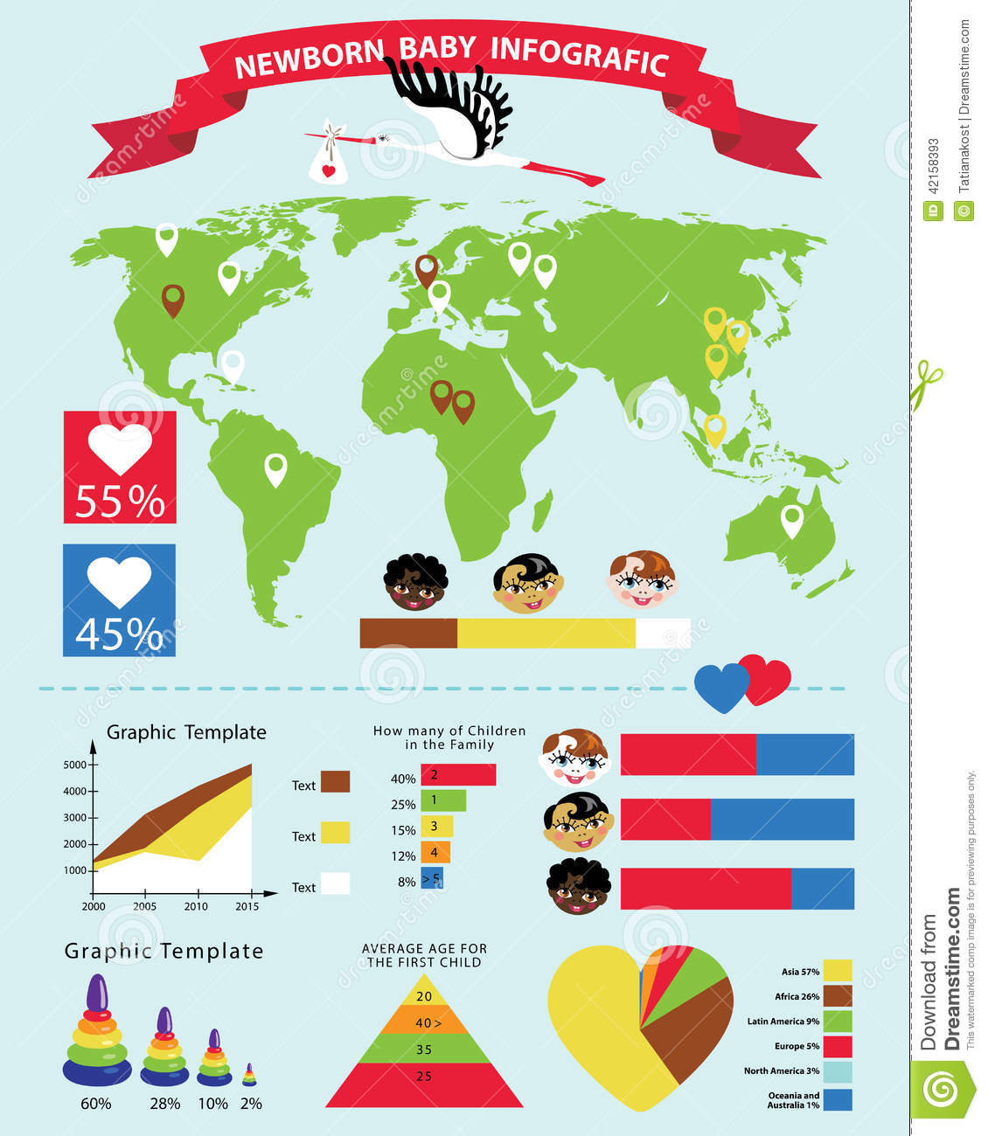
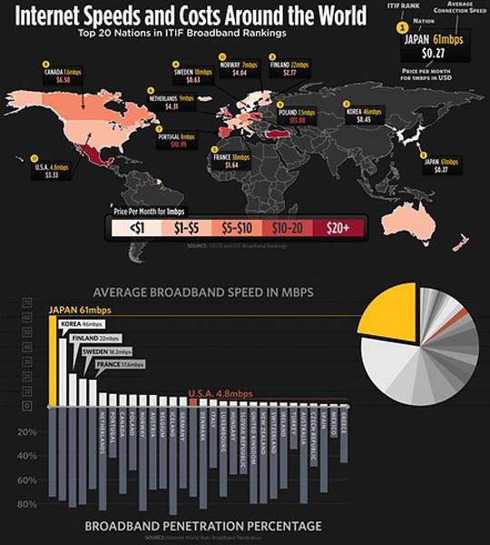
Petunjuk Infografis
Tipe Infografis
Map
When to use:
compare places and cultures using location-centric data
Notes:
Tambahin contoh infografis dan dos and donts for infografis

Slide 8
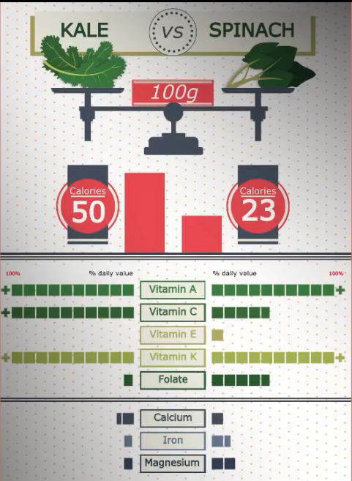
Petunjuk Infografis
Tipe Infografis
Versus / Comparison
When to use:
highlight differences between two similar things
highlight similarities between two unlike things
prove one option is superior/inferior to the other
Notes:
Tambahin contoh infografis dan dos and donts for infografis

Slide 9
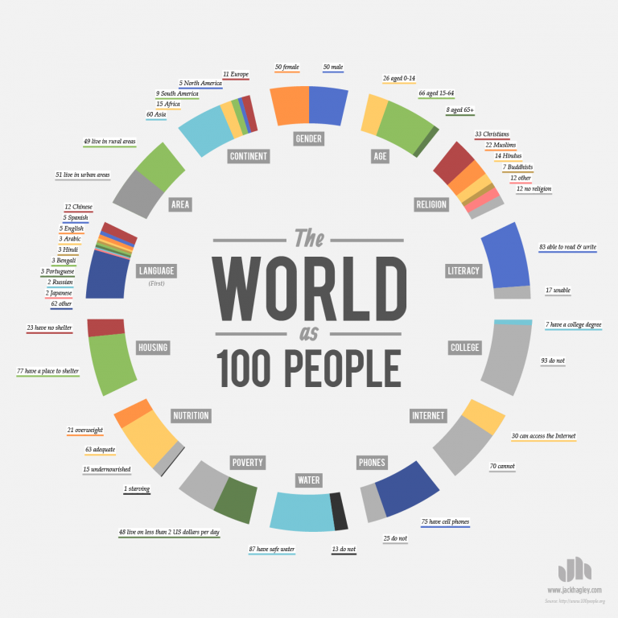
Petunjuk Infografis
Tipe Infografis
Data Visualization
When to use:
make data-driven arguments easier to understand
make facts and statistics more
Notes:
Tambahin contoh infografis dan dos and donts for infografis

Slide 10
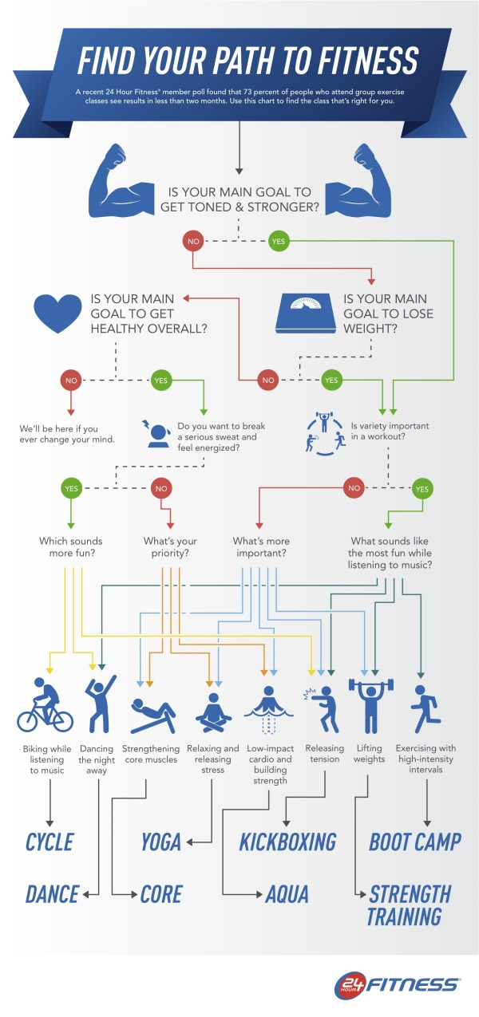
Petunjuk Infografis
Tipe Infografis
Flowchart
When to use:
provide personalized answers for readers
showcase how multiple situations can reach the same conclusion
Notes:
Tambahin contoh infografis dan dos and donts for infografis

Slide 11
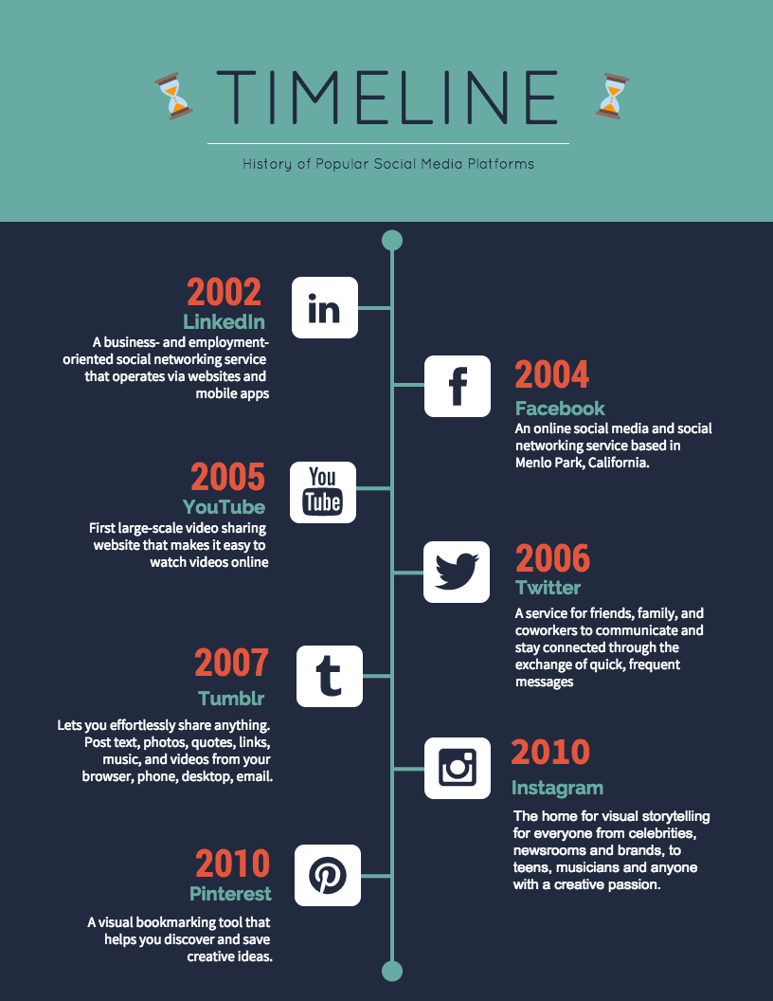
Petunjuk Infografis
Tipe Infografis
Timeline
When to use:
show how something has changed over time
make a long, complicated story easier to understand
show how one thing leads to another
Notes:
Tambahin contoh infografis dan dos and donts for infografis

Slide 12
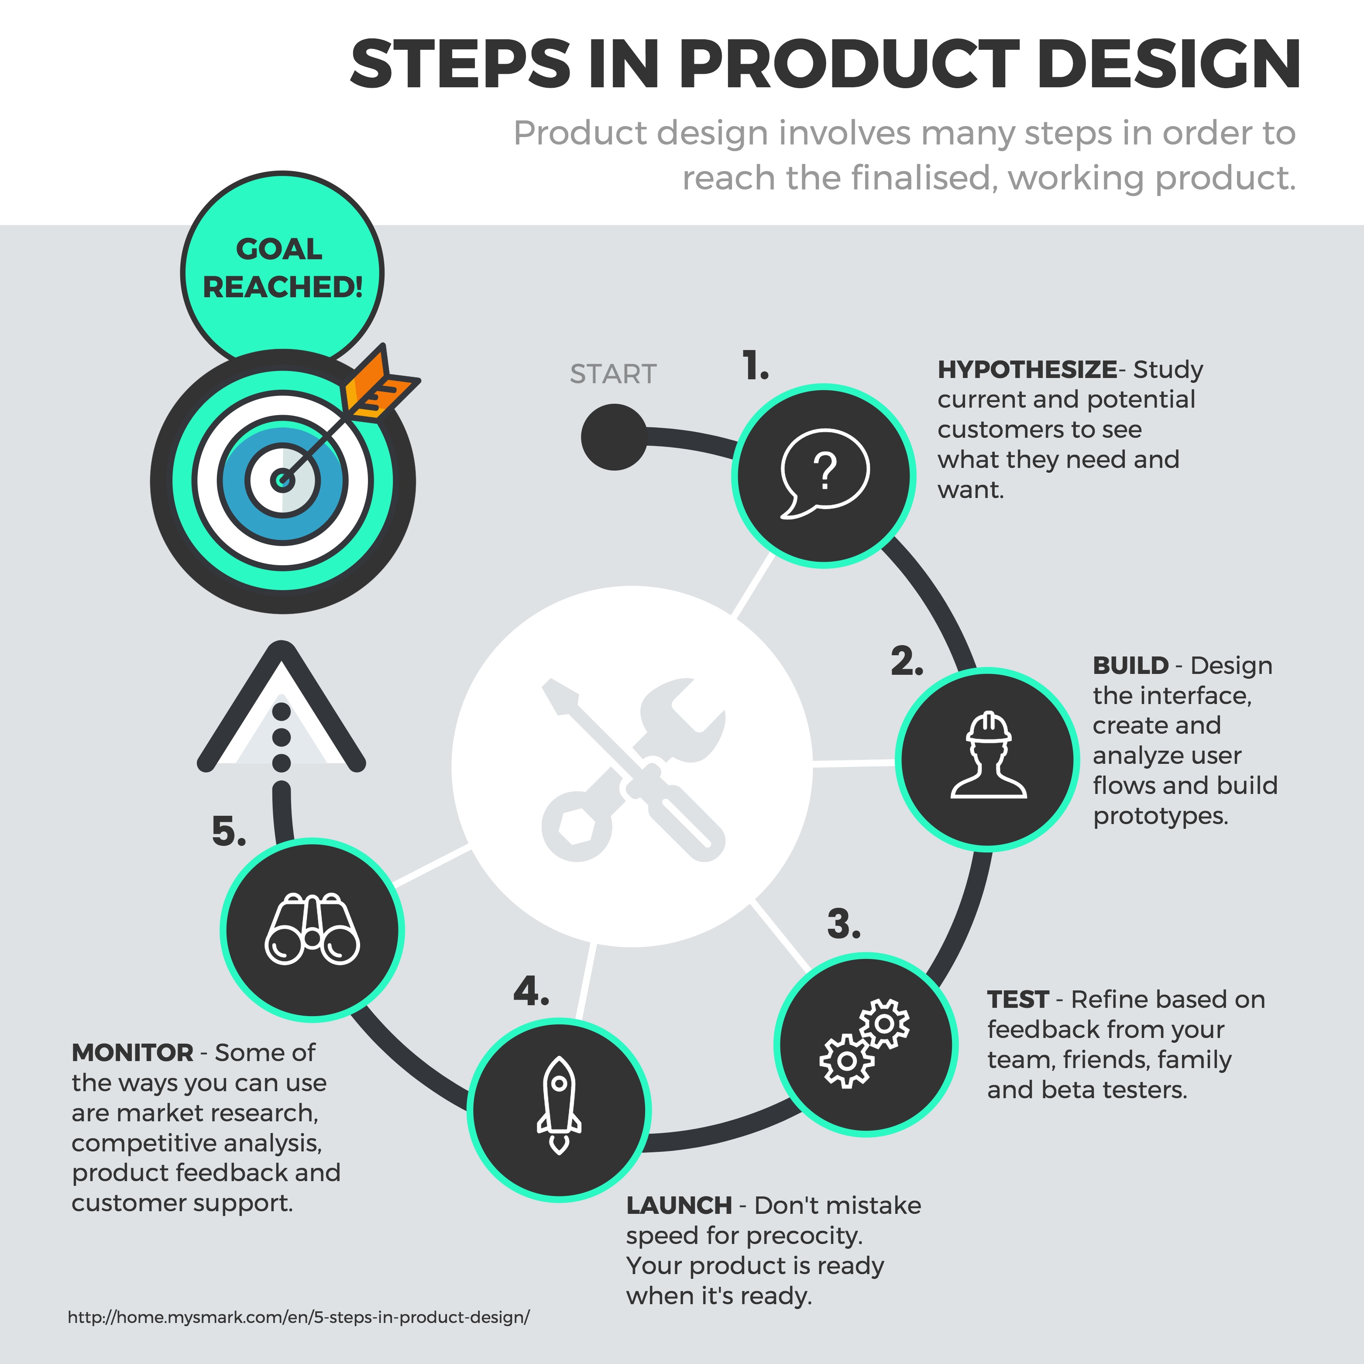
Petunjuk Infografis
Tipe Infografis
Process
When to use:
explain step of the process
Notes:
Tambahin contoh infografis dan dos and donts for infografis

Slide 13
Petunjuk Infografis
Tips Pembuatan Infografis
Do’s
Don’ts
Keep it simple
Make a believable message
Make a memorable chart design
Try to say too much with one chart
Use boring title that tell everything
Show number without context/info
Notes:
Tambahin contoh infografis dan dos and donts for infografis

Slide 14
Tugas 14 April 2020
Format Infografis:
Ukuran : square (untuk social media)
Dikerjakan setidaknya dengan aplikasi MS. Word (dapat pula dengan photoshop)
Non margin
Terkait dengan kampanye media PR yang dibuat oleh kelompok
Maks 5 jenis data yang ditampilkan
Menggunakan gambar/impresi yang mendukung
Menggunakan konsep 8 tahap dalam penyusunan (Purpose, Objective Facts, the public, media, the creative approach, visualization, language, repetition)
Softcopy desain dikumpulkan paling lambat Selasa, 20 April 2020, pukul 10.00 WIB di drive

Slide 15
Petunjuk Infografis
Notes:
Tambahin contoh infografis dan dos and donts for infografis

Slide 16
SOCIAL MEDIA PR CAMPAIGN PLANNING (UAS)
Penggunaan
Media promosi
Socmed activity
Penentuan Objective
Awareness
Engagement
Alur Konten
Teaser 1
Campaign 3
Produksi Konten
Report 1 (jika dibutuhkan)
Minimal 2 platform
Masing-masing platform 5 sample konten
Conversion

Slide 17
SOCIAL MEDIA PR CAMPAIGN PLANNING (UAS)
Content Plan
Paper
Periode 1 bulan
Sample content 5 per platform
Minimal 2 platform
Asistensi 21 April 2020 (minimal 5 konten, termasuk infografis)
Batas akhir pengumpulan tugas content plan 28 April 2020 (format .xlx)
Situation analysis
Strategy
Tactic (cantumkan seluruh sample konten yang terdapat pada content plan)
Action (rencana action)
Control (rencana control)
Objective

