Slide 1



WEBINAR

Slide 2
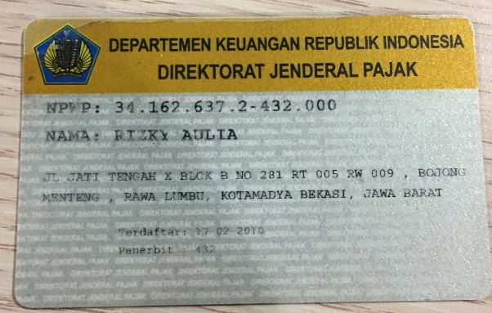
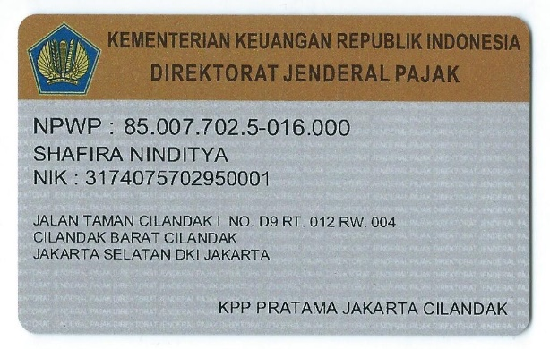
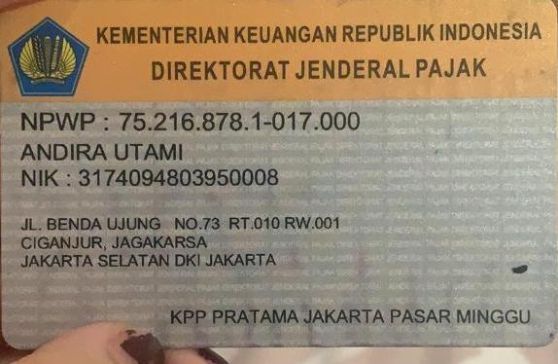
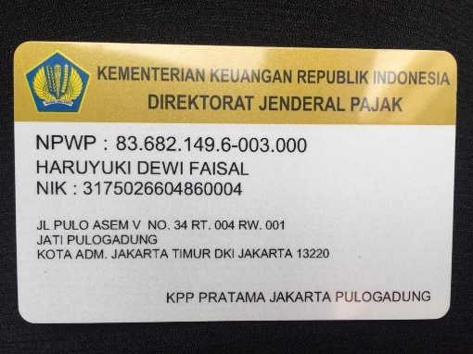
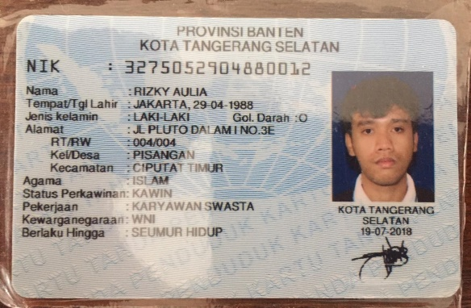
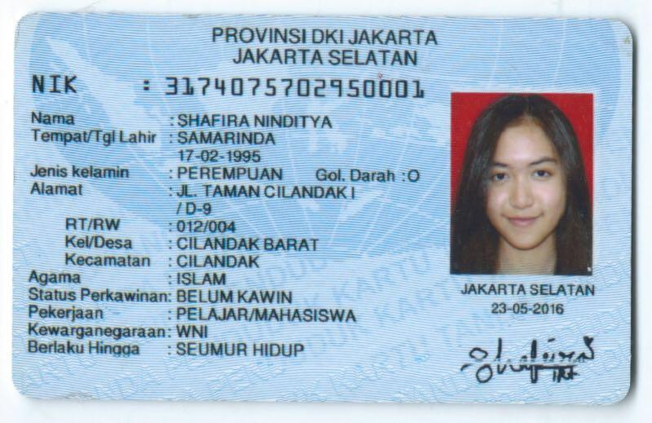
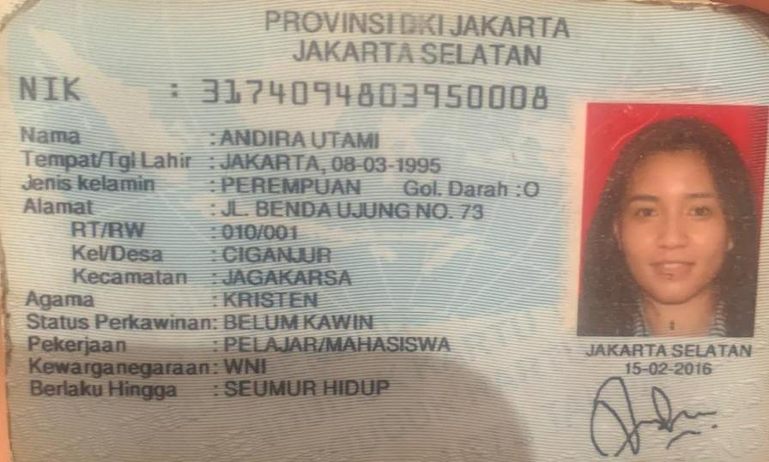
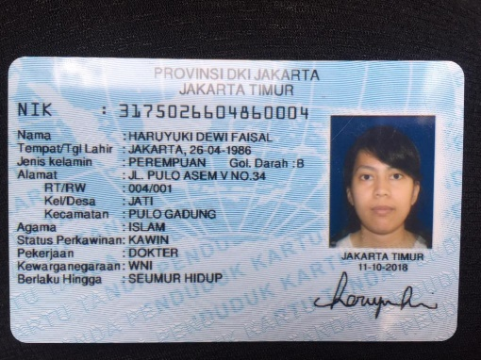
No | Nama | Harga | Rekening
1 | Andira Utami | 1.000.000 | BNI – 0420416591
2 | Dr. Haruyuki | 500.000 | Mandiri - 1200010976814
3 | dr Shafira | 500.000 | BCA – 2378170295
4 | Kiki Ucup | 500.000 | BCA – 5680838943

Slide 3








Konten yang belum up

Slide 4
Body text email peserta
Dear (name),
Terima kasih atas partisipasinya dalam mengikuti webinar, “Preventive Action Against Covid-19“
Date :
Sat, 2 Mei 2019
10.00 - 12.00 WIB
Join ZOOM meeting :
LinkID
Pass
*Harap join ZOOM 5 menit sebelum acara dimulai
*Harap link ini tidak disebarluaskan
Contact person: Rega Ervanto 0815-1127-8125
Regards,Nada Berliana

Slide 5
Naurissa Biasini is inviting you to a scheduled Zoom meeting.
Topic: Webinar Manajemen Acara 1
Time: May 9, 2020 10:00 AM Jakarta
Join Zoom Meeting
https://us02web.zoom.us/j/87382922756?pwd=UklhN1EyL3FyTGNvTkZlNi9ZT0Nhdz0xx
Meeting ID: 873 xxxx 2756
Password: xxx626
Naurissa Biasini is inviting you to a scheduled Zoom meeting.
Topic: Webinar Manajemen Acara 2
Time: May 9, 2020 02:00 PM Jakarta
Join Zoom Meeting
https://us02web.zoom.us/j/81138908283?pwd=THpvcUlLRHhuTy9HMEVpQXMyQU82xxxx
Meeting ID: 811 3890 xxxx
Password: 029xxx

Slide 6
Update peserta webinar
Preventive : 27
Music : 33
Bundling : 39
138 Peserta

Slide 7


TIKTOK CHALLENGE

Slide 8
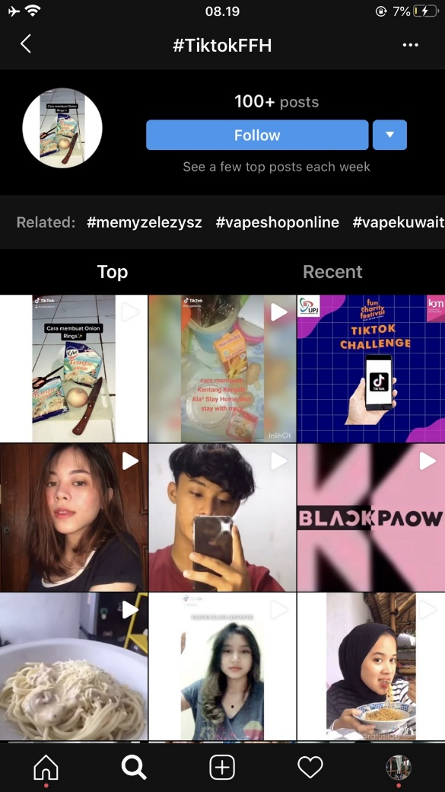
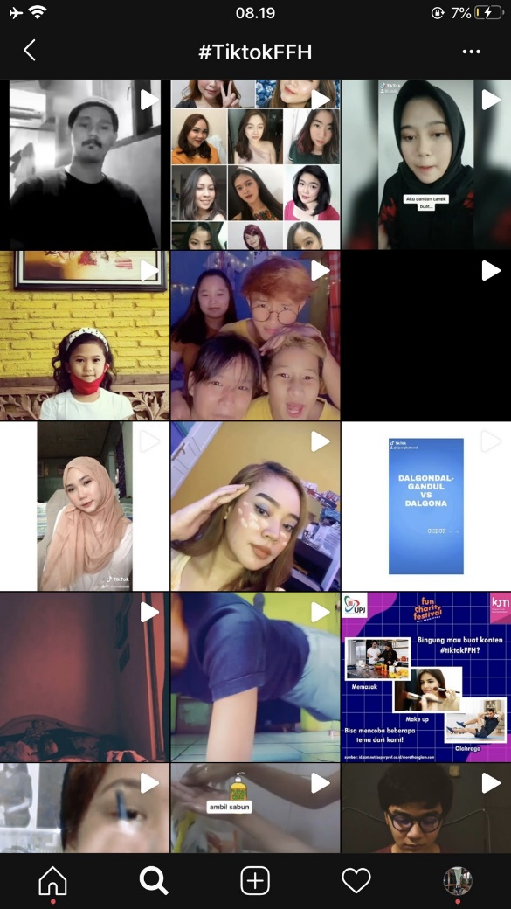
UPDATE PESERTA TIKTOK
Peserta Upload: 103

Slide 9
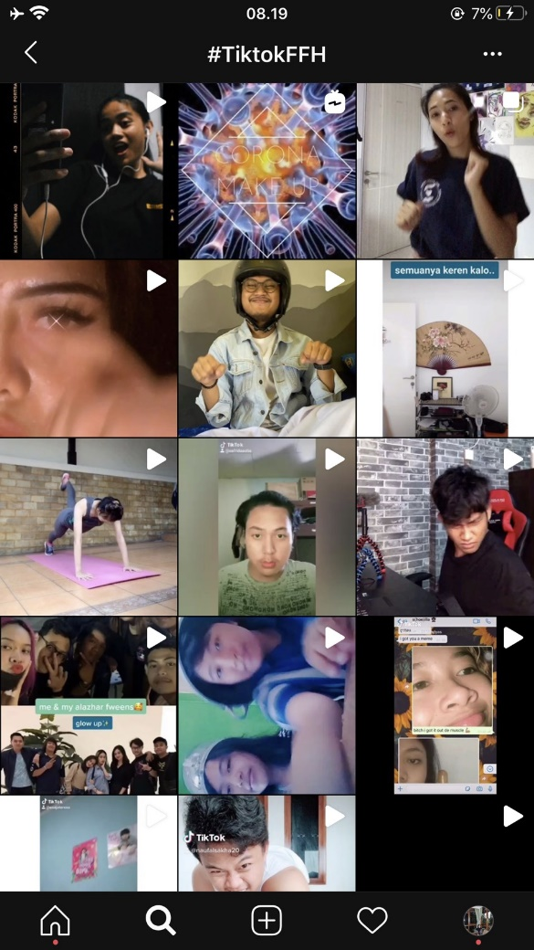
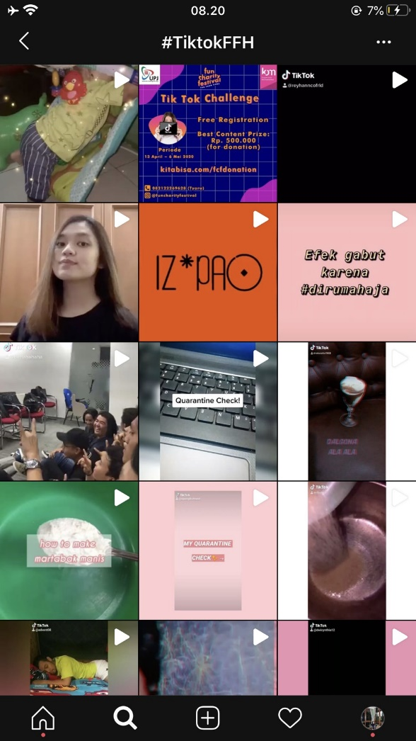
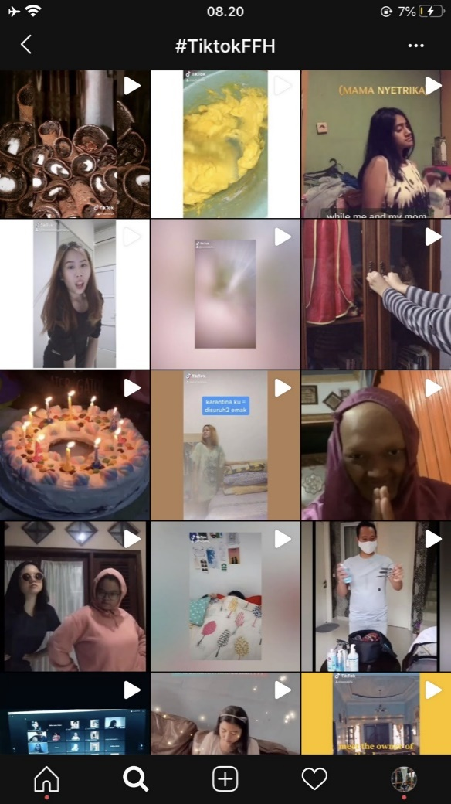
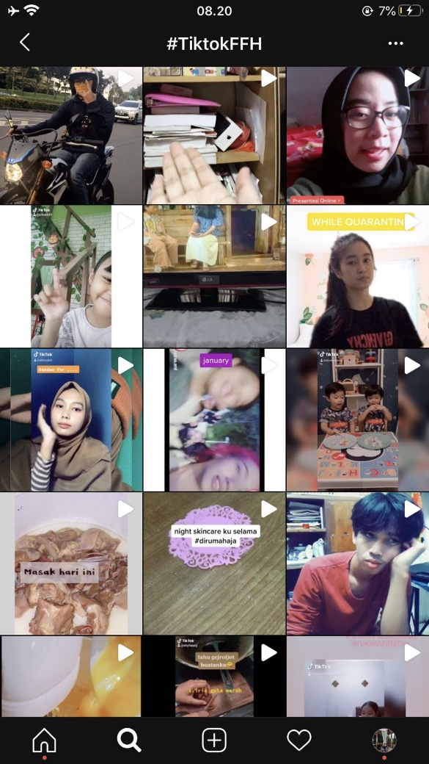
UPDATE PESERTA TIKTOK

Slide 10
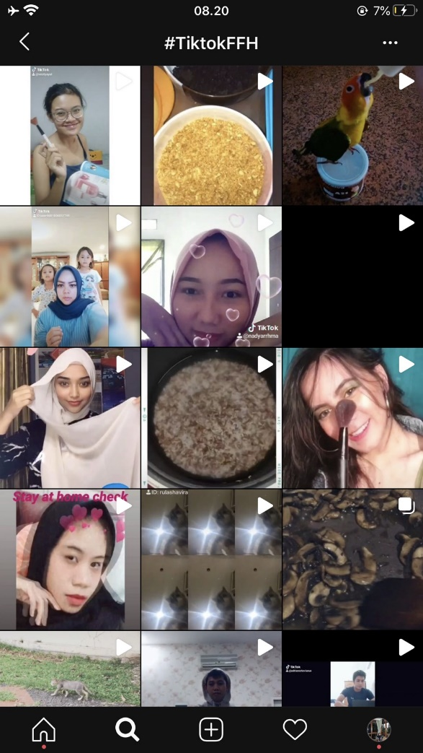
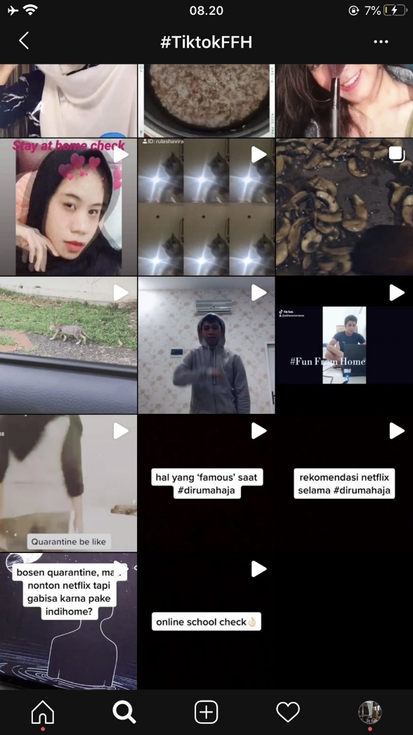
UPDATE PESERTA TIKTOK

Slide 11
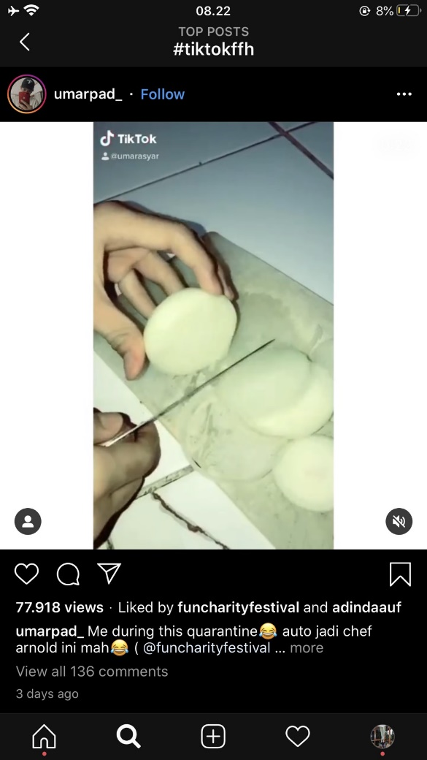
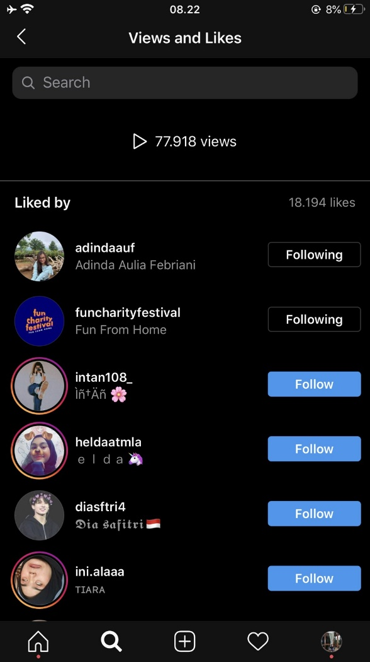
LIKES TERBANYAK
@umarpad_
Likes: 18.194 likes

Slide 12
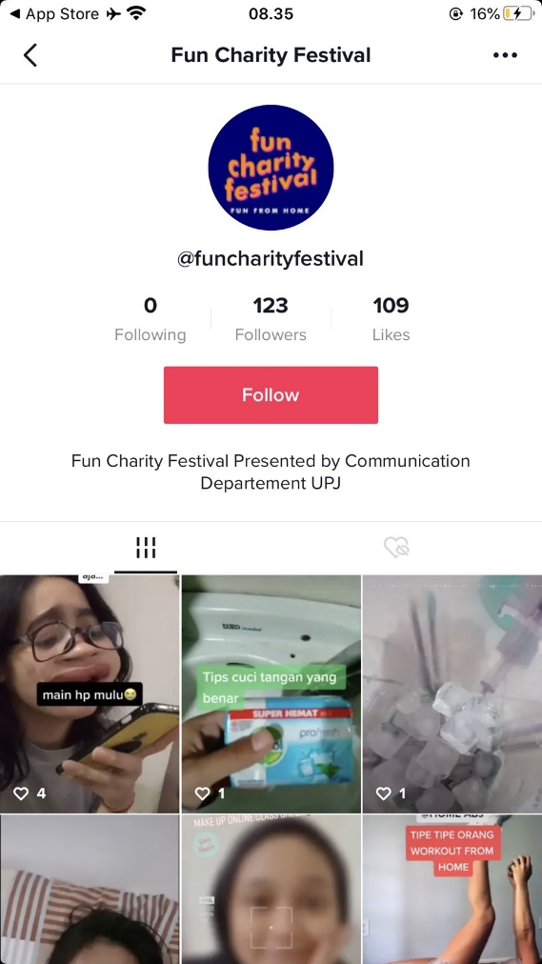
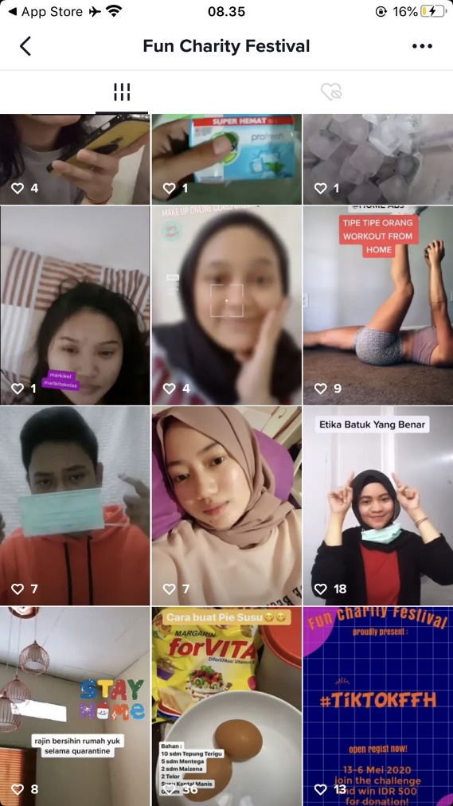
KONTEN TIKTOK
Upload 1x sehari selama challenge berlangsung

Slide 13
PELAPORAN DONASI
JUMLAH DONASI FUN CHARITY FESTIVAL (25-04) = Rp 42.261.693
JUMLAH DONASI DARI DONATUR PANITIA = Rp 30.808.196

Slide 14
NAMA PANITIA YANG SUDAH MENCAPAI TARGET (65 PANITIA)

Slide 15
Thank You

