Slide 1
EVENT PLANNING
2019

Slide 2
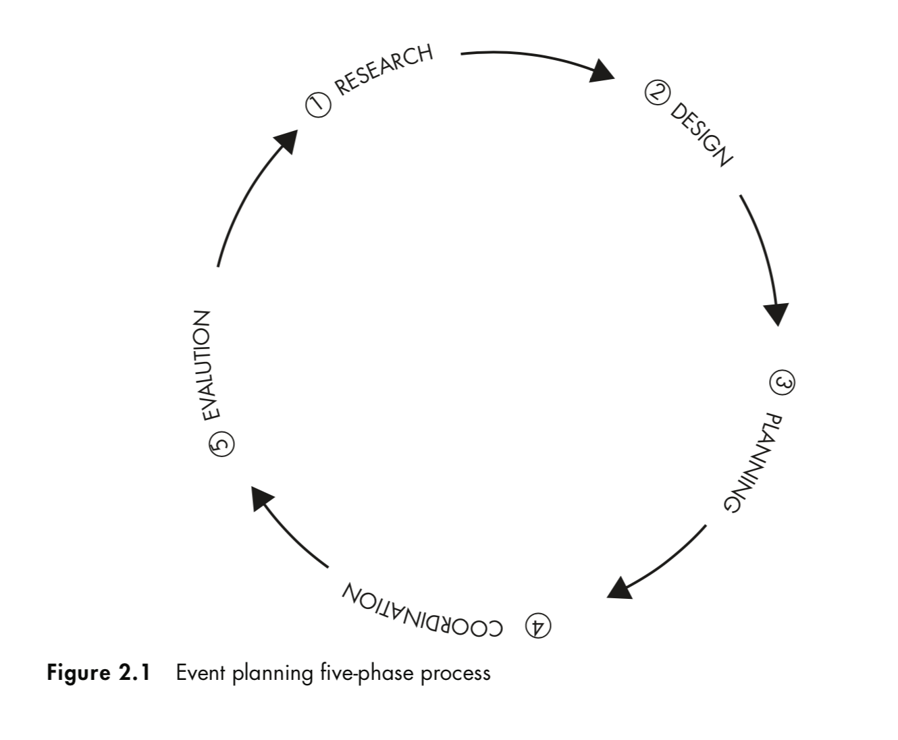
EVENT PLANNING

Slide 3
RESEARCH
Qualitative Pre-Event Research
Quantitative Pre-Event Research
Analysis and Interpretating
5W 1H

Slide 4
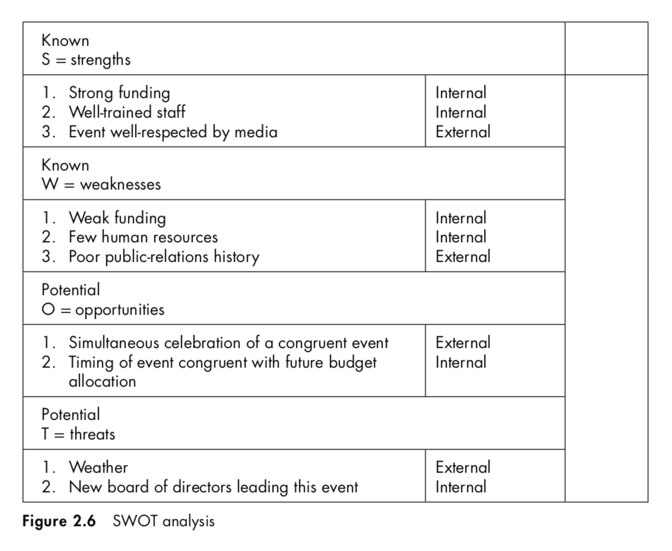
SWOT ANALYSIS

Slide 5
FEASIBLE?
Finance
Human
Politic

Slide 6
APPROVAL PROCESS
Team
Manager
Leader/ Ass. Leader
Ass. GM
GM

Slide 7
TIMING
Time plan
Time VS Budget

Slide 8
COMMUNICATION IS A MUST
Event planning is a profession whose success or failure ratio often depends on people’s ability to communicate effectively with one another.
It does not matter whether this communication is oral, written, electronic, or all three.
What is important is that event planners become practiced communicators in order to maintain clear communications with all stakeholders.

Slide 9
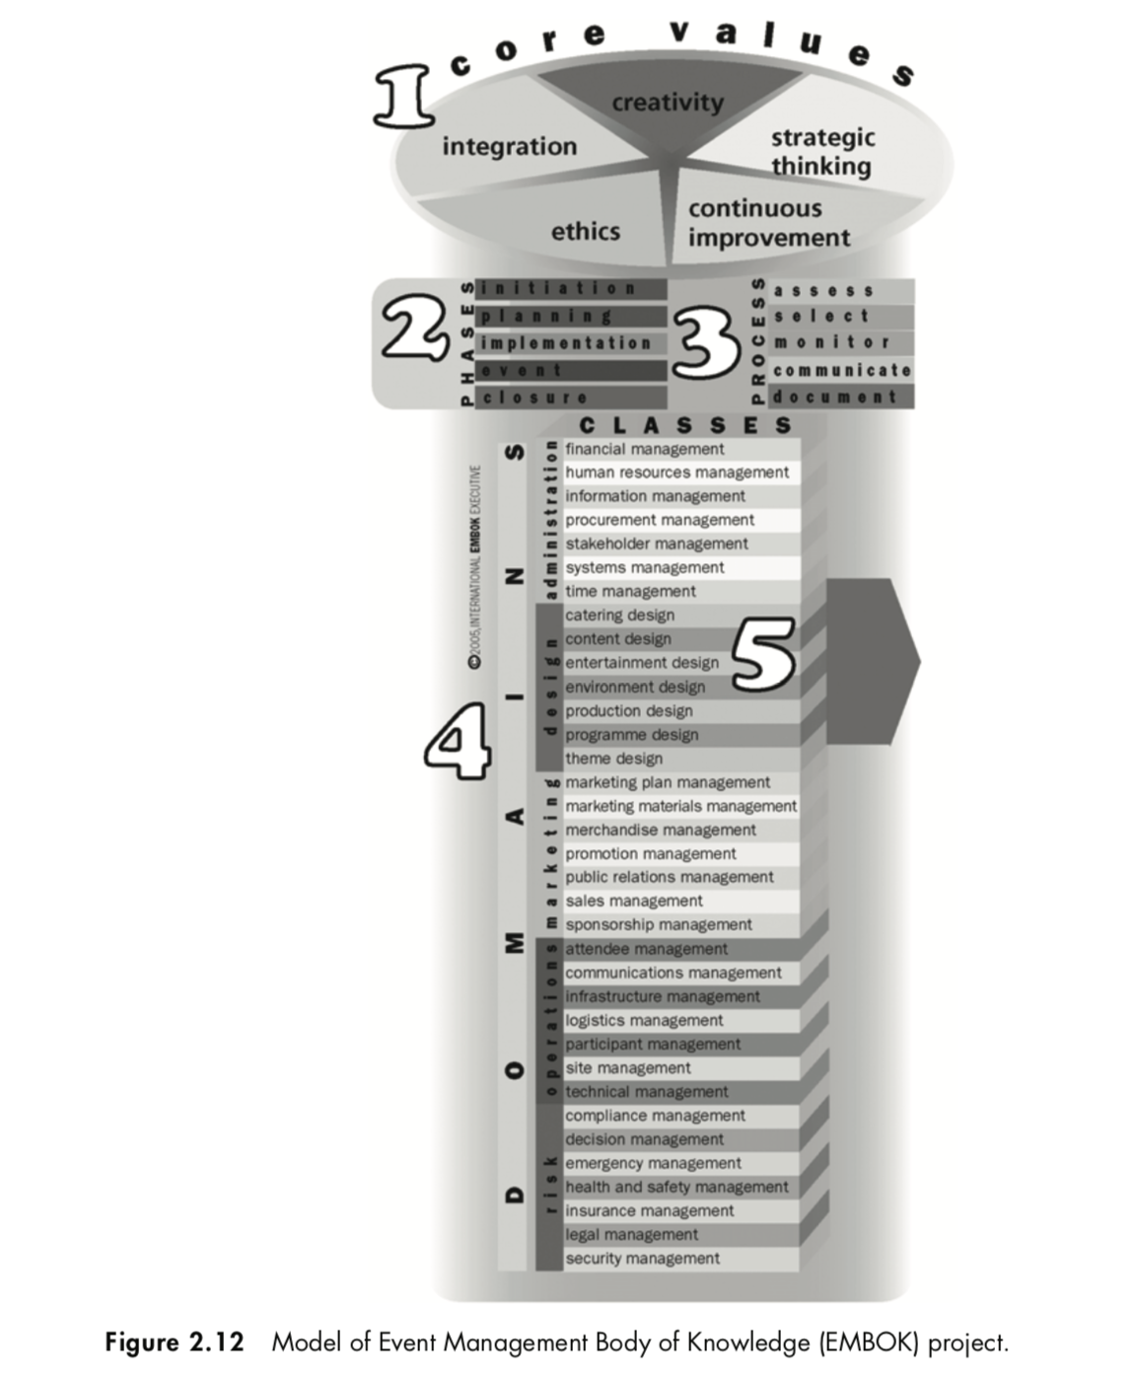
MODEL OF EVENT MANAGEMENT

Slide 10
EXERCISE
Cari data kualitatif dan kuantitatif dari masalah yang dihadapi RFE saat ini
  Lari malam
  Bulan puasa
  Biaya
  Konten acara
  Keamanan dll.

