Slide 1
KOMUNIKASI LINGKUNGAN
PERTEMUAN 7:
PERENCANAAN KOMUNIKASI
(OUTLINE)

Slide 2
PLANNING ENVIRONMENTAL COMMUNICATION
Problem statement
Goals
Audience Analysis
Objectives
Message Development/Media Options/Audience Suitability
Media Choice and Design
Timeline
Front-End Evaluation
Formative Evaluation.
Summative Evaluation
Project Budget

Slide 3
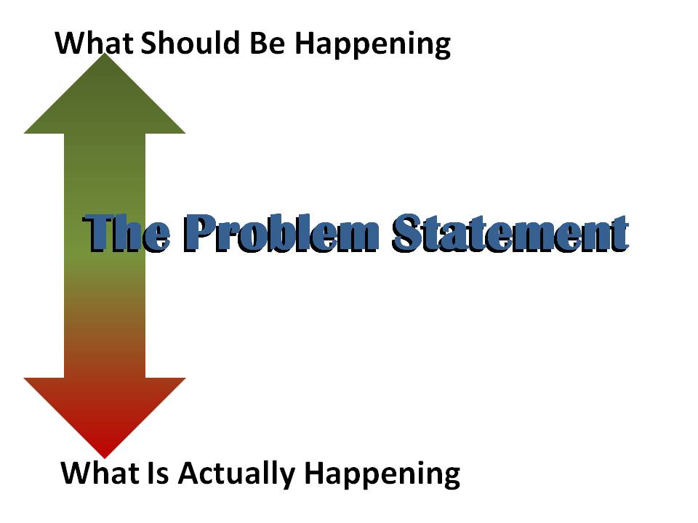
PROBLEM STATEMENT

Slide 4


Slide 5

GOALS
Represent the ultimate aims of project
They reflect long-term, lasting outcomes

