Slide 1
WELCOME!
Intercultural Communication
-
Komunikasi Antar Budaya

Slide 2
You guys know me, right?
Naurissa Biasini, S.Si, M.I.Kom
Bidang Keahlian : Komunikasi Massa, Kajian Media
S1 : STIKOM LSPR Jakarta
S2 : Universitas Pelita Harapan
Academic experience : 9 years
Industry experiences : 7 years in IkuZo!, ½ year in RRI and Prambors
Phone : 0817 38 8145
Email : naurissa.biasini@upj.ac.id
Notes:
Insert a map of your country.

Slide 3
Do these, and we’re all happy :D
Please… please… call me “Miss”, or “Kak” only!
Be punctual! If you’re late more than 15 minutes, you’ll be marked absent
You have FOUR times chance to skip the class. Remember, FOUR!
Please submit your assignments on time based on format and content that we agreed upon.
Drink and candy eating is permitted (clean your own mess!)
No more sleeping in my class
Ask relevant questions
PLEASE USE YOUR GADGET OUTSIDE THE CLASSROOM, or
I will take it from you and will not give it back
Liable protest is permitted
Please be on a positive attitude and behavior
Consultation is doable in working time
Notes:
Insert a picture of one of the geographic features of your country.

Slide 4
Books
Communications between cultures
Larry A Samovar, Richard E Porter, Edwin R McDaniel, 2010, Boston: Wadsworth
Komunikasi Lintas Budaya
Larry A Samovar, Richard E Porter, Edwin R McDaniel, 2010, Jakarta: Salemba Humanika
Komunikasi Antar Budaya di Era Budaya Siber
Rulli Nasrullah. 2014. Jakarta: Kencana

Slide 5
Pengertian, Ruang Lingkup, Dimensi Komunikasi Antar Budaya
Pertemuan 1
By : Naurissa Biasini, M.I.Kom

Slide 6
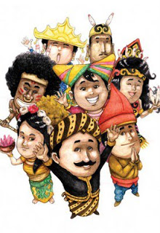
Why do we have to learn this?
Now look around you!
Do your friends come from the same region as you?
Do they look like you?
Do they have the same culture? Language? Habit? Norm?
Have you ever feel uncomfortable when meeting new people?
Have you seen something strange done by your friends? Or other people?
Different culture = different communication?
Notes:
Insert a picture illustrating a season in your country.

Slide 8
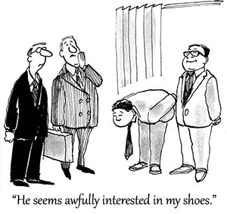
The reasons!
Globalization
World Trade and International Business
Technology and Travel
Competition for Natural Resources
International Conflict and Security
Environmental Challenges
World Health Issue
Shifting Population
Immigration
The aging population
Multicultural Society
Notes:
Insert a picture of an animal and or plant found in your country.

Slide 9
What is Intercultural Communication?
Intercultural communication occurs when a member of one culture produces a message for consumption by a member of another culture.
Intercultural communication involves interaction between people whose cultural perceptions and symbol systems are distinct enough to alter the communication event.

Slide 10
The Dominant Culture
Co-Culture
This is the group that usually has the greatest amount of control over how the culture carries out its business.
This group possesses the power that allows it to speak for the entire culture while setting the tone and agenda that other will usually follow
They control religious institution, media, government, education, military, etc.
Within the dominant culture, you will find numerous co-cultures and specialized cultures.
Some co-cultures share many of the patterns and perceptions found within the larger, dominant culture, but their members also have distinct and unique patterns of communication that they have learned as part of their membership in the co-culture.
These co-cultural affiliations can be based on race, ethnic, gender, age, sexual preference, etc.

Slide 11
What is Culture?
Culture is a set of human-made objective and subjective elements that in the past have increased the probability of survival and resulted in satisfaction for the participants in an ecological niche, and thus became shared among those who could communicate with each other because they had a common language and they lived in the same time and place. (Triandis)
Budaya adalah seperangkat elemen obyektif dan subjektif yang dibuat manusia yang di masa lalu telah meningkatkan kemungkinan bertahan hidup dan menghasilkan kepuasan bagi para peserta dalam ekologi, dan kemudian dibagi di antara mereka yang dapat berkomunikasi satu sama lain karena mereka memiliki bahasa yang sama dan mereka tinggal di waktu dan tempat yang sama.

Slide 12
The Basic Functions of Culture
To improve the adaptation of members of the culture to a particular ecology, and it includes the knowledge that people need to have in order to function effectively in their social environment. (Triadis)
To set the limits on behavior and guides it along predictable paths. (Haviland)

Slide 13
Elements of Culture
History
Religion
Values
Social Organizations
Language

Slide 14
Characteristics of Culture
Culture is learned
Proverbs
Art
Mass media
Culture is shared
Culture is transmitted from generation to generation
Culture is based on symbols
Culture is dynamic
Culture is an integrated system

Slide 15
Studying Intercultural Communication
Individual uniqueness
Stereotyping
Objectivity
Communication is not a Cure-all

Slide 16
Questions?

Slide 17
Thank you

