Slide 1
Media Structure, Economics and Global
Komunikasi Massa
Program Studi Ilmu Komunikasi
Universitas Pembangunan jaya

Slide 2
Normative Theory of Media and Society

Slide 3
Normative Theory
refer to the ideas of right and responsibility that underlie these expectations of benefit from the media to individuals and society.
the media ought or are expected to be organized and to behave in the wider public interest or for the good of society as a whole
the most fundamental source are stem from the historical context that has shaped the role of the media institution. This has meant a close link between democratic political institutions and the role of the media as carrier of news and former of opinion.

Slide 4
Sources of normative expectations from media
Social and political theory on the press
Professional theory and practice of journalism
The public as citizens (public opinion)
The public as audience
The media market
The state and its agencies
Interested parties in the society affected by media

Slide 5
Main public interest criteria for media
Structure
Freedom of publication
Plurality of ownership
Content
Diversity of channel and form
Extensive (near universal)
Diversity of information, opinion and culture
Supportive of public order and the law
High quality of information and culture
Supportive of the democratic political system (public sphere)
Respectful of international obligations and human rights
Avoiding harm to society and individuals

Slide 6
Social responsibility theory: main propositions
The media have obligations to society, and media ownership is a public trust
News media should be truthful, accurate, fair, objective and relevant
The media should be free, but self-regulated
The media should follow agreed codes of ethics and professional conduct
Under some circumstances, government may need to intervene to safeguard the public interest

Slide 7
Most frequently found principles in journalistic codes
Truthfulness of information
Clarity of information
Defence of the public’s rights
Responsibilities in forming public opinion
Standards of gathering and presenting information
Respecting the integrity of the sources

Slide 8
Media Structure and Performance: Principles and
Accountability

Slide 9
Main public benefits of media freedom
Systematic and independent public scrutiny of those in power and an adequate supply of reliable information about their activities (this refers to the ‘watchdog’ or critical role of the press)
Stimulation of an active and informed democratic system and social life
Opportunities to express ideas, beliefs and views about the world
Continued renewal and change of culture and society
Increase in the amount and variety of freedom available

Slide 10
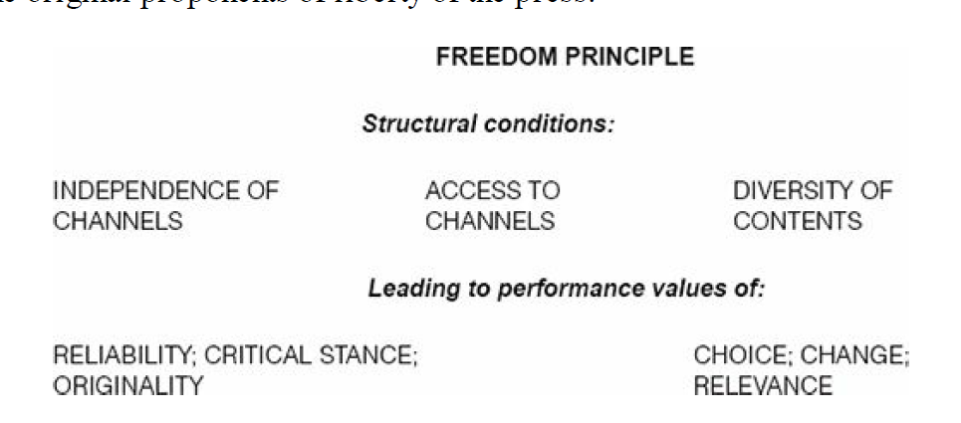

Slide 11
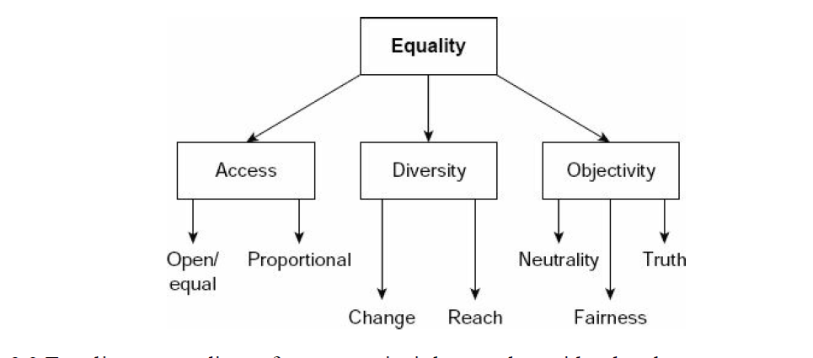
Media Equality as a Principle

Slide 12
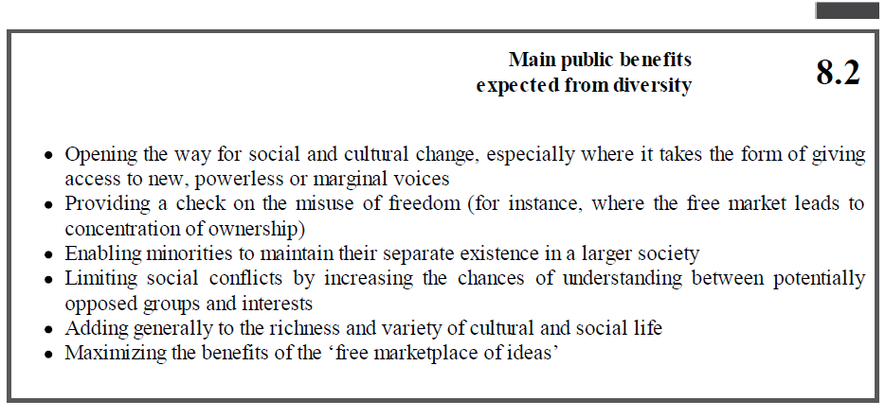
Media Diversity as a Principle

Slide 13
Media Economics and Governance

Slide 14
Media ‘Not Just Any Other Business
The key to the unusual character of the media institution is that its activities are inextricably both economic and political as well as being very dependent on continually changing technologies. These activities involve the production of goods and services which are often both private (consumption for individual personal satisfaction) and public (viewed as necessary for the working of society as a whole and also in the pub-lic domain). The public character of the media derives mainly from the political func-tion of the media in a democracy, but also from the fact that information, culture and ideas are considered as the collective property of all. Nor, as with other public goods, such as air and daylight, does their use diminish their availability for others

Slide 15
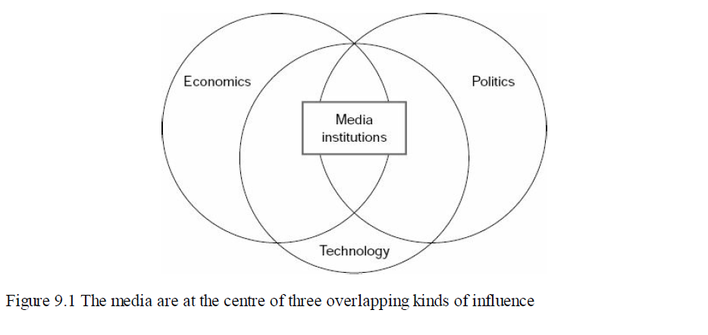

Slide 16
Media ownership and control
Freedom of the press supports the rights of owners to decide on content
Form of ownership inevitably has an influence on content
Multiplicity of ownership and free competition are the best defence against misuse of powers of ownership
There are usually checks and balances in the system to limit undesirable owner influence

Slide 17
Horizontal versus vertical concentration
Vertical concentration
pattern of ownership which extends through different stages of production and distribution (for instance, a film studio owning a cinema chain) or geographically (a national concern buying city or local newspapers
Horizontal concentration
mergers within the same market (for example, of two competing city or national newspaper organizations or of a telephone and a cable network)

Slide 18
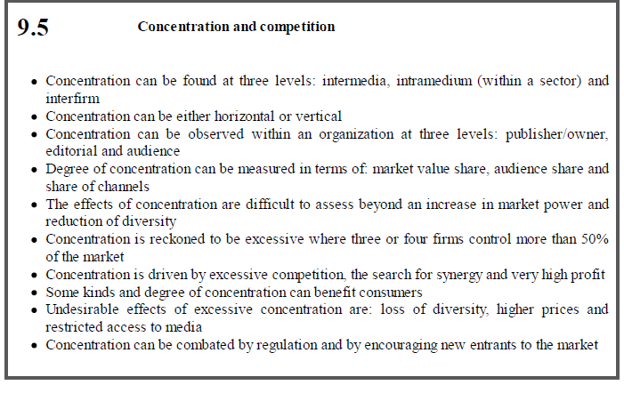

Slide 19
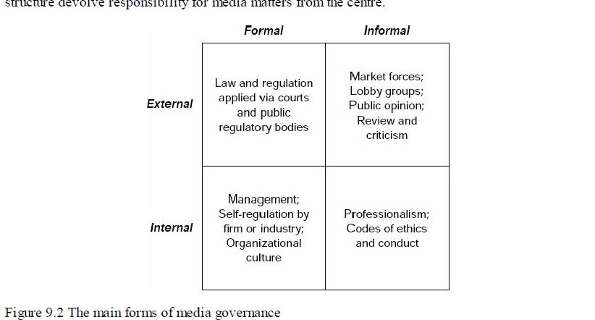
Mass Media Governance

Slide 20
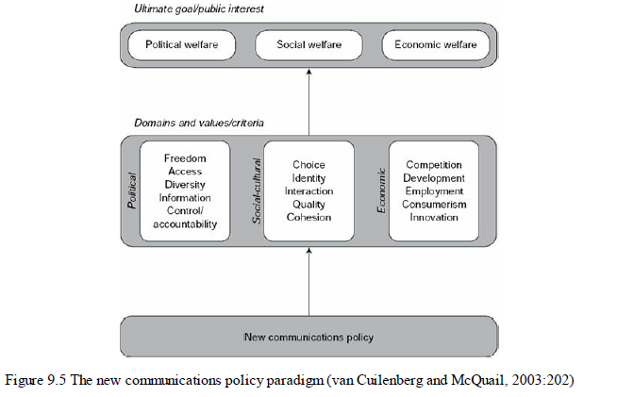

Slide 21
Global Mass Communication

Slide 22
Causes of media globalization
More powerful technologies for long-distance transmission
Commercial enterprise
Follow-on from trade and diplomatic relations
Colonization and imperialism, past and present
Economic dependency
Geopolitical imbalances
Advertising
Expansion of telecommunications

Slide 23
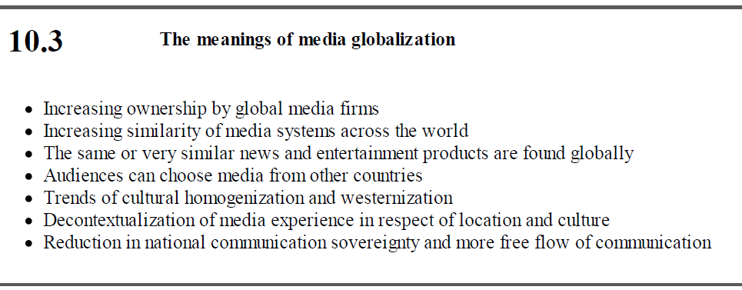

Slide 24
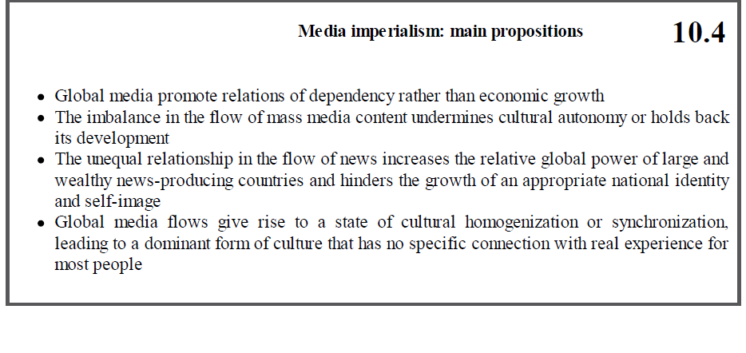

Slide 25
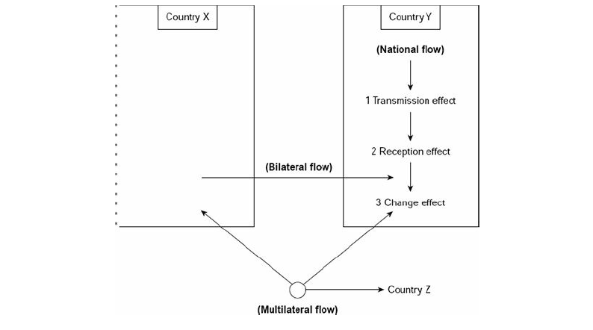
The Media Transnationalization Process

Slide 26
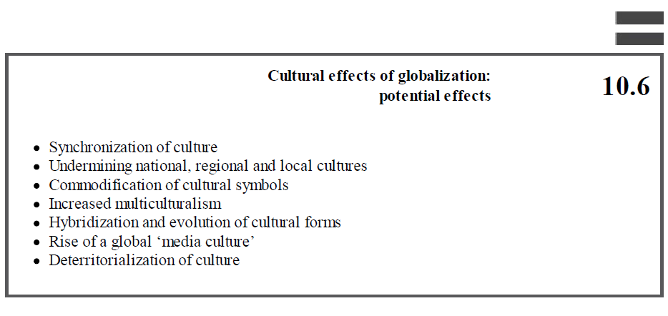

Slide 27
Thank you and see you next week

