Slide 1
MANAJEMEN MEDIA
Pertemuan 7:
Lansekap Media di Era Digital

Slide 2
the platform serves a different purpose

Slide 3
“Fear of missing out”
FOMO
is a common way to describe how social media can make people feel like everyone else is part of something.

Slide 4
YOUTUBE STATS 2020
YouTube has 2 billion users worldwide.
79 percent of Internet users have their own YouTube account.
You can navigate YouTube in a total of 80 different languages which covers 95% of the Internet population.
94 percent of American users between the age range of 18-44 year old accessed YouTube at least once a month.
Everyday people watch one billion hours of video on YouTube.
62 percent of businesses use YouTube as a channel to post video content.
More than 70 percent of YouTube watch time comes from mobile devices.
90 percent of people say they discover new brands or products on YouTube.
400 hours of video are uploaded to YouTube every minute worldwide.
YouTube is Responsible for 37 percent of All Mobile Internet Traffic.

Slide 5
TIKTOK STATS 2020
TikTok has 500 million active users worldwide.
The TikTok app has been downloaded over 1.5 billion times on the App Store and Google Play.
TikTok ranked as the top most downloaded app in Apple’s iOS App Store for Q1 2019, with more than 33 million downloads.
41 percent of TikTok users are aged between 16 and 24.
TikTok has been downloaded 467 million times in India – nearly one-third of its total downloads.
When it comes to the daily time spent on TikTok, users spend an average of 52 minutes per day on the app.
TikTok is available in 155 countries, and in 75 languages.
90 percent of all TikTok users access the app on a daily basis.
In less than 18 months, the number of US adult TikTok users grew 5.5 times.
There was an average number of more than 1 million videos viewed every day in a year.

Slide 6
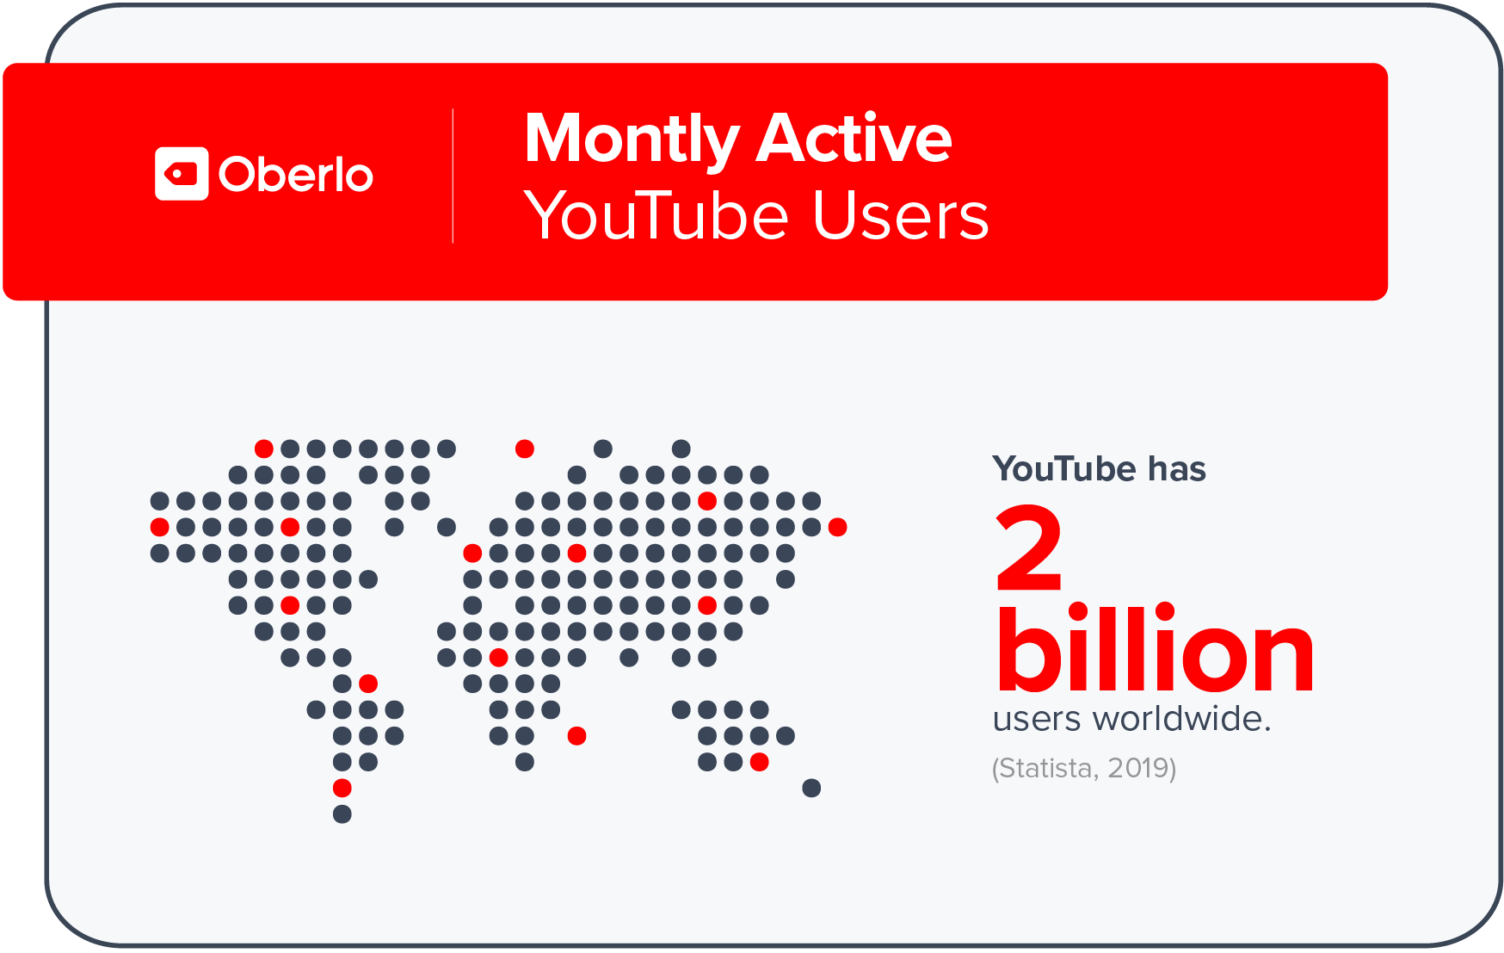

Slide 7
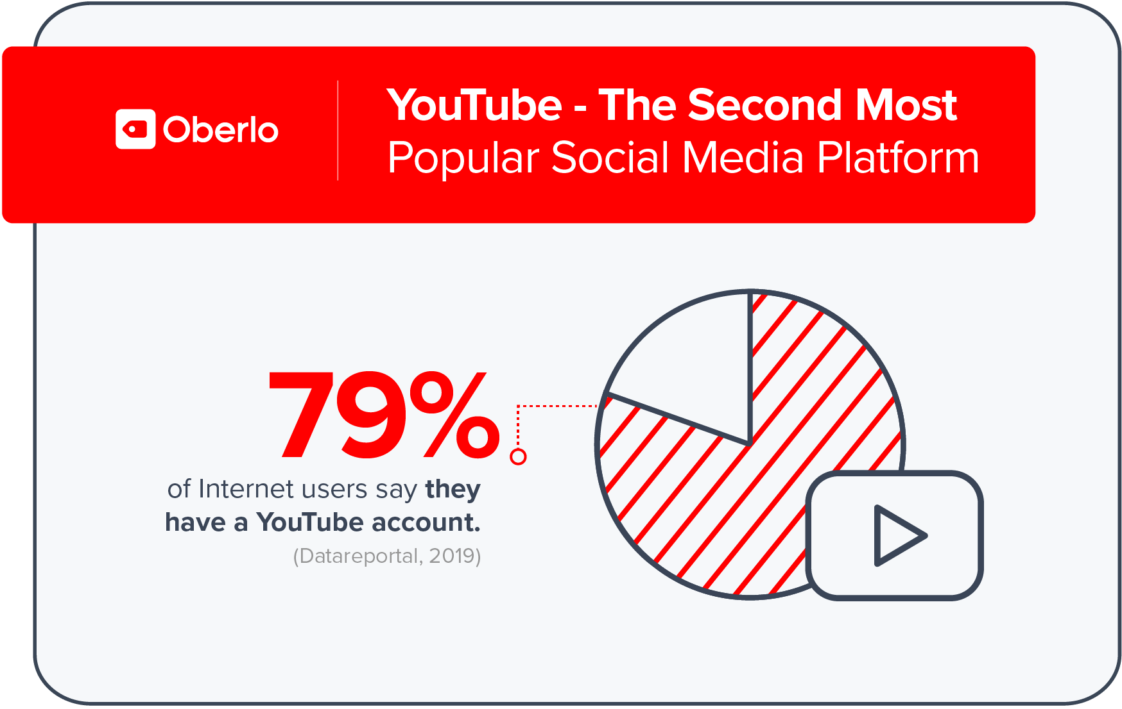

Slide 8
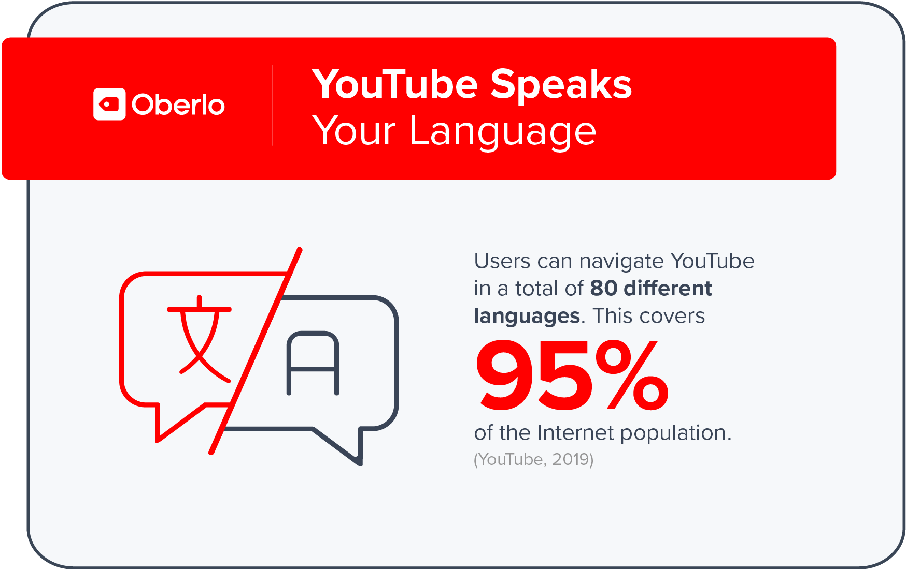

Slide 9
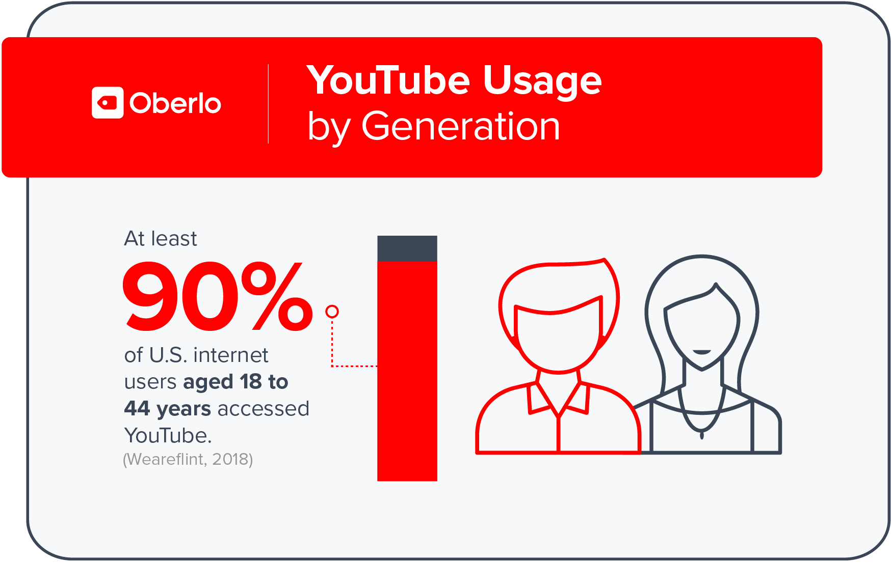

Slide 10
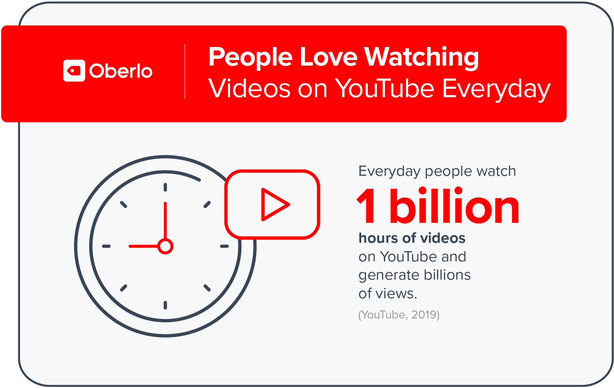

Slide 11
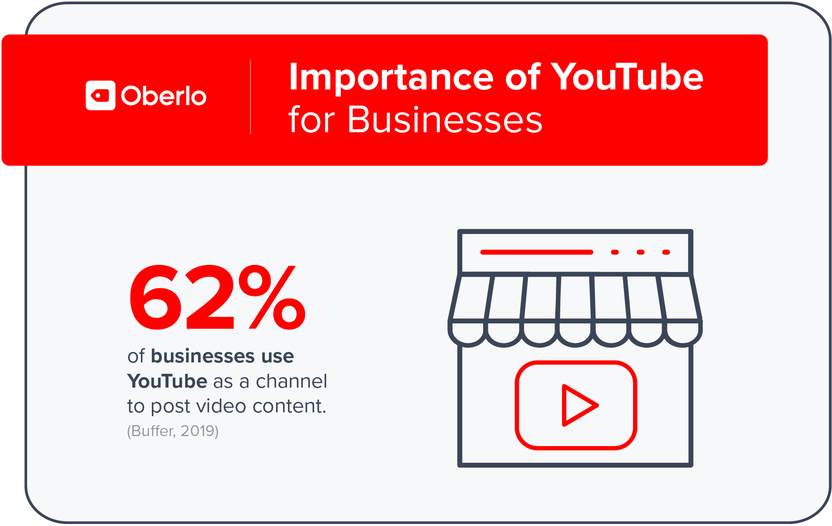

Slide 12
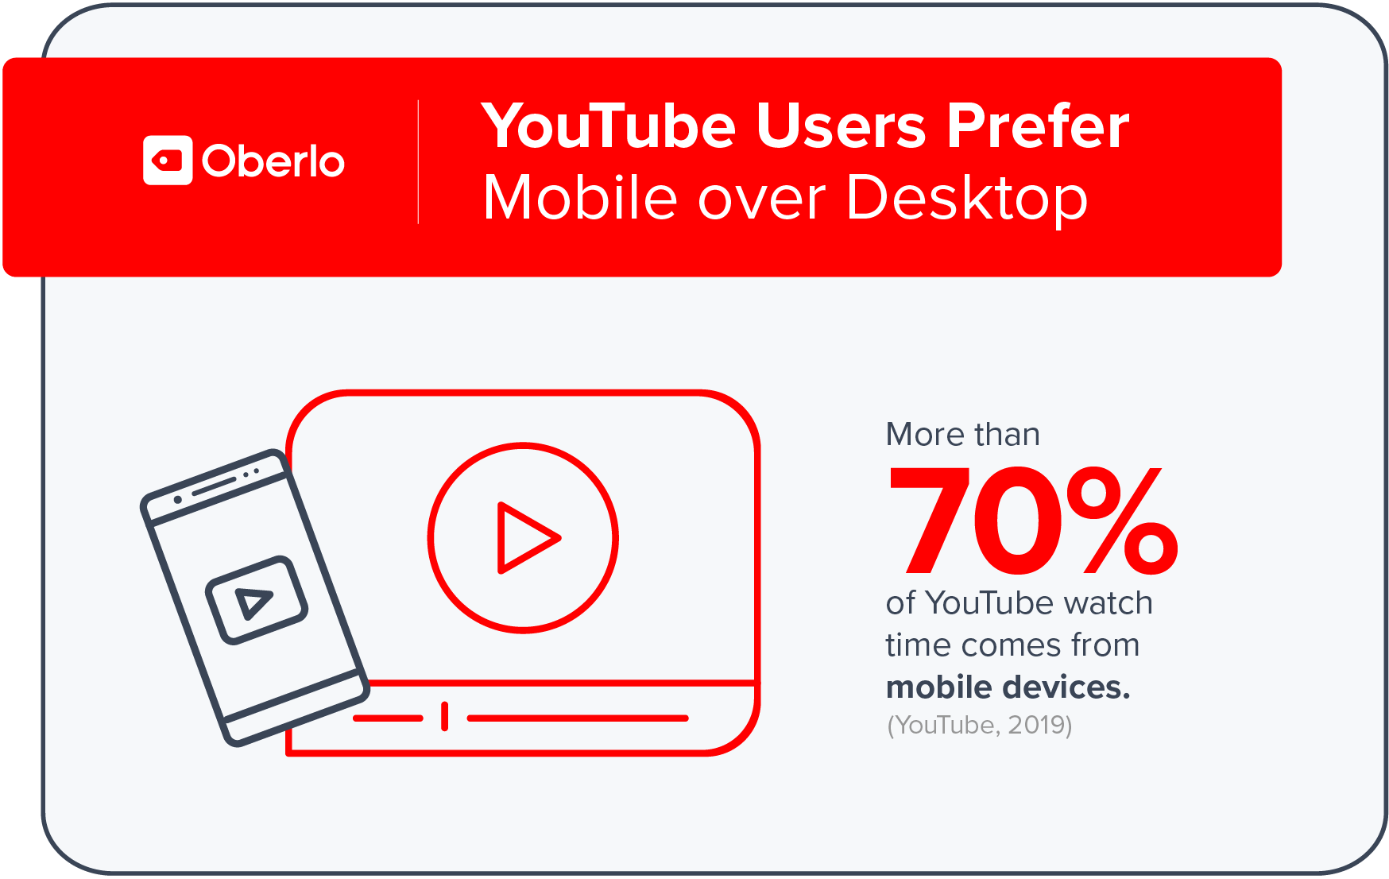

Slide 13
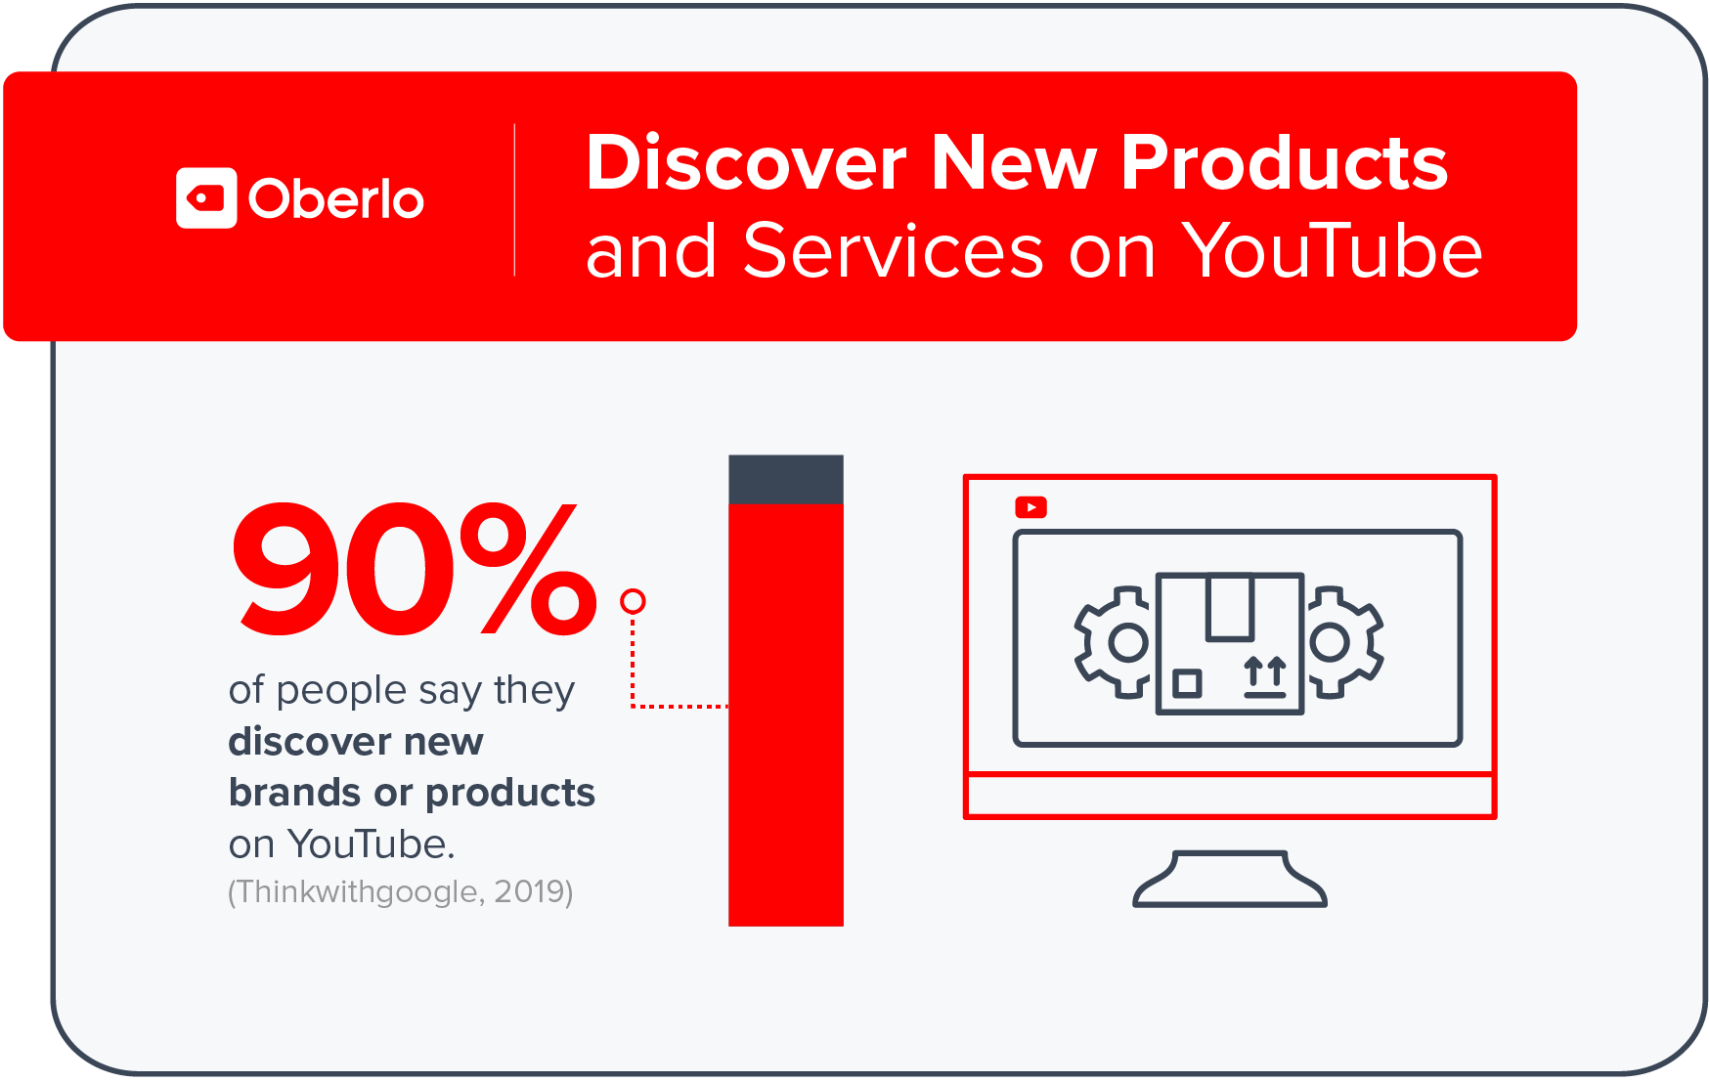

Slide 14
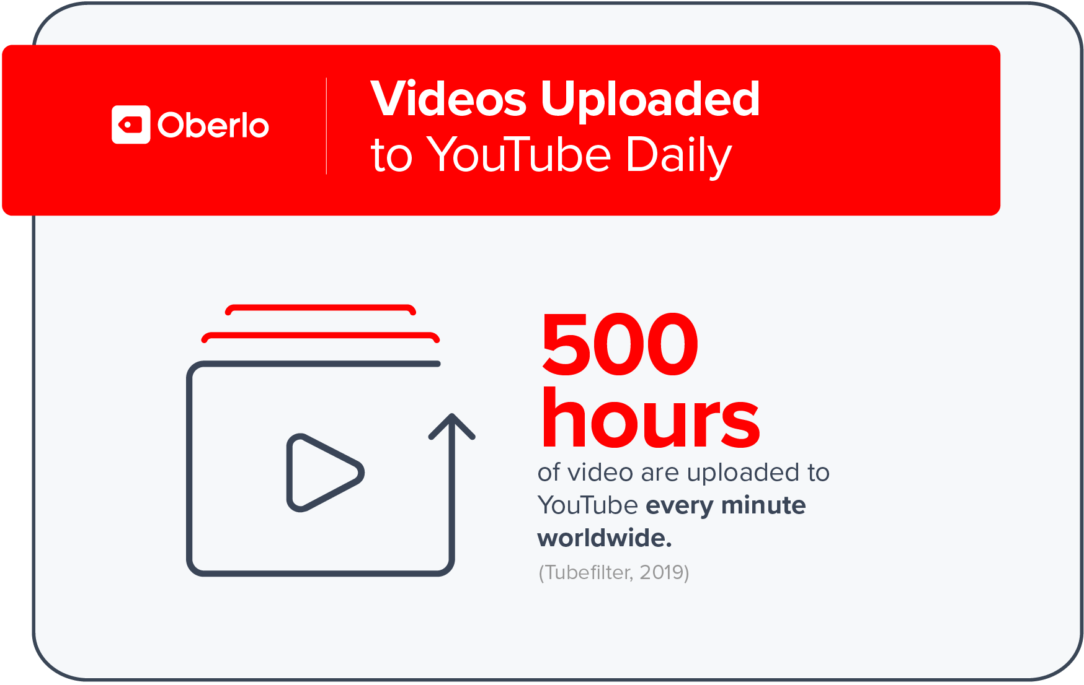

Slide 15
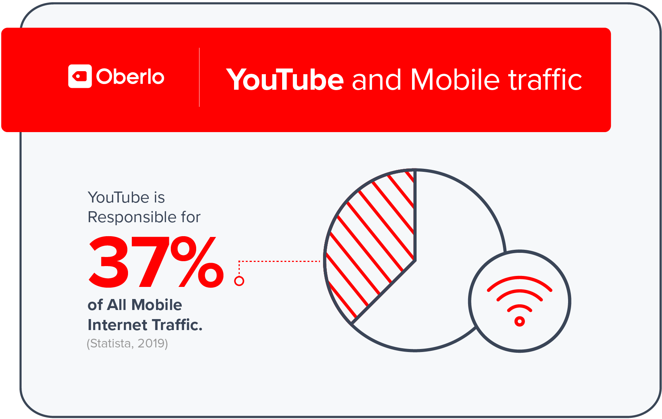

Slide 16
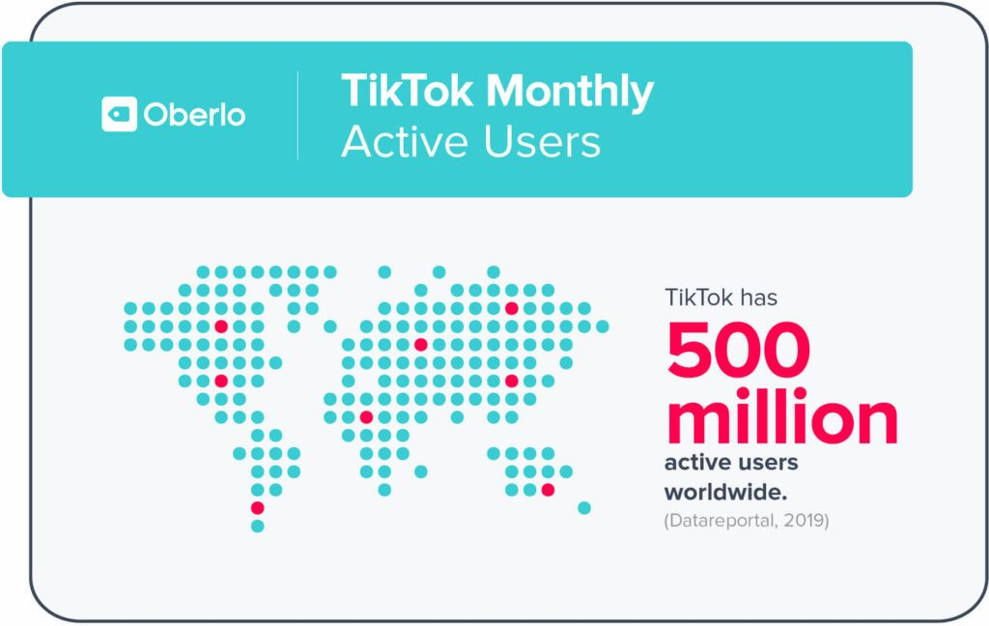

Slide 17
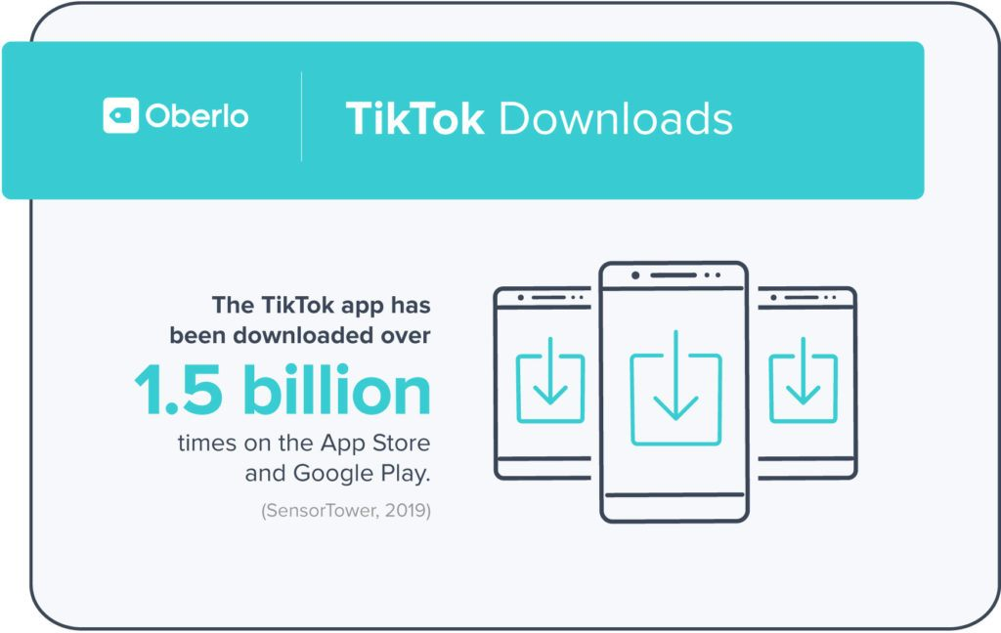

Slide 18
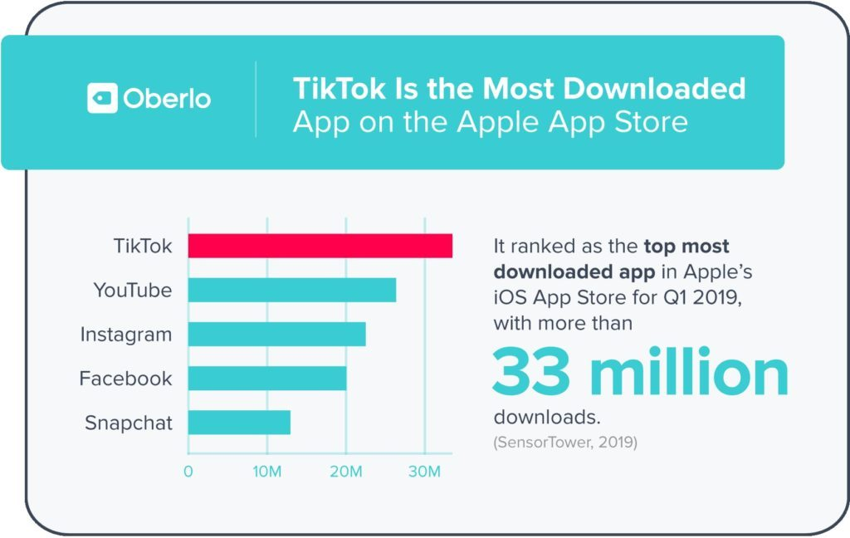

Slide 19
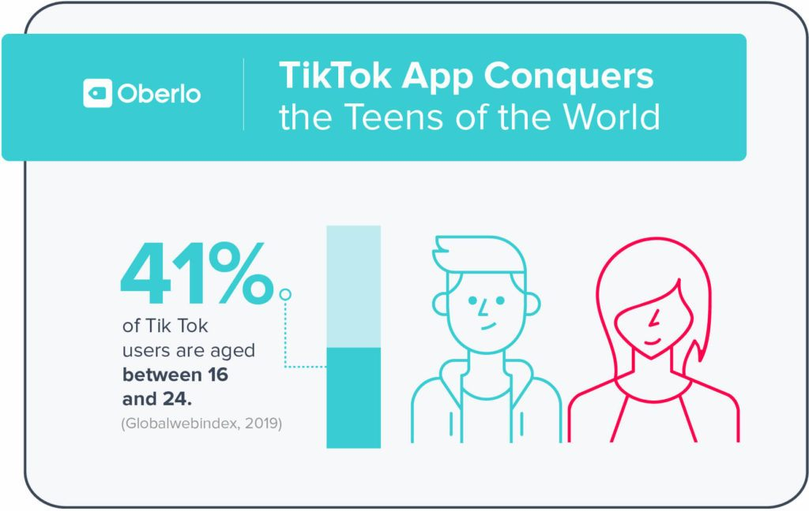

Slide 20
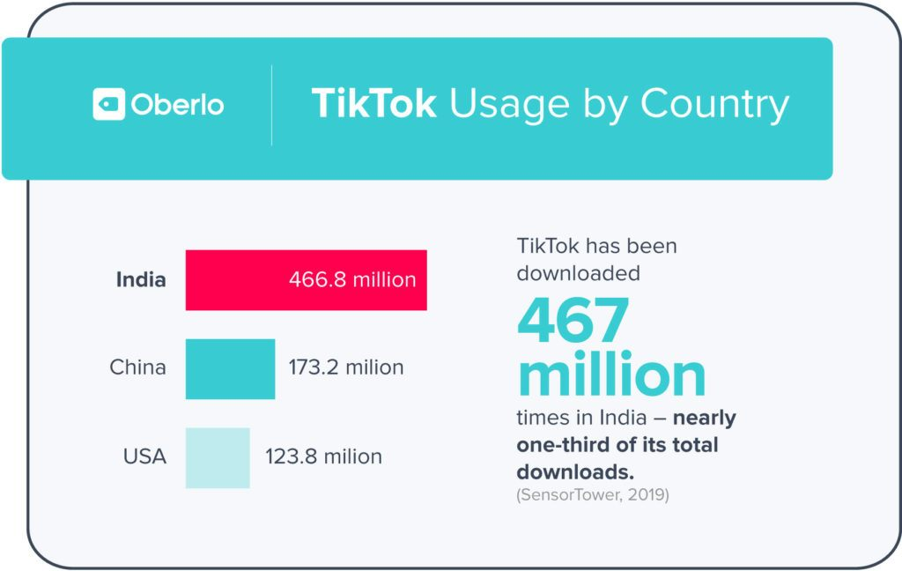

Slide 21
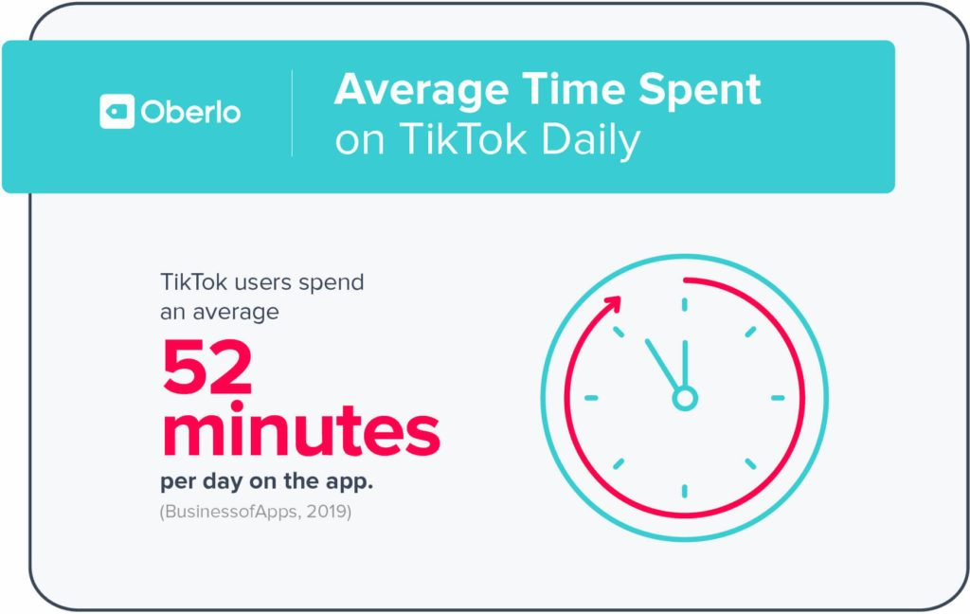

Slide 22
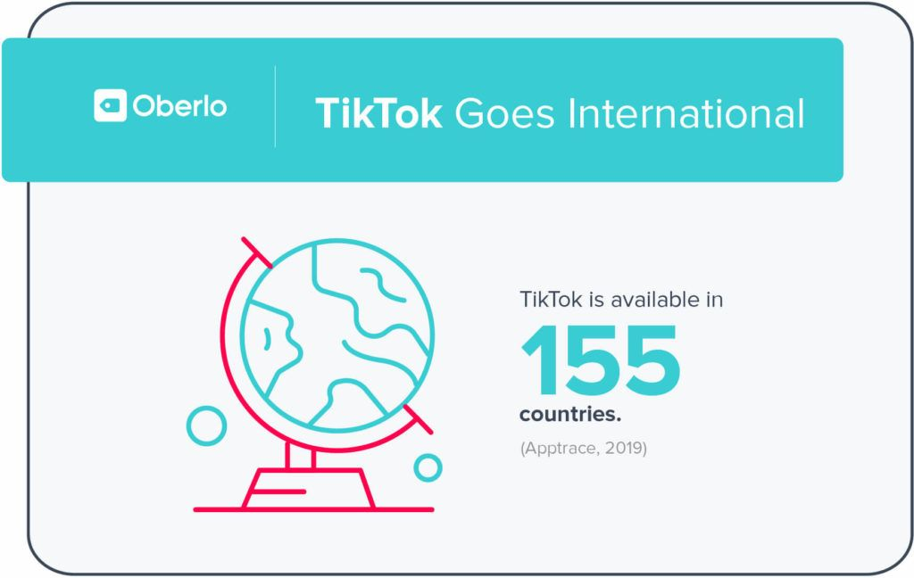

Slide 23
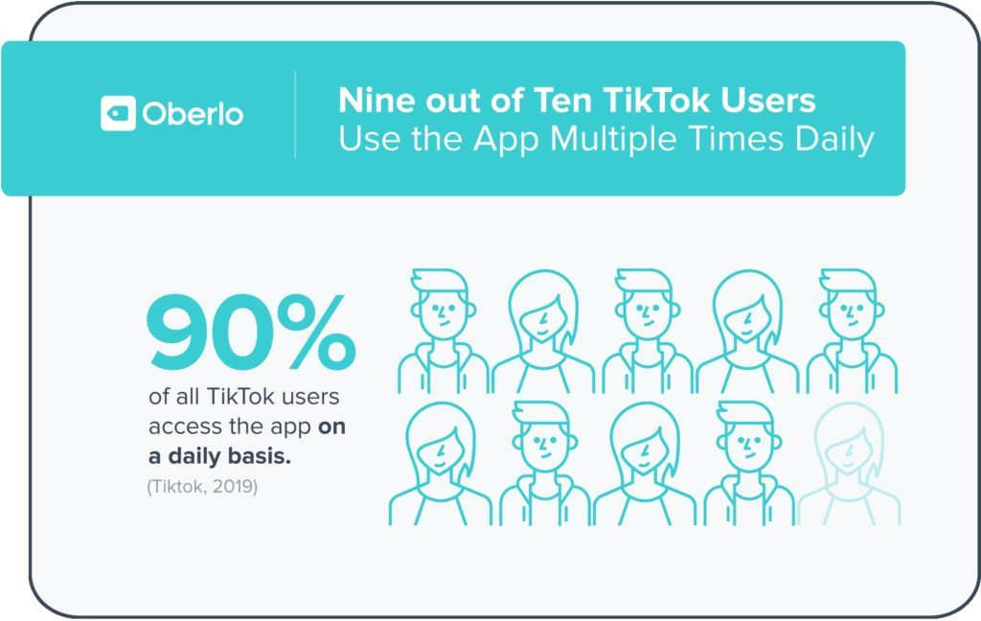

Slide 24
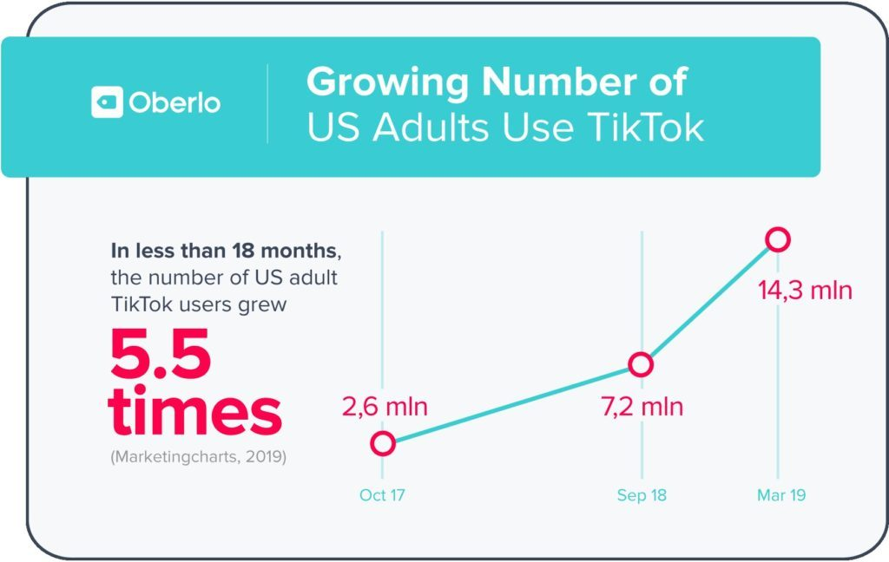

Slide 25
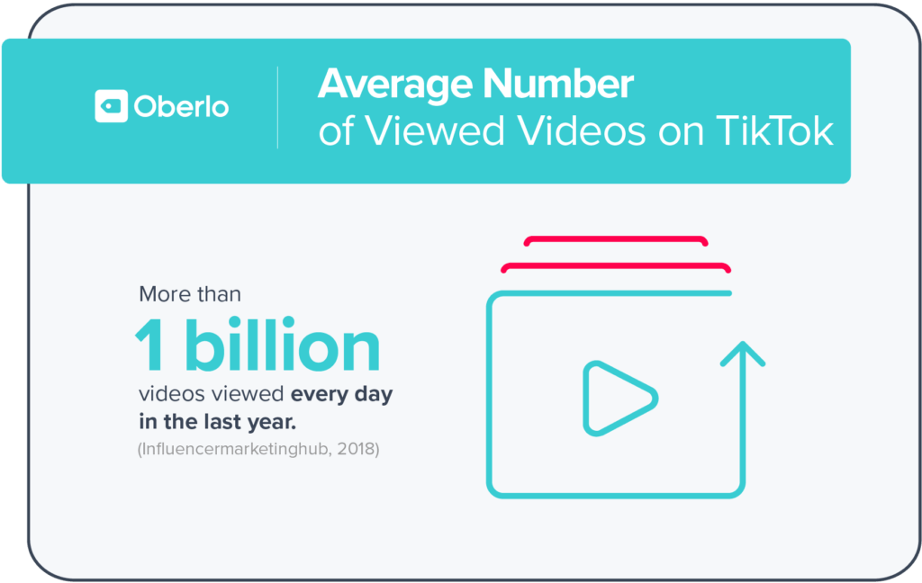

Slide 26
SEE YOU NEXT!
Sumber bacaan: oberlo.com, newyorktimes.com, rollingstones.com

