Slide 1
Marketing and Integrated Communications Technology
Event Management
Reni Dyanasari & Fasya Syifa Mutma

Slide 2

Event Marketing
The first step in the event marketing process must be careful, thoughtful, and comprehensive research
The outcome of this research must result in the identification of measureable goals and objectives for your event-marketing campaign or program
A campaign is usually an extended series of marketing activities designed to market an event, cause, product, service targeted to different market segment

Slide 3
The Six Ps of Marketing

Slide 4
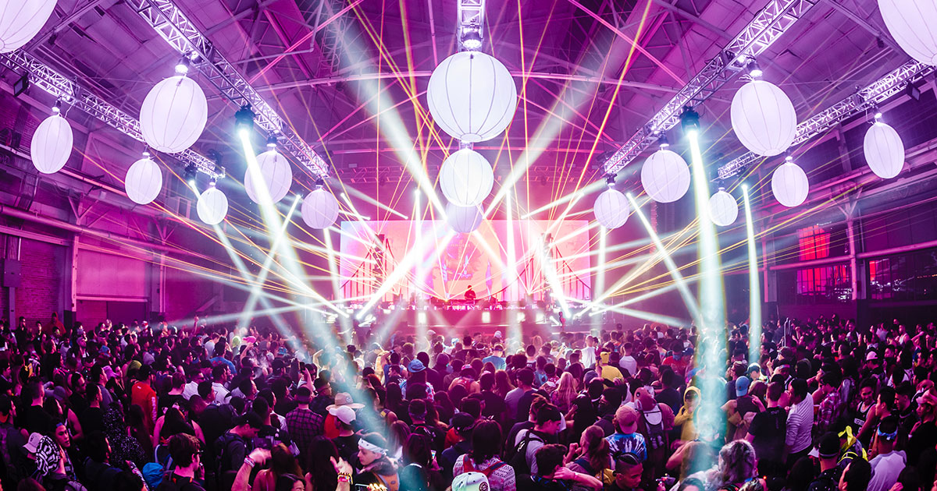
Internal vs External Event Marketing
A blend of internal and external event marketing is being utilized to promote events
Event planners may use an event or a series of events as one of the marketing methods to promote external events, products, service

Slide 5
External Event Marketing

Slide 6
Event Promotion Techniques

Slide 7
Event Promotion Techniques

Slide 8

Internet Event Marketing
Advertising has been changed as dramatically as with the introduction of the Internet
Event marketing has now fully embrace the electronic marketplace
All events should have a web home page
Event invitation through email
The internet will continue to drive the development of the global meetings, conferences, and event industries

Slide 9

Online Consumer-Generated Media (CGM)
Where online content is created and managed by consumer
Costumer wish to be fully engaged in a product or service before they will recommend or express their positive opinion to others
You must use multiple touch point, including consumer-generated media, to turn your casual guests into raving evangelist
Through social networking websites such as Facebook, LinkedIn, Pinterest, Instagram, Twitter, etc
CGM provide your guests with the opportunity to become better informed and fully participate in your event before, during, and after the event

Slide 10
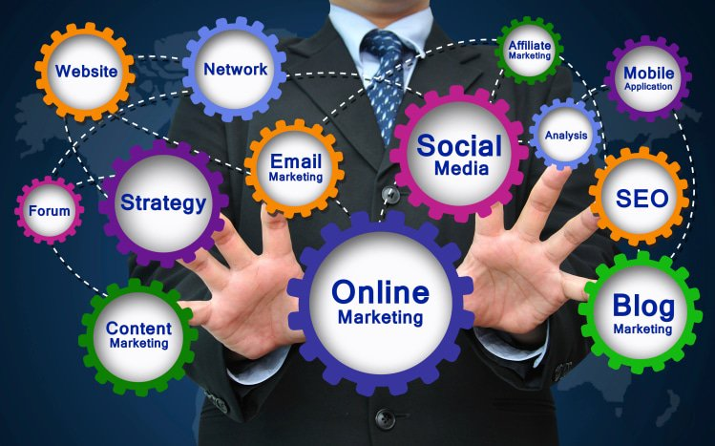
Internet Marketing for Events
The Internet can be a highly efficient tool in marketing events
Major marketing concepts enchanced by online tools include brand building, direct marketing, online sales & online commerce, costumer support, market research, and product or service development & testing

Slide 11
Advantages of Internet Marketing for Event

Slide 12
Advantages of Internet Marketing for Event

Slide 13
Web Design and Management

Slide 14
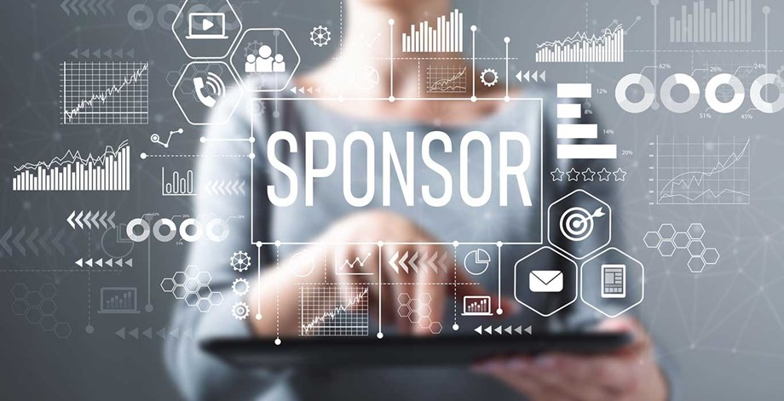
Commercial Event Sponsorship
In sponsorship language, the event is defined as the property or sponsee. While the sponsors is the organization provide funding
Without sponsorship, many events would not be financially feasible
Would not be able to provide the quality expected, and achieved their specific goals & objectives

Slide 15

Commercial Event Sponsorship

Slide 16
Commercial Event Sponsorship

Slide 17
Commercial Event Sponsorship

Slide 18
Evaluating Your Event Marketing Campaign

Slide 19
THANKYOU
Source: Goldbatt, J. (2014). Special Events: Creating and Sustaining a New World for Celebration. John Wiley & Sons Inc: New Jersey.

