Slide 1
Vendor Partners, Contracts, and On-Site Production
Reni Dyanasari & Fasya Syifa Mutma

Slide 2
DEVELOPING APPROPRIATE RESOURCES
Event resources generally include people, time, finances, technology, and physical assets
You must learn to allocate scarce resources to achieve maximum benefit
The event planner must first identify appropriate resources for his or her event during the proposal stage
Must be able to identify approriate resources quickly and accurately

Slide 3
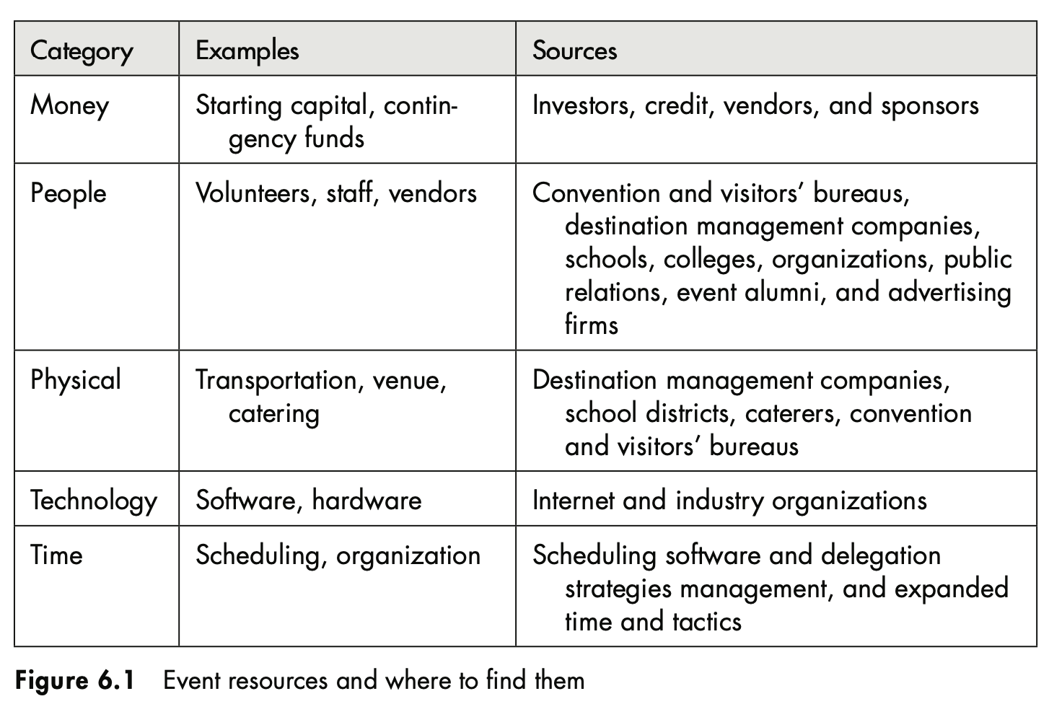
EVENT RESOURCE

Slide 4
METHODS FOR IDENTIFYING APPROPRIATE RESOURCES
Conduct a comprehensive needs assessment
Determine the projected budget allowing for contingencies
Develop the request for proposal document and evaluation criteria
Identify appropriate firms or idividuals to submit proposals
Distribute a request for proposal
Review the proposals
Select the suppliers
Negotiate with the suppliers
Develop and execute contracts with the suppliers
Monitor contract performance by vendors and event staff

Slide 5
WORKING WITH SUPPLIERS AND VENDORS
Your ability to work with your vendors to satisfy the needs of your guests will ultimately help determine the level of success you achieve as an event planner

Slide 6
WORKING WITH SUPPLIERS AND VENDORS
Advertising agency
Advertising specialty providers
Amusement-games providers
Animal providers
Audiovisual providers
Balloons
Caterers
Clowns
Corporate social responsibility consultants
Décor specialist
Destination management companies
Dietary consultants
Environmental specialists
Entertainment providers
Envelope addressers
First-aid providers
Flag providers
Fundraising consultants
Florists
Government agencies
Health and safety experts
Hotels
Insurance brokers and underwriters
Invitation designers
Legal counsel
Lighting providers
Magicians
Medical personnel
Mobile technology providers
Printers
Public relations counselors
Puppeteers
Pyrotechnic designers
Security providers
Simultaneous interpreters
Special events providers
Technology (computers, WiFi) specialists
Translation providers
Valet parking providers
Venue lessors and operators
Web design and managers
Caterers & technological production specialist

Slide 7
CONTRACTING YOUR VENDOR PARTNERS
Once the vendor partners have been selected, it is essential to prepare and execute proper contracts to further clarify expectations related to performance, identify roles and responsibility, and reduce risk
In U.S and other countries, official permission is required to conduct most public events. The larger the events in terms of attendances or technical complexity, the more official oversight is usually required
Official review may come from local (town, city, country), state or province, or federal agencies
Event must comply with existing laws and regulations to protect legal interest, to abide ethical practices, to ensure the safety and security of your event stakeholders, and to protect your financial investment

Slide 8

CONTRACT
Contract is a written agreement between two or more parties specifying the obligations of each party in the production of the special event
Contract may be considered one of the primary risk avoidance, reduction, and retention tools of your event
Contracts or agreements may range from a simple letter or memorandum of understanding to complex multipage documents with lengthy riders (attachments)

Slide 9
KEY CONTRACT COMPONENTS
Parties
The names of the be clearly identified arties must and defined
Offer
The offer is the service or product tendered by one party to another
Consideration
Acceptance
What one party will provide the other upon acceptance of an offer
When both parties accept an offer, they execute (sign) the agreement confirming that they understand and agree to comply with the terms and conditions of the agreement
The agreement must be described as being between parties
Between event planner and his or her client or vendor
The offer should list all services that an event professional offers to provide
May be either cash or in-kind products or services

Slide 10
OTHER COMPONENTS IN CONTRACTS
Terms
How and when the funds will be paid to the person extending the offer
Cancellation
Defines under what circumstances either party may cancel, how notification must be provided, and what penalties may be required in the event of cancellation
Force Majeure (Act of God)
Arbitration
Both parties agree on which circumstances, deemed to be beyond their control, will permit an event to be canceled without penalty to either party
Billing
Allows both parties to use arbitration in place of a legal judgement when they fail to agree
Defines how entertainers will be listed in advertising and in the program
Specified to reflect the most common or predictable occurances, such as disaster, etc
Arbitration may save the parties substantial costs over traditional litigation

Slide 11
OTHER COMPONENTS IN CONTRACTS
Time is of the essence
Instructs both parties that the agreement is valid only if it is signed within a prescribed period of time
Assignment
The agreement contain clauses indicating that the contract may not be assigned to other parties
Insurance
Hold Harmless and Indemnification
Detail the type and limits of insurance that must be in force by both parties
Reputation
In the event of negligence by either party, the negligent party agrees to hold the other party harmless and to defend it (indemnify) against harm
Complete or entire agreement
Specific clause that recognize the importance of the purchaser’s reputation and state that the event planner will try the best to protect and preserve that reputation
The final clause which states that the agreement constitutes the full understanding of both parties

Slide 12
RIDER
Rider is an attachment to a main agreement and usually lists the important ingredients that support the main contract
Include sound equipment and labor, lighting, F&B, transportation, housing for entertainers, & other financial consideration (payment schedule)
Should be attached to the main agreement, and should be initialed or signed by both parties

Slide 13
CHANGES, TERMS AND SEQUENCE OF EXECUTION
Most agreement will require negotiation prior to execution, and the result of these executions will be changes
First and foremost, always require that the other party sign the agreement prior to affixing your signature
Second, refrain from using a verbal agreement or a facsimile. Use an original signed agreement
Third, take the time to sign the agreement together with other party

Slide 14
OTHER TYPES OF AGREEMENTS
Permits
A written approval from a local jurisdiction or other government or private organization that allows you to conduct the event
Licenses
A written approval to conduct the event provided by a government or private organization to allow you to conduct specific activities. (example : license to be able to serve alcohol, use of copyright recorded, live music performances)
Environmental Regulations
Sponsorship Regulations
Submit an environmental plan to local government. Event planner must be prepared to comply with all environmental regulations, example : polution and waste caused by the event
Travel Documents, Visas, and Work Permits
Several organization have been required to only accept funds from corporate sponsors when those funds directly support the educational mission of the organization
Check the regulation of visas and work permits

Slide 15
CATERING MANAGEMENT
Event caterer are usually one of three business type, an each defined by location
First, the institutional caterer, commonly described as an in-house or on-premises caterer, who may or may not have permanent kitchens and offices at the event venue
Second, the traditional off-premises caterer, whose clients engage him or her to cater meals at a temporary location
Third, the concessionaire, where the food and beverage served from a truck, trailer or within a venue

Slide 16
CATERING MANAGEMENT
Location, location, location
Location of the event is a critical consideration for the off-premises caterer. It is about the delivery of the food to the event location
Equipment
Table, chairs, china, cutlery, and other standard equipment will be required to serve a high-quality meal
Utilities
Time Constraints
Plugs, electricity, waste management
Prepare and deliver food in amount of time to ensure freshness and quality
Service Style
Logistic Coordination
Methods use to serving a catered meal. Example: the seated banquet, the standing or seated buffet, the standing reception, the exposition/exhibition, picnic style, English and Russian services
Proper and efficient guest flow as well as effective methods for ensuring timely delivered of meal are essential consideration

Slide 17
COORDINATING CATERING OPERATIONS
Catering Presentation Ideas
Selecting the Best Caterer
Catering Coordination
Catering Trends

Slide 18
CATERING PRESENTATION IDEAS
The Living Buffet
The Human Buffet Table
The Living Dessert Models
The Old Black Magic
The Servers Parade
The Incredible Edible Centerpiece
The Ice Cold Logo

Slide 19
SELECTING THE BEST CATERER
The best caterer is the organization best equipped with experiences, knowledge, creativity, personnel, and resources (human and actual equipment) to achieve your goals and objectives

Slide 20
CATERING COORDINATION
The event planner must closely coordinate all event activities with the director or catering team leader
The first, reviewing proposal from caterer
Visit some food testing event held by the caterer to taste the foods & beverages
Second, negotiate about the price, and the offer, etc
Talk about every details you want the caterer to serve
Sign the contract

Slide 21
CATERING TRENDS
A trend is a pattern of behavior that is likely to be sustained over time
There are five trends may be viewed as future economic opportunities provided that education and commitment to quality are implemented consistently
First, nutrition and organic menus
Second, a wider range in alcohol service
Third, the growing wide range of dietary needs
Fourth, the need to label food items by describing their ingredients
Fifth, the expansion of the caterer’s service to include those of full-service event planning

Slide 22
COORDINATING TECHNICAL PRODUCTION RESOURCES (AUDIOVISUAL, LIGHTING, SOUND, AND SPECIAL EFFECTS)
The use of technical production elements, including but not limited to sound, lights, and special effects
The list below can be used as a primary coordination tool for selecting and engaging these resources:
  Identify the purposes of event technology for your program
  Determine the size of the live audience
  Identify the age, culture, and learning style of your guests
  Inspect the venue and inventory assets
  Sit or stand in the guest’s place, try to envision the event, check the obstructed views and other distractions, identify potential solution

Slide 23
PURPOSES OF EVENT TECHNOLOGICAL PRODUCTION
The technology that you select will help you best achieve your goals and objectives
Projectors, teleprompter, theatrical lighting, special events : fog, laser, strobe lights
The purpose of the event will determine the final selection and coordination of the event technology
Audiovisual : the use of audio and visual elements for your event

Slide 24
CONDUCTING AND ANALYZING THE EVENT SITE INSPECTION
Conduct a site inspection (survey lokasi) using the internet or visit the site to inspect the physical assets
Physical inspection is essential to confirm and verify the quality of the physical space
Using a comprehensive, customized checklist will make this task efficient and thorough
Use the site floor plan or diagram to make your event layout

Slide 25
DETERMINE THE PRODUCTION SCHEDULE
The production schedule is the primary instrument (other than the event diagram) that is used during the coordination phase
During this phase, the event planner must implement a minute-by-minute plan and monitor the tasks that lead to the ultimate conclusion of the event itself

Slide 26
ANTICIPATING & RESOLVING OPERATIONAL CONFLICTS
During the coordination phase, numerous operational conflicts will develop
The key is for the event planner to anticipate and resolve these problems quickly by practicing what is often referred to as damage control

Slide 27
ANTICIPATING & RESOLVING OPERATIONAL CONFLICTS
Late-arriving vendor partner, maintain the phone numbers and contact late-arriving vendors to determine the location
Multiple vendors arriving simultaneously, Sequence arrivals in logical order of installation
Caterer running late in food delivery, Monitor service carefully and use distraction such as dancing to cover long delays
Speaker or entertainer cancels, use prerecorded music or video to cover
Guests arrive too early, prepare for this,have appropraite staff to greet and serve them
Medical emergency, use standard operating procedures and work closely with venue to resolve

Slide 28
THANK YOU

