Slide 1
HUMAS RESOURCES AND TIME MANAGEMENT
Manajemen Acara
2021
Fasya Syifa Mutma

Slide 2
LEADERSHIP STYLES

Slide 3
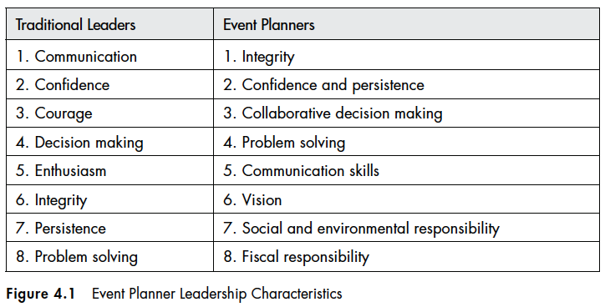
LEADERSHIP CHARACTERISTICS

Slide 4
LEADERSHIP CHARACTERISTICS

Slide 5
LEADERSHIP CHARACTERISTICS

Slide 6
THE FIVE-STEPS SYSTEM TO SOLVE PROBLEM
UNDERSTAND the size, scope, and time sensitivity of the problem
IDENTIFY the key informants and stakeholders affected by the problem
Determine if there is a MODEL or comparable problem whose solution could be used for this problem
TEST the potential solution by seeking the collaborative input of those affected by the problem
Once a decision has been made, MONITOR the impact to determine if anything further must be done to mitigate future problems resulting from your decision

Slide 7
HUMAN RESOURCE MANAGEMENT

Slide 8
HUMAN RESOURCE MANAGEMENT

Slide 9
TIME MANAGEMENT
Your return on your event investment is in direct proportion to your ability to manage your time efficiently and meet various deadlines
How you spend your time performing everyday activities directly influences how you achieve your goals during your career
The ability to manage your time does not decrease as the number of assignments and tasks that you are involved in increases
The busier you get and the more things you have planned, the more efficient you are in your time management anf the projects you manage to complete

Slide 10
ORGANIZATIONAL STRUCTURES/CHARTS

Slide 11
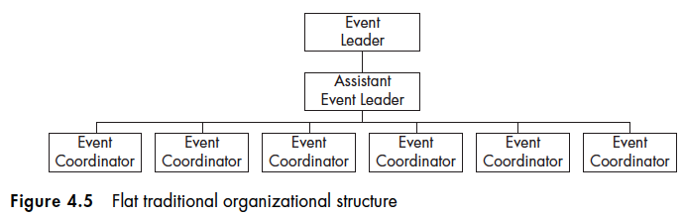
FLAT TRADITIONAL ORG. STRUCTURE
With little opportunity for growth and significant power in two managers’ hands
Employee retention under this structure is likely to be low, since most people would like to see a potential for growth and promotion

Slide 12
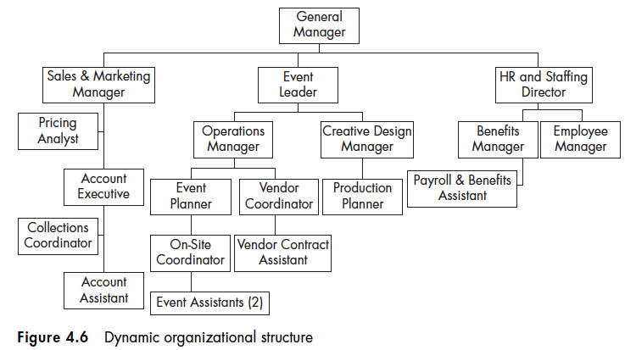
DYNAMIC ORG. STRUCTURE
More dynamic and complex organizational structure that offers its employees better growth potential, higher titles, and more focused work assignments

Slide 13
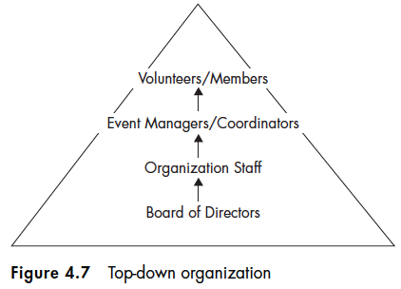
TOP-DOWN ORG.
Everything is determined by upper management and is passed down the chain of command
Each rung on the ladder is responsible for carrying out the will of the rung above it, with little room for comment or criticism
While middle management may sometimes be involved in the decision-making process depending on the organization’s size (Organimi, 2020)

Slide 14
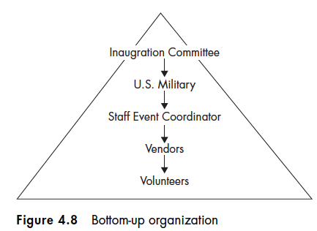
BOTTOM-UP ORG.
Where the whole organization participates in the process of leadership and decision-making
Teams tend to be more autonomous and are put together based on skills and experiences
Ability to raise morale, retain talent, and get the most out of employees (Organimi, 2020)

Slide 15
DEVELOPING POLICIES, PROCEDURES AND PRACTICES
Important to develop policies, procedures and practices that reflect the culture of your organization
Everyone benefits from well-written policies and procedures. Internal stakeholders, external stakeholders, and the guests themselves
Policies are conceived of and approved by sponsoring organization’s trustees
Procedures are the implementation tactics for policy
Make certain that what you have written can be implemented easily and effectively
Make certain that your policies and procedures ar fully compliance with loical, state, provincial and federal laws
Finally, regulary evaluate and revise your policies and procedures

Slide 16
THANKYOU
References :
Goldblatt, J. (2013). Special Events: Creating and Sustaining a New World for Celebration, Ed. 7th. United States of America : John Wiley & Sons, Inc.
https://www.organimi.com/org-structures-top-down-vs-bottom-up/

