Slide 1
SPECIAL EVENT & CHANGING WORLD

Slide 2
KONTRAK KULIAH
Wajib hadir 4 pertemuan daring tatap muka melalui zoom atau media lainnya (atau dengan kesepakatan lain di kelas)
Pada pertemuan daring tatap muka wajib menyalakan video
Selama kuliah daring mahasiswa dalam keadaan siap mengikuti perkuliahaan tidak berbarengan dengan kegiatan lain, contoh: bekerja, dalam perjalanan, sibuk berdiskusi dengan pihak lain, atau sibuk dengan gadget/ aplikasi lain
Wajib mengisi presensi pada waktu yang telah ditentukan
Aktif pada forum untuk nilai komponen mingguan
Aktif membuka setiap materi perkuliahan pada collabor, data log dan hits sangat menentukan nilai harian anda pada kuliah online ini
Mengumpulkan tugas/ UTS/ UAS tepat waktu, terlambat NILAI 0 (nol)
Silakan hubungi dosen di hari dan jam kerja dosen
Bersikap dan bertindak professional sesuai nilai program studi

Slide 3
NILAI PROGAM STUDI ILMU KOMUNIKASI
Integritas
Komit
Dorongan Berprestasi
Intra/
Entrepreneurship
Adil

Slide 4
RENCANA PEMBELAJARAN SEMESTER
PERTEMUAN KE | MATERI PEMBAHASAN
1 | Kontrak kuliah, pembentukan struktur organisasi, Sejarah acara dunia, definisi acara, perkembangan acara, jenis-jenis acara
2 | Struktur organisasi dan pengelolaan SDM, kepemimpinan dalam acara
3 | Keuangan Acara
4 | Event planning (riset, SWOT, analysis, feasibility studies, komunikasi dalam tim)
5 | Mendesain suasana acara, kebutuhan audiens, keamaan dalam acara, pihak yang bekerja sama)
6 | Vendor & Kontrak
7 | Ide konsep acara, strategi promosi, sponsorship
9 | Manajemen risiko, prosedur manajemen risiko
10 | Progress acara
11 | Progress acara
12 | Progress acara
13 | Progress acara
14 | Progress acara
15 | Progress acara

Slide 5
PROBLEM?

Slide 6
SPECIAL EVENT
Unique moment in time celebrated with ceremony and ritual to satisfy specific needs.
The term event is derived from the Latin word e-venire, which means “outcome.” Therefore, every event is, in fact, an outcome produced by a team that is led by the Event Leader.

Slide 8
EVENT PLANNING PROFESSION
Characteristics:
the profession must have a unique body of knowledge
the profession typically has voluntary standards that often result in certification
the profession has an accepted code of conduct or ethics
Event planning is a profession that, through planned events, requires public assembly for the purpose of celebration, education, marketing, and reunion

Slide 9
EVENT PURPOSES
Celebration
Education
Marketing
Reunion
Is characterized by festive ranging from fairs and festivals to social life-cycle events
Educational events mark, deliver, test, and support growth for all human being
Serve to create awareness and persuade prospects to purchase goods and service
When human beings reunite for the purposes of remembrance, rekindling friendships, or simply rebonding as a gruop
Where events are held for the purpose of celebration
Parades, civic events, festivals, weddings, anniversaries, birthday, religious events etc
Such as convocation, commencements, alumni events, training, meeting, certification program, seminar, workshop
Such as product launching, product bazaar

Slide 10
EVENT SUBFIELDS
Civic Events
Exhibition
Fairs/ Festival
Hospitality
Meeting/ Conferences
Retail Events
Social Life-Cycle Events
Sport Events

Slide 11
EVENT SUBFIELDS
Civic Events
Related to public events to celebrate religious, cultural, ritual traditions
Expositions/Exhibitions
Pameran, pertunjukkan. Ada yang dipamerkan, ada ruangan pameran
Fairs and Festivals
When people assembled in the marketplace to conduct business, commercial as well as religious influenced
Hospitality
Hospitality : pelayanan. Event di mana terdapat treatment dan penyambutan yang diberikan kepada pengunjung
State events (acara kenegaraan) : pemilu, upacara bendera
Tidak selalu bertujuan untuk sales
Bentuk lebih kompleks, bisa berbentuk pameran
Misal : launching restoran/hotel mengundang orang utk datang, kemudian ada treatment khusus

Slide 12
EVENT SUBFIELDS
Meeting and Conferences
These events are primarily educational seminars that provide networking opportunities for association members and corporate employess
Retail Events
Sellers have used promotions and events to attract buyers and drive sales
Social Life-Cycle Events
Berkaitan dengan kehidupan sosial manusia dari lahir sampe meninggal
Sports Events
Acara yang berhubungan dengan olahraga
Sebuah toko bikin event sendiri
Ulang tahun, selametan, pernikahan, aqiqah, lamaran, kematian
Sea games, Asian games, olimpiade olahraga, acara tempat fitness
Rapat, konferensi

Slide 13
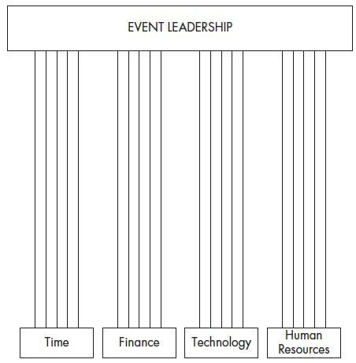
EVENT PLANNING - CAREER
“There is no substitute for performance”
Four-pillars of long-term success in event planning – time, finance, technology, and human resources management must be applied to achieve consistent success

Slide 14
EVENT PLANNING - CAREER
Yourself
Time Management
Finance
The person to be managed is you
Managing yourself essentially involves setting personal and professional goals and then devising a strategic plan to achieve them
The ability to use your time effectively by distinguishing between what is urgent & what is important
Begin with setting personal and professional activities
During your event planning career, you will be required to read and interpret spreadsheet filled with financial data

Slide 15
EVENT PLANNING - CAREER
Modern Technology
Human Resources Skills
Technology (digital, internet, soc med) rapidly transforming the way in which we conduct business
Empowering people is one of the most important human resource skills
Software programs for word processing, financial management, database management

