Slide 1
pereNCANAAN KAMPANYE LINGKUNGAN
KOMUNIKASI LINGKUNGAN
PERTEMUAN 13

Slide 2
CAMPAIGN COMMUNICATION
Are intended to generate specific outcomes in a relatively large number of individuals, within a specified time, and through an organized set of communication activities. (little John, Encyclopedia of Communication theory)

Slide 3
CAMPAIGN COMMUNICATION
Campaigns employ communication strategies and theories to influence large audiences in some measurable ways.

Slide 4
CAMPAIGN COMMUNICATION
to persuade consumers to purchase a particular product,
to influence an attitude,
To increase knowledge,
to promote awareness,
To change behavior.

Slide 5
https://www.unilever.com/sustainable-living/our-strategy/embedding-sustainability/encouraging-behaviour-change/

Slide 6
3 MAJOR PHASES of CAMPAIGN
Planning
1
Implementation
2
Evaluation
3

Slide 7
PLANNING
A basic management function involving formulation of one or more detailed plans to achieve optimum balance of needs or demands with the available resources. (businessdictionary.com)

Slide 8
PLANNING PROCESS
(1) identifies the goals or objectives to be achieved,
(2) formulates strategies to achieve them,
(3) arranges or creates the means required, and (4) implements, directs, and monitors all steps in their proper sequence.

Slide 9
PLAN PURPOSE
To harness and focus the power of the resulting communication system, to make it efficient and effective.
Efisien?
Efektif?
Efisien: bagaimana hemat waktu, biaya dan tenaga
Efektif: bagaimana mencapai hasil maksimal

Slide 10
PLANNING ENVIRONMENTAL COMMUNICATION
Problem statement
Goals
Audience Analysis
Objectives
Message Development/Media Options/Audience Suitability
Media Choice and Design
Timeline
Front-End Evaluation
Formative Evaluation.
Summative Evaluation
Project Budget

Slide 11
PROBLEM STATEMENT

Slide 13
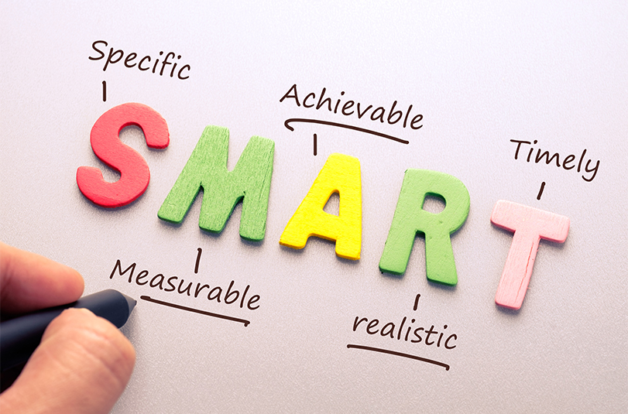
GOALS
Represent the ultimate aims of project
They reflect long-term, lasting outcomes

