Slide 1

KOMUNIKASI LINGKUNGAN
Emma R. Aliudin
2021
PERTEMUAN 2

Slide 2
DEFINISI
KOMUNIKASI LINGKUNGAN
“The pragmatic and constitutive vehicle for our understanding of the environment as well as our relationships to the natural world; It is the symbolic medium that we use in constructing environmental problems and negotiating society’s different responses to them.”
(ROBERT COX, 2006)

Slide 3
Yang artinya…
Kendaraan praktis dan utama yang mengantarkan kita pada pemahaman tentang lingkungan dan cara berhubungan dengan alam;
Sebuah medium simbolik yang kita gunakan dalam memaknai masalah-masalah lingkungan dan mendiskusikan pandangan-pandangan yang berbeda di masyarakat dalam menyikapi masalah lingkungan. (Ingat teori Interaksi Simbolik yang mengatakan bahwa ‘Komunikasi adalah proses pertukaran symbol’ )

Slide 4
TUJUAN KOMUNIKASI LINGKUNGAN
“CREATING
UNDERSTANDING
ABOUT
ENVIRONMENT”
(Corbett, 2006)

Slide 5
ILMU INI MEMBAHAS
Bagaimana cara kita berkomunikasi tentang lingkungan?
Bagaimana komunikasi tersebut memengaruhi persepsi* kita terhadap lingkungan dan diri kita sendiri?
Bagaimana komunikasi tersebut membentuk hubungan kita dengan lingkungan?
*Persepsi adalah proses memberikan makna pada stimuli inderawi; proses menafsirkan pesan

Slide 6
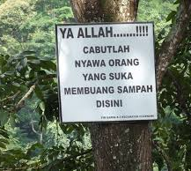
What do you think about this…

Slide 7
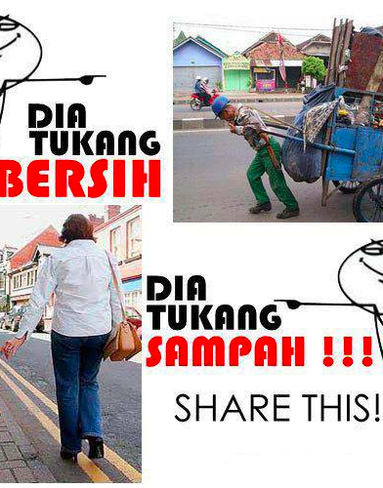
This…

Slide 8
Komunikasi adalah proses pertukaran simbol.

Slide 9

100% recycled? No, wait!
Means that the product maybe recycled or contains recycle material. Doesn’t mean that the product is 100% recycleable.

Slide 10
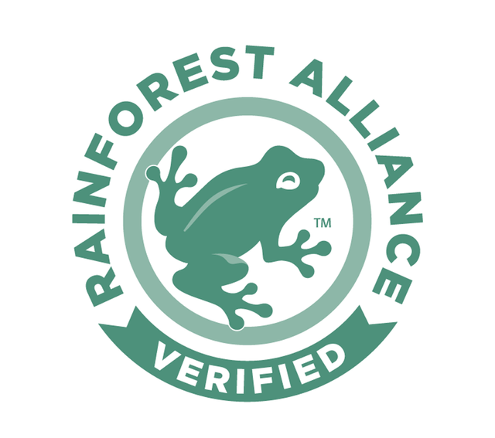
Sustainable?
Means that companies are producing things sustainably. Only businesses, farms & forest that meet the strict environmental & social standards are given this award

Slide 11

Kode apa ini?
Plastic Resin Code. Means that products made with plastic resin. Number range 1-7. Some numbers are accepted in some recycling plants while others aren’t.

Slide 12

APA MAKSUDNYA?

Slide 13

Botol kaca mesti diapakan?
Don’t just throw away glass products. Recycle them appropriately.

Slide 14

Penjelasannya bagaimana?
Products contribute in the reduction of greenhouse gas emission and save ur money

Slide 15

Ini apa???

Slide 16

Artinya?
Recyclable steel

Slide 17

Apa lagi ini?
The plastic material is biodegradable. Make sure to throw in the compost section, not in the plastic recycling centers as they can contaminate the other plastic when breaking down.

Slide 18

Paham nggak?
Any wood product or any product made out of the wood that comes from FSC approved forest is sustainable. The forest is very well managed under strict standards on environments, economic & social.

