Slide 1
Intercultural Conflict and Conflict Management Strategies
Komunikasi Antar Budaya Pertemuan 10

Slide 2
Culture and Context
Communication is rule governed
Context helps specify communication rules
Communication rules are culturally diverse

Slide 3
Assessing The Context
Formality and Informality
Assertiveness and Interpersonal harmony
Status relationships
  Egalitarian
  Hierarchical

Slide 4
Communication in the Multicultural Business Context

Slide 5
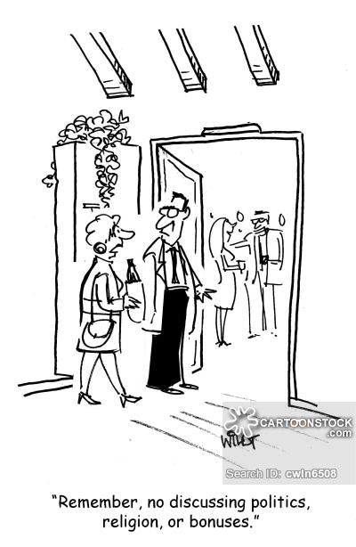
Business Protocol
Initial Contacts
Greeting Behavior
Personal Appearance
Gift Giving
Conversational Taboos

Slide 6
Intercultural Management
Read the case on your book!
Leadership Styles
What are the leadership styles difference among countries?
Decision-Making Styles
What are the decision-making styles difference among countries?

Slide 7
Intercultural Business Negotiations
1. Be prepared.
2. Develop sensitivity to the use of time.
3. Listen carefully.
4. Learn to tolerate ambiguity.
5. Try to locate areas of agreement

Slide 8
Questions?

Slide 9
Intercultural Conflict Management
Avoidance
Accommodation
Competition
Collaboration

Slide 10
Conflict: an intercultural perspective
Each culture’s way of perceiving and dealing with conflict reflects its value system
Collectivistic culture have an aversion to open, direct conflict, which is seen as a threat to organizational accord and stability and to the relationships among group members
USA prefer head-on confrontation style

Slide 11
Managing Cultural conflict
Identify the contentious issues
Keep an open mind
Do not rush
Keep the conflict centered on ideas, not people
Develop techniques for avoiding conflict

Slide 12
Thank you
Questions?

