Slide 1
Language and Culture: Verbal and Nonverbal
Komunikasi Antar Budaya
Pertemuan 10

Slide 2
Social and Cultural Functions of Language
Communication exchange
Language and Identity
Language and Unity

Slide 3
Language and Culture
What is language?
  At the most basic level, language is merely a set of shared symbols or signs that a cooperative group of people has mutually agreed to use to help them create meaning.
  The symbols and their meanings are often arbitrary.

Slide 4
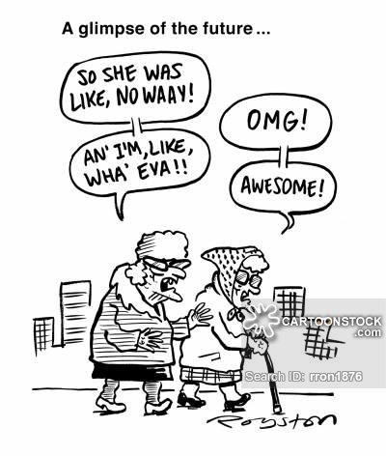
LANGUAGE VARIATIONS
Accent
Dialect
Argot
Slang
Branding

Slide 5
The Symbiosis of Language and Culture
In order to have culture, language is needed so group members can share knowledge of beliefs, values, and behaviors and engage in communal endeavors.
In turn, culture is needed to organize disparate individuals into a cohesive group so those beliefs, values, behaviors, and communal activities can develop.

Slide 6
Language as a Reflection of Cultural Values
High and Low Context
High and Low Power Distance
Individualism and Collectivism

Slide 7
Language in Intercultural Communication Interactions
Interpersonal Interactions
  Mindfulness
  Speech Rate
  Vocabulary
  Monitor nonverbal feedback
  checking
Interpretation and Translation
  Interpretation
  Translation

Slide 8
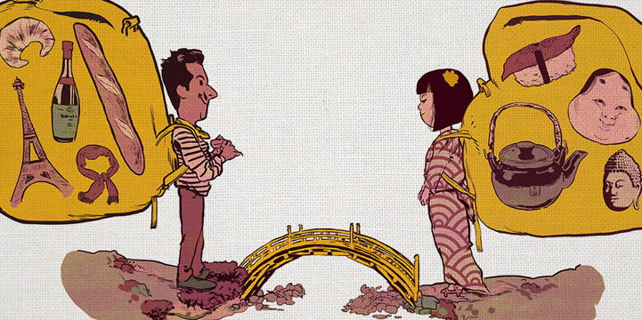
Intercultural Marriage
What problem do you think can happen in intercultural marriage?

Slide 9
Communication Technology and Language
The digital age has greatly enhanced the ability of people around to world to easily and quickly “connect” with others through a variety of media.
English continues to be the most common language among Internet users, which has raised concern of it becoming the world’s dominant language.
What seems possible, however, is “an oligarchy of the world’s largest languages—Chinese, Spanish, English, Arabic, Malay, Hindi, Russian—each of them dominating in its geographical region, where it also enjoys economic and cultural influences.” – Danet and Herring

Slide 10
Questions?

