Slide 1
REVIEW
Komunikasi Antar Budaya
Pertemuan 7

Slide 2
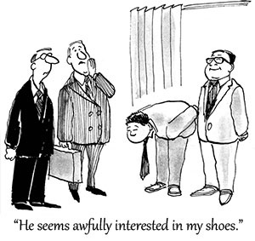
The reasons of Learning Intercultural Communication
Globalization
  World Trade and International Business
  Technology and Travel
  Competition for Natural Resources
International Conflict and Security
Environmental Challenges
World Health Issue
Shifting Population
  Immigration
  The aging population
  Multicultural Society
Notes:
Insert a picture of an animal and or plant found in your country.

Slide 3
What is Intercultural Communication?
Intercultural communication occurs when a member of one culture produces a message for consumption by a member of another culture.
Intercultural communication involves interaction between people whose cultural perceptions and symbol systems are distinct enough to alter the communication event.

Slide 4
The Dominant Culture
Co-Culture
This is the group that usually has the greatest amount of control over how the culture carries out its business.
This group possesses the power that allows it to speak for the entire culture while setting the tone and agenda that other will usually follow
They control religious institution, media, government, education, military, etc.
Within the dominant culture, you will find numerous co-cultures and specialized cultures.
Some co-cultures share many of the patterns and perceptions found within the larger, dominant culture, but their members also have distinct and unique patterns of communication that they have learned as part of their membership in the co-culture.
These co-cultural affiliations can be based on race, ethnic, gender, age, sexual preference, etc.

Slide 5
Studying Intercultural Communication
Individual uniqueness
Stereotyping
Objectivity
Communication is not a Cure-all

Slide 6
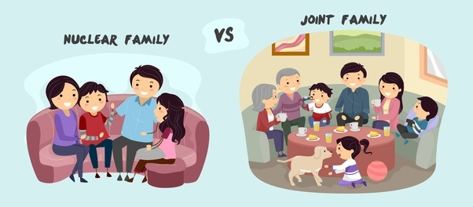
Forms of Family
Nuclear Family
Extended Family
Changing Families in the world
Globalization and Families
  Mass Media
  Immigration

Slide 7
Functions of the Family
Reproduction
Teaching economic values
Socialization
Teaching core values and worldview
Identity development
Communication training

Slide 8
Cultural Variants in Family Interaction
Gender Roles
Changing Gender Roles
Individualism and Collectivism
Age Grouping
Social skills

Slide 9
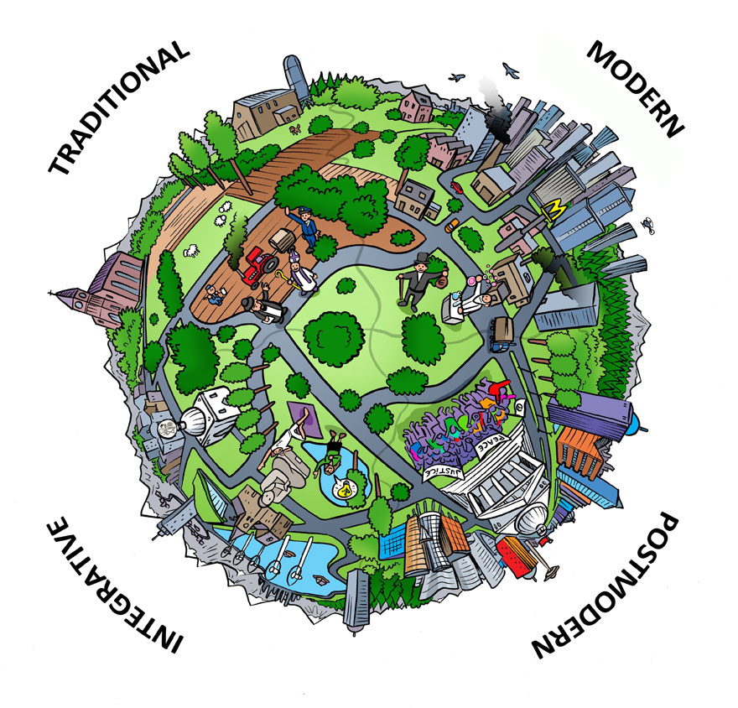
Worldview
The way people interpret reality and events, including images of themselves and how they relate to the world around them. (Peoples & Bailey)
Worldview is a culture’s orientation toward God, humanity, nature, question of existence, the universe and cosmos, life, moral and ethical reasoning, suffering, death, and other philosophical issues that influence how its members perceive their world. (Ishii, Coke, Klopf)

Slide 10
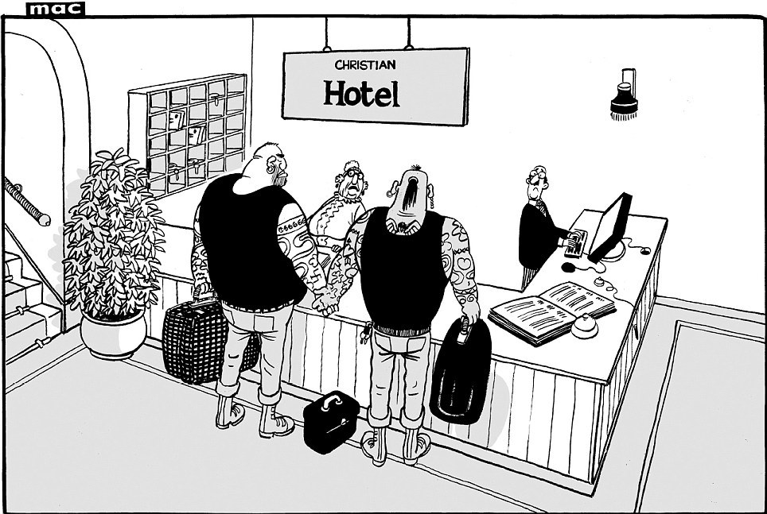
The Importance of Worldview
Perception of women
Perception of nature
Produce different attitudes toward nature
Perception of business

Slide 11
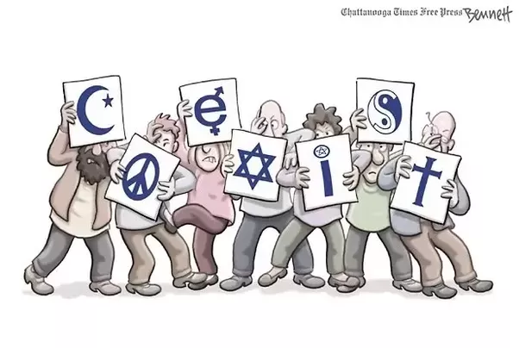
Forms of Worldview
Religion as worldview
Secularism as worldview
Spirituality as worldview

Slide 12
Religion
The Enduring Significance
of Religion
Religion and the Study of Intercultural Communication
It has been linking people together while creating and preserving their cultures’ worldviews.
Perhaps religions’ most enduring aspect has been its attempt to address questions about mortality and immortality, suffering, and the origin of the universe.
Mechanism of social control
Religion and behavior
The study of religion in the 21st Century

Slide 13
Religious Similarities
Speculation
Sacred Scriptures
Rituals
Ethics
Safe Haven

Slide 14
The Importance of Identity
1
Identity development plays a critical role in the individual’s psychological well-being.
2
An understanding of identity is also an essential aspect of the study of intercultural communication
3
The unsettled world that we all live in is in part influenced by adherence to varying perceptions of identity
4
Identity influences and guides expectations about your own and others’ social roles, and provides guidelines for your communication interaction with others.
Samovar et all. 2010. Communication Between Cultures

Slide 15
Selected Social Identities
Remember! We have more than one identity.
01
Racial Identity
02
Ethnic Identity
Mongoloid
Caucasoid
Negroid
Capoid
Australoid
Derived from a sense of shared heritage, history, traditions, values, similar behaviors, area of origin, and in some instances, language.
03
Gender Identity
04
National Identity
The meanings and interpretations we hold concerning our self-images and expected other-images of ‘femaleness’ and ‘maleness’. (Ting-Toomey)
Refers to your nationality
Samovar et all. 2010. Communication Between Cultures

Slide 16
Selected Social Identities
Remember! We have more than one identity.
05
Regional Identity
06
Organizational Identity
Every country can be divided into a number of different geographical regions, and often these regions reflect varying cultural traits.
In some cultures, a person’s organizational affiliation can be an important source of identity.
07
Personal Identity
08
Cyber and Fantasy Identity
Consist of those characteristics that set one apart from others in his or her in-group, those things that make one unique, and how one sees oneself.
The internet provides an opportunity to escape the constraints of everyday identities. (Suler)
Samovar et all. 2010. Communication Between Cultures

Slide 17
Acquiring and Developing Identities
Three-stage Model from Phinney
Final stage
Second stage
Ethnic Achievement
First stage
Ethnic identity search
Unexamined ethnic identity
Samovar et all. 2010. Communication Between Cultures

Slide 18
Acquiring and Developing Identities
Four-stage Model from Martin and Nakayama
Final stage
Third stage
Integration
Second stage
Resistance and separatism
First stage
Conformity
Unexamined identity
Based on how they were achieved, your identities can also be classified as ascribed or avowed. This refers to whether your identities were obtained involuntarily or voluntarily.
Samovar et all. 2010. Communication Between Cultures

Slide 19
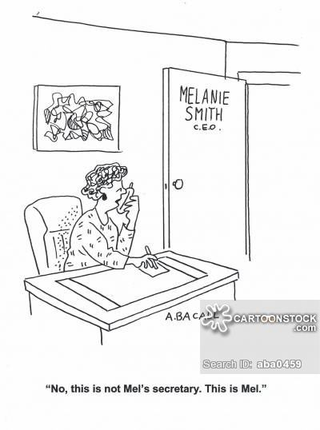
LEARNING STEREOTYPES
When do we learn stereotypes?
Remember, you are not born with stereotypes; they are learned, and like culture, they are learned in a variety of ways.
The most obvious, and perhaps most important, agent of stereotypes is the socialization process, which begins with our parents. While many parents try to avoid teaching their children to think in stereotypes, we tend to agree with Schneider when he notes that often parents directly or indirectly actually promote them.
Many stereotypes are generated by the mass media and widely disseminated through a variety of formats such as advertisements, movies, and TV sitcoms, soap operas, and reality shows.
Television has been guilty of providing distorted images of many ethnic groups, the elderly, and gay people. Media has also played a role in perpetuating certain stereotyped perceptions of women and men.
Samovar et all. 2010. Communication Between Cultures

Slide 20
The Dark Side of Identity
Prejudice
Prejudice occurs when a person holds a generalization about a group of people or things, often based on little or no factual experience. Prejudice can be positive (liking a certain group or thing) or negative (disliking a certain group or thing).
In a communication setting, according to Ruscher, the negative feelings and attitudes held by those who hold a prejudicial perspective are often exhibited through the use of group labels, hostile humor, or speech that alleges the superiority of one group over another.
The Functions of Prejudice
The ego-defensive function allows individuals to hold a prejudice while denying to themselves that they possess negative beliefs about a group.
The utilitarian function permits people to believe that their prejudicial beliefs produce a positive outcome. This is often found in situations where economic gain is involved.
The value-expressive function occurs when people maintain their prejudice in the belief that their attitudes represent the highest and most moral values of the culture.
The knowledge function enables people to categorize, organize, and construct their perceptions of other people in a manner they see as rational—even if that perception is woefully inaccurate.
Samovar et all. 2010. Communication Between Cultures

Slide 21
EXPRESSIONS OF PREJUDICE
First, prejudice can be expressed through what Allport refers to as antilocution, which involves talking about a member of the target group in negative and stereotypical terms.
Second, people act out prejudice through avoidance. This occurs when people avoid and/or withdraw from contact with the disliked group.
Third, when discrimination is the expression of prejudice, the prejudiced person will attempt to exclude all members of the group in question from access to certain types of employment, residential housing, political rights, educational and recreational opportunities, churches, hospitals, or other social institutions.
The fourth level of prejudice involves physical attacks, which often escalate in hostility and intensity if left unchecked.
The fifth, and most alarming, form of prejudice is extermination. This expression of prejudice leads to acts of physical violence with the objective of removing or eliminating all or major segments of the target group community.
Samovar et all. 2010. Communication Between Cultures

Slide 22
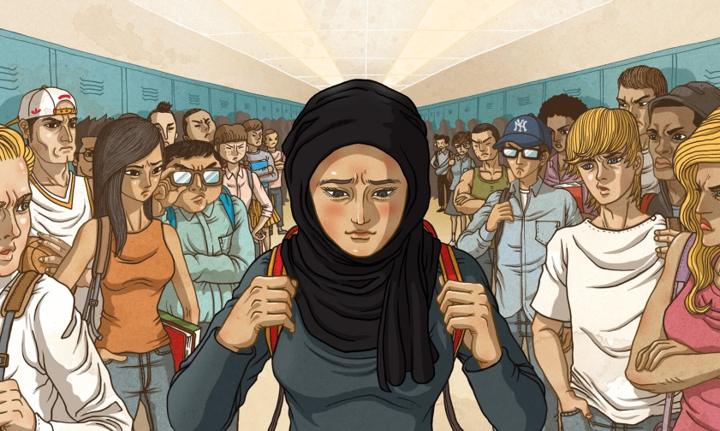
CAUSES OF PREJUDICE
(1) Societal sources: A great deal of prejudice is built into the major organizations and institutions of a society. According to Oskamp, these organizations produce norms, rules, regulations, and laws that give rise to societal prejudice and help “maintain the power of the dominant groups over subordinate ones.”
(2) Maintaining social identity: At the beginning of this chapter we pointed out the important role that identity plays in connecting people to their culture. This link is very personal and emotional because it creates the bond that binds people and culture together.
(3) Scapegoating: Scapegoating occurs when a particular group of people, usually a minority, is singled out to bear the blame for certain events or circumstances, such as economic or social hardships, that adversely affect the dominant group.
Samovar et all. 2010. Communication Between Cultures

Slide 23
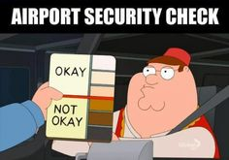
The Dark Side of Identity
Racism
Racism is the belief in the inherent superiority of a particular race. It denies the basic equality of humankind and correlates ability with physical composition. Thus, it assumes that success or failure in any societal endeavor will depend upon genetic endowment rather than environment and access to opportunity. ~ Leone
The idea of superiority allows one group of people to mistreat another group on the basis of race, color, national origin, ancestry, religion, or sexual preference.
Samovar et all. 2010. Communication Between Cultures

Slide 24
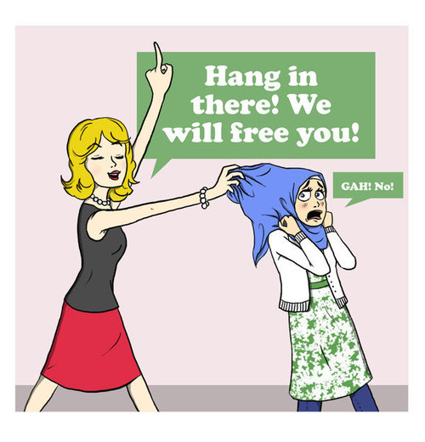
The Dark Side of Identity
Ethnocentrism
Ethnocentrism is the notion that one’s own culture is superior to any other. It is the idea that other cultures should be measured by the degree to which they live up to our cultural standards. We are ethnocentric when we view other cultures through the narrow lens of our own culture or social position. ~ Nanda and Warms.
Samovar et all. 2010. Communication Between Cultures

Slide 25
CHARACTERISTICS OF ETHNOCENTRISM
Levels of Ethnocentrism
positive, negative, and extremely negative.
Ethnocentrism Is Universal
Most people are ethnocentric, and a certain degree of ethnocentrism probably is essential if people are to be content with their lives and if their culture is to persist.
Ethnocentrism Contributes to Cultural Identity
Another reason ethnocentrism is so pervasive is that it provides members of a culture with feelings of identity and belonging.
Ethnocentrism is strongest in moral and religious contexts, where emotionalism may overshadow rationality and cause the type of hostility.

